Slide 1
Antipatterns
Negative solutions that leads more problems than they are indented to solve

Slide 2
Design patterns
Antipatterns
Time tested solution to a recurring problem in a specific context.
Benefits exceeds negative consequences
Commonly occurring solution to a problem that generates bad results
  Repeated software failures
  common pitfalls to avoid
Negative consequences exceeds benefits
Jim Coplien: "an anti-pattern is something that looks like a good idea, but which backfires badly when applied."

Slide 3
Antipatterns
negative consequences.
  code harder to read, maintain, test, and extend, ultimately reducing the overall quality
Importance:
Identifying bad practices can be as valuable as identifying good practices.
  “It's not fun documenting the things that most people agree won't work, but it's necessary because many people may not recognize the AntiPattern.”
http://c2.com/cgi/wiki?AntiPattern

Slide 4
Anti-pattern: Result of
poor design choices, lack of experience, misunderstanding of best practices
applying a perfectly good pattern in the wrong context.
  “The resulting code tends to be full of factories that only ever return a single thing, that thing being a proxy to a delegate that wraps a class that has a method that has the three lines of code you actually want to execute.”
Our Aim: diagnose and fix the common failures we will inherit in real-world code.
Notes:
https://sourcemaking.com/refactoring

Slide 5
Categories
Software Development antipatterns
  Bad Coding/design solutions
Architectural antipatterns
  System-level antipatterns.
  Common mistakes in creation, implementation, and management of architecture.
Project Management antipatterns
Antipattern web site www.antipatterns.com

Slide 6
1) Poltergeist
short-lived, stateless objects created to perform simple tasks and then discarded.
  These objects often serve as intermediaries that add unnecessary complexity to the system.
A.k.a. Proliferation of classes
Poltergeists add no significant value
  only perform a single action
  or pass data between other objects
  without maintaining any state or long-term responsibility

Slide 7
Activity
AuditLogger.log("Task process started"); before the task process begins.
class TaskInitializer {
public void initializeTask(String name) {
Task task = new Task(name);
TaskExecutor executor = new TaskExecutor();
executor.executeTask(task);
}
}
class TaskExecutor {
public void executeTask(Task task) {
task.execute();
}
}
class TaskManager {
public void manageTask(String name) {
TaskInitializer initializer = new TaskInitializer();
initializer.initializeTask(name);
}
}
Poltergeist:
only to perform a single action or pass data between other classes,
without maintaining any state or long-term responsibility
public class Main {
public static void main(String[] args) {
TaskManager manager = new TaskManager();
manager.manageTask("Sample Task");
}
}
Notes:
To find where the Task is created, how many files do you have to open and 'step into' to follow the logic from TaskManager?
2) You have one line of code to add. Which class file does it go in: TaskManager or TaskInitializer? the Architectural Debate.
3) Why are we even debating this? Why is such a simple, 1-line change so confusing?
Surfacing the True Symptom (lack of clear responsibility).
4) What is the real responsibility of TaskInitializer? What value or logic does it actually provide?G

Slide 8
class TaskInitializer {
public void initializeTask(String name) {
Task task = new Task(name);
TaskExecutor executor = new TaskExecutor();
executor.executeTask(task);
}
}
class TaskExecutor {
public void executeTask(Task task) {
task.execute();
}
}
class TaskManager {
public void manageTask(String name) {
Task task=new Task(name);
task.execute();
}
}
public class Main {
public static void main(String[] args) {
TaskManager manager = new TaskManager();
manager.manageTask("Sample Task");
}
}
Notes:
_________ class is a 'ghost.' It's a short-lived, stateless object that just adds noise and confusion, but no value.
TaskManager does everything is the simplest, most direct cure for the Poltergeist. However, it's often too simple for real-world architectures.

Slide 9
class TaskExecutor { //NOT a poltergeist anymore
private Queue<Task> taskQueue = new LinkedList<>();
public void addTask(Task task) {
taskQueue.add(task);
}
public void executeTasks() {
while (!taskQueue.isEmpty()) {
Task task = taskQueue.poll();
task.execute();
}
}
}
maintains a queue of tasks and has methods to add and execute tasks.
a long-lived object with clear responsibilities.

Slide 10
class TaskExecutor { //NOT a poltergeist anymore
private Queue<Task> taskQueue = new LinkedList<>();
public void addTask(Task task) {
taskQueue.add(task);
}
public void executeTasks() {
while (!taskQueue.isEmpty()) {
Task task = taskQueue.poll();
task.execute();
}
}
}
class TaskManager {
private TaskExecutor executor = new TaskExecutor();
public void manageTask(String name) {
Task task = new Task(name);
executor.addTask(task);
}
public void executeAllTasks() {
executor.executeTasks();
}
}
Notes:
If we refactor and remove the Poltergeist, where does the log statement go? In TaskManager, right after new Task(name). It's obvious. It's a 1-second decision. That is good design.

Slide 11
Causes
When designers familiar with process modeling but new to define architectures
Poor object design: Creating short-lived, stateless objects that only serve to invoke methods in other classes.
Over-engineering: Anticipating future needs that may never materialize.
Misuse of design patterns: Applying patterns like Command or Factory without a real need.

Slide 12
Question
Proxy vs poltergeist?
  Is there an added value?
Façade vs poltergeist?
  What is the added value?

Slide 13
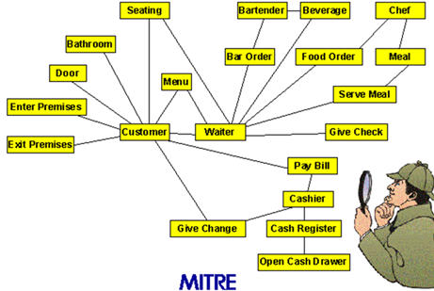
Poltergeist: Symptoms
Redundant navigation paths.
Spurious classes & associations
  Transient associations.
  Stateless classes.
Temporary, short-duration objects and classes.
Classes with few responsibilities
  Single-operation classes that exist only to "seed" or "invoke" other classes through temporary associations.
Classes with "control-like" operation names such as start_process_alpha.
Notes:
their names are often suffixed by _manager or _controller.

Slide 14
Poltergeist: Consequences
Poltergeists clutter software designs, creating unnecessary abstractions
Increases complexity and maintenance costs.
  Excessive complexity, hard to understand, and hard to maintain.
Makes the system harder to understand and debug.
Wastes resources and impacts performance.
  They are unnecessary, so they waste resources every time they "appear."
inefficient because they utilize several redundant navigation paths.

Slide 15
Poltergeist
Poltergeists add no significant value
  perform initialization and not used anymore
  only perform a single action or pass data between other objects without maintaining any state
  no long-term responsibility
  invoke other objects through temporary associations

Slide 16
Refactoring Poltergeist
Delete them
Refactor classes with short lifecycles and no responsibilities
  Move them into collaborating classes
  Regroup to form a cohesive class
Delete the poltergeist and insert its functionality in the invoked class

Slide 17
How to avoid
YAGNI Principle:
"You Aren't Gonna Need It"
  don't add complexity for hypothetical future requirements.
Identify and refactor poltergeist objects early
  regular code reviews or refactor often

Slide 19
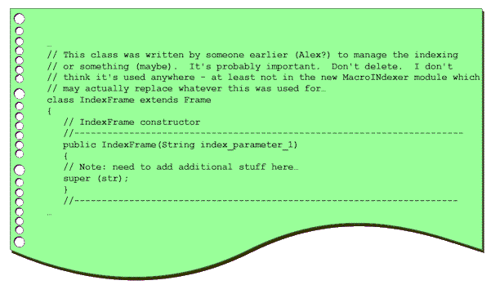
2) Lava flow
What do you do when you see this?
What are your real options?
Painful to cure: not easy to throw away unnecessary parts
Notes:
You are a new developer, and you see this in the code."
Questions :
"What do you do? What are your real options?"
"Do you delete it and pray?"
"Do you ask a senior dev (who also doesn't know)?"
"Do you just... ignore it and work around it?"
Result: "That feeling of paralysis and fear is the problem."
---famous phrase: dont delete, not sure

Slide 20
Lava flow
Lava Flow antipattern:
Dead code that is too scary to remove
Dead code or forgotten design information are frozen in an ever-changing design.
  e.g. Legacy code no one dares to touch
  e.g. Quick fixes that became permanent
Code becomes expensive to analyze, verify and test.
Common Causes:
  R&D code or "abandoned experiments" left in production.
  Lack of code reviews.
  Lack of version control
Notes:
Lava-like "flows" of previous developmental versions on the code landscape, now hardened into a immovable, generally useless mass of code which no one can remember much of anything about.

Slide 21
Lava flow: Symptoms
Frequent unjustifiable variables and code fragments
Code that seem important, but no one can really explain what they do or why they exist
Undocumented complex, important-looking classes or segments which don’t clearly relate to the architecture.
Whole blocks of commented-out code with no explanation or documentation
  The famous comment:
  "// Don't delete this, not sure why it's here but it breaks things."
Unused (dead) code, just left in. Unused, inexplicable or obsolete interfaces
Notes:
Lava-like "flows" of previous developmental versions on the code landscape, now hardened into a immovable, generally useless mass of code which no one can remember much of anything about.

Slide 22
Typical causes
R&D code placed into production without thought toward configuration management.
Uncontrolled distribution of unfinished code. Implementation of several trial approaches toward implementing some functionality.
Lack of versioning system, configuration management or compliance with process management policies.
Lack of architecture, or non-architecture-driven development.
Architectural scars.
  Some architectural commitments are found not to work later in the development. The system architecture may be reconfigured, but these inline mistakes are seldom removed.
  especially hard in a development environments with hundreds of source code individual files

Slide 23
Lava Flow – Consequences
Increased maintenance costs
Higher risk of bugs and errors
Expensive to analyze, verify and test.
Consumes memory and resources, impacting performance.
Proliferates if not removed, as code is reused.
If processes causing to lava flow is not checked, it will lead to geometric growth of issues.
  produce new, secondary flows as they try to "work around the original ones.
As the flow hardens, understanding the architecture to make documentation and improvements becomes impossible.
Notes:
Expensive to analyze, verify and test.
Can be expensive to load into memory, wasting important resources and impacting performance
If not removed, the lava flow can continue to proliferate as code is reused in other areas
If the process that leads to lava flow is not checked, there can be a geometric growth as succeeding developers, to rushed or intimidated to analyze the original flows, continue to produce new, secondary flows as they try to "work around the original ones.
As the flows compound and harden, it rapidly becomes impossible to document the code or understand its architecture enough to make improvements.

Slide 24
Cure: prevention
Use versioning and analysis tools.
  Version control: git blame will tell who wrote it when
  Static analysis to tell if anything still calls this class.
Code reviews.
  stops new Lava Flow from forming.
Regular Refactoring: Continuously clean up and refactor code to remove obsolete or unused parts.
Left uncured, leads to "Boat Anchor " antipattern
  a piece of code that does nothing but hold the project down.
  The same cure: Have the courage to delete dead code.

Slide 25
Anectodes…
"Ugh! What a mess!"
"You do realize that the language supports more than one function, right?"
"It's easier to rewrite this code than to attempt to modify it."
"Software engineers don't write spaghetti code."
"The quality of your software structure is an investment for future modification and extension.

Slide 26
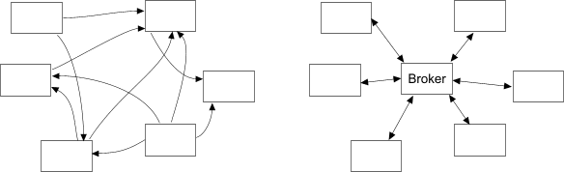
3) Spaghetti design
Unstructured code or design that is hard to maintain

Slide 27
working with a spaghetti
Activity: you got two tickets. Resolve them.
double calculateInterestRate(){
if(maturity==0){ //new customer
double capital= calculateAssets()+montlyIncome;
return riskFactor(capital)*1.75;
}else if(maturity<5){ //fairly new customer
double capital= calculateAssets()+montlyIncome;
return riskFactor(capital)*0.85;
}else if(maturity>10){ //mature customer
if(stable) return currentInterestRate*0.8
else return currentInterestRate;
}
return 0.0;
}
Bug Report: A customer with 7 years maturity. Their interest rate is 0.0!
New Feature: Add a 'Super-Mature' customer type for maturity > 20. Their rate is currentInterestRate * 0.7
Questions
Where is the bug?
Where do you add the `else if` for the new feature?
How "brittle" does this code feel?
Notes:
"So, what's the correct rate? The spec is missing. I have to guess. Is the logic for maturity<5 supposed to extend to 10? Or is the logic for maturity>10 supposed to start at 5?
"Let's assume the 'fairly new' rate applies up to 10 years. The 'patch' would be to change else if(maturity<5) to else if(maturity<=10).
But wait! The >10 check has different logic (if(stable)). This implies the 5-10 year range is its own thing. This code is so ambiguous, I'm creating risk no matter what I do.
This is the real pain. I can't fix the bug because the code is unreadable and the intent is lost. I'd have to go hunt down a business analyst to even solve this ticket."

Slide 28
Complex Conditionals
Solution:
Clean it first, then add or fix
applies to all spaghetti code
double calculateInterestRate(){
if(maturity==0){ //new customer
double capital= calculateAssets()+montlyIncome;
return riskFactor(capital)*1.75;
}else if(maturity<5){ //fairly new customer
double capital= calculateAssets()+montlyIncome;
return riskFactor(capital)*0.85;
}else if(maturity>10){ //mature customer
if(stable) return currentInterestRate*0.8
else return currentInterestRate;
}}

Slide 29
Example Refactored-1
double calculateInterestRate(){
return rateStrategy.calculate();}
BankAccount
+calculateInterestRate()
RateStrategy
+calculate()
ImmatureCustomerRateStrategy
+calculate()
FairlyMatureCustomerRateStrategy
MatureCustomerRateStratgey
calculate(){
double capital= calculateAssets()+montlyIncome;
return riskFactor(capital)*1.75;}

Slide 30
Example Refactored -2
double calculateInterestRate(){
return state.calculateInterestRate();}
BankAccount
+calculateInterestRate()
CustomerState
+calculateInterestRate()
ImmatureCustomer
+calculateInterestRate()
FairlyMatureCustomer
MatureCustomer
calculate(){
double capital= calculateAssets()+montlyIncome;
return riskFactor(capital)*1.75;}

Slide 31
Refactoring Spaghetti code
Combine: capture aggregations and components
  Move members to where they belong
Generalize: Abstract Superclass
  Make subclass method signatures compatible
  Add method signatures to the superclass
  Migrate common code to superclass
Specialize: simplify conditionals
  For each condition, make a subclass with matching invariant
  State and Strategy patterns may help
  Command pattern?
Notes:
the if-else if-else chain—is brittle because its structure makes it impossible to isolate changes. The goal of refactoring is to move the logic out of that single monolithic function and into specialized, well-defined objects.
1. Combine: Capture Aggregations and Components
The first step addresses tight coupling and objects that lack cohesion
Move members to where they belong: When you see a method (like calculateInterestRate in the Spaghetti example) constantly retrieving data from a different class, it means the processing logic is in the wrong place. We move that logic, or the data it uses, to its rightful "home." This improves cohesion.
2. Generalize: Abstract Superclass
This step addresses duplication and prepares the system for flexibility.
Make subclass method signatures compatible: Before we can reuse anything, all the similar methods we want to generalize must look the same (have the same name, return type, and parameters).
Add method signatures to the superclass: Create an abstract superclass (e.g., RateStrategy) and define the common interface (e.g., calculate()). This is the foundation of polymorphism.
Migrate common code to superclass: Any duplicate helper logic found in the original conditional branches is now pulled up into the superclass to be shared, ensuring we follow the Don't Repeat Yourself (DRY) principle.
3. Specialize: Simplify Conditionals (The State/Strategy Fix)
This is the final, most powerful step, where the old if-else chain is completely eliminated.
For each condition, make a subclass with matching invariant: This is the key insight. Instead of writing if (maturity < 5), you create a class named FairlyMatureCustomerRateStrategy. The condition becomes the name of the class.
State and Strategy patterns may help: You then implement the logic inside these new, small classes.
Strategy Pattern (Example Refactored-1 ): You inject the correct strategy object (immatureCustomerRateStrategy) into the client object. The client only calls rateStrategy.calculate().
State Pattern (Example Refactored-2 ): The customer object itself has a state object (e.g., ImmatureCustomer). The client calls state.calculateInterestRate().
By specializing the code, you eliminate the massive, brittle if-else chain. When a New Feature comes along (like the 'Super-Mature' customer), you simply add one new subclass—you don't have to touch or risk breaking the existing rate calculation logic.

Slide 32
Spaghetti code: Symptoms
Many object methods with no attribute
Tight coupling between many classes
Suspicious class or global variables
Methods use global variables to perform computations
Unforeseen relationships between objects
Inheritance cannot be used to extend the system
Polymorphism is not effective

Slide 33
Very difficult to reuse
Methods are very process-oriented; frequently, in fact, objects are named as processes.
The flow of execution is dictated by object implementation, not by the clients of the objects.
Minimal relationships exist between objects.
Many object methods have no parameters and utilize class or global variables for processing.
Benefits of object orientation are lost
  inheritance is not used to extend the system
  polymorphism is not used.
Follow-on maintenance efforts contribute to the problem.
Software quickly reaches a point of diminishing returns;
  the effort involved in maintaining an existing code base is greater than the cost of developing a new solution from the ground up.

Slide 34
Resolving Spaghetti
The best way to resolve the Spaghetti Code AntiPattern is through prevention
  Think before act
If the code base is unmaintainable and reengineering is not an option, avoid compounding the problem.
When adding new features, do not simply add code in the same style.
Instead, clean up the code first, then add the new feature.

Slide 35
suggestions of low-level refactoring
no direct member variable use i other classes
Convert a code segment into a function that can be reused in future maintenance and refactoring efforts.
Reorder function arguments to achieve greater consistency throughout the code base.
  Even consistently bad Spaghetti Code is easier to maintain than inconsistent Spaghetti Code.
Remove portions of the code that may become, or are already, inaccessible.
Rename classes, functions, or data types to conform to an enterprise or industry standard and/or maintainable entity.

Slide 36
Spaghetti code/Design
Causes:
  Quick demo code that became operational
  Lack of modular design
  continuous, unplanned changes and poor coding practices, quick fixes.
  Poor separation of concern
  no SOLID
Consequences
  Most of maintenance time spent on rediscovery
  Undocumented source code that cannot be extended or modified without extreme difficulty due to its structure
  Difficult to understand and debug.
  Hard to reuse and test
  Increases risk of bugs and errors.

Slide 38
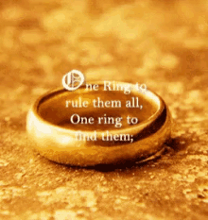
Blob (God Class)
one class monopolizes the processing, other classes primarily encapsulate data
Simple
Class A
Simple
Class B
Everything Else
Simple
Class C
Simple
Class E
Simple
Class D
procedural design disguised in objects and OOP

Slide 39
Characteristics of Blob
Overly Complex Class: Handles multiple unrelated tasks.
High Coupling: Interacts with many other classes.
Difficult to Maintain: Hard to understand and modify.
Single Point of Failure: Changes can have widespread impact.
cohesion? coupling? SRP?

Slide 40
Blob Example
Bug Fix: A 'Premium' user is being charged the 'Standard' user fine. Find the bug in returnBook(?)
New Feature: We need a 'Book Reservation’
LibraryControl
+doInventory()
+checkOut(item)
+checkIn(item)
+printCatalog()
+sortCatalog()
+searchCatalog(param)
+editItem(item)
+findItem(item)
+print()
+listCatalogs()
+issueLibraryCard()
+activateCatalogs(..)
+calculateLateFine(…)
+returnBook()
……..
Item
-title
-author
….
Person
-….
Catalog
-topic
-inventory
….
From http://www.antipatterns.com
Notes:
Bug Fix: A 'Premium' user is being charged the 'Standard' user fine. Find the bug in returnBook and write down the corrected code.
New Feature: The business wants a new feature: "We need a 'Book Reservation' system."
Discuss: Where would your new reserveBook method go? What other methods would you have to change to make it work?

Slide 41
public class LibraryControl { //15 atttributes
public LibraryControl(){…} //...a huge constructor that initializes everything...
//….methods for user management: book registration, inventory, etc. ...
public void issueBook(int userID, int bookID) { // ... 50 lines of code ...
// ... logic to check user status, book availability ...
// ... logic to update database and send email notification ...
}
public void returnBook(int userID, int bookID) { // ... 60 lines of code ...
if (isOverdue(bookID)) { // ... logic to check if late ...
double fine = 0;
if (getUser(userID).isPremiumMember()) fine = 2.50;
else fine = 2.50
// ... more logic ...
paymentProcessor.chargeFine(userID, fine);
notifier.sendFineEmail(userID, fine);
} //…logic to update the database
}
public void generateOverdueReport(String reportType) { // ... 80 lines of code ...
// ... complex database query ... // ... logic to format and email report to managers .. }}
Bug Fix: A 'Premium' user is being charged the 'Standard' user fine. Find the bug in returnBook(?)
New Feature: We need a 'Book Reservation’
Notes:
If I add reserveBook, I also have to modify issueBook. issueBook now has to check if the book is reserved, and if so, if it's reserved by this user.
I also have to modify returnBook. When a book is returned, I have to check if there's a reservation pending and maybe send a notification to the next user in line.
I probably have to modify searchCatalog to show a book's reservation status.
----How do I test this fix?
To even call returnBook, I first need an instance of LibraryControl.
Looking at the constructor, I'll bet it's huge and needs a database connection, a logger, and who knows what else.
The returnBook method itself calls getUser , paymentProcessor.chargeFine , and notifier.sendFineEmail.
OMG. To write a simple unit test for a one-line bug fix, I have to mock a database, a payment gateway, and an email service.
This is the pain: The code is completely untestable. The trivial fine logic is hopelessly tangled with database calls, payments, and notifications. I can't fix this bug with any confidence that I'm not breaking something else."

Slide 42
Blob Example
Fix Blob before adding new code.
What are the different jobs LibraryControl is trying to do all at once?
LibraryControl
+doInventory()
+checkOut(item)
+checkIn(item)
+printCatalog()
+sortCatalog()
+searchCatalog(param)
+editItem(item)
+findItem(item)
+print()
+listCatalogs()
+issueLibraryCard()
+activateCatalogs(..)
+calculateLateFine(…)
……..
Item
-title
-author
….
Person
-….
Catalog
-topic
-inventory
….
From http://www.antipatterns.com

Slide 43
Refactoring Blob
Break down into smaller focused classes
  Each class should handle one responsibility
Distribute the responsibility and isolate the effect of changes
  Categorize related attributes and operations
    Consider cohesion
  Find natural hosts for these collections and migrate these code there
  Extract methods, subclasses, abstract classes
  Correct the associations/dependencies
Notes:
If there is a base class that is a blob and hundreds of subclasses with little content
Can be fixed by proper use of delegation, interface inheritance and patterns such as Strategy or Visitor

Slide 44
Breaking down the Blob
LibraryControl
Find natural homes
+doInventory()
+checkOut(item)
+checkIn(item)
+printCatalog()
+sortCatalog()
+searchCatalog(param)
+editItem(item)
+findItem(item)
+print()
+listCatalogs()
+issueLibraryCard()
+archiveCatalogs(..)
+calculateLateFine(…)
……..
Inventory
Catalog
UserService
From http://www.antipatterns.com

Slide 45
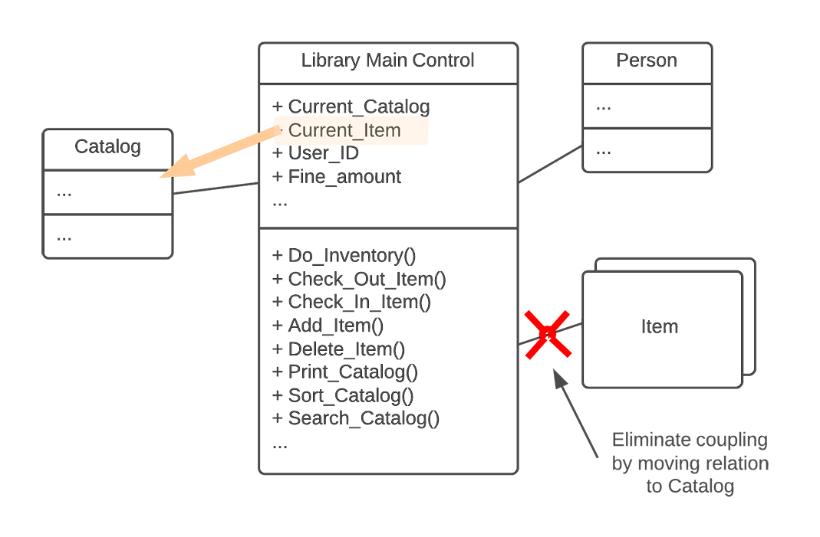

Slide 46
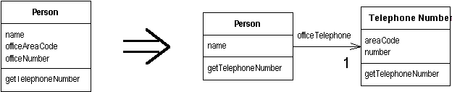
Breaking down into classes
If after moving to natural homes the blob is still huge, break it down

Slide 47
Mediator vs Blob
Be careful with Mediator pattern.
  Mediator can become a Blob
  If the implementation gone wrong, consider Observer
    Pro: Colleagues notify other colleagues; often easier to make reusable Subjects/Observers.
    Con: In N-to-N dependencies, Observer creates a web of cascading, untraceable updates.
  Safety-Critical Systems (like aircraft/control tower), the decentralized, non-deterministic nature of the Observer pattern is dangerous

Slide 48
The Blob: Symptoms
Single class with many attributes and operations
  Is there Cohesion?
  A class with 60 or more attributes and operations usually indicates the presence of the Blob
Controller class with simple, data-object classes
  Be careful with Mediator
  Procedural design implemented in OOP
A disparate collection of unrelated attributes and operations encapsulated in a single class.
single class nearly encapsulates the applications entire functionality, like a procedural main program.
  A program main loop inside the Blob class associated with relatively passive data objects

Slide 49
Negative impact
OO advantage is lost
Hard to maintain and extend.
  Blob limits the ability to modify the system without affecting the functionality of other encapsulated objects.
  Modifications to other objects in the system are also likely to have impact on the Blob's software.
Difficult to understand, reuse, and test.
Increases risk of bugs.
Expensive to load
  The Blob Class may be expensive to load into memory, using excessive resources, even for simple operations.

Slide 50
Causes
Violation of Single Responsibility Principle:
  One class takes on too many responsibilities.
Lack of modular design:
  Functions and responsibilities are not properly separated.
Pressure to deliver quickly:
  Leads to adding more functionality to existing classes instead of creating new ones.

Slide 51
Blob…
Complex, error-prone, and unmanageable code.
Refactor into smaller, focused classes improves maintainability, testability, and readability.
Adhering to the Single Responsibility Principle is key to avoiding the Blob anti-pattern.

Slide 52
Related Antipatterns
The Blob is often accompanied by unnecessary code
  making it hard to differentiate between the useful functionality of the Blob Class and no-longer-used code
  Lava Flow
  spaghetti code
  poltergeist

Slide 53
SW Development Antipatterns
Blob
Lava flow
Functional decomposition
Poltergeist
Golden hammer
Spaghetti code
Cut and paste programming
Mini antipatterns
Boat anchor
Input kludge
Magic Numbers
Continuous obsolescence
Premature optimization

Slide 54
Development Antipatterns(1)
Blob (God Class)
  One big class with too many responsibilities
Proliferation of classes (Poltergeist)
  Small classes with short life cycles
Spaghetti code
  Ad-hoc code structure that is hard to extend and modify
Lava flow
  Dead code or forgotten design information that are frozen and no one understands
Cut and paste programming
  Duplication of code, leads to many errors like duplicates errors

Slide 55
Development Antipatterns (2)
Golden hammer
  Belief that a particular technology solves everything
    Misapplication of a favored tool or concept
    Gained high level of confidence on a solution, then every problem is viewed as something that is best solved with it
Mini antipatterns
  Input kludge
    unexpected combinations of user-accessible features crashes your system –race conditions on concurrent input; validation;
  Boat anchor
    Keeping something that is no longer used in the current system
  Magic Number
    unexplained numerical values in code instead of named constants
Notes:
Continuous obsolescence: developers spend more time upgrading existing dependencies than developing new features.
cure for the Input Kludge remains sound design: robust input validation (checking state before proceeding) and careful handling of concurrency and race conditions using locks, queues, or state machines
Input Kludge is when the system fails because of a bad combination of valid features. It's not the individual input that's wrong, it's the sequence.
example:
mobile banking app with two simple features: Transfer Money and Change Password.
Both features work perfectly on their own.
The Kludge Sequence:
A user starts a large Money Transfer (Feature A). The app sends the request to the server, and the transfer is now "pending."
While the transaction is still pending, the user quickly goes to settings and Changes their Password (Feature B).
The Pain poor design: didn't check the state of the transfer before allowing the password change.
When the password changes, the old security session is destroyed.
The server then tries to finalize the pending Money Transfer, but it can't find a valid session or user ID.
Result: The transaction fails, the app crashes, or worse—the system enters an unstable state where the transfer amount is deducted from the source account but never credited to the destination.
Lesson: valid inputs can combine into invalid state. design must look beyond individual inputs and enforce rules about system state.
"Can the user legally perform action B while action A is currently running?"
If the answer is no, you must temporarily disable, queue, or validate against the pending action

