Slide 1
Structural Patterns
Proxy

Slide 2
Proxy
Intent
Provide a placeholder for another object to control access to it
A.k.a. Surrogate
Put a placeholder when direct access to an object is not desirable or practical due to
Security
Performance optimization
…
Notes:
“This could be due to security concerns, performance optimizations, or the need to introduce additional functionality without modifying the original object.”
https://medium.com/@mehar.chand.cloud/proxy-design-pattern-use-case-access-control-bb2b0aedcdb6

Slide 3
Proxy
Intent
Provide a placeholder for another object to control access to it
A Proxy object controls access to another object, which may be
remote
expensive to create
in need of protection, require permission
Or need a smart reference doing more than a simple pointer
Notes:
versatile: cok yonlu

Slide 4
Proxy patterns
Real object is remote
Remote proxy: illusion that an object on a different machine is a local
Real object is expensive to create
Virtual proxy: creates object lazily
in need of protection/security
Protection proxy: checks permissions and policies
Resource optimization
Caching proxy: delivers cached result
Pointer with extra responsibility
Smart reference

Slide 5
Applicability
Whenever there is a need for a more versatile reference to an object than a simple pointer.
Remote proxy: when real object is in a different address space
Virtual proxy: when creation of an object is costly
Protection proxy: when objects should have different access rights
Smart reference: when you need for a more versatile reference to an object than a simple pointer
E.g. Count number of references and then delete
Notes:
versatile: cok yonlu
Deferred object creation
Permission
Resource optimization )caching)

Slide 6
Proxy –Structure
Client
Subject
+request()
realSubject.request()
RealSubject
Proxy
realSubject
+request()
+request()
Participants: Subject, RealSubject, Proxy. Client do not care the difference
Notes:
Subject interface: so that client treats proxy juts like the real one

Slide 7
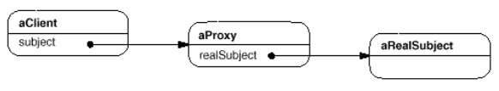
Proxy structure
A possible Object diagram of a proxy at runtime
Question: Can I have multiple proxies on top of each other?

Slide 8
Remote proxy
Example Scenario: A machine at the College of OOAD has several utility services running as daemons on well-known ports. We want to be able to access these services from various client machines as if they were local objects.
Solution: Use a Remote Proxy!
Have a local placeholder for an object in a different address space
This is the essence of modern distributed object technology such as REST, RPC like gRPC, event driven protocols like WebSockets
Notes:
provides a local representative for an object in a different address space.”=geeksfor geeks
gRPC: A high-performance, strongly typed RPC system ideal for microservices.

Slide 9
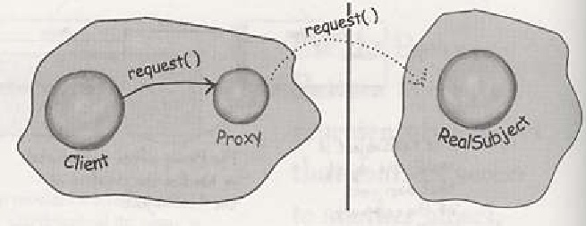
Remote proxy
Client treats the proxy as local object
Proxy actually deals with remote communication and access the remote object
stubs created in RMI compiler
commonly used in client-server applications
Source: head first design patterns
Notes:
Using rmic to generate stubs and skeletons. Then insert them into rmiregistry

Slide 10
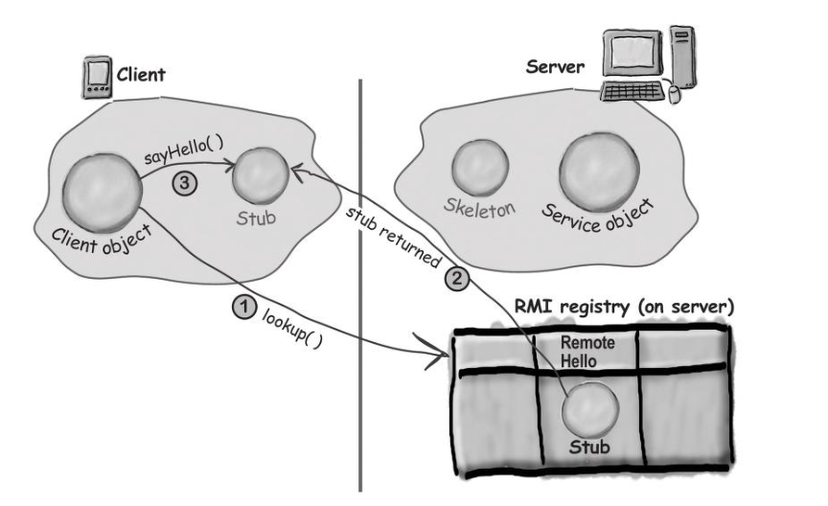
Image Source: head first design patterns
RealSubject is in the Server
Stub is the Proxy.
Client makes regular method call to Stub.
Java RMI is not supported anymore.
But it helps explaining the concept
When using Rest API, create your own remote proxies
SOAP web service frameworks generate proxies

Slide 11
Server Side using WebService
import javax.jws.WebService;
import javax.jws.WebMethod;
@WebService
@SOAPBinding(style = Style.RPC)
public interface MyComplex {
@WebMethod ComplexData getComplexData();
}
@WebService(endpointInterface = “MyComplex")
public class MyComplexImpl implements MyComplex {..}
public static void main(String[] args) {
Endpoint.publish("http://localhost:9999/ws/mydata",
new MyComplexImpl());}
JAX-WS automatically generates a WSDL document for your service.
Client programmer downloads from http://localhost:9999/ws/mydata?wsdl.
Notes:
Main method is in a publisher class.

Slide 12
Client Side using Web Service
Create an interface description using the WSDL file –wsimport comes with JDK
wsimport -keep -p com.example.client http://localhost:9999/ws/mydata?wsdl
It will generate necessary client files, which is depends on the provided WSDL file.
In this example, it will generate one interface and one service implementation file.
MyComplex.java
MyComplexImplService.java
Source: https://mkyong.com/webservices/jax-ws/jax-ws-hello-world-example/

Slide 13
Client code using Remote proxy
import com.example.client.MyComplex;
import com.example.client.MyComplexImplService;
public class Client{
public static void main(String[] args) {
MyComplexService service = new MyComplexImplService();
MyComplex proxy = service.getMyComplexImplPort();
System.out.println(proxy.getComplexData());
//regular method call.
}
}
When return/parameter type is custom object, create proxies from their wsdl files as well.
Notes:
NO url, no open connection, no SOAP envelop …all details are hidden from client

Slide 14
import com.example.client.MyComplex;
public class MyComplexProxy {
private MyComplex proxy;
public MyComplexProxy() {
try {
URL url = new URL("http://localhost:9999/ws/mydata?wsdl");
QName qname = new QName(uri, “MyComplexImplService");
Service service = Service.create(url, qname);
MyComplex proxy = service.getPort(MyComplex.class);
} catch (Exception e) {
throw new RuntimeException(e);
}
}
public ComplexData getComplexData() {
return proxy.getComplexData();
}
} //alternative without using wsimport
Notes:
import java.net.URL;
import javax.xml.namespace.QName;
import javax.xml.ws.Service;

Slide 15
Another Web Service
generate stubs. Remote proxy!
wsdl2jws –wsdl calculatorService.wsdl
Client code
public class Main {
public static void main(String[] args) {
// Create a proxy for the calculator service
CalculatorService calculatorService = new CalculatorService();
ICalculator calculator = calculatorService.getICalculatorPort();
// Call the "add" operation
int result = calculator.add(10, 5);
System.out.println("The result is: " + result);
}
}

Slide 16
Virtual proxy
Deferred object creation
Client treats it as real object, but the real object is not created until it is needed.
don’t create until its methods are invoked or fields are accessed
after the creation, proxy is just a delegator
Control access:
proxy controls access to the real subject so that before it is loaded proxy provides a default behavior –like “in progress”.
Once it is loaded proxy allows full access to it.

Slide 17
Virtual proxy: Example
Application has an image object loading from a URL, but it takes too much time.
Do not stall while loading the image, show something.
Virtual proxy stands in place of the image
while loading the image in the background
in another thread
shows “loading image” message
Notes:
image is loaded from an URL, and that takes too much time.
while doing that, when the application says draw, the proxy draws itself
loading in the background using another thread.
control access: proxy controls access to image so that before it is loaded proxy provides another display. once the image is loaded proxy allows access to it.

Slide 18
// Subject
interface IImage {
void modify();
void save(String fileName);
}
// Real Subject
ImageImpl implements IImage{
private BufferedImage img;
public ImageImpl(String imageUrl){
img = ImageIO.read(new URL(imageUrl));
}
public void save (String fileName){
ImageIO.write(originalImage, "jpg", fileName);
}
public void modify(){…..}
}
Notes:
BufferedImage myPicture = ImageIO.read(new File(imagePath));

Slide 19
ImageProxy implements IImage{
private IImage realImage=null;
private String name; private Image dummy;
public ImageProxy(String imgUrl){
name=imgUrl;
dummy=ImageIO.read(dummy.jpg); /*“loading image” msg*/}
public void save(){
if (realImage!=null) realImage.save() else load();}
public void modify(){
if (realImage!=null) realImage.modify() else load();}
private void load(){ //load the real one in another thread
Thread t=new Runnable(){
public void run(){
realImage=new ImageImpl(imageUrl);}};
t.start(); //need synchronization, todo
}
}
Notes:
All classes other than the proxy itself must access the target class indirectly through the proxy.
If any class makes a static reference to the target class, the JVM will downloaded the class even if no instantiation is done.

Slide 20
//client
public class ImageDisplayFX extends Application {
String url=https://cs.someschool.edu/any.jpg
public void start(Stage stage) throws IOException {
IImage image = new ImageProxy(url);
// would be better with dependency injection
ImageView imageView = new ImageView(image);
StackPane root = new StackPane(imageView);
Scene scene = new Scene(root, image.getWidth(), image.getHeight());
primaryStage.setTitle("Image Display (JavaFX)");
primaryStage.setScene(scene);
primaryStage.show();
}
Notes:
public void setImg(Image img){ image=img;}
public void main(String[] args){
Image image = new ImageProxy(url);
setImg(image);
launch(args);
}

Slide 21
Realistic scenario…
Image is built-in in Java; let’s have a more realistic scenario
“There is an ImageIcon that loads its image from a URL.”
Same solution
Load the inner image when the icon is painted with a worker thread
public class ImageProxy implements Icon{
volatile ImageIcon imageIcon; //to protect reads in multithread
final URL imageURL;Thread worker; boolean retrieving=false;
public ImageProxy(URL url){imageURL=url;}
public int getIconHeight(){
if(imageIcon==null) return 800 //default until icon is loaded
else return imageIcon.getIconHeight();
}
Source: Head first design patterns

Slide 22
Draw the class diagram
public void paintIcon(final Component c , Graphics g, int x, int y){
if(imageIcon!=null) imageicon.paintIcon(g,g,x,y); //simple delegation
else {// do not stall. Show something while loading
g.drawString(“Loading image….”, x+300, y+200);
if (!retrieving) { //not to restart loading again and again
retrieving=true;
worker=new Thread(new Runnable(){
public void run{ //worker thread loads the image
try{
setImageIcon(new ImageIcon(imageURL, “MyIcon”));
c.paint(); //display when ready
}catch(Exception e) {e.printStackTrace();}}};
worker.start();//worker setup done. Start loading
}
synchronized void setImageIcon(ImageIcon i) {imageIcon=I;}
}
Source: Head first design patterns

Slide 23
Whole class in one place
public class ImageProxy implements Icon{
volatile ImageIcon imageIcon; //to protect reads in multithread
final URL imageURL;Thread worker; boolean retrieving=false;
public ImageProxy(URL url){imageURL=url;}
public int getIconHeight(){
if(imageIcon==null) return 800 //default until icon is loaded
else return imgicon.getIconHeight();}
public void paintIcon(final Component c , Graphics g, int x, int y){
if(imageIcon!=null) imageicon.paintIcon(g,g,x,y); //simple delegation
else {// do not stall. Show something while loading
g.drawString(“Loading image….”, x+300, y+200);
if (!retrieving) {
retrieving=true;
worker=new Thread(new Runnable(){
public void run{ //worker thread loads the image
try{
setImageIcon(new ImageIcon(imageURL, “MyIcon”));
c.paint(); //display when ready
}catch(Exception e) {e.printStackTrace();}}};
worker.start();//worker setup done. Start loading
}
synchronized void setImageIcon(ImageIcon i) {imageIcon=I;}
}
Source: Head first design patterns

Slide 24
Exercise: Draw a diagram
We need to use only a few methods of some costly objects we'll initialize those objects when we need them entirely.
Until that point, we can use some light objects exposing the same interface as the heavy objects.
What are the participants?

Slide 25
Protection proxy
like a secretary doesn’t forward all the phone calls to a manager
Example 1: only owner modifies its personal data in a chat application
if a non-owner access to your personal info than a proxy is returned
proxy allows get methods (query methods) but disallows set methods
Notes:
Protection (security) Proxies that controls access to objects can be found in many object oriented languages including java, C#, C++

Slide 26
Protection proxy
like a secretary doesn’t forward all the phone calls to a manager
Example 2: Grade information for a student shared by administrators and the student. Teachers have access to the grades of students in their own courses, and only those grade in their courses.
Grade information need protection.
Implementation issue:
A protection might refuse to perform an operation that the subject will perform
its interface may be a subset of the subject’s.

Slide 27
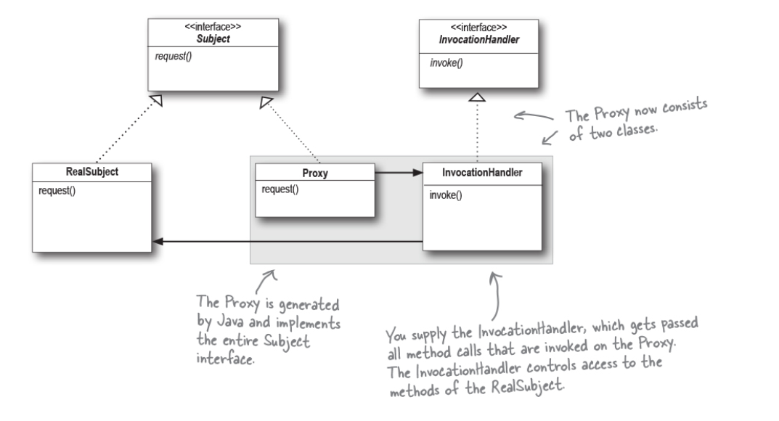
Dynamic Proxy in Java is a variation of Proxy.
Instead of putting control behavior in proxy, we write code in the InvocationHandler.
Proxy methods delegate to invoke(Object proxy, Method m, Object[] args);
Notes:
Read geek matching app in the book head first design patterns. –java dynamic proxy
It is a protection proxy, Person class is protected
Geekmatching: Full access with OwnerInvocationHandler, some access with NonOwnerInvocationHandler
Some implementation issues, uses reflection…look at the book if interested

Slide 28
Implementation Issues
Proxy class can deal with its subject solely through an abstract interface
Not in virtual proxy. since it will instantiate RealSubjects, they have to know the concrete class.
Overloading the member access operator in C++
overloading operator-> lets you perform additional work whenever an object is dereferenced.
the proxy behaves just like a pointer.

Slide 29
Example: Overloading -> in C++
class ImagePtr:Graphics {
public:
ImagePtr(const char* imageFile);
virtual ~ImagePtr();
virtual Image* operator->();
virtual Image& operator*();
private:
Image* LoadImage();
private:
Image* _image;
const char* _imageFile;
};
//impl in next slide
class Image:Graphics{
public: Image(const char* file);
virtual void Draw(const Point& at);
virtual void Load(istream& from);
…
}
//client
ImagePtr image = ImagePtr("anImageFileName");
image->Draw(Point(50, 100));

Slide 30
Example: overloading -> C++
ImagePtr::ImagePtr (
const char* theImageFile) {
_imageFile = theImageFile;
_image = 0;
}
Image* ImagePtr::LoadImage () {
if (_image == 0) {
_image =
LoadAnImageFile(_imageFile);
}
return _image;
}
Image* ImagePtr::operator-> () {
return LoadImage();}
Image& ImagePtr::operator* () {
return *LoadImage();}
class Image:Graphics{
public: Image(const char* file);
virtual void Draw(const Point& at);
virtual void Load(istream& from);
…
}
//client
ImagePtr image = ImagePtr("anImageFileName");
image->Draw(Point(50, 100));
The image proxy acts like a pointer, but it's not declared to be a pointer to an Image.

Slide 31
Smart reference
Surrogate of an object that performs additional actions when object is accessed
Typical uses:
checking real object’s locks before it is accessed
counting #of references for garbage collection
copy-on-write

Slide 32
Scenario 1: Problem
Java has garbage collection
C++ does not.
When exiting a function, destructors of the objects are invoked.
That is not enough…
Memory leak
void myfun (){
int * p=new int();
*p=20;
cout << *ptr;}
Upon exiting myfun
p is not valid
local variable
Memory allocated is still there!
Need explicit delete

Slide 33
Scenario 1: Solution
Let’s solve this problem with a smart reference
SmartPtr
Wrap the int* in an object
Put delete ptr inside ~SmartPtr
myfun will have a SmartPtr instead of int*
The object destroys itself when it goes out of its scope
Deleting ptr for us
Memory leak
void myfun (){
int * p=new int();
*p=20;
cout << *ptr;}
Upon exiting myfun
p is not valid
local variable
Memory allocated is still there!
Need explicit delete
source: https://www.geeksforgeeks.org/smart-pointers-cpp/
Notes:
We do not need to delete ptr as SmartPointer destructor will handle it.
// We don't need to call delete ptr: when the object
// ptr goes out of scope, the destructor for it is
// automatically called and destructor does delete ptr.

Slide 34
Scenario 1: Smart Ref Solution
class SmartPtr {
int* ptr; // Actual pointer
public:
explicit SmartPtr(int* p = NULL)
{ ptr = p; }
~SmartPtr() { delete (ptr); }
// Overload dereferencing op.
int& operator*() { return *ptr; }
};
Memory leak:
void myfun (){
int * p=new int();
*p=20;
cout << *ptr;}
No memory leak:
void fun(){
SmartPtr ptr(new int());
*ptr = 20;
cout << *ptr;
}
source: https://www.geeksforgeeks.org/smart-pointers-cpp/
Notes:
smart pointer destroys itself when it goes out of its scope
So, we don’t need to delete it as Smart Pointer will handle it.

Slide 35
Scenario 1: Solution
class SmartPtr {
int* ptr; // Actual pointer
public:
explicit SmartPtr(int* p = NULL)
{ ptr = p; }
~SmartPtr() { delete (ptr); }
// Overload dereferencing op.
int& operator*() { return *ptr; }
};
For a more generic solution, use a template
Notes:
The principle that objects own resources is also known as "resource acquisition is initialization," or RAII.

Slide 36
Smart Pointers in C++
template <typename T>
class SmartPtr {
T* ptr; // Actual pointer
public:
explicit SmartPtr(T* p = NULL)
{ ptr = p; }
~SmartPtr() { delete (ptr); }
// Overload dereferencing op.
T& operator*() { return *ptr; }
};
STL provides: std::unique_ptr
std::shared_ptr
std::weak_ptr
std::auto_ptr
“Smart pointers enable automatic, exception-safe, object lifetime management.”
https://en.cppreference.com/w/cpp/memory#Smart_pointers
Notes:
Only one unique_ptr can point to one resource
therefore, unique_ptr cannot be copied but can be moved
unique_ptr<A> ptr1 (new A);
unique_ptr<A> ptr2 = ptr1; //ERROR
unique_ptr<A> ptr2 = move(ptr1); //resource now stored in ptr2

Slide 37
STL support for Smartpointer
#include <memory>
class myclass{
private:
std::unique_ptr<int[]> data;
public:
myclass(const int size) { data = std::make_unique<int[]>(size); }
void do_something() {}
};
void functionUsingMyclass() {
myclass w(1000000); // lifetime automatically tied to enclosing scope
// constructs w, including the member w.data
w.do_something();
} // automatic destruction and deallocation for w and w.data
https://learn.microsoft.com/en-us/cpp/cpp/object-lifetime-and-resource-management-modern-cpp
Notes:
Only one unique_ptr can point to one resource
therefore, unique_ptr cannot be copied but can be moved
unique_ptr<A> ptr1 (new A);
unique_ptr<A> ptr2 = ptr1; //ERROR
unique_ptr<A> ptr2 = move(ptr1); //resource now stored in ptr2

Slide 38
Smart pointers are a smart reference–style proxy that focuses on lifetime.
Most structural proxies mediate access control, caching, logging, remoting..
Notes:
shared_ptr: lock-efficient, exception-safe, aliasing-aware, thread-safe
If what you need is exclusive ownership of a resource, build on std::unique_ptr (or a tiny RAII wrapper).
If you actually need behavioral mediation on access, that is Proxy—write a proxy
We may write our own for:
Policy-added access (a true proxy): synchronization, validation, lazy-load, thread-affinity checks, call-logging, throttling.
Special semantics not in the standard: intrusive refcounting, copy-on-write, arena/pooled lifetimes, cross-thread ownership rules, handle-body (pImpl with special behaviors).

Slide 39
Scenario2:Copy-on-write
"Copy on write" : everyone has a single shared copy of the same data until it's written,
Make actual copying only if it is modified
When copying a large complicated object is costly
Postpone the copying and pay the price only if the object is modified
If the copy is never modified, then there's no need to pay this cost
Notes:
There's another optimization that the Proxy pattern can hide from the client. It's called copy-on-write, and it's related to creation on demand. Copying a large and complicated object can be an expensive operation. If the copy is never modified, then there's no need to incur this cost. By using a proxy to postpone the copying process, we ensure that we pay the price of copying the object only if it's modified.
To make copy-on-write work, the subject must be reference counted. Copying the proxy will do nothing more than increment this reference count. Only when the client requests an operation that modifies the subject does the proxy actually copy it. In that case the proxy must also decrement the subject's reference count. When the reference count goes to zero, the subject gets deleted.
Copy-on-write can reduce the cost of copying heavyweight subjects significantly.

Slide 40
Scenario2: solution outline
the subject must be reference counted.
Copying the proxy will do nothing more than increment this reference count.
Only when the client requests an operation that modifies the subject does the proxy actually copy it.
In that case the proxy must also decrement the subject's reference count.
When the reference count goes to zero, the subject gets deleted.

Slide 41
Proxy - Consequences
Introduces a level of indirection when accessing an object
Hide extra behavior
Remote proxy: Hide that the real object resides in a different address space
Perform optimizations,
Create object on demand
Caching results
Smart references and protection proxies:
additional housekeeping when objects are accessed

Slide 42
Related patterns
Adapter
Adapter provides a different interface to the object it adapts where a Proxy implements the same interface as its subject.
Decorator
A decorator implementation can be the same as the proxy however a decorator adds responsibilities to an object while a proxy controls access to it.
Notes:
Read fireside chats between Proxy and Decorator in the Head First Design patterns.

