Slide 1
Structural Patterns
Bridge
Flyweight

Slide 2
Bridge
Intent
Decouple an abstraction from its implementation so that they can vary independently
Employs 2 design guidelines
"Find what varies and encapsulate it“
"Favor aggregation over class inheritance"
Abstraction and implementation can be changed independently
If you use inheritance, only implementation can change

Slide 3
Example
When abstraction is bound to its implementation with inheritance
Window
I need to extend the
window abstraction and
have an IconWindow
XWindow
MSWindow

Slide 4
Example
When abstraction is bound to its implementation with inheritance
Window
I need to extend the
window abstraction and
have an IconWindow
XWindow
MSWindow
IconWindow
XIconWindow
MSIconWindow
Awkward. What if I need
another type of window?

Slide 5
Alternative 1
Widget
Window
IconWindow
XWindow
MSWindow
XIconWindow
MSIconWindow
Still not good. Problem is more visible

Slide 6
Alternative 2
Widget
X_Platform
MS_Platform
XWindow
XIconWindow
MSWindow
MSIconWindow
Still not good.
Notes:
Decouple abstraction (platform) from implementation (xWindow & MSIconWindow)

Slide 7
Toward solution
What is varying?
Widget encapsulates window, iconwindow,etc
Varying: subtypes of windowing/widget
Platform encapsulates the OS specifics
Varying: X-platform or MS-platform
Notes:
Latter choice:violates encapsulation. Drawing objects would have to know
specific information about the Shapes (that is, the kind of Shape)
in order to draw them. The objects are not really responsible for their own behaviors.

Slide 8
Towards Solution
Widget
Platform
window
iconwindow
XPlatform
MSPlatform
Notes:
Needs a bridge between widget and platform
Wodget <>--- platform

Slide 9
Toward solution
What is varying?
Widget encapsulates window, iconwindow,etc
Varying: subtypes of windowing/widget
Platform encapsulates the OS specifics
Varying: X-platform or MS-platform
How to relate them without inheritance
does widget uses platform OR
platform uses widget?
Notes:
Latter choice:violates encapsulation. Drawing objects would have to know
specific information about the Shapes (that is, the kind of Shape)
in order to draw them. The objects are not really responsible for their own behaviors.

Slide 10
Solution
Widget
Platform
window
iconwindow
XPlatform
MSPlatform
Widget:: expand{
platfrom.drawRectangle(x,y,x2,y2);
platform.color(white);
}

Slide 11
Bridge-Structure
Participants?
Abstraction
Implementor
+operation()
+operationImpl()
RefinedAbstraction
ConcreteImplementorA
ConcreteImplementorB
+operationImpl()
+operationImpl()
impl.operationImpl()
Collaboration: Abstraction forwards client requests to its Implementor object.
Notes:
can change implementation during runtime
You can vary abstraction (add more) or implementation without changing the other one => two ways to extend open-close-principle

Slide 12
Using the Bridge
Widget
WindowImpl
+drawRectangle()
+devDrawLine()
IconWindow
Window
XWindowImpl
MSWindowImpl
impl.devDrawLine(l1);
impl.devDrawLine(l2);..
+devDrawLine()
+devDrawLine()
We can extend Window abstraction with
more window types easily
We can add other platforms
to implement a window

Slide 13
Implementor vs Abstraction
Implementor interface does not have to correspond exactly to Abstraction's interface.
The two interfaces can be quite different.
the Implementor interface provides only primitive operations,
drawLine, movePoint
Abstraction defines higher-level operations based on these primitives.
drawBorder, drawBoundingBox
Notes:
The intent is to decouple abstraction from implementation (though it looks like adaptor design pattern)

Slide 14
Bridge-Applicability
You want to select (or switch) implementation of an abstraction at runtime
Inheritance binds implementation to abstraction permanently
Both the abstractions and their implementations should be extensible by subclassing.
Inheritance is not practical
Changes on the implementation of an abstraction (RefinedAbstraction) should not require recompilation of client codes
Want to hide the implementation of an abstraction completely from clients
Notes:
so powerful and applies to so many situations. It also goes against a common tendency to handle special cases with inheritance
PIMPL in c++

Slide 15
Hide implementation from clients
Using just an interface the client can cheat!
Abstraction widget = new ConcreteImplA();
widget.operation();
((ConcreteImplA) widget).concreteOperation();
//cheating
In the Bridge pattern the client code cannot access the implementation
No inheritance → no casting

Slide 16
Hide implementation from clients
Java uses Bridge to prevent programmer from accessing platform specific implementations of interface widgets, etc.
It is actually about decoupling for extensibility
public synchronized void setCursor(Cursor cursor) {
this.cursor = cursor;
ComponentPeer peer = this.peer;
if (peer != null) {
//invoke implementor
peer.setCursor(cursor);
}
}
(peer is the implementation)
No dependency injection

Slide 17
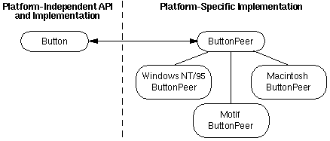
Bridge –Known uses
Java runs on different platforms
Create components without committing a concrete implementation
Component and Component Peers decoupled
Notes:
Java AWT/Swing uses Bridge to decouple platform-independent components (e.g., Button, Window) from platform-specific implementations (e.g., ComponentPeer). This allows the same component to work across different operating systems (e.g., Windows, X-Window) without changing client code.

Slide 18
C++ idiom PIMPL
Pointer to Implementation
Hiding implementation!
Removes implementation details of a class from its object representation
i.e. separating implementation from the interface.
A specific application of the Bridge pattern to solve
the problem of compile-time dependencies and
hide private implementation details.
Notes:
Do you see the bridge? A more specific application of the bridge pattern
The pattern does not talk about inner class or pointers. The idiom is more specific.

Slide 19
C++ idiom PIMPL
Pointer to Implementation
Removes implementation details of a class from its object representation
i.e. separating implementation from the interface.
Move the private data and member functions in a separate class and accessing them through a pointer
smart pointer to control the lifetime
Reduces build dependencies
Hide implementation from clients
Do you see the Bridge?
https://en.cppreference.com/w/cpp/language/pimpl
https://www.geeksforgeeks.org/pimpl-idiom-in-c-with-examples/
Notes:
Do you see the bridge? A more specific application of the bridge pattern
The pattern does not talk about inner class or pointers. The idiom is more specific.

Slide 20
/* |INTERFACE| User.h file */
class User {
public:
User(string name);
~User()=default;
User(const User& other);
User& operator=(User rhs);
//operations
int getSalary();
void setSalary(int);
void do2things();
private:
// Internal Implementor
class Impl;
// pointer to the implementor
unique_ptr<Impl> pimpl;
};
No implementation detail in the header file.
No data structure info
Notes:
#include "User.h"
#include <iostream>
using namespace std;
The Bridge Pattern – MC++ BLOG (modernescpp.com)

Slide 21
class User::Impl { //implementor
public:
Impl(string name): name(move(name)){};
~Impl()=default;
void doSth(){cout<<“impl do sth”<<endl;}
int salary=-1;
private: string name;
};
// Constructor connected with the Impl
User::User(string name)
: pimpl(new Impl(move(name))) {}
User::User(const User& other)
: pimpl(new Impl(*other.pimpl)){}
User& User::operator=(User rhs){
swap(pimpl, rhs.pimpl); return *this;}
int User::getSalary(){ return pimpl->salary;}
void User::setSalary(int salary) {
pimpl->salary = salary;}
void User::do2things(){
pimpl->doSth(); pimpl->doSth();}
/* |INTERFACE| User.h file */
class User {
public:
User(string name);
~User()=default;
User(const User& other);
User& operator=(User rhs);
//operations
int getSalary();
void setSalary(int);
void do2things();
private:
// Internal Implementor
class Impl;
// pointer to the implementor
unique_ptr<Impl> pimpl;
};
Do you see the Bridge?
Notes:
#include "User.h"
#include <iostream>
using namespace std;
The Bridge Pattern – MC++ BLOG (modernescpp.com)
Pimp(new impl(move(name))){} -> this is the bridge. `class impl` is the bridge
The above code is mainly about Information hiding (hiding implementation from client)

Slide 22
Hide implementation from clients: Sample scenario
Want to hide the implementation of an abstraction completely from clients
If a collection class supports multiple implementations, the decision can be based on the size of the collection.
A linked list implementation can be used for small collections and a hash table for larger ones.
If the collection grows bigger than a certain threshold, then it switches its implementation to one that's more appropriate for a large number of items.

Slide 23
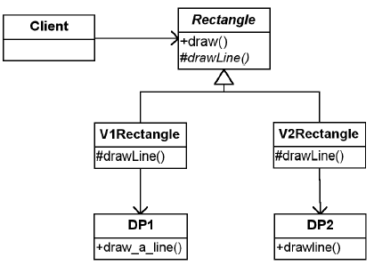
Another example

Slide 24
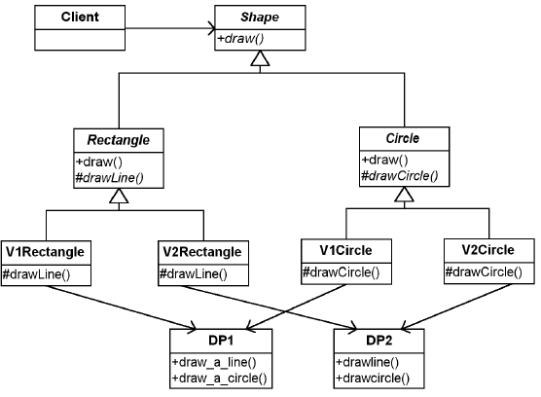
Adding a circle

Slide 25
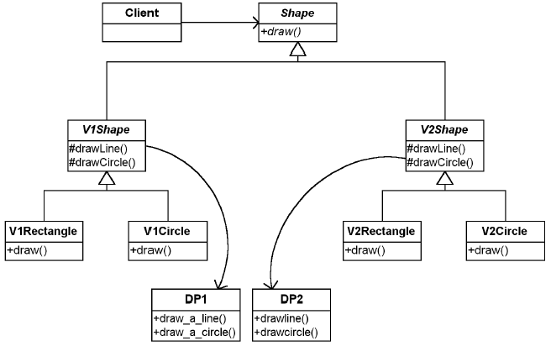
Not a solution

Slide 26
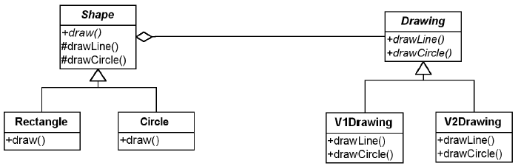
Using Bridge
Notes:
Expanding the design
In this design, Shape uses Drawing to manifest its behavior. I left out the details of V1Drawing using the DP1 program and
V2Drawing using the DP2 program. I add this as well as the protected methods drawLine and drawCircle (in
Shape), which calls Drawing’s drawLine, and drawCircle, respectively.

Slide 27
Bridge-Consequences
Decoupling abstraction and implementation
Implementation is not bound permanently to a particular interface
Enables to switch implementations on-the-fly
Reduces compile-time dependencies
Changing an implementation class does not require recompilation of Abstraction classes and its clients
When layering, upper layer only knows Abstraction and Implementor
Notes:
Changes to the concrete abstraction classes do not affect the client.

Slide 28
Bridge-Consequences
Improved extensibility
Abstraction and Implementor hierarchies can be extended independently.
Useful any time you need to vary an interface and an implementation in different ways.
e.g. Graphics that need to run over multiple platforms
Hiding implementation details from clients.
Notes:
Hiding implementation details from clients. You can shield clients from implementation details, like the sharing of implementor objects and the accompanying reference count mechanism (if any).

Slide 29
Implementation issues-1
How, when, and where to instantiate which Implementor class when there's more than one?
If Abstraction knows about all ConcreteImplementor classes, it can instantiate one of them in its constructor
decide between them based on parameters passed to it
Choose a default implementation initially and change it later according to usage.
Delegate the decision to another object: factory
Abstraction is not coupled directly to any of the Implementor classes.
Notes:
If, for example, a collection class supports multiple implementations, the decision can be based on the size of the collection. A linked list implementation can be used for small collections and a hash table for larger ones.
For example, if the collection grows bigger than a certain threshold, then it switches its implementation to one that's more appropriate for a large number of items.

Slide 30
Implementation issues -2
Use multiple inheritance in C++ to combine an interface with its implementation
e.g., a class can inherit publicly from Abstraction and privately from a ConcreteImplementor.
But it binds an implementation permanently to its interface.
You cannot substitute different implementors dynamically.
Therefore, we cannot implement a true Bridge with multiple inheritance—at least not in C++.

Slide 31
Multiple inheritance?
class MyClass : public Abstraction, private ConcreteImplementor {
// binds implementation directly
public:
void operation() override {
implementation(); // use the concrete method
}
};
cannot substitute different implementors dynamically.
Exposes implementation in the class hierarchy.
Does not reduce compile-time dependencies.

Slide 32
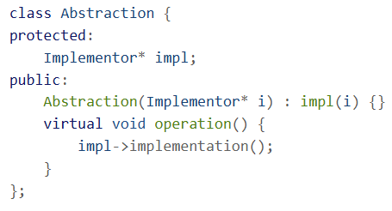
Implementation issues -2 (cont’d)
Enables substituting different implementors dynamically
Bridge implementation in C++
This is not Pimpl
Pimpl uses a single concrete implementation hidden behind a pointer.

Slide 33
Bridge vs Adapter
Difference in intention
The Adapter pattern’s intent is making unrelated classes work together
Make things work after they are designed
Bridge pattern intent’s is to allows us to use multiple implementations with possibly multiple interfaces
Make things work before they are designed
Both promotes flexibility by providing a level of indirection to another object
Notes:
An Abstract Factory (87) can create and configure a particular Bridge.

Slide 34
flyweight

Slide 35
Flyweight
Intent
Use sharing to support large numbers of fine-grained objects efficiently
Some programs require a large number of objects whose states are the same.
Why not SHARE these objects instead of creating unique instances?
Shared object that can be used in multiple contexts simultaneously.

Slide 36
Flyweight: Example Scenario
A scene drawing application
There are 10000 trees each of them have different location
All trees look the same. They are not the primary objective of this scene.
Memory problem… what can be shared?
class TreeRealistic{
private:
Texture bark_;
Texture leaves_;
Vector position_;
double height_;
double thickness_;
Color barkTint_;
Color leafTint_;
};
public class Tree{
private int height;
private Point p;
private Color color;
public void display(Graphics g){ ..}
public Tree(…) {…}
}
Encapsulate what varies
Notes:
tree instance per tree to be shown? 10000s of instances waste the memory
Only 1 or few tree instance of tree and application maintains the state of ALL. => Flyweight

Slide 37
class Tree{
private int height;
private Point p;
private Color color;
public void display(Graphics g) {
….g.setColor(color);
g.fillOval(p.x - 5, p.y - 10, 10, 10);}
public Tree(…){..}
}
class Forest { //client
private Tree[ ] trees;
void plantTree(){
for (int i=0;i<10000; i++)
trees[i]=new Tree(…);}
void paint(Graphics g){
for(var t:trees) t.display(g);}
}
class Tree{ //FLYWEIGHT
private int height;
private Color color;
display(Point p,Graphics g) { …g.fillOval(p.x - 5, p.y - 10, 10, 10);}
public Tree(int h, Color c){…}
}
class Forest { //client
private Point[ ] pos;
private Tree[ ] trees;
void plantTree(){
for (int i=0;i<10000; i++)
trees[i]=new Tree(100,green);}
void paint(Graphics g){
for (int i=0;i<1000; mi++)
t.display(pos[i],g)}
}
Still not sharing
Notes:
Draw a memory diagram or object diagram

Slide 38
public class TreeFactory{
Map<String,Tree> dict;
public Tree getTree(String name, int height, Color c){
Tree result=dict.get(name);
if(result==null)
dict.put(name,
new Tree(height,c));
return result;
}
public TreeFactory(){
dict=new HashMap<Tree>();
}
//make this class Singleton
}
class Tree{ //FLYWEIGHT
private int height;
private Color color;
display(Point p,Graphics g) { …g.fillOval(p.x - 5, p.y - 10, 10, 10);}
public Tree(int h, Color c){…}
}
class Forest { //client
private Point[ ] pos;
private Tree[ ] trees;
void plantTree(){
for (int i=0;i<10000; i++)
trees[i]=new Tree(100,green);}
void paint(Graphics g){
for (int i=0;i<1000; mi++)
t.display(pos[i],g)}
}
Notes:
Draw a memory diagram or object diagram

Slide 39
class Tree{ //FLYWEIGHT
private int height;
private Color color;
display(Point p,Graphics g) { …g.fillOval(p.x - 5, p.y - 10, 10, 10);}
public Tree(int h, Color c){…}
}
class Forest { //client
private Point[ ] pos;
private Tree[ ] trees;
void plantTree(){
for (int i=0;i<10000; i++)
trees[i]=
factory.getTree(“y”,100,green);}
void paint(Graphics g){
for (int i=0;i<1000; mi++)
t.display(pos[i],g)}
}
public class TreeFactory{
Map<String,Tree> dict;
public Tree getTree(String key,
int height, Color c){
Tree result=dict.get(name);
if(result==null)
dict.put(name,
new Tree(height,c));
return result;
}
public TreeFactory(){
dict=new HashMap<Tree>();
}
//make this class Singleton
}
Notes:
Draw a memory diagram or object diagram

Slide 40
Structure of the Scene
Forest
-pos:Point[]
-trees:Tree[]
TreeFactory
Flyweight
+getTree(key)
+display(Point,Graphics)
Tree
-height:int
-color:Color
+display(Point, Graphics)
Create only 1 instance for tree
The extrinsic state (location) is
passed from outside when display
is called
Notes:
Factory-to ensure flywegiths are shared properly
This pattern works best if ”Tree” is immutable

Slide 41
Flyweight -Structure
Client
FlyweightFactory
Flyweight
+getFlyweight(key)
+operation(context)
ConcreteFlyweight
UnsharedConcreteFlyweight
intrinsicState
+operation(context)
allState
+operation(context)
Intrinsic state=state that does not depend on the context
Notes:
Factory-to ensure flywegiths are shared properly

Slide 42
Flyweight participants
Flyweight - Declares an interface through which flyweights can receive and act on extrinsic state.
FlyweightFactory - The factory creates and manages flyweight objects. Ensures sharing of the flyweight objects. Maintains a pool of different flyweight objects.
Client - A client maintains references to flyweights in addition to computing and maintaining extrinsic state (context)
ConcreteFlyweight - Implements the Flyweight interface and stores intrinsic state. Sharable. Manipulates state that is extrinsic.

Slide 43
Flyweight - Structure
Object diagram
Stores the context of
the flyweight as well.
:Client
:Client
:FlyweightFactory
flyweights
Factor ensures flyweights are shared properly
:ConcreteFlyweight
:ConcreteFlyweight
intrinsicState
intrinsiclState
Flyweight pool

Slide 44
Client and Context
Client stores or calculate values of the extrinsic state (context) to be able to call methods of flyweight objects.
Violates Single Responsibility
Extract a Context class for cohesion
Move the extrinsic state along with the flyweight-referencing field to a separate context class.

Slide 45
Using a separate Context
public class Tree {
private Point p;
private TreeType type;
public Tree(Point p,
TreeType type) {
this.p= p;
this.type = type;
}
public void draw(Graphics g) {
type.draw(p,g);
}
}
public class TreeType {
private String name;
private Color color;
privare int height;
public TreeType(String name,
Color color, int h) {
this.name = name;
this.color = color; height=h;
}
public void draw(Point p, Graphics g) {
g.setColor(Color.BLACK);
g.fillRect(p.x - 1, p.y, 3, 5);
g.setColor(color);
g.fillOval(p.x - 5, p.y - 10, 10, 10);
}
}
Which one is Flyweight?
Which one is Context?
Is there another pattern here?
https://refactoring.guru/design-patterns/flyweight/java/example
Notes:
What other pattern do you see here?
treeType is the flyweight
Tree is the context, context class have reference to the flyweight

Slide 46
public class TreeFactory {
static Map<String, TreeType> treeTypes = new HashMap<>();
public static TreeType getTreeType(String name, Color color, int height) {
TreeType result = treeTypes.get(name);
if (result == null) {
result = new TreeType(name, color, height);
treeTypes.put(name, result);
}
return result; }
}
Which one is the
Flyweight Factory?
public class Forest extends JFrame {
public void plantTree(Point p, String name, Color color, int height) {
TreeType type = TreeFactory.getTreeType(name, color, height);
Tree tree = new Tree(p, type);
trees.add(tree);
}
public void paint(Graphics graphics) {
for (Tree tree : trees) {
tree.draw(graphics);
}
}
private List<Tree> trees = new ArrayList<>();
}
Notes:
Flyweight Factory => TreeFactory.getTreeType
This is common in game programming.

Slide 47
public class Demo {
static int CanvasSIZE= 500;
static int TREENUM = 1000000;
static int TREE_TYPES = 2;
public static void main(String[] args) {
Forest forest = new Forest();
for (int i = 0; i < Math.floor(TREENUM/ TREE_TYPES); i++) {
forest.plantTree(random(0, CanvasSIZE),
"Summer Oak", Color.GREEN, "Oak texture stub");
forest.plantTree(random(0, CANVAS_SIZE),
"Autumn Oak", Color.ORANGE, "Autumn Oak texture stub");
}
forest.setSize(CanvasSIZE, CanvasSIZE);
forest.setVisible(true);
}
public static Point random(int min, int max) {……}
}
Draw UML diagram
Please see https://refactoring.guru/design-patterns/flyweight/java/example
used 7MB instead of 36MB

Slide 48
Flyweight
Intent
Use sharing to support large numbers of fine-grained objects efficiently
Applicability (All should apply)
Application uses large number of objects, and
Storage costs are high due to quantity of objects, and
Most object state can be made extrinsic (can be passed as parameter), and
Many groups of objects may be replaced by a few shared objects once the extrinsic state (context) is removed, and
Application does not depend on object identity
Works good with immutable objects

Slide 49
Flyweight -Structure
Client
FlyweightFactory
Flyweight
+getFlyweight(key)
+operation(context)
ConcreteFlyweight
UnsharedConcreteFlyweight
intrinsicState
+operation(context)
allState
+operation(context)
Clients should not instantiate Flyweights directly, since they are shared.
Notes:
Factory-to ensure flywegiths are shared properly

Slide 50
Flyweight
Use flyweight when you need one instance of a class can be used to provide many “virtual instances”
Support a large number of small objects efficiently by
Allowing them to be shared with essential values and
Storing them in a factory or manager
Shared objects modified with extrinsic values from their context

Slide 51
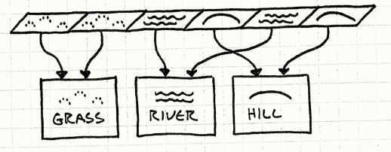
Use case: Game programming
Game programming →optimization
Coding with enum and lots of switch-case is efficient, but
No OOP advantage
No Open-Closed principle
Could we use flyweights and get similar efficiency?
Please read the “Terrain”
implementation in Game Programming Patterns book.
See https://gameprogrammingpatterns.com/flyweight.html

Slide 52
Flyweight: Example 2
Would you have an object for each character in a document?
Each character object has the font and style information
Have a limited character objects and a context that says where and with what attributes it exists in the document?
Shared Character flyweights with intrinsic state as character code
Character context that says character location and their formatting attributes (extrinsic states)
When using the flyweight operations, pass the extrinsic value to it without modifying the intrinsic state
Notes:
Another example see: https://www.oodesign.com/flyweight-pattern-wargame-example-java-sourcecode
SoldierClient.java is actually the Context of the soldier. Main method is the client code.

Slide 53
Flyweight - Consequences
Saves space by sacrificing performance
Reduces # of instances
Sacrificing time for transfer, find, and compute extrinsic state
Space saving depends on
Reduction in total number of instances
Amount of essential state per object
Whether extrinsic state is stored or computed
Centralizes state for many virtual objects into a single location
Cannot perform identity test
Instances cannot behave independently from other instances

Slide 54
Related patterns
Often combined with the Composite when leaf nodes are shared objects
Tree turns into a directed-acyclic graph
No Parent pointer in the flyweight-- extrinsic state
Implement State and Strategy objects as flyweights. (later)
Known use:
java.lang.Integer#valueOf(int)
Notes:
Integer (Java Platform SE 8 ) (oracle.com)
flyweight leaf nodes cannot store a pointer to their parent. Rather, the parent pointer is passed to the flyweight as part of its extrinsic state. This has a major impact on how the objects in the hierarchy communicate with each other.

