Slide 1
Vorstellung:
Anwendungsfelder Business Analytics
Prof. Dr. Kai Brüssau
Jacqueline Franßen
Matrikelnummer: 496804
Hamburg, 09.11.2019

Slide 2
HealthBro
Ideas
Business Case(s)
Workflow
Software Architecture
Data Processing

Slide 3
Ideas
Wie lange hat man es ?
Chatbot, which controls
Dokumentation:
Blutdruck-Werte
Was hat man (der Patient)?
Dokumentations-Apps werden unregelmäßig genutzt, sind unpersönlich.
Jack → Your personal Health Bro (Chatbot)

Slide 4
Jack - Your personal HealthBro
Bot Personality
ehrlich
Ihm ist die Gesundheit des Users wichtig
Harmoniebedürftig
einfühlsam
Aufmerksam

Slide 5
Business Case(s)
Continous reporting to doctor (every 2 weeks a diagram with current blood pressure values is sent to doctor)
Map: the nearest doctors are recommended through open view map

Slide 6
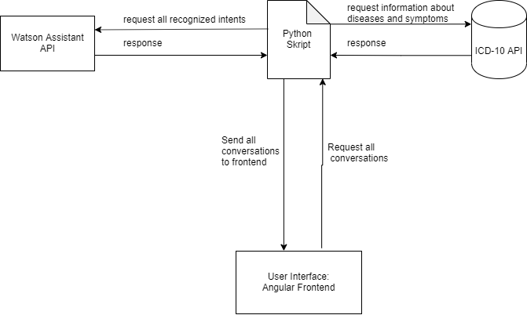
Architecture

Slide 7
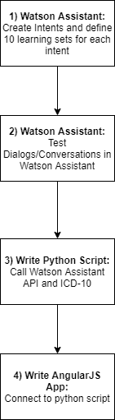
Workflow

Slide 8
Structure of Watson Assistant Dialog
Todo: draw io with basic nodes of dialog

Slide 9
As-Is
(Web-Interface with Angular, MongoDB setup locally, basic dialog structure WA
Screenshots einfügen
Skizze von report
To-Be Scenario: deploy everything to cloud

Slide 10
Demo: Watson Assistant
(Web-Interface with Angular, MongoDB setup locally, basic dialog structure WA
Screenshots einfügen
Skizze von report
To-Be Scenario: deploy everything to cloud

