Slide 1
Manage your jobs with Job DSL
Niels Bech Nielsen, 9consult
nbn@nine.dk

Slide 2

Services
Public Services
Professional Services
Projects & DevOps
Application Management
Architecture
Security
Open Source

Slide 3





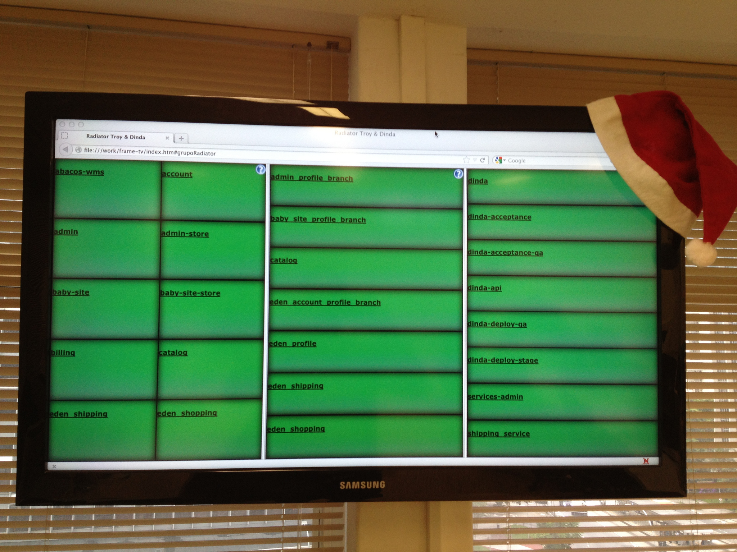
Circle of Software Development
Happy
Customer
One Button Deployment
>sed –i s/bug/feature/g *
>git commit -a -m ”Fixed”
Continuous Integration X–Mas Pipeline

Slide 4
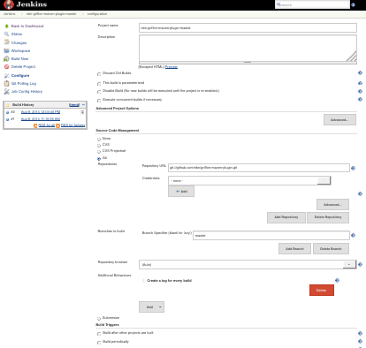

How do you manage changes in your Pipelines?
X
?

Slide 5
How do you manage changes in your Pipelines?
Project A
Commit
Project B
Commit
Project C
Commit
Regression tests
Integration Tests
Q+A
Regression tests
Q+A
Deployment
Nightly Release
Integration Tests
Q+A
Deployment
Test Deploy
Acceptance Tests
Deployment

Slide 6
Options include
Template Project Plugin
Job Generator Plugin
Parameterized Build Plugin
… (your own homegrown solution or click-edit)
Job DSL Plugin

Slide 7
Configuration as Code
Treat your configuration as Code
Versioned
Simplified
DRY
Job DSL provide a simple, intuitive Groovy DSL to create Jenkins jobs from scripts
Generate all your jobs from a ’seed’ job
Abstract utility functions
Supports all Jenkins plugins through extension
NO MORE HTML EDITING
def project = 'nbn/griffon-maven-plugin'
def branchApi = new URL("https://api.github.com/repos/${project}/branches")
def branches = new groovy.json.JsonSlurper().parse(branchApi.newReader())
branches.each {
def branchName = it.name
job {
name "${project}-${branchName}".replaceAll('/','-')
scm {
git("git://github.com/${project}.git", branchName)
}
steps {
maven("test -Dproject.name=${project}/${branchName} ")
}
}
}

Slide 8
Photo Credits
Nerd – Stephanie Klocke
Happy Customer – VeganSoldier
Fujii and Pri – Marcelo Jorge Vieria
Jenkins without broken builds – Henrique Imbertti Jr
Antares Rocket Test Launch – NASA
Launch Button – Steven Depolo
Etsy Jenkins Cluster – Noah Sussman

Slide 9
Simple DSL example
def project = 'nbn/griffon-maven-plugin'
def branchApi = new URL("https://api.github.com/repos/${project}/branches")
def branches = new groovy.json.JsonSlurper().parse(branchApi.newReader())
branches.each {
def branchName = it.name
job {
name "${project}-${branchName}".replaceAll('/','-')
scm {
git("git://github.com/${project}.git", branchName)
}
steps {
maven("test -Dproject.name=${project}/${branchName} ")
}
}
}
https://github.com/jenkinsci/job-dsl-plugin/wiki/Job-DSL-Commands

Slide 10
Utility Methods in Common Files
import javaposse.jobdsl.dsl.Job
public class Common {
static def addNightlyScmTrigger(Job job) {
job.with {
triggers {
scm('H 23 * * *')
} } } }
import Common
def job = …
Common.addNightlyScmTrigger(job)

Slide 11
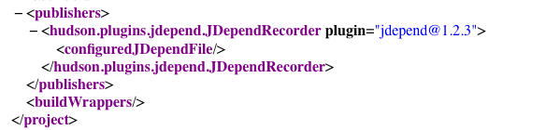
Extending the project with custom XML
${project}/config.xml

Slide 12
Configure Project Node
job {
name "${project}-${branchName}".replaceAll('/','-')
scm {
git("git://github.com/${project}.git", branchName)
}
steps {
maven("test -Dproject.name=${project}/${branchName} ")
}
configure { projectNode ->
projectNode / publishers << "hudson.plugins.jdepend.JDependRecorder" {
configuredJDependFile()
}
}

Slide 13
Monkey Patch
Add new features to job dsl entities
Find existing ContextNode and add new method
Import JDependContext
job {
name "${project}-${branchName}".replaceAll('/','-')
scm {
git("git://github.com/${project}.git", branchName)
}
publishers {
jdepend() // Takes an optional string arg
}
}

Slide 14
Monkey Patching in a Static Block
import javaposse.jobdsl.dsl.helpers.publisher.*
public class JDependContext {
static {
PublisherContext.metaClass.jdepend = { String preGeneratedJDependFile = '' ->
publisherNodes << new NodeBuilder().
"hudson.plugins.jdepend.JDependRecorder" {
configuredJDependFile(preGeneratedJDependFile)
}
}
}

