Slide 1

DriverPass
System Analysis
Joshua Castellanos
October 18, 2026
Notes:
[No speaker notes required for this slide.]

Slide 2

System Requirements
Functional Requirements
Students can take practice tests and view results.
Students can schedule driving lessons and purchase packages.
Nonfunctional Requirements
The system must be secure and protect user data.
The system must be available 24/7 with reliable performance.
Notes:
These requirements describe what the system must do and how it must perform. Students need access to practice tests, scheduling tools, and learning materials. The nonfunctional requirements ensure the system is dependable, secure, and always available when users need it.

Slide 3
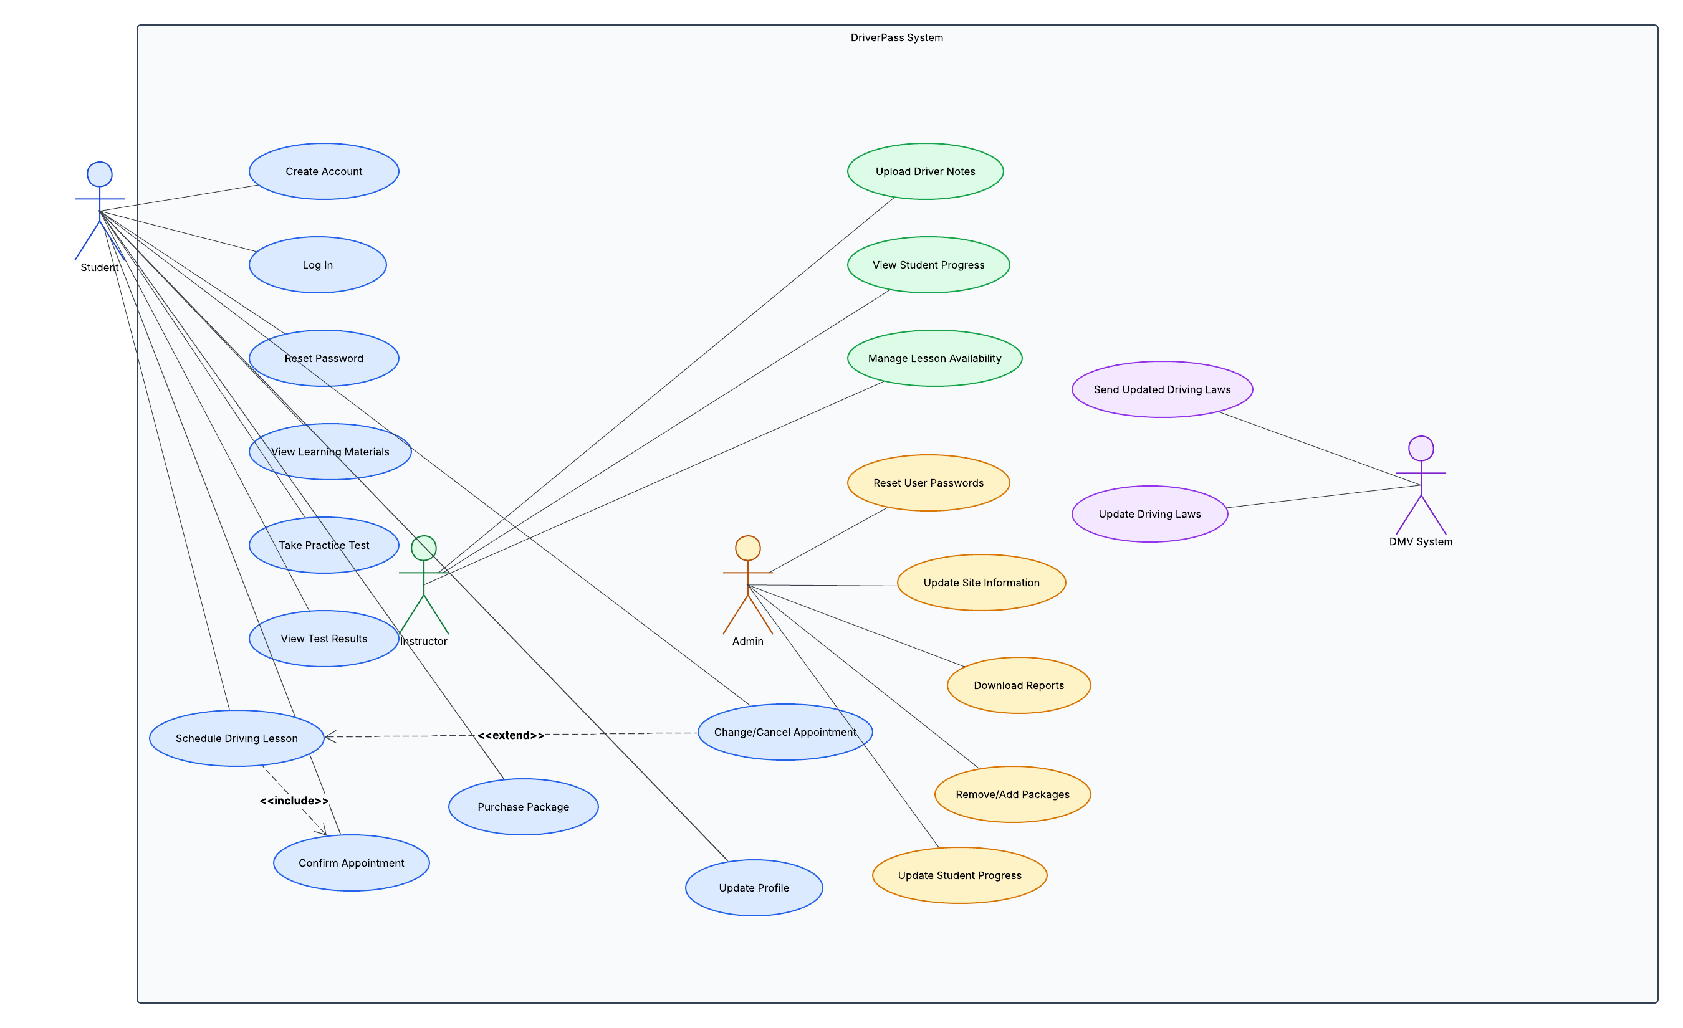
Use Case Diagram
Notes:
This diagram shows how students, instructors, administrators, and drivers interact with the system. It highlights the core features such as scheduling, testing, updating progress, and managing packages. This helps DriverPass visualize how each part of the system supports their business goals.

Slide 4
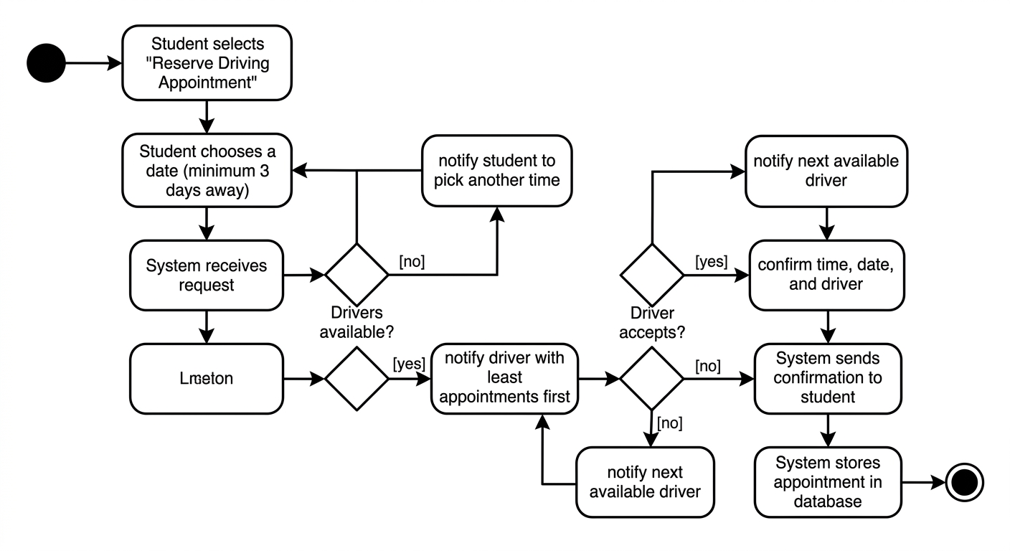
Activity
Diagram
Notes:
This activity diagram shows the steps a user takes to log in or schedule a driving appointment. It demonstrates how the system guides the user through each step, ensuring clarity, security, and ease of use.

Slide 5
Security
Encrypted communication protects user data.
Secure login prevents unauthorized access.
Role‑based access ensures users only see what they should.
Backup and recovery systems protect against data loss.
Notes:
Security is built into every part of the system. Students’ personal information, test results, and payment details are protected through encryption and secure authentication. Role‑based access ensures instructors and admins only access the information they need.

Slide 6
System Limitations
Requires internet access for all features.
Instructor availability must be updated manually.
System performance depends on cloud service uptime.
Users must enter accurate information for best results.
Notes:
These limitations are normal for online systems. DriverPass users must be connected to the internet, and instructors must keep their schedules updated. The system relies on cloud services, but these are highly reliable. Accurate data entry ensures the system works smoothly.

