Slide 1
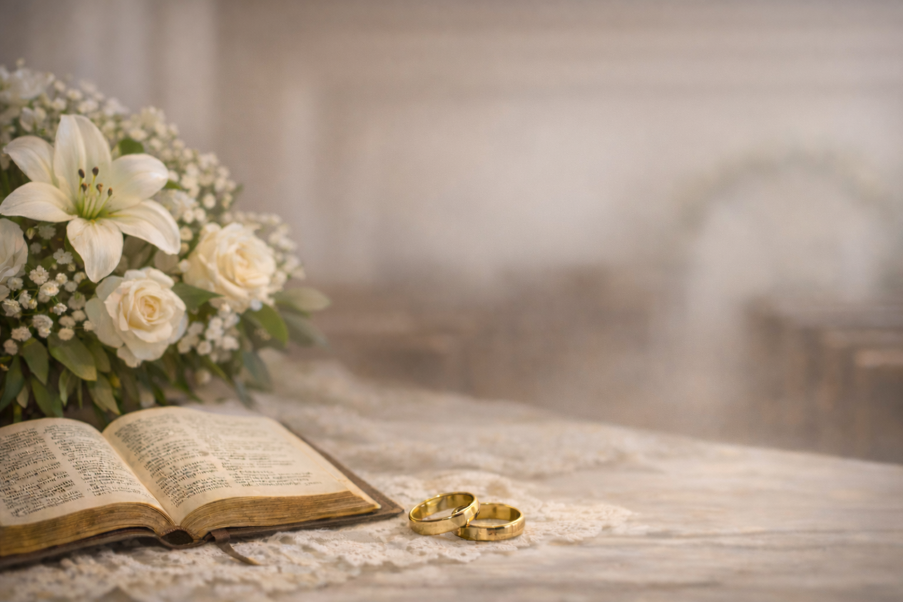
Congratulations
Justin & Charlotte MacKenzie

Slide 2
Table of Contents
01: Father I adore you
02: At Calvary
03: Wonderful Grace of Jesus
04: Man of Sorrows
05: I’ve Found a Friend
06: It is Well with my soul
07: The Love that Jesus had for me
08: And can it be
09: Love sent my Savior
10: I seek no other argument
11: Was it for me
12: Near the Cross
13: Just as I am
14: Thou art the everlasting Word
15: The Lords my Shepherd
16: When I survey
17: To God be the Glory

Slide 3
Father I Adore You
*ROUNDS*
Father, I adore You
And I lay my life before You
How I love You
Jesus, I adore You
And I lay my life before You
How I love You
Spirit, I adore You
And I lay my life before You
How I love You
I love you Lord and I lift my voice
to worship You.
Oh my soul, rejoice.
Take joy my King,
in what You hear.
Let it be a sweet, sweet sound,
in Your ear.

Slide 4
At Calvary
Verse 1:
Years I spent in vanity and pride,
Caring not my Lord was crucified,
Knowing not it was for me He died
On Calvary.
(Chorus)
Mercy there was great and grace was free,
Pardon there was multiplied to me,
There my burdened soul found liberty–
At Calvary.
Verse 2:
Now I've give to Jesus everything,
Now I gladly own Him as my King,
Now my raptured soul can only sing
Of Calvary.
Verse 3:
O the love that drew salvation's plan!
O the grace that brought it down to man!
O the mighty gulf that God did span
At Calvary.

Slide 5
Wonderful Grace of Jesus
Verse 1:
Wonderful grace of Jesus,
Greater than all my sin;
How shall my tongue describe it,
Where shall its praise begin?
Taking away my burden, setting my spirit free;
For the wonderful grace of Jesus reaches me.
(Chorus)
Wonderful the matchless grace
(the matchless grace) of Jesus,
Deeper than the mighty rolling sea
(the rolling sea);
Higher than the mountain,
Sparkling like a fountain,
All-sufficient grace for even me (for even me);
Broader than the scope of my transgressions,
Greater far than all my sin and shame,
O magnify the precious Name of Jesus,
Praise His Name!
Verse 2:
Wonderful grace of Jesus,
Reaching to all the lost,
By it I have been pardoned,
Saved to the uttermost,
Chains have been torn asunder, giving me liberty;
For the wonderful grace of Jesus reaches me.
Verse 3:
Wonderful grace of Jesus,
Reaching the most defiled,
By its transforming power,
Making him God's dear child,
Purchasing peace and heaven, for all eternity;
For the wonderful grace of Jesus reaches me.

Slide 6
Man of Sorrows
Verse 1:
Man of Sorrows! what a name
For the Son of God, who came
Ruined sinners to reclaim!
Hallelujah! what a Saviour!
Verse 2:
Bearing shame and scoffing rude
In my place condemned He stood;
Sealed my pardon with His blood:
Hallelujah! what a Saviour!
Verse 3:
Guilty, vile, and helpless, we;
Spotless Lamb of God was He:
Full atonement, can it be?
Hallelujah! what a Saviour!
Verse 4:
Lifted up was He to die,
It is finished, was His cry;
Now in heaven exalted high:
Hallelujah! what a Saviour!
Verse 5:
When He comes, our glorious King,
All His ransomed home to bring,
Then anew this song we'll sing:
Hallelujah! what a Saviour!

Slide 7
I’ve found a Friend
Verse 1:
I’ve found a Friend; O such a Friend!
He loved me ere I knew Him;
He drew me with the cords of love,
And thus He bound me to Him.
And round my heart still closely twine
Those ties which nought can sever,
For I am Christ’s and He is mine,
For ever and for ever.
Verse 2:
I’ve found a Friend; O such a Friend!
He bled, He died to save me;
And not alone the gift of life,
But His own self He gave me.
Nought that I have, mine own I’ll call,
I’ll hold it for the Giver:
My heart, my strength, my life, my all,
Are His, and His forever.
Verse 3:
I’ve found a Friend; O such a Friend!
All power to Him is given
To guard me on my onward course
And bring me safe to heaven.
Th’ eternal glories gleam afar
To nerve my faint endeavour;
So now to watch! To work! To war!
And then to rest for ever.
Verse 4:
I’ve found a Friend; O such a Friend!
So kind, and true, and tender,
So wise a Counsellor and Guide,
So mighty a Defender.
From Him, who loves me now so well,
What power my soul can sever?
Shall life? Or death? shall earth? or hell?
No! I am His forever.

Slide 8
It Is Well with My Soul
Verse 1:
When peace, like a river, attendeth my way,
When sorrows, like sea-billows roll;
Whatever my lot, Thou hast taught me to say,
It is well, it is well with my soul.
Chorus:
It is well with my soul,
It is well, it is well with my soul.
Verse 2:
Though Satan should buffet, though trials should come,
Let this blest assurance control,
That Christ hath regarded my helpless estate,
And hath shed His own blood for my soul.
Verse 3:
My sin, O the bliss of this glorious thought!
My sin, not in part but the whole,
Is nailed to His Cross, and I bear it no more;
Praise the Lord, praise the Lord, O my soul!
Verse 4:
For me be it Christ, be it Christ hence to live!
If death’s waters o’er me shall roll
No pang shall be mine, for in death as in life,
Thou wilt whisper Thy peace to my soul.
Verse 5:
But, Lord, ’tis for Thee, for Thy coming we wait;
The sky, not the grave is our goal:
O trump of the angel! O voice of the Lord!
Blessed hope! Blessed rest of my soul!

Slide 9
The Love that Jesus had for me
Verse 1:
The love that Jesus had for me,
To suffer on the cruel tree,
That I a ransomed soul might be,
Is more than tongue can tell.
Chorus:
His love is more than tongue can tell;
His love is more than tongue can tell;
The love that Jesus had for me
Is more than tongue can tell.
Verse 2:
The many sorrows that He bore,
And O, the crown of thorns He wore,
That I might live for evermore,
Is more than tongue can tell.
Verse 3:
The peace I have in Him, my Lord,
Who pleads before the throne of God,
The merits of His precious blood
Is more than tongue can tell.
Verse 4:
The joy that comes when He is near,
The rest He gives, so free from fear,
The hope in Him so bright and clear,
Is more than tongue can tell.

Slide 10
And can it be
Verse 1:
And can it be that I should gain
An interest in the Saviour's blood
Died He for me, who caused His pain
For me, who Him to death pursued
Amazing love! how can it be
That Thou, my God, shouldst die for me
Verse 2:
'Tis mystery all! The Immortal dies!
Who can explore His strange design
In vain the first-born seraph tries
To sound the depths of love divine.
'Tis mercy all! let earth adore,
Let angel minds inquire no more.
Verse 3:
He left His Father's throne above,
So free, so infinite His grace;
Humbled Himself and in His love
He bled for Adam's helpless race;
'Tis mercy all, immense and free;
For, O my God, it found out me.
Verse 4:
Long my imprisoned spirit lay
Fast bound in sin and nature's night;
Thine eye diffused a quickening ray,
I woke, the dungeon flamed with light;
My chains fell off, my heart was free;
I rose, went forth, and followed Thee.
Verse 5:
No condemnation now I dread;
Jesus, and all in Him, is mine!
Alive in Him, my living Head,
And clothed in righteousness divine,
Bold I approach the eternal throne
And claim the crown, through Christ my own.

Slide 11
Love sent my Savior
Verse 1:
Love sent my Saviour to die in my stead,
Why should He love me so?
Meekly to Calvary's cross He was led,
Why should He love me so?
Chorus:
Why should He love me so?
Why should He love me so?
Why should my Saviour to Calvary go?
Why should He love me so?
Verse 2:
Nails pierced His hands and His feet for my sin,
Why should He love me so?
He suffered sore my salvation to win,
Why should He love me so?
Verse 3:
O how He agonized there in my place,
Why should He love me so?
Nothing withholding my sin to efface,
Why should He love me so?

Slide 12
I seek no other argument
Verse 1:
The Lamb of God for sinners died,
A victim on the tree;
He gave Himself a sacrifice,
To set the guilty free.
Chorus:
I seek no other argument,
I want no other plea,
It is enough that Jesus died
And rose again for me.
Verse 2:
The great Redeemer left the throne,
The radiant throne on high,
Surprising mercy! love unknown!
To suffer, bleed, and die!
Verse 3:
He took the guilty sinner's place,
And suffered in his stead;
For man (O miracle of grace!)
For man, the Saviour bled.

Slide 13
Was it for me
Verse 1:
Was it for me, for me alone,
The Saviour left His glorious throne,
The dazzling splendours of the sky,
Was it for me He came to die?
Chorus:
It was for me, yes, all for me;
O, love of God so great, so free;
O, wondrous love, I'll shout and sing,
He died for me, my Lord, the King.
Verse 2:
Was it for me sweet angel strains
Came floating o'er Judea's plains,
That starlight night so long ago?
Was it for me God planned it so?
Verse 3:
Was it for me He wept and prayed,
When prostrate in the garden laid,
That night within Gethsemane?
Was it for me, that agony?
Verse 4:
Was it for me He bowed His head
Upon the cross, and freely shed
His precious blood - that crimson tide?
Was it for me the Saviour died?

Slide 14
Near the Cross
Verse 1:
Jesus, keep me near the cross,
There a precious fountain.
Free to all, a healing stream
Flows from Calvary’s mountain
Chorus:
In the cross, in the cross
Be my glory ever;
Till my raptured soul shall find
Rest beyond the river
Verse 2:
Near the cross, a trembling soul,
Love and mercy found me;
There the Bright and Morning Star
Shed His beams around me.
Verse 3:
Near the cross, O Lamb of God,
Bring its scenes before me;
Help me walk from day to day,
With its shadows o’er me
Verse 4:
Near the cross, I’ll watch and wait,
Hoping, trusting ever,
Till I reach the golden strand,
Just beyond the river.

Slide 15
Just as I am
Verse 1:
Just as I am, without one plea
But that Thy blood was shed for me,
And that Thou bidst me come to Thee,
O Lamb of God, I come!
Verse 2:
Just as I am, and waiting not
To rid my soul of one dark blot,
To Thee, whose blood can cleanse each spot,
O Lamb of God, I come!
Verse 3:
Just as I am, though tossed about
With many a conflict, many a doubt,
Fightings within, and foes without,
O Lamb of God, I come!
Verse 4:
Just as I am, poor, wretched, blind,
Sight, riches, healing of the mind,
Yea, all I need in Thee to find,
O Lamb of God, I come!
Verse 5:
Just as I am, Thou wilt receive,
Wilt welcome, pardon, cleanse, relieve;
Because Thy promise I believe,
O Lamb of God, I come!
Verse 6:
Just as I am, Thy love unknown
Has broken every barrier down;
Now to be Thine, yea, Thine alone,
O Lamb of God, I come!

Slide 16
My Soul in Sad Exile
Verse 1:
My soul is sad exile was out on life’s sea,
So burdened with sin and distresses.
‘Till I heard a sweet voice saying, “Make me your choice.”
And I entered the haven of rest.
Chorus:
I’ve anchored my soul in the haven od rest,
I’ll sail the wide seas no more;
The tempest may sweep o’er the wild stormy deep,
In Jesus I’m safe evermore.
Verse 2:
I yielded myself to His tender embrace,
And faith taking hold of the Word,
My fetters fell off, and I anchored my soul;
The haven of rest is my lord.
Verse 3:
O come to the Saviour! He patiently waits
To save by His power divine;
Come, anchor your soul in the haven of rest,
And say, “My beloved is mine.”

Slide 17
Thou art the everlasting Word
Verse 1:
Thou art the Everlasting Word,
The Father's only Son,
God manifestly seen and heard,
And heaven's beloved One.
Chorus:
Worthy, O Lamb of God, art Thou,
That every knee to Thee should bow.
Verse 2:
In Thee, most perfectly expressed,
The Father's glories shine,
Of the full Deity possessed,
Eternally divine.
Verse 3:
True image of the Infinite,
Whose essence is concealed;
Brightness of uncreated light,
The heart of God revealed.
Verse 4:
But the high myst'ries of His name
An angel's grasp transcend;
The Father only, glorious claim!
The Son can comprehend.
Verse 5:
Yet loving Thee, on whom His love
Ineffable doth rest,
Thy members all, in Thee, above,
As one with Thee are blest.
Verse 6:
Throughout the universe of bliss
The centre Thou, and Sun,
Th' eternal theme of praise is this,
To heaven's beloved One.

Slide 18
The Lords my Shepherd
Verse 1:
The Lord's my Shepherd, I'll not want:
He makes me down to lie
In pastures green; He leadeth me
The quiet waters by.
Verse 2:
My soul He doth restore again;
And me to walk doth make
Within the paths of righteousness,
E'en for His own name's sake.
Verse 3:
Yea, though I walk in death's dark vale,
Yet will I fear none ill;
For Thou art with me; and Thy rod
And staff me comfort still.
Verse 4:
My table Thou hast furnished
In presence of my foes;
My head Thou dost with oil anoint,
And my cup overflows.
Verse 5:
Goodness and mercy all my life
Shall surely follow me;
And in God's house for evermore
My dwelling-place shall be.

Slide 19
When I survey
Verse 1:
When I survey the wondrous Cross
On which the Prince of Glory died,
My richest gain I count but loss,
And pour contempt on all my pride.
Verse 2:
Forbid it, Lord, that I should boast,
Save in the Cross of Christ, my God;
All the vain things that charm me most
I sacrifice them to His blood.
Verse 3:
See from His head, His hands, His feet,
Sorrow and love flow mingled down;
Did e'er such love and sorrow meet,
Or thorns compose so rich a crown?
Verse 4:
Were the whole realm of nature mine
That were an offering far too small;
Love so amazing, so divine,
Demands my heart, my life, my all!

Slide 20
To God be the Glory
Verse 1:
To God be the glory! Great things He hath done;
So loved He the world that He gave us His Son;
Who yielded His life an atonement for sin,
And opened the Life-gate that all may go in.
Verse 2:
O perfect redemption, the purchase of blood,
To every believer the free gift of God;
The vilest offender who truly believes,
That moment, through Jesus, a pardon receives.
Verse 3:
Great things He hath taught us, great things He hath done,
And great our rejoicing through Jesus the Son;
But purer, and higher, and greater will be
Our wonder, our triumph, when Jesus we see.
Chorus:
Praise the Lord! Praise the Lord! Let the earth hear His voice!
Praise the Lord! Praise the Lord! Let His people rejoice!
O, come to the Father through Jesus the Son,
And give Him the glory!
Great things He hath done.

Slide 21


Slide 22
Still Like A Rollback
Verse 1:
Went to every bible conference
Under the guise of bible knowledge
But everyone knew what was on my mind
If you get past the cars and trucks
And all that other useless stuff
Its not good for man to be alone
Chorus:
But I still like a rollback in O'Leary now and then
And ill grin when I tell a joke that nobody gets
A gearshift in my hand, I'm a man without a plan
But I know I want to grow the Mackenzie clan
Verse 2:
Trusting God to show me who
I’m doing a lot of looking too
Is there one who's right for me?
Maybe I’m supposed to be single
Maybe I should try Christian-mingle
Maybe I should just get in my car
Chorus (Begin with “Cause”)
Verse 3:
Then that fateful Iowa trip
That Honda van motor started to slip
Marcus tore it down, in upstate new York
While the van was in surgery
I found the girl who’d marry me
Bad for Marcus, but good for me
Chorus (Final):
Now I’ll go, do a rollback, in O’Leary, once again
And ill still tell a goofy joke, that nobody gets
A diamond on her hand, I’m glad she had a plan
Now time to try a rollback... in my van

Slide 23
Justin born on P E Isle,
‎Played with friends for many a mile.
‎They were married one by one,
‎Where was Justin's Honeybun?
‎
‎Justin kept on praying (x3)
‎And waited God's reply.
‎
‎Charlotte's folks thought she wouldn't find,
‎One who'd be so brave and kind.
‎Someone said God wouldn't at all
‎Bring her man into the hall.
‎
‎But our God was working (x3)
‎To bring them into one.
‎
‎Mr. Justin plowed the roads,
‎Visiting folks in their abodes.
‎Praying God would soon provide
‎A faithful one to be his bride.
‎
‎Down he went to Belfast (x3)
‎And found Dear Charlotte there.
In her nursing, she showed care,
To each and ev'ry patient there.
Hospitality she gave,
She sought to see children saved.
Her life showed devotion (x3)
Which God will repay.
‎
‎Wives to your own husbands be,
‎Subject till eternity.
‎In God's word we read again,
‎Husbands love your wives, that's plain.
‎
‎Justin you must love her
‎Justin you must love her...
‎Charlotte you must respect him,
‎As the church to Christ, her head.
‎
‎Now United in God's love,
‎Kept by Him till safe above.
‎Live for Christ each passing day,
‎Till He calls us thence away...
‎
‎In God's love now resting... (x3)
‎Enjoy His love below

Slide 24
I've kept a close watch for a gal of mine
But fall asleep in meeting every time
I keep my eye out for a knot to bind
Alas none is mine, so I walk the line
Was coming home from conference late one night
My car weaving then I see flashing lights
Oh officer please, I'm really doing fine
Young man don't whine, just walk the line
As sure as night is dark and day is light
I've looked for you everyday and right
In Nova Scotia, Cape Breton, Ontario fine
But not a sign, I've walked the line.
Then just last fall every one was in shock
A gal with Justin with her reddish locks
Oh Charlotte darling you're Justintime
If you’ll be mine I’ll walk the line
And now the wedding day is here at last
Those lonely days, they finally are past
I got money and music talent combined
and since your mine, I'll walk the line
A married man must tow the line.

