Slide 1
Orlando City Crime Data Analysis
UCF Data and Visualization Bootcamp
2018

Slide 2

Data Search?
Geocode API
Census Data
.gov database

Slide 3
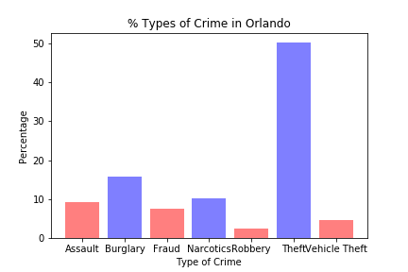
Clean that Data
Drop your NaNs!
pd.dropna()
Remove redundant columns
Pd.drop(columns=)
Append necessary columns to populate remaining values

Slide 4
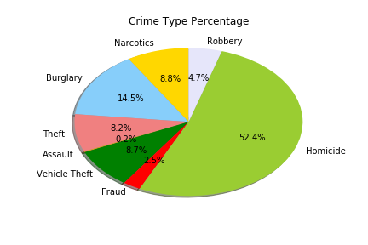
Types of Crime
Assault
Arson
Burglary
Fraud
Homicide
Narcotics
Robbery
Theft
Vehicle Theft

Slide 5
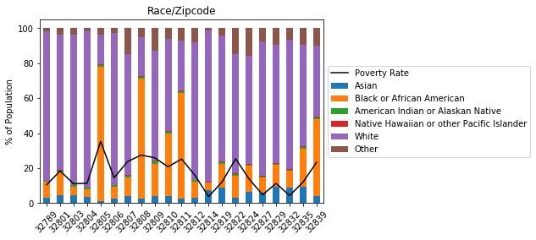
Orlando Demographics
Race
Median Income
Poverty Rate

Slide 6
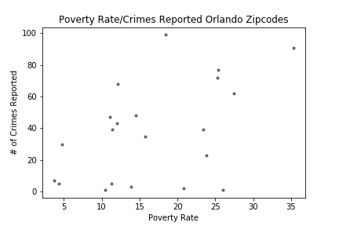
Visualized Demographics
- The scatter plots show the lack of strong correlating data within the chart

