Slide 1
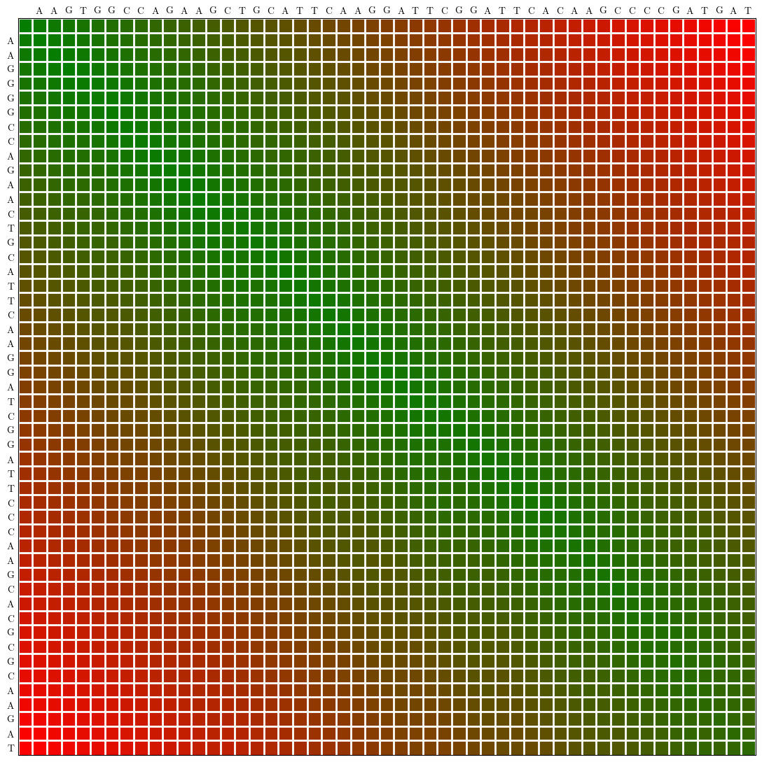
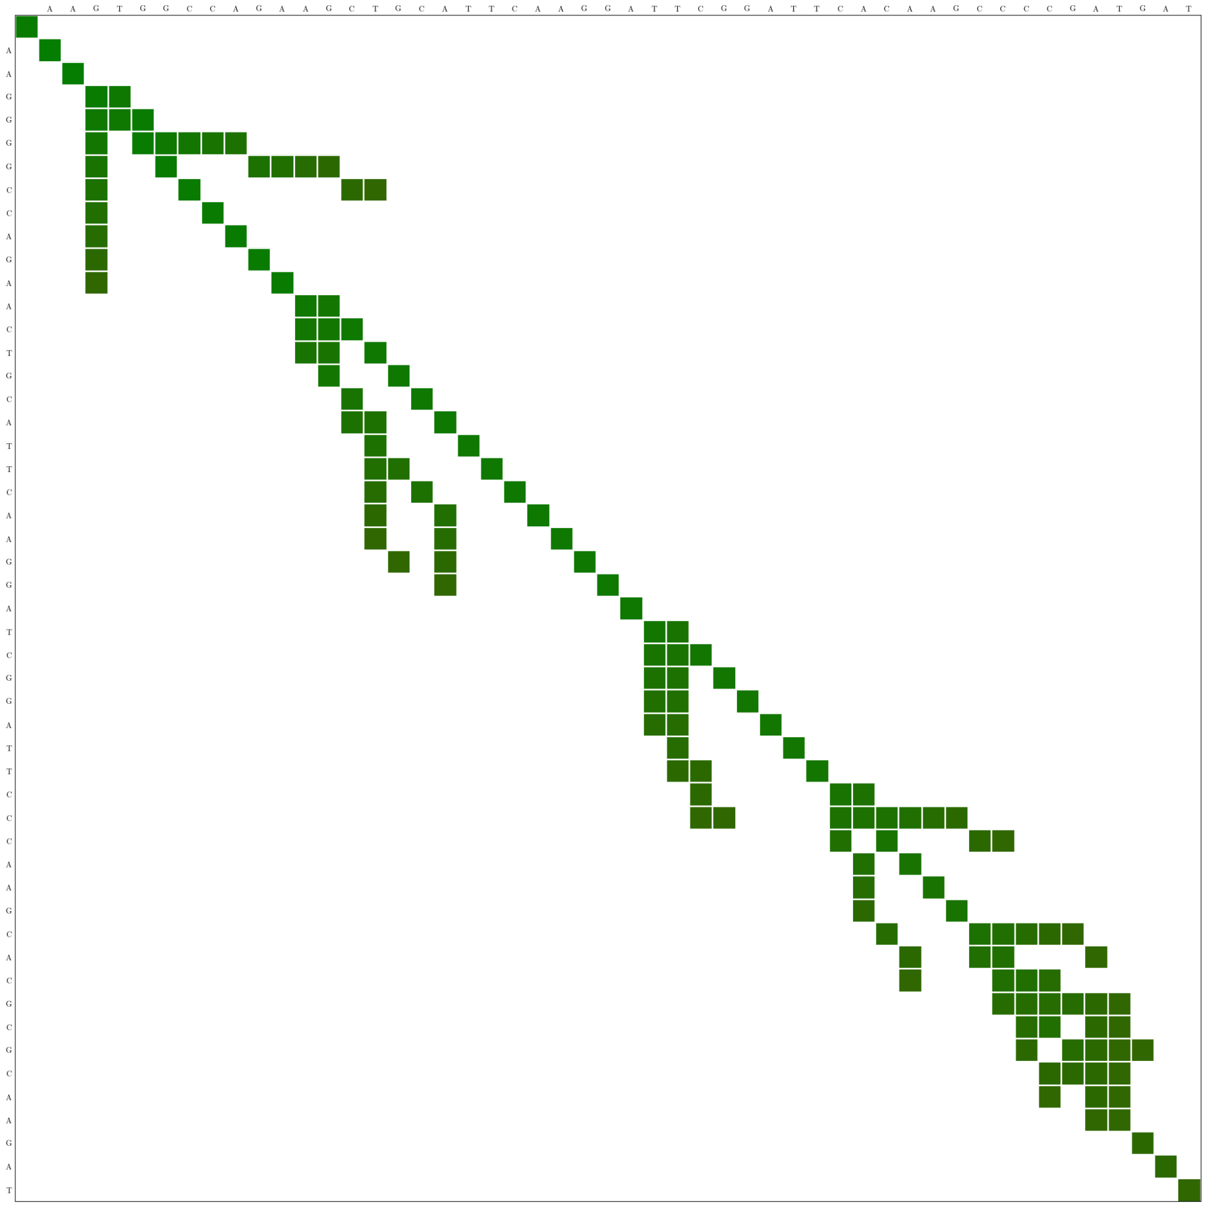
Motivation: best-performing program
Algorithmic complexity
Hardware-friendly requirements
Work:
Smart
parallel
local
regular
WFA:
Yes
Coarse + Fine
tiling
not good
Quicked:
not good
Coarse + Fine
tiling
Yes
Can we get the best of both worlds?
DP
WFA
Tiled WFA

Slide 2
At some point, the computed band cannot guarantee that the optimal alignment must necessarily be inside the band
QuickED rationale: continue till the end and get a bound
WFA: assure all paths with a minimum promising cost are visited

Slide 3
DP
WFA

Slide 4
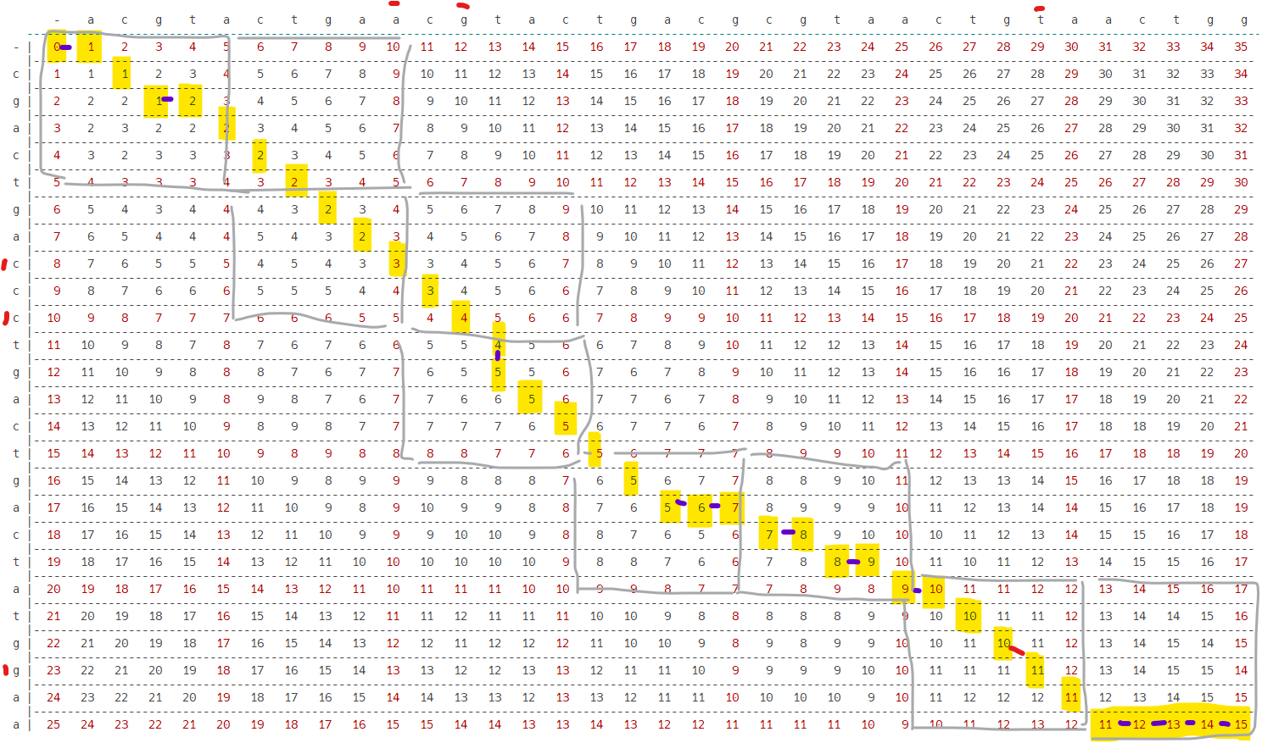

Slide 5
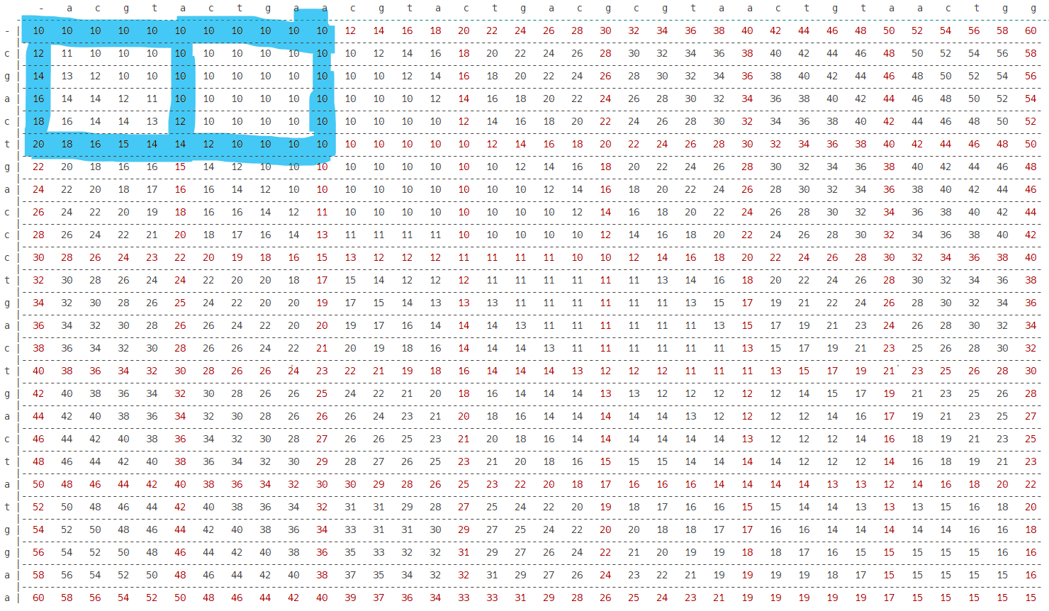

Slide 6
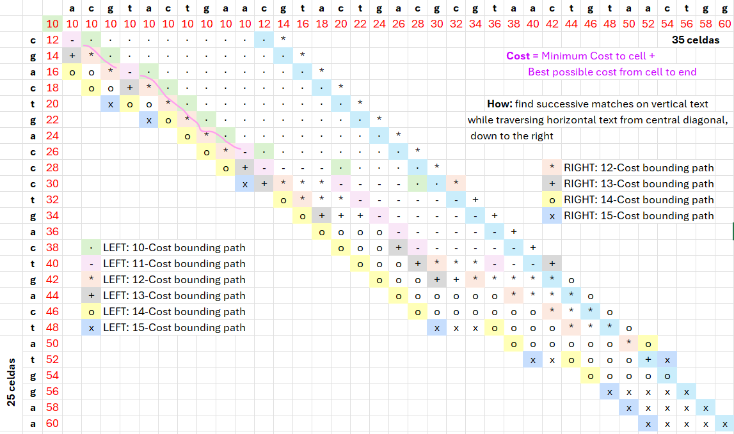

Slide 7
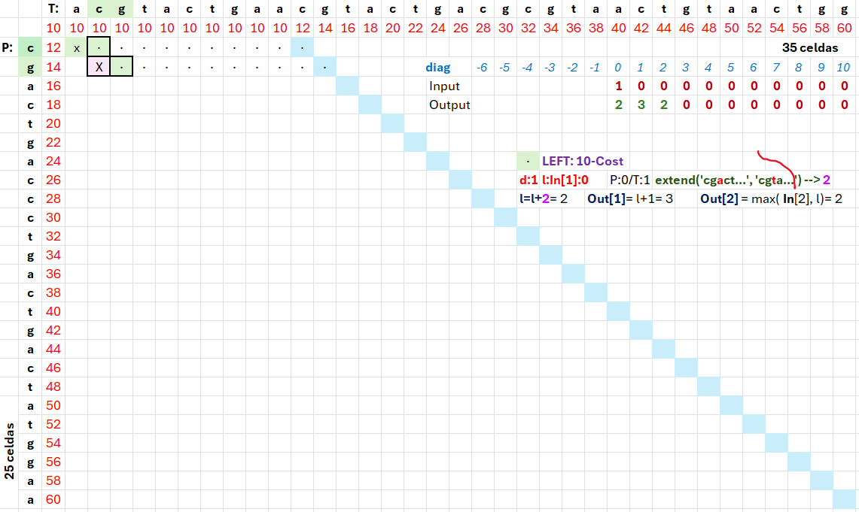

Slide 8
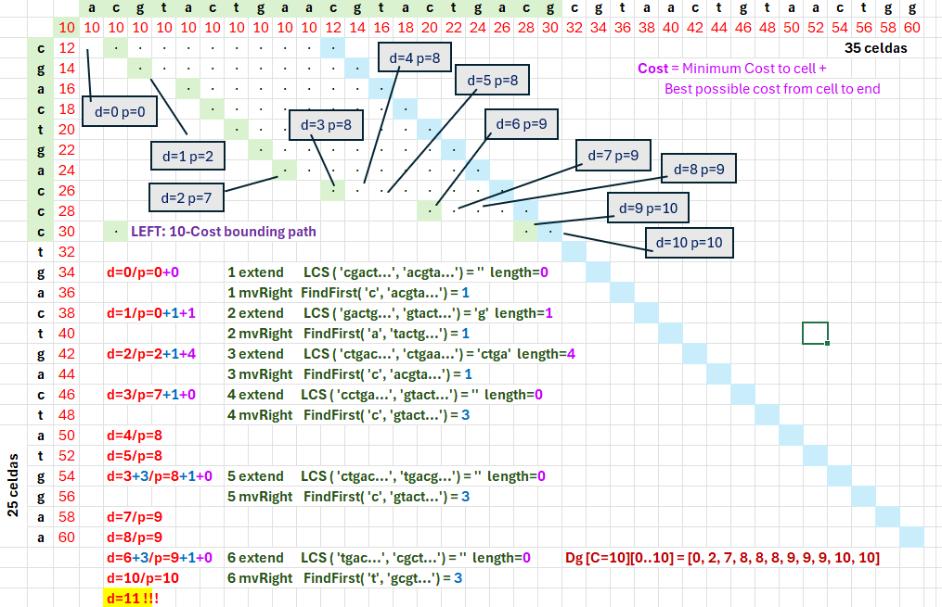

Slide 9
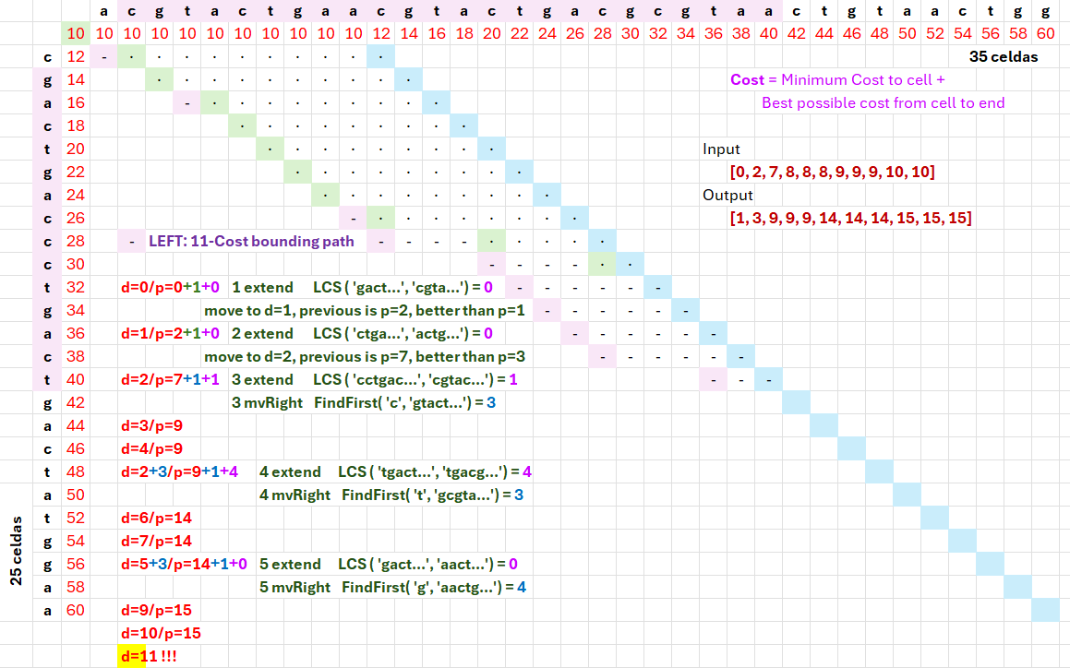

Slide 10
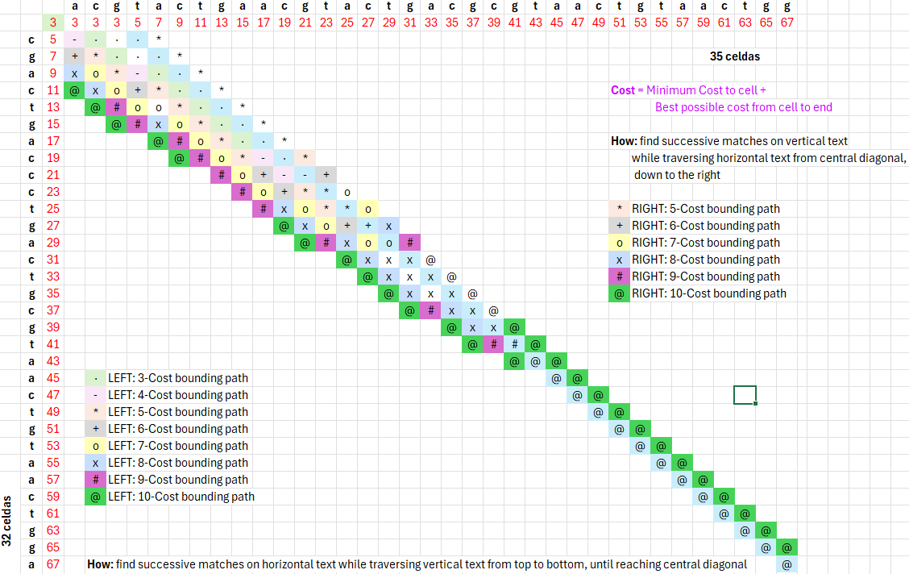

Slide 11
Data Structures: hold tile frontiers
right frontier
1: promote sequential accesses to frontier data, required for tile-computing
2: simplify look for most-promising tile on a super-antidiagonal, required for next-tile computation
3: temporal locality: prioritize data stored in fast memory → (1) more likely to be used in the near future & (2) more expensive to recompute in case it is not available
left frontier
front

Slide 13
14
15
16
18
20
14 14 12 10 10 10
15 15 14 12 10 10
16 15 15 14 12 11
18 16 16 16 14 13
20 18 17 17 16 15

Slide 14
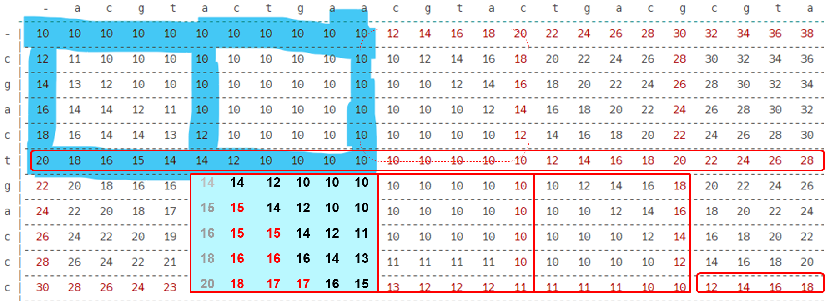

Slide 15
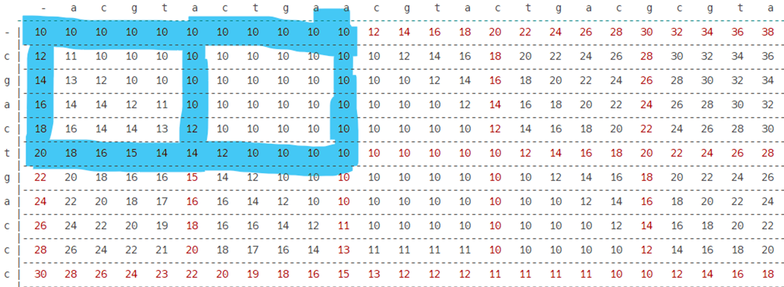
14 14 12 10 10 10
15 15 14 12 10 10
16 15 15 14 12 11
18 16 16 16 14 13
20 18 17 17 16 15
12 11 11 11 11 11
12 12 11 11 11 11
12 12 12 11 11 11
13 13 13 13 11 11
15 14 14 14 13 12

Slide 16
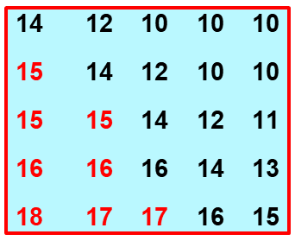
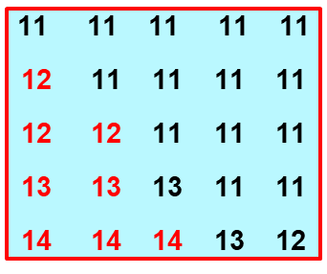


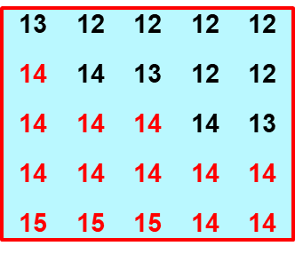
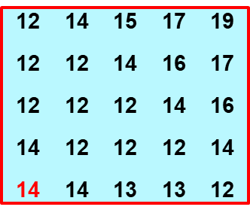


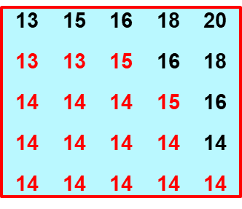
14 is assured minimum cost, but maybe 15

Slide 17

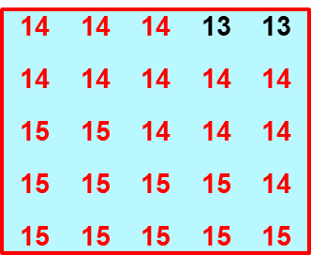
Identify frontier differences
Compute tile & generate more precise frontier

Slide 19
14 16 17 19 20
13 14 14 14 15
14
15
15
15
15
13 12 12 12 12
14 14 13 12 12
14 14 14 14 13
14 14 14 14 14
15 15 15 14 14
14 14 14 13 13
14 14 14 14 14
15 15 14 14 14
15 15 15 15 14
15 15 15 15 15

Slide 20
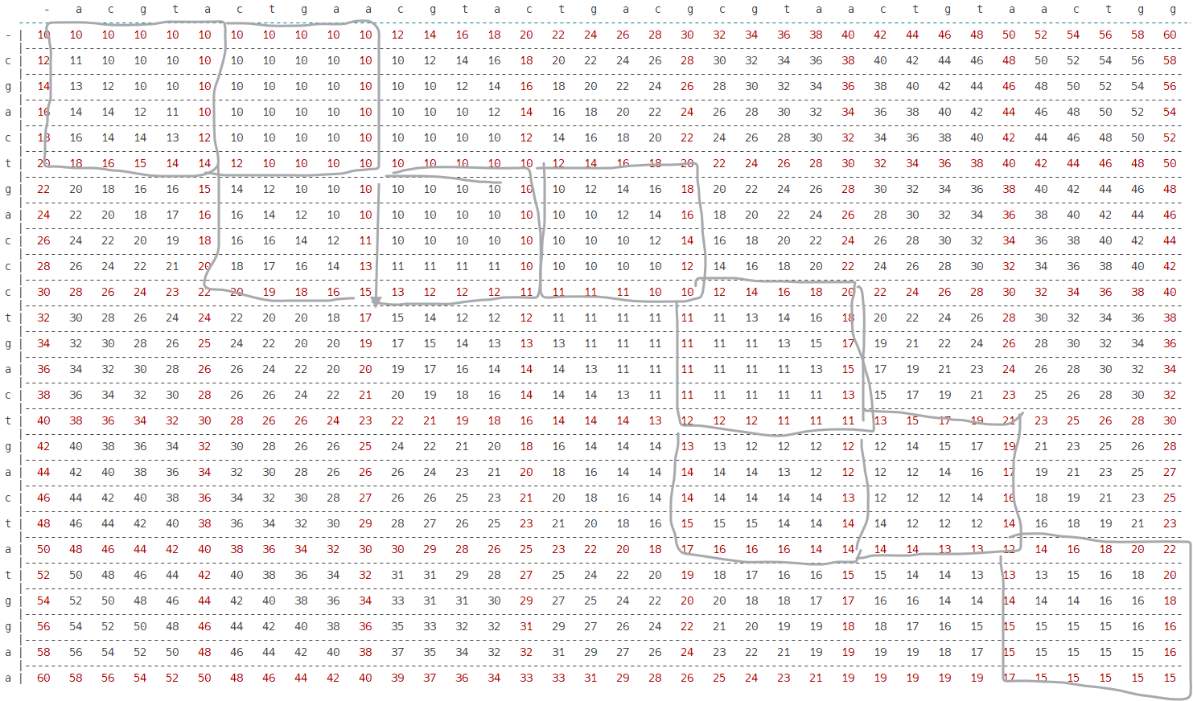

Slide 21
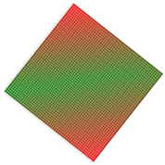

Slide 22
best cost from right
Tile-Computation: orchestrate optimal sequence of tile computations
best cost from right
1: promising cost is actual cost + minimum cost to reach final matrix corner
2: starting in an advanced position in a certain super-antidiagonal can be tricky: must consider best and worst cases
best cost from right
best cost from left
best cost from left
best & worst promising cost

Slide 23
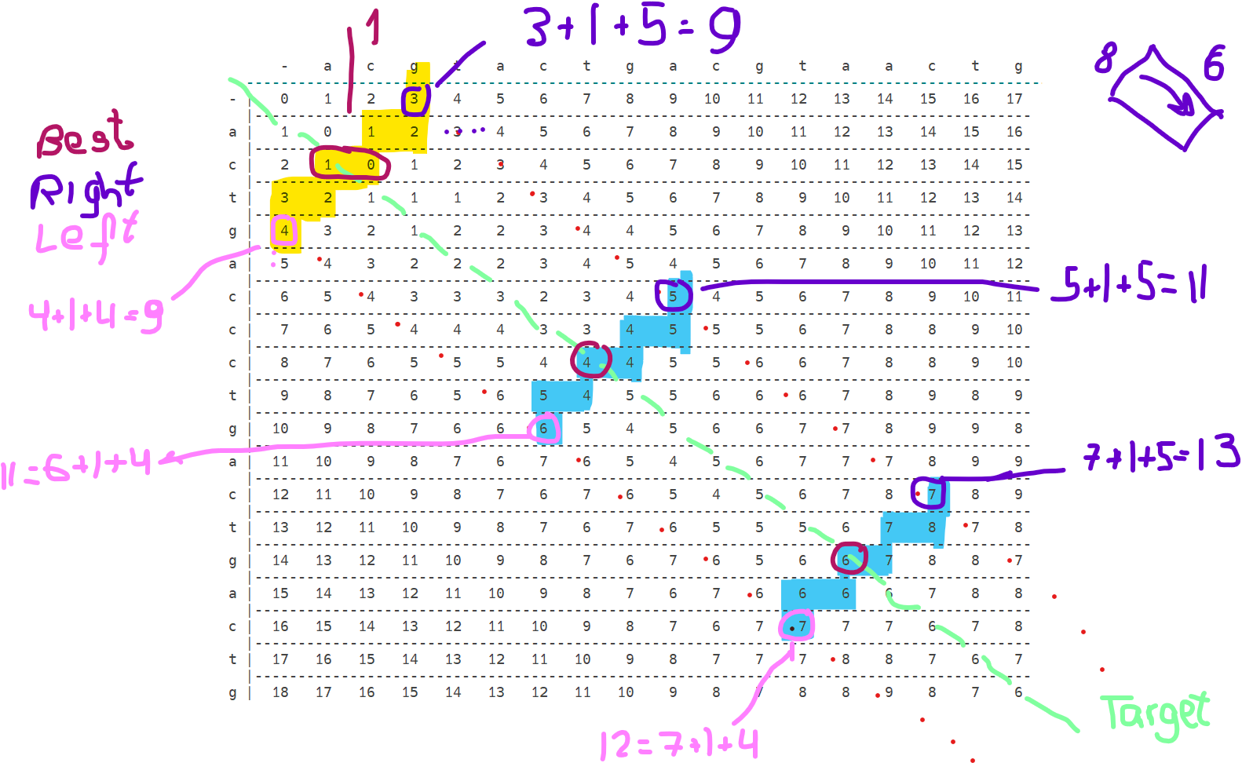

Slide 24
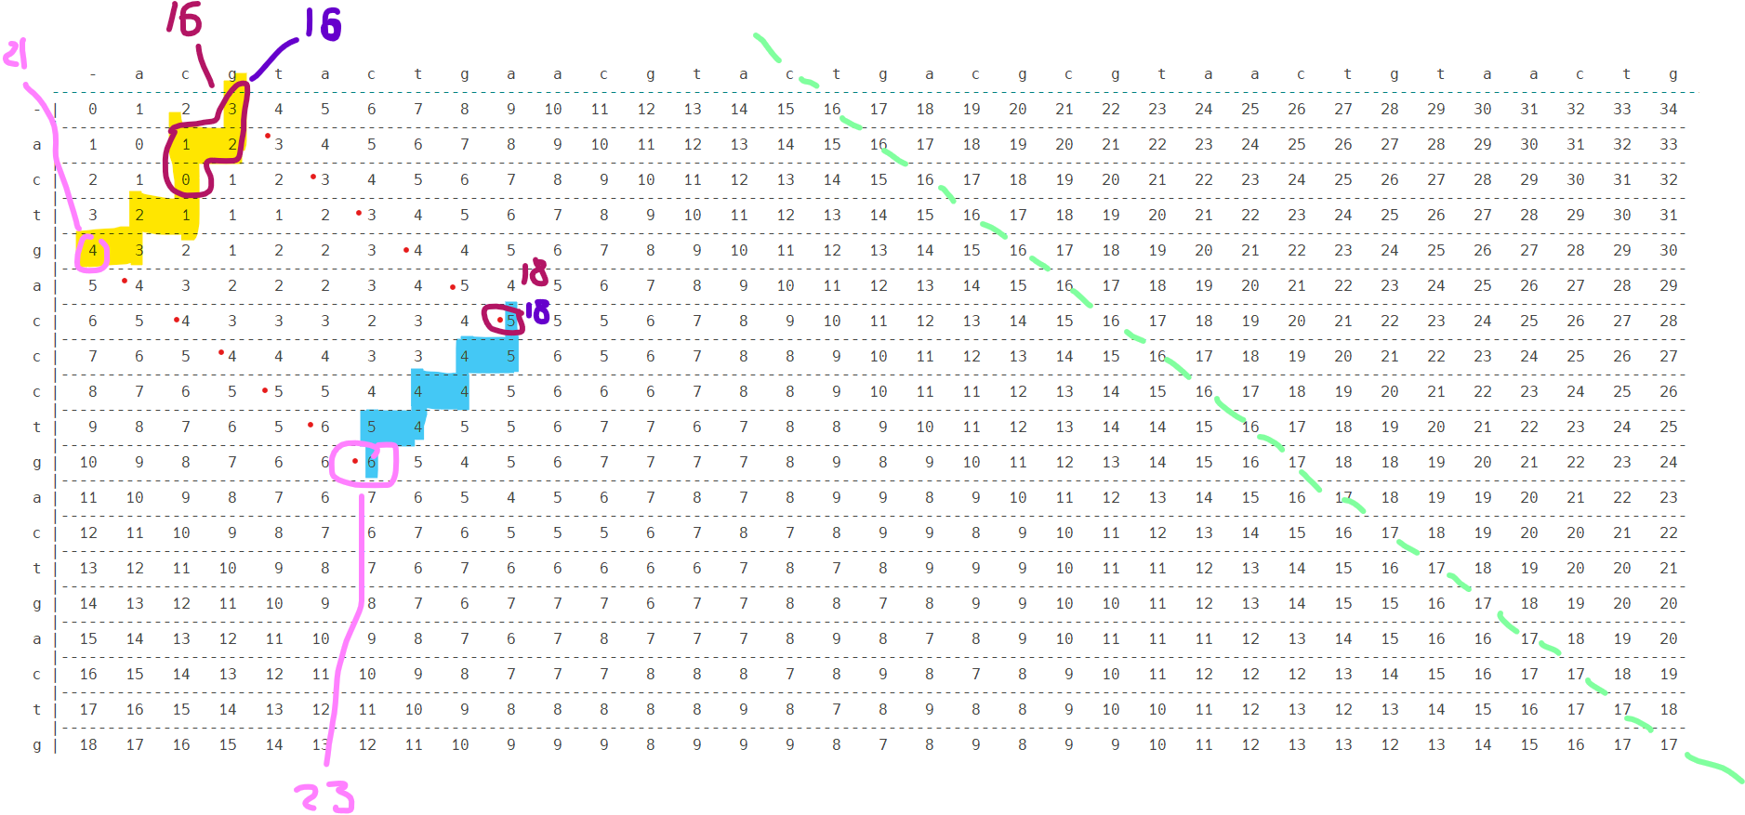

Slide 25
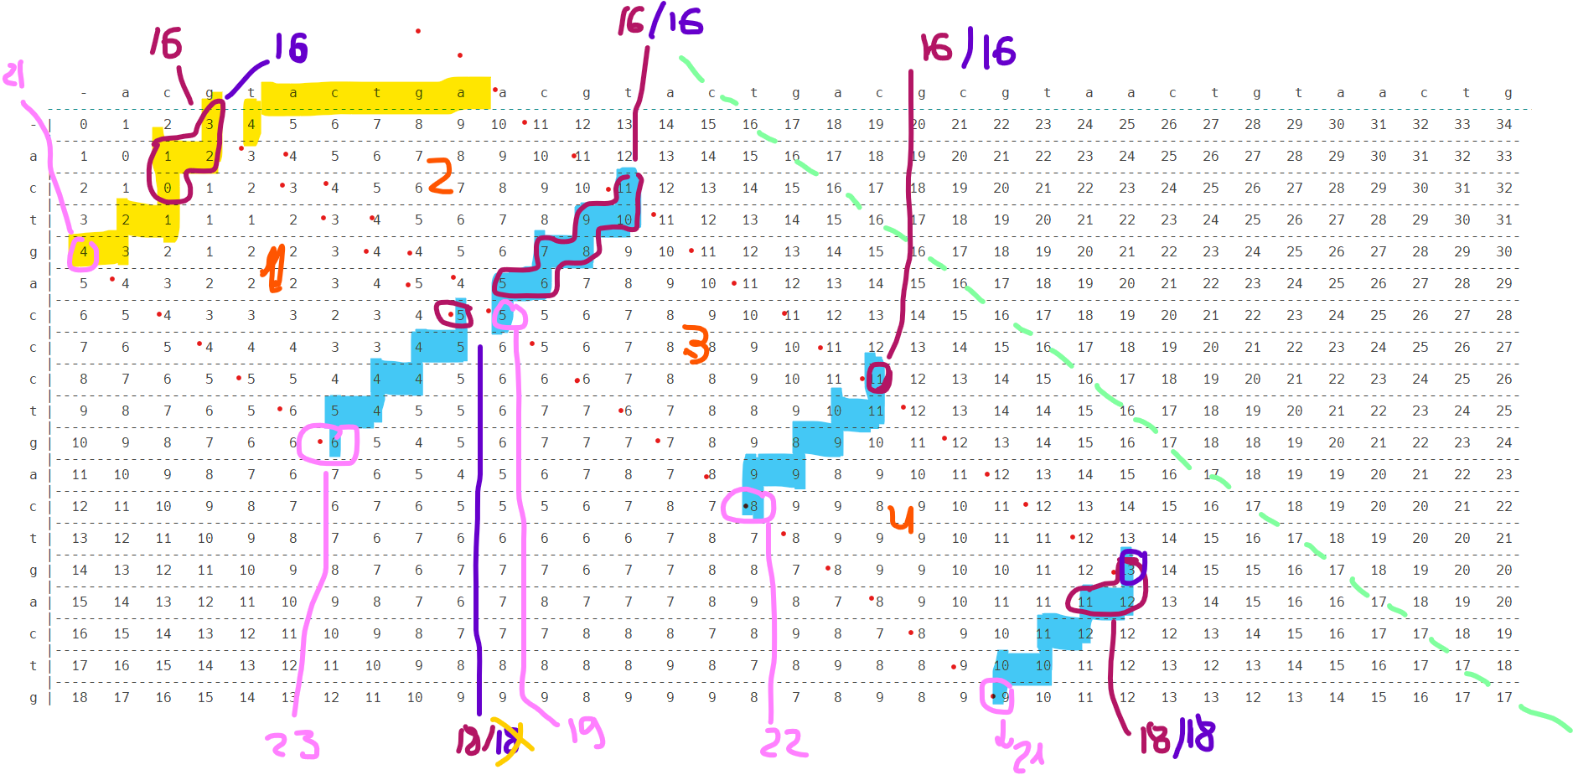

Slide 26
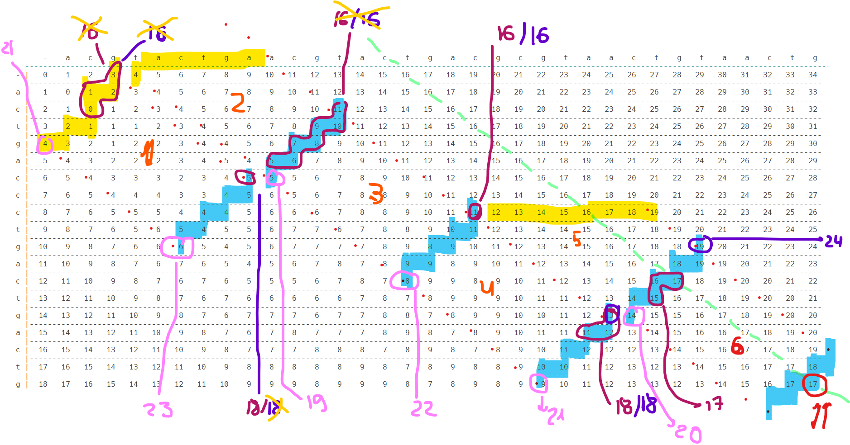

Slide 27
