Slide 1
Tracking
3D Human Pose/Motion Tracking
1

Slide 2
Tracking
3D Human Pose/Motion Tracking
Local tracking (camera coordinates)
Global tracking (world coordinates)
Joint Human-Scene Tracking
Track the person and the scene together
Make it physically realistic
→ This is our direction
2

Slide 3
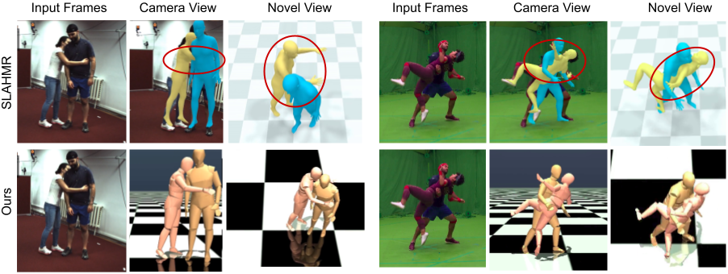
Tracking
The Problem
Current methods track people well,
but the results aren't physical.
Feet slide on the ground
Bodies go through floors
Motion looks jittery
Can't use it in a physics simulator
Fix: add physics constraints
MultiPhys (CVPR'24) — adding physics fixes artifacts
3

Slide 4
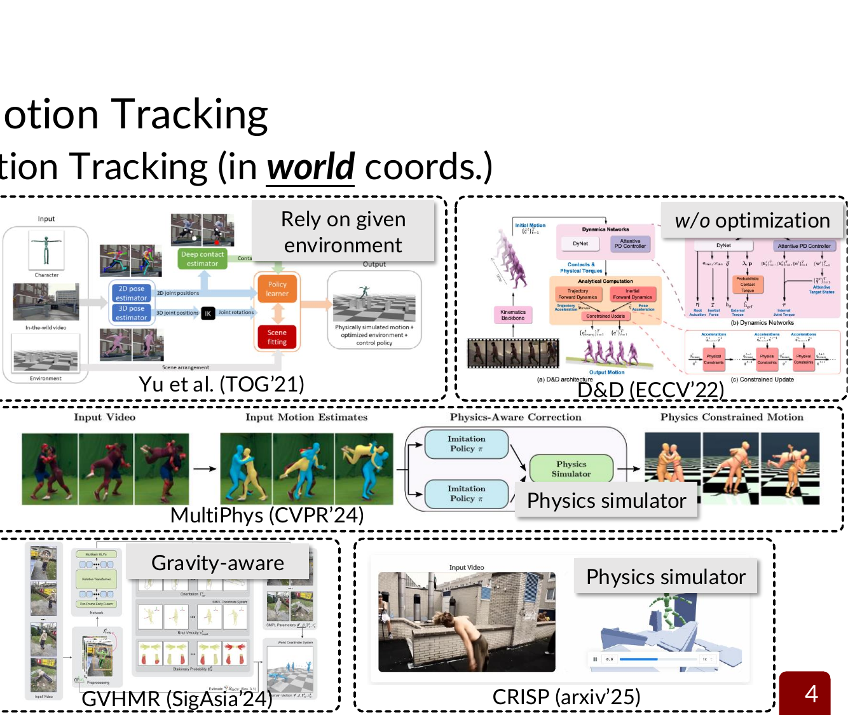
Tracking
Recent Methods
Body trackers (video → 3D body):
GVHMR (SigAsia'24) — best accuracy, fast
Human3R (arxiv'25) — real-time, multi-person
Scene reconstruction (video → 3D scene):
Depth Anything 3 — depth + geometry from video
CUT3R — underlies Human3R
Physics-aware methods:
MultiPhys (CVPR'24) — physics simulator loop
PhysHMR (SigAsia'25) — end-to-end physics
Nobody combines all three yet.
GVHMR, MultiPhys, CRISP — recent physics-aware trackers
4

Slide 5

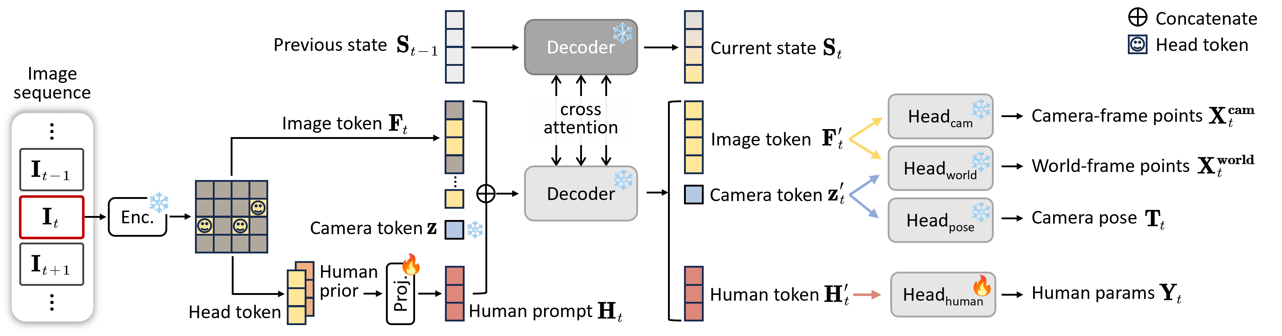
Tracking
Key Tools
GVHMR (SigAsia'24)
Video in → 3D body in world coordinates
Very fast, very accurate
Single-person only
Human3R (arxiv'25)
Video in → 3D people + scene, real-time
Multi-person, MIT license
Known issues: penetration, no physics
5

Slide 6
Tracking
Physics Helps — Evidence
Multiple papers show: adding physics improves results
MultiPhys: 7x less body-ground penetration
CRISP: 8x lower failure rate
PhysDiff: 86% less physical error
LEMO: eliminates foot skating
Physics doesn't just look better — it improves accuracy too.
6

Slide 7
Tracking
Proposed Approach
Input: Video
↓
Body Tracker
Scene Reconstruction
GVHMR or Human3R → 3D body poses
Depth Anything 3 → 3D geometry
↓
↓
Physics Refinement
Keep feet on ground • No body-floor penetration • Smooth motion • Stable balance
↓
Output: Physically realistic 3D motion + scene
7

Slide 8
Tracking
Why This Is Feasible
No training needed
Use existing pretrained models
Just add physics on top
Runs on 1 GPU
< 16 GB VRAM
Fully open-source stack
Human3R (MIT), DA3 (Apache-2.0)
MuJoCo (Apache-2.0)
7+ papers prove the approach works
We're combining, not inventing
8-week plan:
1–2 Setup + run existing models
3–4 Add physics constraints
5 Human-object interaction (stretch)
6–7 Evaluate on benchmarks
8 Demo + writeup
8

Slide 9
Tracking
Possible Directions
Physics-aware tracking
Terrain-aware ground contact
Body non-penetration
Contact estimation
Human-object interaction
Rigid objects
Deformable objects
Simulation-ready output
Direct use in physics engines
Method | Venue | Note
JOSH | ICLR'26 | Best offline
Human3R | arxiv'25 | Real-time, multi-person
DA3 | arxiv'25 | Scene geometry
MultiPhys | CVPR'24 | Physics simulator
CRISP | arxiv'25 | Physics + scene
PhysHMR | SigAsia'25 | End-to-end physics
GVHMR | SigAsia'24 | Best single-person
9

Slide 10
Track people in 3D from video
Reconstruct the scene around them
Add physics so it looks and acts real
No training. One GPU. Open-source.
10

