Slide 1




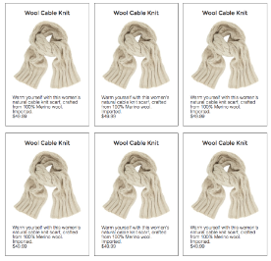
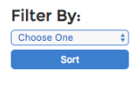
@media width >= 800px
3
6
3
<header>
Search for…
100% width
Bckgrnd color TBD
Grid: 3-6-3
Winter Wear Warehouse
Lists specials, clearances, promotions, etc. updated daily/hourly
<navbar>
Hats Gloves Scarves
100% width
Bckgrnd color: TBD dark
Use flexbox
<article>
80% width
Bckgrnd color: white
Use flexbox
<aside>
20% width
Bckgrnd color: same as header
100% width
Bckgrnd color: same as nav_bar
<footer>

Slide 2




@media width < 600px
Mobile devices
100% width
Bckgrnd color TBD
Winter Wear Warehouse
<header>
Search for…
Lists specials, clearances, promotions, etc
100% width
Bckgrnd color: TBD dark
Use flexbox to make 1 column
Hats
Gloves
Scarves
<navbar>
100% width
Bckgrnd color: same as header
Use flexbox to move to here
<aside>
100% width
Bckgrnd color: white
Flexbox: 1 column wide
<article>
100% width
Bckgrnd color: same as nav_bar
<footer>

