Slide 1
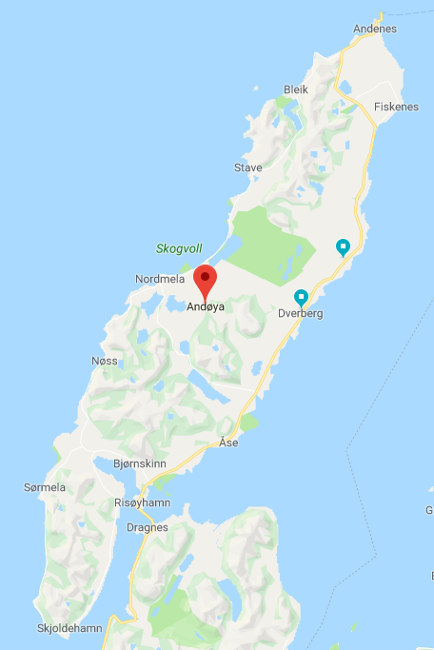
Grandpa’s Farm
Saura
Grandma’s Farm
Dverberg
Church

