Slide 1
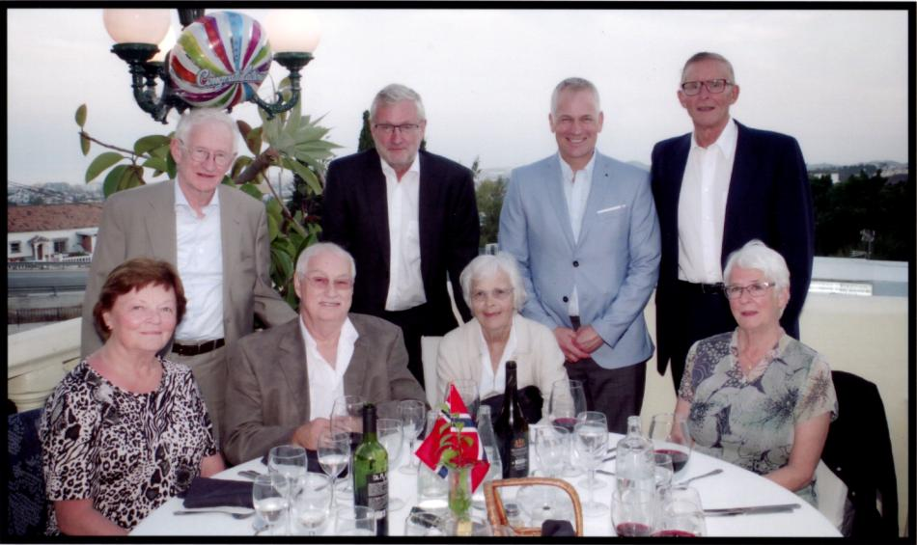
Jarle Gunnar Odd Helge Erik
Eli Steinar Hill Berit

Slide 2
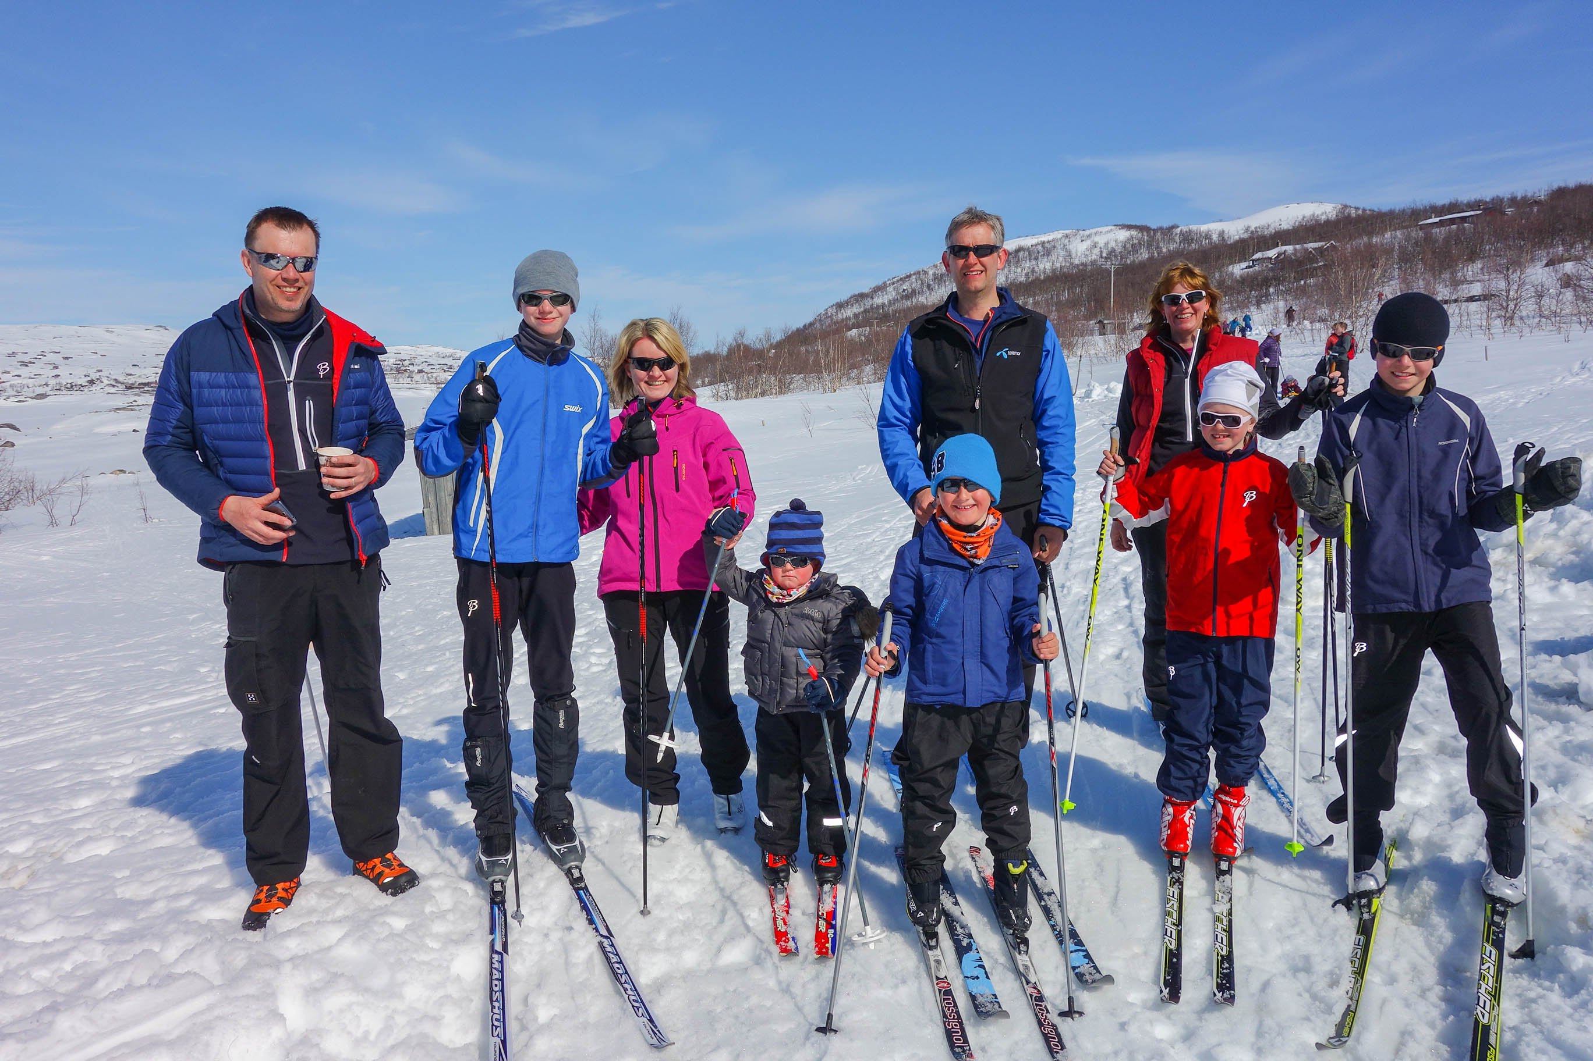
Helge Thomas Elisabeth Torgeir Ingrid
Henrik Eirik Thea Fredrik

