Slide 1
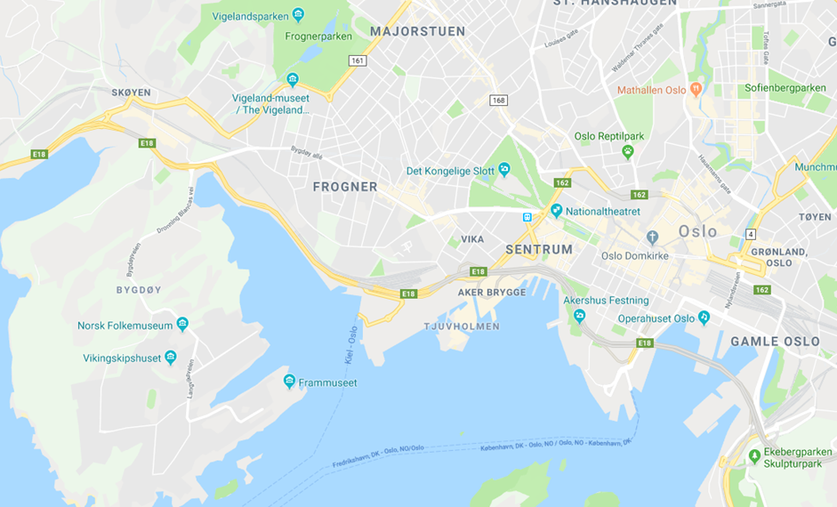
Vigeland Sculptures
Aker Brygge
Train Station
Waterfront
Folk Museum
Castle
Viking Ship
Museum
Ferry to Bygdoy
Maritime
Museums

Slide 2
