Slide 1
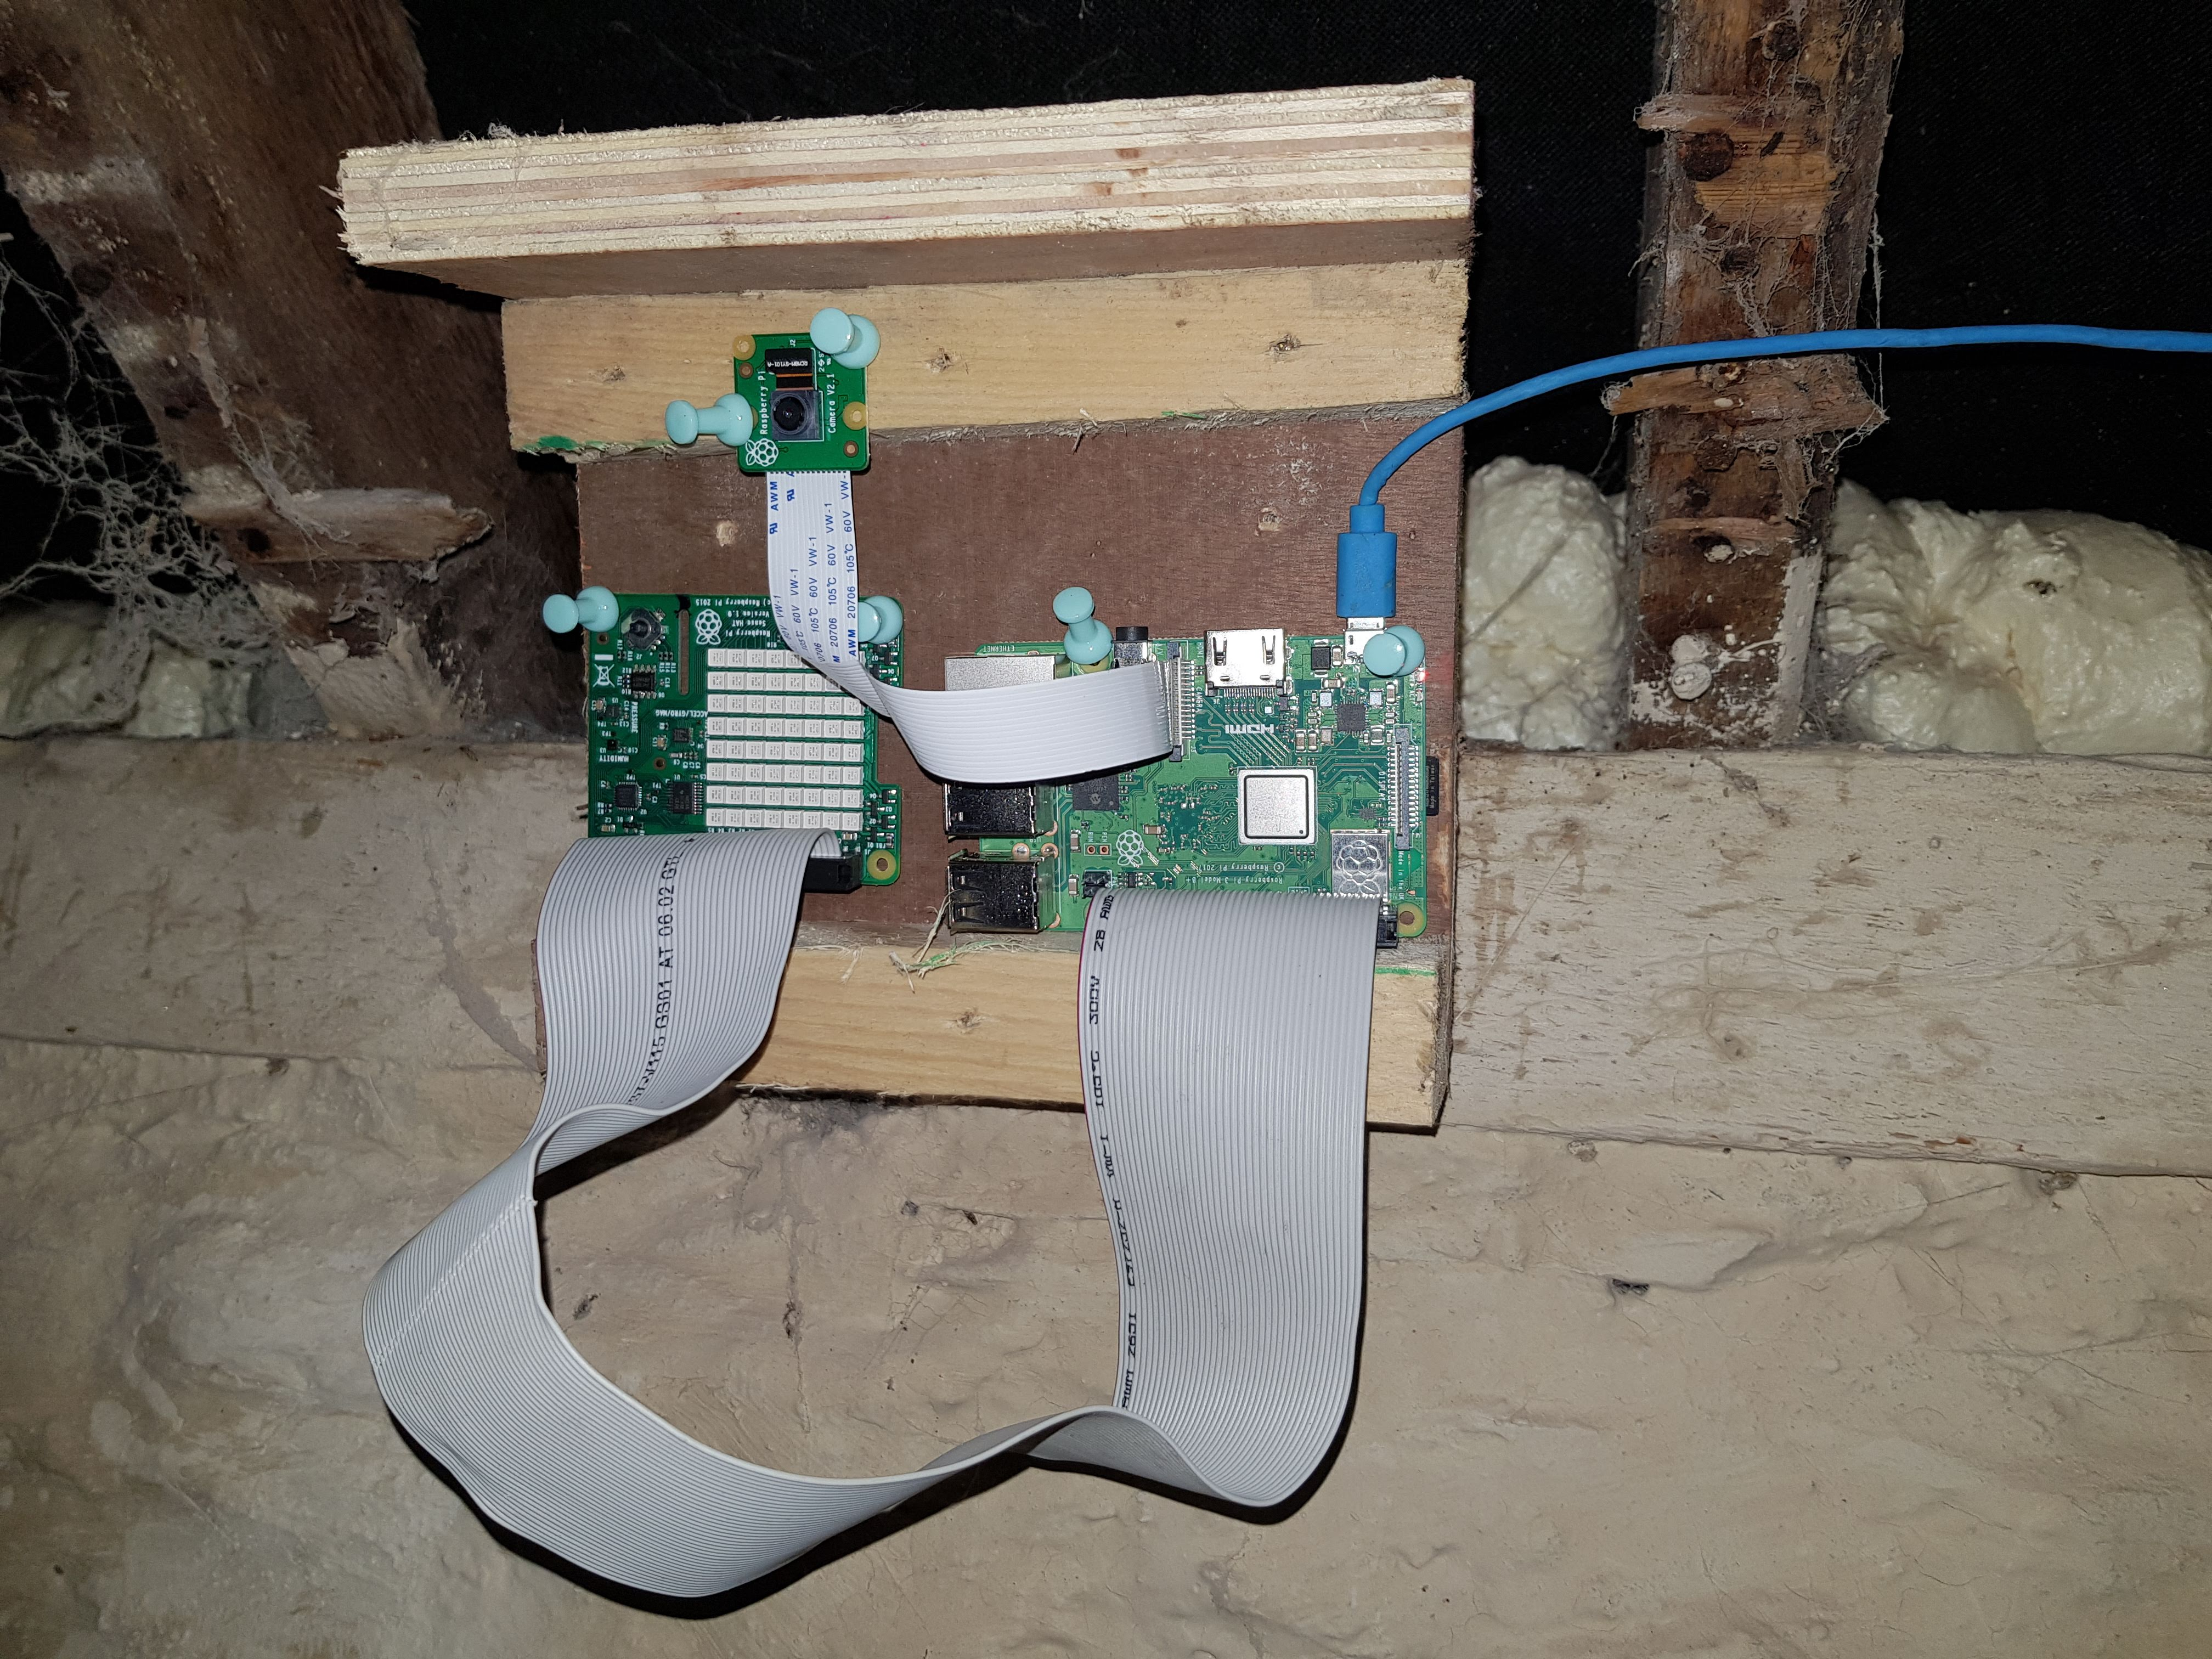
ChickenWatch
ChickenWatch system keeps track of current and trending conditions in a chicken shed. It measures temperature, humidity and air pressure. Extremes in temperature or huimidty requires attention, eg, bedding or ventilation. Air pressure monitor indicates incoming weather and thus the system duplicates as a simple weather station. It can also take a photo of the shed interior via remote HTTP request from web app.

Slide 2
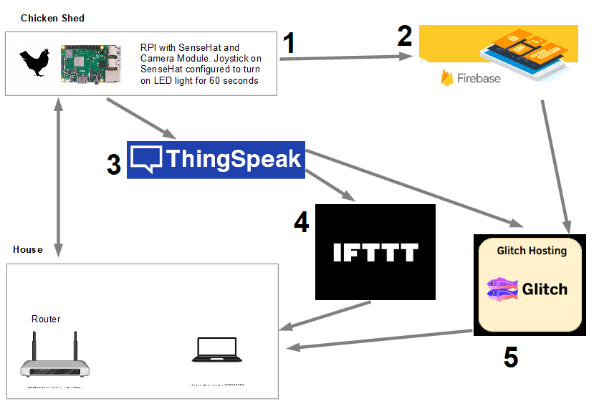

Slide 3
1. RPI
The RPI in the Chicken Shed is running 3 scripts - photo.py, button.py & readings.py
Photo.py listens for a HTTP request (sent from Glitch app). When the POST rtequest is received, a photo is taken, stored temporarily, then uploaded to FireBase storage and even is added to FireBase Realtime DB. The photo is then deleted from RPI storage.
Button.py is a simple script which listens for a “pressed” event on the SenseHat joystick, and turns on the white LED lights for 60 seconds when it is pressed. It functions as a timer light in the chicken shed.
Readings.py takes intermittent readings of temp, humidity & pressure from the SenseHat. These are uploaded to the FireBase Realitme DB and also sent to a Thingspeak channel via webAPI for use of graphs and React.

Slide 4
2 FireBase
FireBase project-486889781985
Realtime DB with 2 child containers, 1 for readings and one for photo storage reference
https://chickenminder484-64635-default-rtdb.firebaseio.com/
Storage bucket for photos: chickenminder484-64635.appspot.com
WebApp ID: 1:486889781985:web:aac701e4fb44fb494115a0

Slide 5
3 & 4 - Thingspeak & IFTTT
Thingspeak public channel: https://thingspeak.com/channels/1271506
Time, temp, humidity & pressure readings sent as json from RPI via API
Cold Temp React (less than 2 degrees) triggers ThingHTTP which sends HTTP to API in IFTTT to send alert email that temperature is low:
On Mon, 28 Dec 2020 at 20:06, Webhooks via IFTTT <action@ifttt.com> wrote:
The temperature in the Chicken House is 2 degrees Celsius at December 28, 2020 at 08:06PM. Consider extra bedding

Slide 6
5 – Glitch
https://chicken-minder.glitch.me
https://glitch.com/edit/#!/chicken-minder
Glitch website displays latest DB updates from FireBase for sensor readings and also downloads latest photo uploaded to storage. Last 10 photos in FireBase are also displayed.
A button sends HTTP request over LAN to RPI to take a photo. Graphs of sensor data from Thingspeak are displayed in iframes

