Slide 1

MITgcm-Docker Project: Product Design Overview
By: Justin Campbell

Slide 2
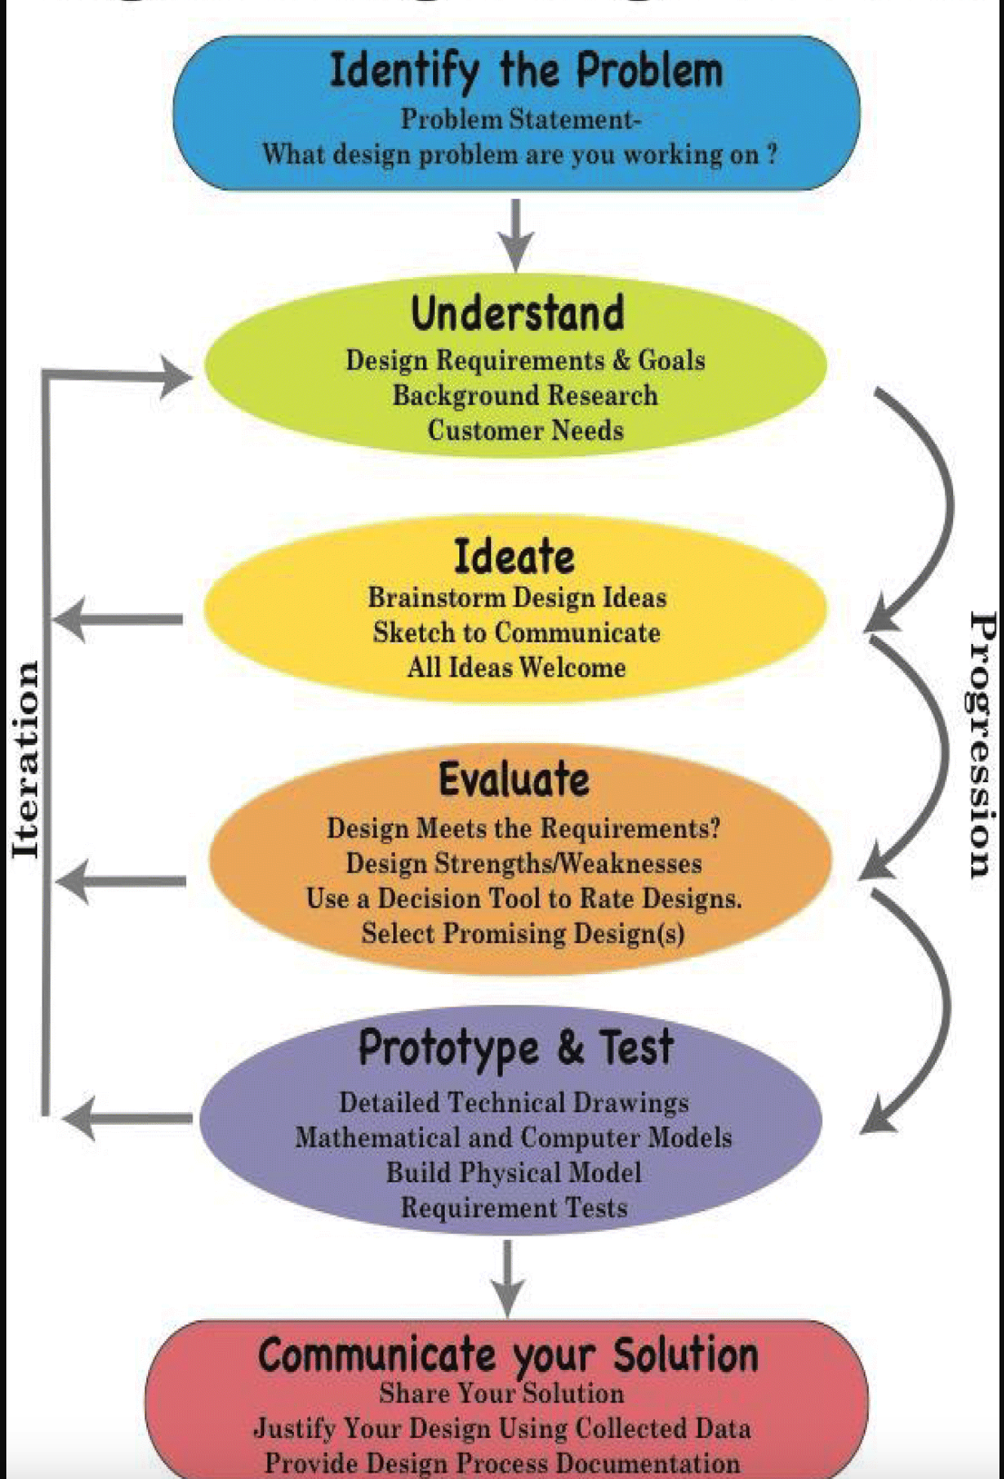
Notes:
Speaker Notes:
So before running through the product and sub-system designs, I want to provide a refresher on the design process methodology that I am incorporating into this project. This methodology is broken down into the six phases shown in this schematic. Having begun incorporating feedback from project collaborators on requirements and design ideas into my product system designs, I am currently progressing through the ‘Understand’ and ‘Ideate’ phases to develop the framework of my product design before translating that software-application/architecture agnostic product design into working preliminary designs that will be tested in the next step itemized as the ‘Evaluate’ step.

Slide 3
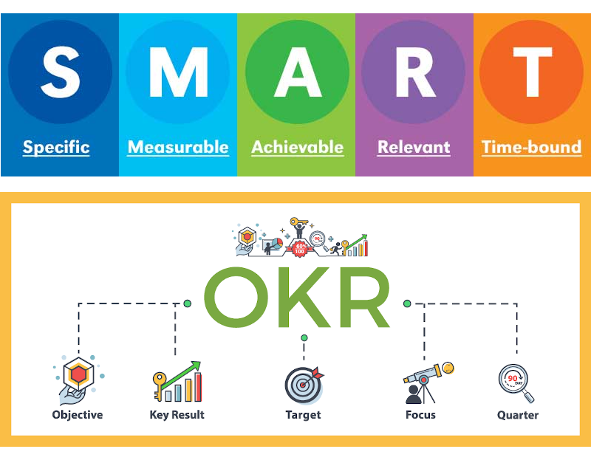
Project Objectives
Smart Goals
Develop portable units of software to build and run computationally inexpensive MITgcm model problems without mpi libraries
Add support for these units of software on common platforms, architectures, and OS according to CRIOS group users
Document detailed working software product designs in code repository and image registry
Present results to MITgcm and ECCO senior scientists for stable release in MITgcm-ECCO ecosystems
Notes:
Speaker Notes:
The next thing I wanted to briefly recap the project’s objectives. As a refresher, the product objectives are broken up into two categories,first, SMART goals that are specific, measurable, achieveable, and time-insensitive that will serve as a baseline for end project goals, and secondly, stretch goals that add complexity or introduce new features to product design that require additional research, time, and collaboration.
The Smart goals are to
Develop portable units of software (ideally containers) that can be leveraged to build, and run computationally inexpensive MITgcm model problems with installation of MITgcm, ECCO libraries and their dependencies and without mpi libraries
Configure support for these units of software on the most frequently used computing platforms, architectures, and operating systems according to CRIOS group users
Document the software products in code repository and image registry and present results to MITgcm-ECCO master repository managers

Slide 4
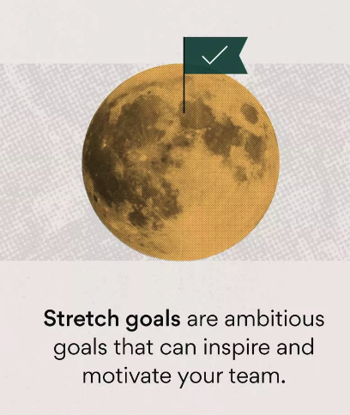
Project Objectives
Stretch Goals
Implement a GUI for end users to input MITgcm model problem specifications in addition to desired post- processing/data analysis tasks
Introduce support for more computationally expensive jobs to enable execution of more robust MITgcm model problems
Implement features for ASTE regional domain model problems
4. Configure support for product on multiple computing platforms for general MITgcm-community use
Notes:
Speaker Notes:
The Stretch Goals then include the following
Implement a graphical-user-interface for end users to input MITgcm model problem parameters and specifications ( such as step size, spatial and temporal domain boundaries, etc) along with desired post-processing and data analysis tasks such as invoking ECCO to render data visualizations and render output on a GUI in the portable unit of software.
Scale up support for MITgcm model problems and ECCO visualization tasks to enable more computationally expensive configurations
Add support for ASTE regional domain model problems
4. Scale up support for product to run on most-widely adopted computing platforms, architectures, and OS according to general purpose MITgcm community use.

Slide 5
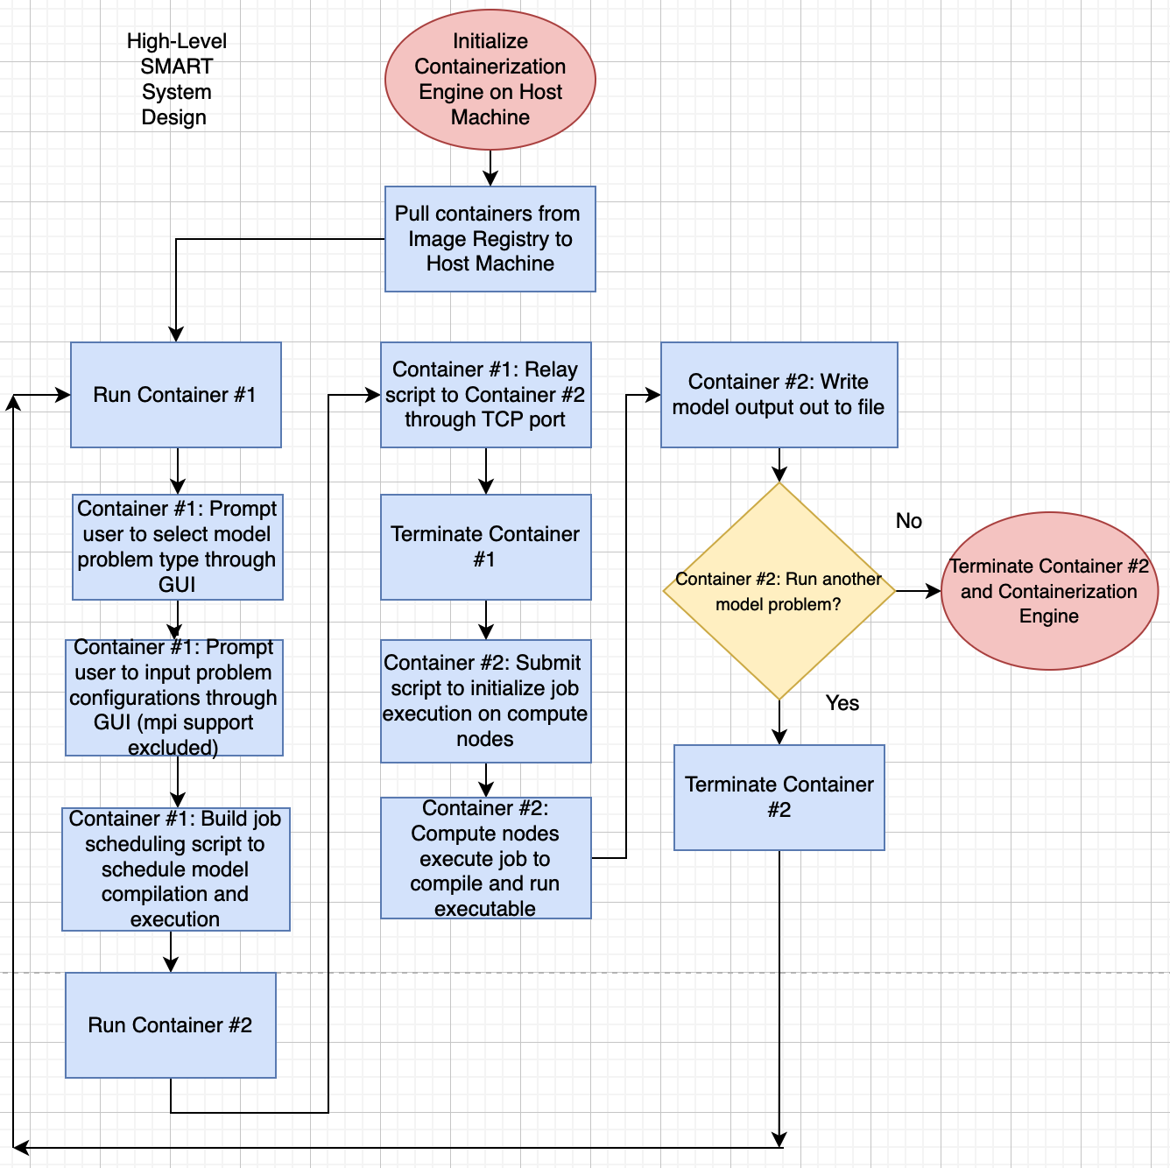
Product Design: CRIOS Environment Release

Slide 6
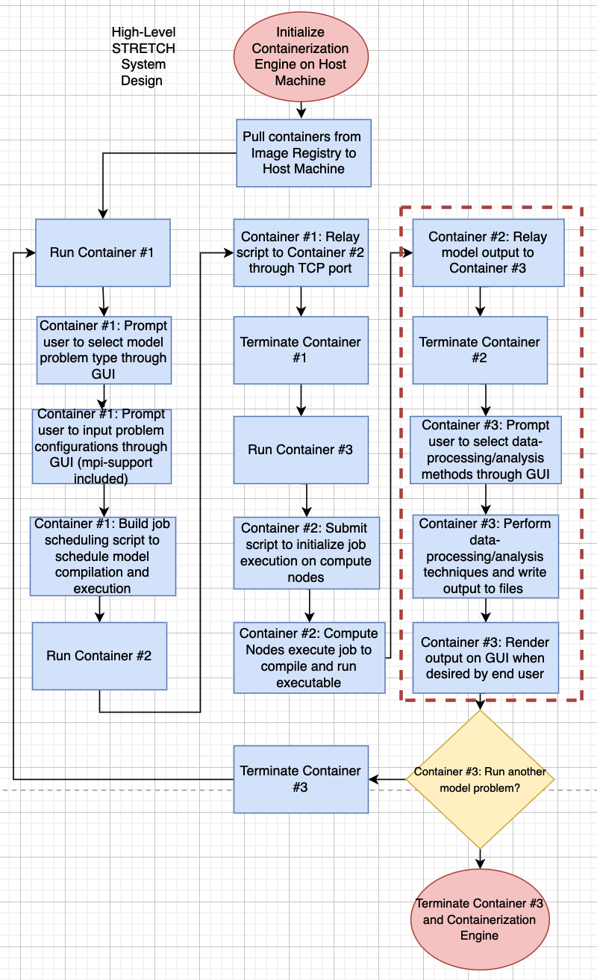
Product Design: MITgcm-ECCO Community Release
Yes
No
Notes:
Provide a list of systems in the product design and how they communicate with each other through a flowchart and/or bulleted list

Slide 7
System #1 Design
Slides 7-10 are in development as I work on testing the feasibility of building and running model problems using the design schematic shown in slide 5
Notes:
Provide high-level flowchart to characterize flow of information in system in a way that is software-application-independent. Consider adding a second slide to do the same for any sub-systems in the system design such as illustrating pseudocode or algorithmic structure using class diagrams.

Slide 8
System #2 Design
Notes:
Provide high-level flowchart to characterize flow of information in system in a way that is software-application-independent. Consider adding a second slide to do the same for any sub-systems in the system design such as illustrating pseudocode or algorithmic structure using class diagrams.

Slide 9
System #3 Design, etc
Notes:
Provide high-level flowchart to characterize flow of information in system in a way that is software-application-independent. Consider adding a second slide to do the same for any sub-systems in the system design such as illustrating pseudocode or algorithmic structure using class diagrams.

Slide 10
Top-Down Product Overview

Slide 11
Next Steps
Next Steps
Finalize and document rudimentary product design and product system design schematics
Develop preliminary designs by implementing product and system designs into platform-specific architectures
Test behavior of preliminary designs and use results to weigh strengths/weaknesses of designs and check designs against requirements
Design and implement Feasibility Tool(s) to downselect designs that are desirable according to requirement validation and project objectives
Notes:
Speaker Notes:
The next steps in the project design process will involve finalizing and documenting product and design and product system design frameworks from their schematics and sketches, using these finalized design frameworks to develop working preliminary designs that are specific to particular software-applications/computing platforms, testing the behavior of the preliminary designs to validate their functionality against requirements and objectives, and use these tested designs to downselect a final design that is most desirable according to the results of one or more Feasbility Tools.

Slide 12
References

