Slide 1

MITgcm-Docker Project Overview
By: Justin Campbell

Slide 2
Problem Statement
Members of the MITgcm community often experience difficulty with configuring access to computing resources, and establishing environments for building, running, and visualizing MITgcm model problems
Additionally, many users find it inconvenient and time-consuming to read through numerous user guides and tutorials to become familiarized with learning new skill sets to perform their research
It can also be meddlesome for users to perform the post-processing tasks of writing out, importing, wrangling, and visualizing model output data using analysis in ECCO
Furthermore, many of these models can take an unreasonable amount of time to build and run-on host architecture and could benefit from a more lightweight execution environment.
Notes:
Speaker notes:
The underlying problem statement that motivates this project and that was in part, inspired by conversations with Ivana, Helen, and Shreyas is that many scientists, researchers, and other members of the MITgcm community experience complexity with, and time-intensive involvement in, configuring access to computing resources, and establishing environments for building, running, and visualizing MITgcm model problems.
Additionally, many users find it inconvenient and time-consuming to read through numerous user guides and tutorials to become familiarized with learning new skill sets to perform their research such as determining what software modules and libraries to install on their host machine, learning new skills such as shell scripting, navigating Linux environments, and others
It can also be meddlesome for users to perform the post-processing/data science tasks of writing out, importing, wrangling, and visualizing model output data using numerous analysis routines that exist within the MITgcm-ECCO community that are always changing
Lastly, many problems developed using MITgcm can take an unreasonable amount of time to build and run on host architecture and could benefit from a more lightweight execution environment

Slide 3


Need Statement
There exists a need for the development of portable units of software that can be used to build and run models in an environment where minimal prior knowledge of software tools is required
These portable units of software would come equipped with all software tools needed to perform all tasks in the MITgcm-ECCO workflow reducing the end users’ learning curves
Additionally, these products would ideally function as lightweight virtual machines that can run on any host machine regardless of that machine’s architecture, operating system, etc.
Notes:
Speaker Notes:
Given these limitations and inconveniences with building, running, and interpreting MITgcm model problems, there exists a need for the development of portable units of software that can be used to build and run models in an isolated environment where minimal prior knowledge of software module, library, and other dependency installation are required.
These portable units of software would ideally come equipped with a pre-installed operating system, along with necessary software modules, libraries, and dependencies needed for the end user to perform all tasks in the MITgcm-ECCO workflow. This would effectively reduce the need for the end user to determine what software tools to install, and certain skill sets in computing (like shell scripting) to acquire, along with the need to comprehend analysis routines for post-processing before building, running, and interpreting results from models
These isolated environments would ideally function as a one-stop-shop for all MITgcm-ECCO workflow tasks and as lightweight virtual machines that can run any host machine (with some fundamental limitations) regardless of that machine’s architecture, operating system, etc.

Slide 4

Project Objectives
To address the need statement, project objectives have been documented into two categories
1. SMART Goals - concrete goals that are smaller in scale and more achievable
2. Stretch Goals – ambitious goals that expand on, or provide an enhanced functionality to, the concrete goals
Notes:
Speaker Notes:
To address this project’s need statement, project objectives have been documented in two categories, namely, SMART Goals (concrete goals that are smaller in scale and more achievable) and Stretch Goals, namely, ambitious goals that expand on or provide an enhanced functionality to, the concrete goals

Slide 5
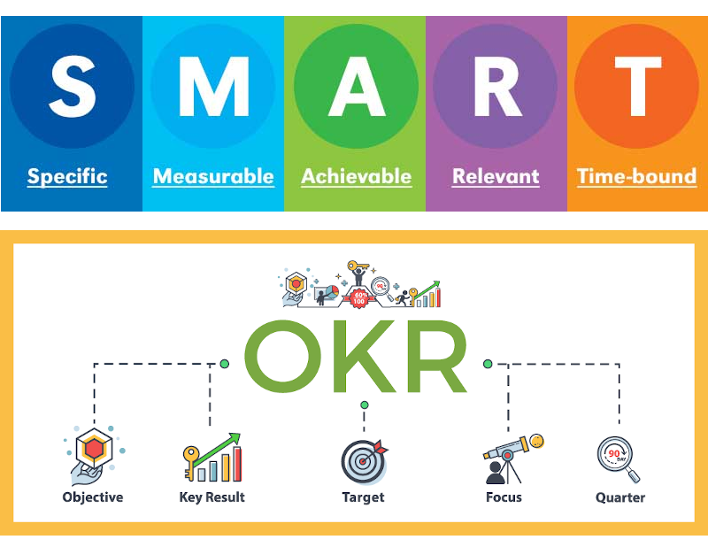
Project Objectives
Smart Goals
Develop portable units of software to build, run, and interpret results from computationally inexpensive MITgcm problems
Add support for these products on the most frequently used host machines according to MITgcm and ECCO end users
3. Document detailed working software product designs in code repository and present results to MITgcm and ECCO senior researchers
Notes:
Speaker Notes:
The Smart goals are as follows:
Develop portable units of software that can be leveraged to build, run, and interpret results from computationally inexpensive MITgcm model problems with installation of MITgcm, ECCO libraries and their dependencies
Configure support for these units of software on the most frequently used computing platforms, architectures, and operating systems according to MITgcm-ECCO researchers and scientists
Document the software products in code repository and present results to MITgcm-ECCO master repository managers

Slide 6
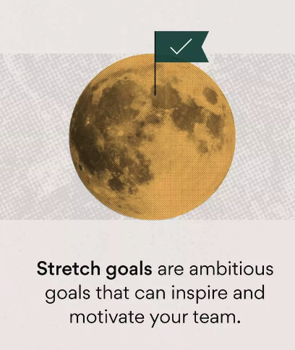
Project Objectives
Stretch Goals
Implement a GUI for end users to input MITgcm model problem specifications in addition to desired ECCO data visualization tasks
Scale up support for MITgcm model problems to facilitate more computationally expensive configurations
Introduce features for ASTE regional domain model problem analysis
4. Configure support for products on multiple Linux distributions
Notes:
Speaker Notes:
The Stretch Goals that I plan on implementing time-permitting and assuming technical compatibility are as follows:
Implement a graphical-user-interface for end users to input MITgcm model problem parameters and specifications ( such as step size, spatial and temporal domain boundaries, etc) along with desired data visualization tasks and render output in the interface
Scale up support for MITgcm model problems and ECCO visualization tasks to enable more computationally expensive configurations
Add support for ASTE regional domain model problems
Configure support for products on multiple Linux distributions to include (in addition to CentOS), Ubuntu, RedHat, and Fedora

Slide 7
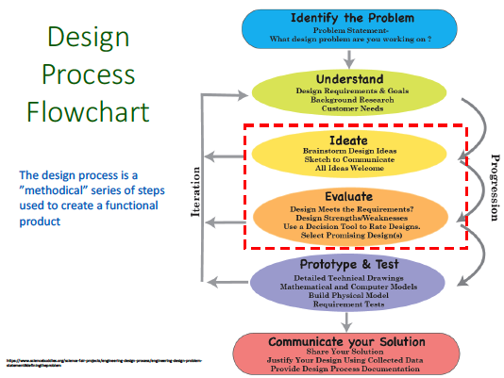
Notes:
Speaker Notes:
On this slide is a schematic that will overview the design process framework that I will follow in working on this project. In particular, the framework follows a conventional iterative product design process that begins with definition of the problem statement and associated need statement that have been discussed earlier in the presentation.
The next phase of the project to be completed, and that is currently in progress, will be the phase documented as ‘Understand’ which will involve the definition of design requirements (both subjective technical requirements and quantitative requirements), performing background research on software tools that the products in this project will utilize through user guides and literature reviews and documenting the outcomes of projects that are similar in scope, and lastly finalizing customer needs (which will likely involve communication with other senior research associates and graduate students to get their input on how this product can be optimized for their collective benefits).
Following the ‘Understand’ phase, we have the ‘Ideate’ phase which will involve the development of sketches and schematics to communicate the flow of information in the product in a hardware/software-independent way by defining the product as a black-box with inputs and outputs and identifying each input/output in the product and the systems they communicate with. Then, the black-box definition of the product will be translated into hardware-software specific product designs deemed as preliminary designs and documented.
Transitioning to the ‘Evaluate’ phase, the preliminary designs will be iteratively tested, troubleshooted, and working designs will then be checked against requirements to determine whether or not they fit with their strengths and weaknesses enumerated. Requirement compromise and decision matrix schematics will then be developed to document trade-offs in the preliminary designs. From here, a decision tool will be incorporated to rate down-selected designs that meet all necessary requirements in a feasibility study and the design or designs that are optimal according to the results of the feasibility study will be selected as detailed designs to carry over into the ‘Prototype and Test’ Phase as shown.
Here, detailed technical drawings and schematics of the detailed designs will be documented and mathematical and/or computed models for the designs will be implemented in the applicable system architecture. Using this information, the physical model of the detailed designs will be built. From here, an analysis plan will be developed to specify approaches to testing and analyzing the performance of detailed designs according to properties such as compile time, runtime, compute resource allocation, etc. and test results of detailed design prototype performances will be documented according to this analysis plan. From here, the last step before communication of the final product will be to perform a requirements verification to check the working product against all critical project requirements according to end user and stakeholder expectations.
After it is determined that the final product is optimized according to critical project requirements in the verification stage, the project work will be committed to a public code repository and MITgcm and ECCO researchers will be granted privileges to view the content. To wrap up the project, meetings will be scheduled with senior research scientists to communicate the results of the project and address plans for incorporating the final product into the MITgcm-ECCO workflow.

Slide 8
Next Steps
Next Steps
Annotate and document user guides for setting up and using software tools applicable to project scope
Perform a literature review on the project’s subject area with a focus of identifying solutions using portable units of software to run climate models in a computing-architecture-independent fashion
Incorporate feedback from researchers, graduate students, and IT administrators within the MITgcm-ECCO community to document design requirements
Notes:
Speaker Notes:
The next steps in the project design process will involve reading through relevant user guides for installing and operating software tools applicable to this project, performing a literature review on this broad subject area of using portable units of software to run climate models in a platform agnostic way and defining design requirements by incorporating feedback from researchers and graduate students in the MITgcm-ECCO community along with IT administrators.

Slide 9
References
Helmenstine, Anne Marie. “Why Is the Ocean Blue? Here's How It Works.” ThoughtCo, ThoughtCo, 11 July 2022, https://www.thoughtco.com/why-is-the-ocean-blue-609420.
McCarty, Scott, and Joe Brockmeier. “A Practical Introduction to Docker Containers.” Red Hat Developer, Red Hat Developer Community, 7 Mar. 2023, https://developers.redhat.com/blog/2014/05/15/practical-introduction-to-docker-containers.
Mathai, Claireice. “How to Dual Boot Windows 11 and Linux.” OnLogic Blog, OnLogic, 15 Feb. 2023, https://www.onlogic.com/company/io-hub/how-to-dual-boot-windows-11-and-linux/.
Dwyer, Susanne. “Are You Still on Target to Meet Your Goal?” RISMedia, RISMedia, 13 June 2019, https://www.rismedia.com/2019/06/13/target-goal/.
Lean East. “Setting Objectives: Measure What Matters.” Lean East, Lean East, 25 Mar. 2022, https://www.leaneast.com/setting-objectives.
Asana, Team. “How to Set & Track Stretch Goals to Inspire Your Team [2023] [2022] • Asana.” Asana, Asana, 19 Nov. 2022, https://asana.com/resources/stretch-goals.
Notes:
Speaker Notes:
And here are the references. Any questions?

