Slide 1

Ocean Circulation Model Containerization Product Design Overview
By: Justin Campbell, Research Engineering/Scientist Assistant with Computational Research in Ice and Ocean Systems (CRIOS) Group
Notes:
Hello, this is Justin Campbell again. Thank you for dropping in; I would assume that you watched the first video and that it peaked your interest. This video will be the second in a series of videos aimed to provide climate science enthusiasts with information on the utility of cloud computing within the scope of building and running climate models. In this deliverable, I will provide you first with a recap of the product design process and the project objectives. Feel free to skip these sections if you are not in need of a recap. From here, a discussion of design requirements in requirements gathering will be provided before moving onto the final and most important topic of this deliverable, namely, a presentation of high-level product designs for distributed systems that aim to satisfy the SMART and stretch goals discussed in the project objectives.

Slide 2
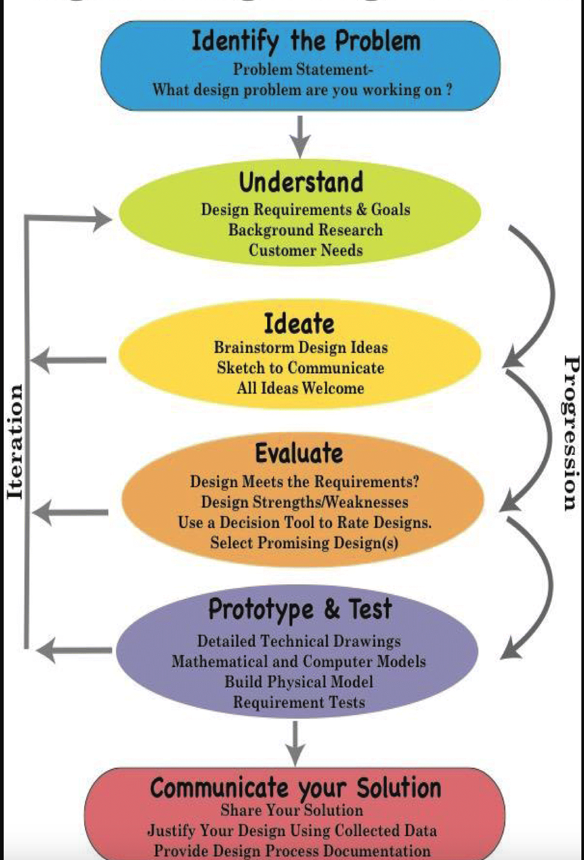
Notes:
Speaker Notes:
So, I want to provide a refresher on the design process methodology that I have incorporated into this project. This methodology is broken down into the six phases shown in this schematic. Having begun incorporating feedback from project collaborators on requirements and design ideas into my product system designs, I am currently progressing through the ‘Understand’ and ‘Ideate’ phases to develop the framework of my product design before translating that software-application/architecture agnostic product design into working preliminary designs that will be tested in the next steps itemized in the ‘Evaluate’ phase.

Slide 3
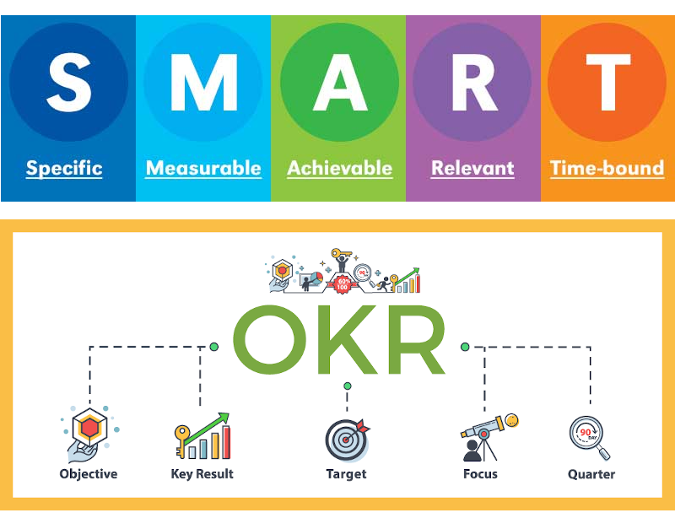
Project Objectives
Smart Goals
Develop portable units of software to build and run computationally inexpensive MITgcm model problems without mpi libraries
Add support for these units of software on common platforms, architectures, and OS according to CRIOS group users
Document detailed working software product designs in code repository and image registry
Present results to MITgcm and ECCO senior scientists for stable release in MITgcm-ECCO ecosystems
Notes:
Speaker Notes:
The next thing I wanted to briefly recap the project’s objectives. As a refresher, the product objectives are broken up into two categories,first, SMART goals that are specific, measurable, achieveable, and time-insensitive that will serve as a baseline for end project goals, and secondly, stretch goals that add complexity or introduce new features to product design that require additional research, time, and collaboration.
The Smart goals are to
Develop portable units of software (ideally containers) that can be leveraged to build, and run computationally inexpensive MITgcm model problems with installation of MITgcm, ECCO libraries and their dependencies and without mpi libraries
Configure support for these units of software on the most frequently used computing platforms, architectures, and operating systems according to CRIOS group users
Document the software products in code repository and image registry and present results to MITgcm-ECCO master repository managers

Slide 4
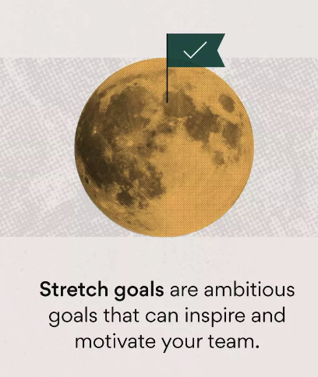
Project Objectives
Stretch Goals
Implement a GUI for end users to input MITgcm model problem specifications in addition to desired post- processing/data analysis tasks
Introduce support for more computationally expensive jobs to enable execution of more robust MITgcm model problems
Implement features for ASTE regional domain model problems
4. Configure support for product on multiple computing platforms for general MITgcm-community use
Notes:
Speaker Notes:
The Stretch Goals then include the following
Implement a graphical-user-interface for end users to input MITgcm model problem parameters and specifications ( such as step size, spatial and temporal domain boundaries, etc) along with desired post-processing and data analysis tasks such as invoking ECCO to render data visualizations and render output on a GUI in the portable unit of software.
Scale up support for MITgcm model problems and ECCO visualization tasks to enable more computationally expensive configurations
Add support for ASTE regional domain model problems
4. Scale up support for product to run on most-widely adopted computing platforms, architectures, and OS according to general purpose MITgcm community use.

Slide 5
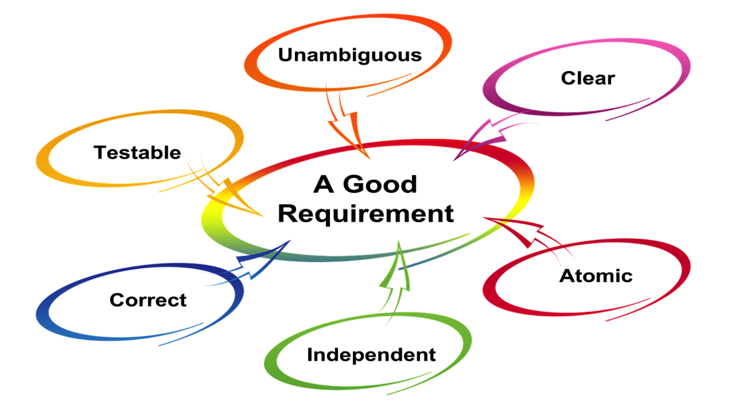
Design Requirements Overview
The project requirements have been documented into two parent categories:
1) Subjective Technical Requirements - requirements that are interpretation-based and describe a product’s requirements at a high level
2) Quantitative Requirements – requirements that are countable, measurable, and are ascribed a numerical value for being met
Notes:
After developing project objectives and determining general frameworks for a product development/design process, development environment workflows, and a communication hierarchy, I began documenting project requirements according to feedback received from fellow graduate students and personal knowledge of how to improve the MITgcm-ECCO workflow. In particular, the project requirements have and will continue to be documented into two parent categories, namely, subjective technical requirements, often referred to as qualitative requirements which are those that are interpretative and describe a product or projects requirements at a high-level, and quantitative requirements sometimes, merely referred to as technical requirements, which are those that are countable, measurable, and thus ascribed a numerical value for verification.
Now, requirements will be continuously updated as I see fit according to time and development environment constraints.

Slide 6
System Design Requirements
The design requirements in the project will be documented according to the system in which they are incorporated:
1) Containerization Technology System – refers to the open-source containerization platform in which the containers will be built, tested, and deployed
2) Container Orchestration System – system in which containers, databases, and other services are developed to communicate in a load-balanced, distributed system
3) Containerization Software Stack – software stack from which the containers, their source code, microservices and the communication between them will be built
Notes:
Since the project’s objectives are to release a product that is robust enough to incorporate a majority if not all of the tasks in the MITgcm-ECCO workflow, it is reasonable to conceive a system design that divides the workflow tasks across multiple portable units of software (containers) to prevent one unit of software from taking on a computationally intensive quantity of tasks that exceed memory allocation, result in slow performance, or crashing to name a concerns. This necessitates the need for the containers to communicate the output of these tasks with one another in real time to effectively balance the workflow which can be accomplished using a container orchestration system. Since both the container technology platform and the container orchestration system will be run on user’s host machine’s there will be host machine software and hardware requirements that must be met for successful use of the products.
Thus, the requirements have been assigned to three systems that will be incorporated into the design of the products, namely, the container technology system, container orchestration system, and a software stack system. The Containerization technology system refers to the open-source containerization platform itself in which the containers will be built, tested, and deployed from (examples include docker, coreOS rkt, and cloud foundry). The Container Orchestration System designation is a system in which the containers, databases, and other services/microservices will be developed to communicate in a load-balanced distributed system. Lastly, the Containerization Software Stack is a software stack from which the containers, the source code running on the containers, microservices, and the communication between them will be built.
Then, to expand on what was mentioned previously, the requirements within each system scope will be categorized as either subjective technical requirements or quantitative requirements.

Slide 7
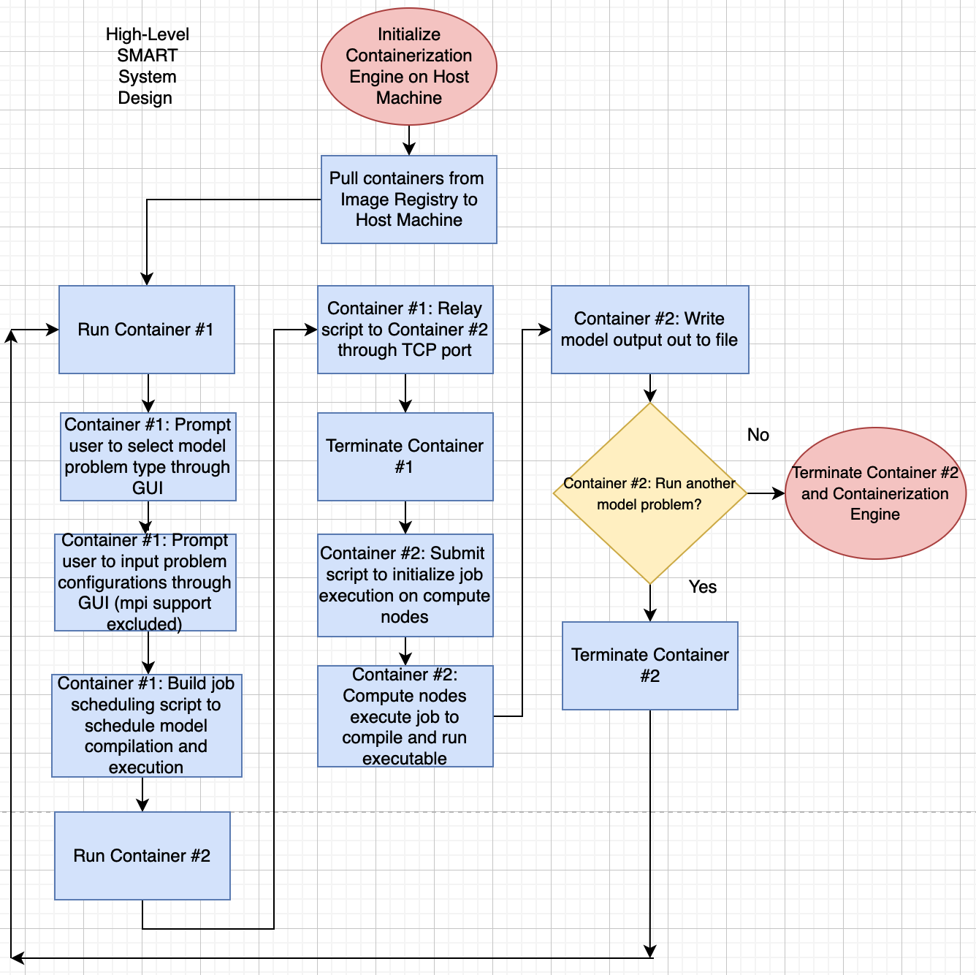
Product Design: SMART Goal Release
Notes:
Next, high-level product designs that are used to communicate the intended workflow of the products will be provided in rudimentary flowcharts. These flowcharts provide a sequential order of operations in which the containers, services and microservices in the product will execute to perform high-level tasks in the MITgcm or MITgcm-ECCO workflow. More high-level schematics and detailed designs will be provided for both individual systems and the services/microservices in those systems later in the project timeline once system designs have been downselected from the Feasibility Analysis and container technology and orchestration systems have been installed and configured in development environments. Now, shown in this slide is a high-level product design of a containerized distributed system whose behavior is to be consistent with the objectives documented under the aforementioned SMART Goals.
From the standpoint of the end user, the first step would be to initialize the containerization engine and container orchestration system on the end users’ machine. From here, the end user would be expected to pull containers that are tagged for release from an Image Registry to their local machine. Then, the end user would be expected to run one more command from the user’s terminal, namely, one that executes a base container, let it be container #1, that prompts the user to input model compile and runtime parameters along with other model configurations such as processor number, temporal/spatial domain ranges, time step sizes etc. through a GUI excluding support for MPI at first due to complexities between libraries that need to be installed both inside and outside of the container on the user’s host machine. From here, the container would build a job scheduling/submission script to schedule the model compilation and execution on a job scheduling platform such as Slurm. Then, the container orchestration system would spin up a second container to load balance tasks running on instances of the container daemon. Before executing any tasks on the second container, the first container would then relay the job submission script to the second container using a network protocol and then terminate the first container to load balance tasks running on the container daemons. From here the job script would be submitted to initialize job scheduling and execution on the compute nodes being leveraged by the host machine’s HPC cluster. Then, when memory is available, the compute nodes will execute the job script to compile the model and run the executable. The container will then write the standard and error output out to a file for the end user to view. The end user may then run commands inside the container to write the data out to a custom volume for future reference. They will then be prompted through a GUI to run another model problem and if yes, the second container will be terminated, the first container run for a second time, and the remainder of the procedure will repeat. Otherwise, if the end user decides not to run another model problem, the container daemon will terminate the container and ultimately the entire distributed system culminating in the shut down of the containerization engine.

Slide 8
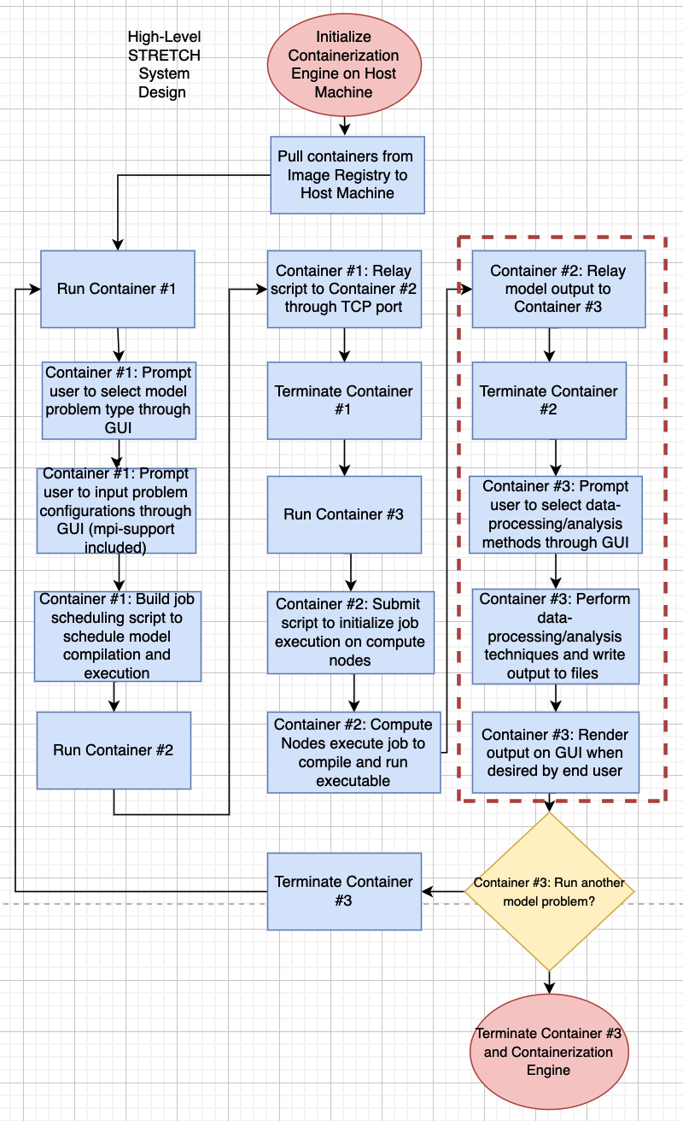
Product Design: Stretch Goal Release
Yes
No
Notes:
Now, this slide provides a similar flowchart whose elements are slightly amended and more introduced with an intention of satisfying the stretch goals in the project. The first difference between the two designs lies in support for building and running model problems using MPI libraries as shown in the third element in the left-most vertical column. Fast-forwarding a bit through the elements, after the compute nodes have executed the job to compile and run the executable, the model output will be relayed to a third container spun up in the container orchestration system before the system terminates the second container. This third container will use a GUI to prompt the user to select data-processing/data analytics methods to execute under the hood to process output data according to subroutines incorporated into ECCO python libraries. This will ideally allow for the system to automate the performance of any analyses technique on the output data that the end user would otherwise be required to learn and reproduce manually upon installing, and configuring an environment for using ECCO libraries on their host machines. The output of these data processing and analyses tasks would then be rendered on a GUI inside of the containerized environment if the end user desires, and they shall be given the option to write out the analyses to a volume on their machine. Laslty, similar to the design of the former product, the end user will be prompted with a message to run another model problem and if yes, the procedure would repeat, otherwise, the distributed system would be terminated.

Slide 9
Next Steps
Next Steps
Continue to document design requirements for each system in product design
Research preliminary designs for Container Technology and Container Orchestration Systems
Document strengths/weaknesses of designs and check designs against requirements
Design and implement Feasibility Analysis Tool to downselect designs that are optimal according to requirement definitions and project objectives
Notes:
Speaker Notes:
The next steps in the project timeline will involve continuing the documentation of product design requirements according to subjective technical requirements and quantitative requirements for each system in the product design, namely, container technology system, container orchestration system, and product software stack systems. Preliminary designs for each system will be researched and documented and for this particular project, the preliminary designs for the container technology and container orchestration systems will refer to open-source products that have already been developed but whose application to this project need be studied. With respect to the software stacks for the two product releases, preliminary designs may be incorporated into the project lifecycle after a suitable container orchestration and technology system have been chosen and incorporated into the developer’s workflow. This potential delay stems from the developer’s interest in determining and getting comfortable with the computational constraints of developing and testing source code using these systems. There may be limitations to translating certain high-level design preferences for the software stack into these development environments (such as environment not being compatible with graphical user interfaces, or memory/load balance restrictions when attempting to run intensive code that satisfies certain stretch objectives.
Thirdly, once these preliminary designs have been set aside, strengths and weaknesses of these designs will be documented and the designs will be checked against requirements
From here, a Feasibility Analysis Tool will be developed to downselect a design for the Container Technology System and the Container Orchestration System that is optimal according to the most critical requirements and desirable project objectives.

Slide 10
References
“MITGCM.” MITgcm, https://mitgcm.org/.
“JPL Science: Ecco.” NASA, NASA, https://science.jpl.nasa.gov/projects/ecco/.
Helmenstine, Anne Marie. “Why Is the Ocean Blue? Here's How It Works.” ThoughtCo, ThoughtCo, 11 July 2022, https://www.thoughtco.com/why-is-the-ocean-blue-609420.
Dwyer, Susanne. “Are You Still on Target to Meet Your Goal?” RISMedia, RISMedia, 13 June 2019, https://www.rismedia.com/2019/06/13/target-goal/.
Lean East. “Setting Objectives: Measure What Matters.” Lean East, Lean East, 25 Mar. 2022, https://www.leaneast.com/setting-objectives.
Asana, Team. “How to Set & Track Stretch Goals to Inspire Your Team [2023] [2022] • Asana.” Asana, Asana, 19 Nov. 2022, https://asana.com/resources/stretch-goals.
Boulouet, Henri. “Clear Requirement.” LinkedIn, 6 July 2022, www.linkedin.com/pulse/clear-requirement-henri-boulouet/.
Notes:
Speaker Notes:
And here are the references. Any questions?

