Slide 1
Trying to Ruin Family Board Game Night: Using Machine Learning to Optimize Can’t Stop
Cameron Carter
Murray State University

Slide 2
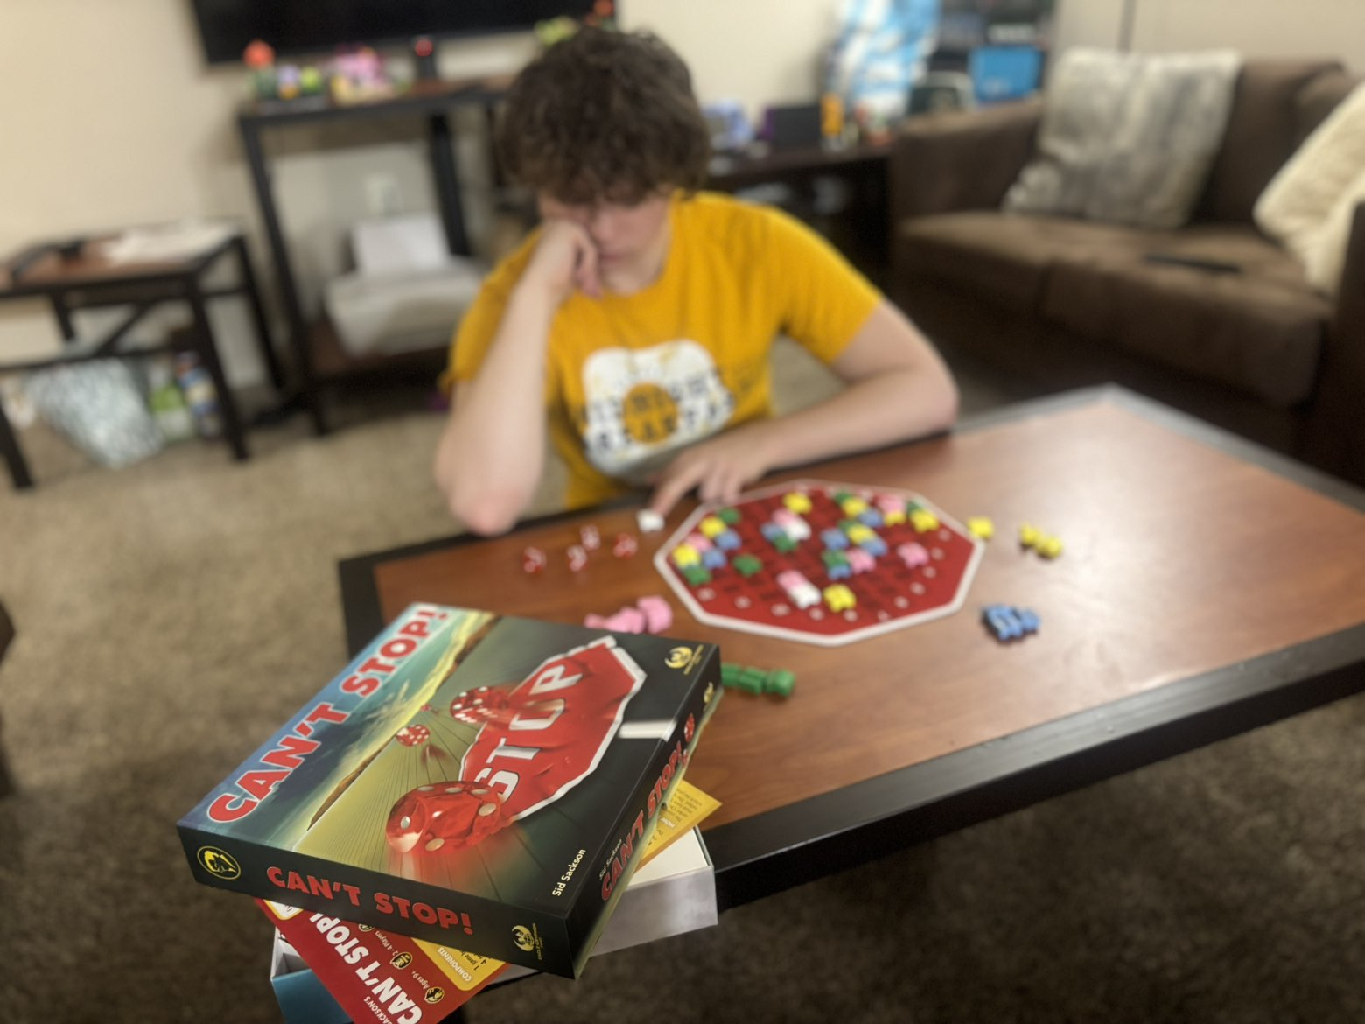
Family Board Game Night
Where it all began…
Notes:
Seeking vengeance on my family

Slide 3
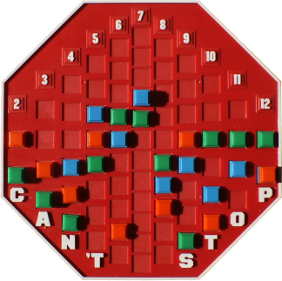
Can’t Stop: The Board Game
Developed by Sid Sackson in 1980
Published by Parker Brothers
2 - 4 players
Jeopardy dice game
Notes:
Dominant decision is whether or not to jeopardize previous gains by rolling dice potential greater gains. Columns start at letters, end at numbers

Slide 4
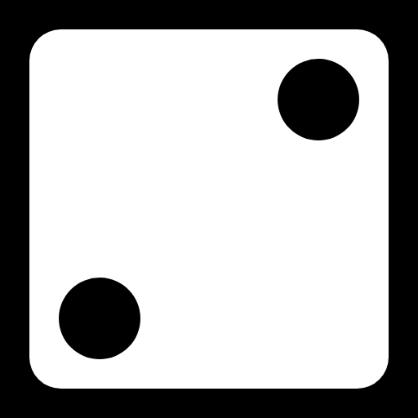
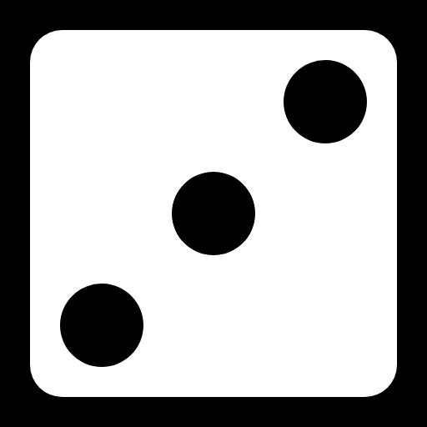


Can’t Stop: The Rules
On a player's turn, they roll all 4 six-sided dice at once
Then form two pairs of numbers
Option 1:
Option 3:
Option 2:
Notes:
Max of 3 unique options

Slide 5
Can’t Stop: The Rules
The sums of these pairs are the column(s) the player must introduce a new runner or move a runner
1:
Place a Runner on both columns 5 and 9
2:
Place Runner on column 7, move one space
3:
Place a Runner on both columns 6 and 8
Notes:
Max 3 runners, 1: 5 & 9 , 2: 7 & 7, 3: 6 & 9

Slide 6
Can’t Stop: The Rules
To keep all progress achieved that turn,
a player stops voluntarily
If a player is forced to stop,
they lose all progress achieved that turn
Win Condition: Get 3 markers to the top of 3 columns

Slide 7
Existing Strategies and Research
Rule of 28 (Keller 1986)
Uses a point scoring system based on the probabilities of hitting each column
Retrograde Approximation Algorithms (Fang, Glenn, & Kruskal 2008)
Solved toy versions
Generalized Heuristic (Glenn & Aloi 2009)
Computer Algorithm; difficult to implement

Slide 8
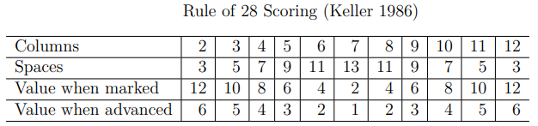
Existing Strategies: Rule of 28

Slide 9
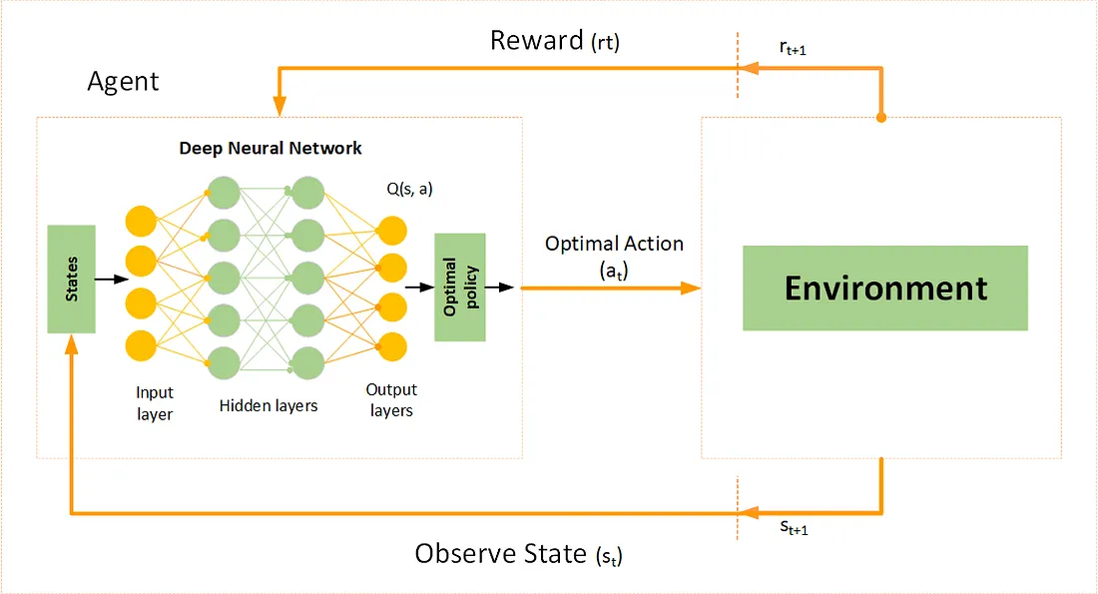
Deep Q-Network

Slide 10
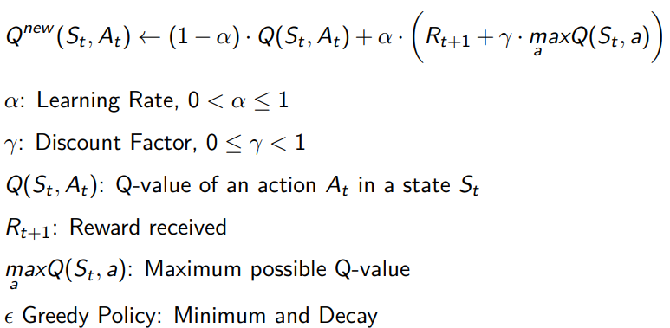
Q-learning
Notes:
Parameter list

Slide 11
Neural Network
51 Features
2 Hidden Layers
64 Neurons Each
20% Dropout
ReLU Activation
Q-Value output
Notes:
Rectified Linear Unit Activation Function – Ramp Function – x if x>0, else 0.

Slide 12
Training Time!
18 Segmented Sessions
7 Possible Opponents

Slide 13
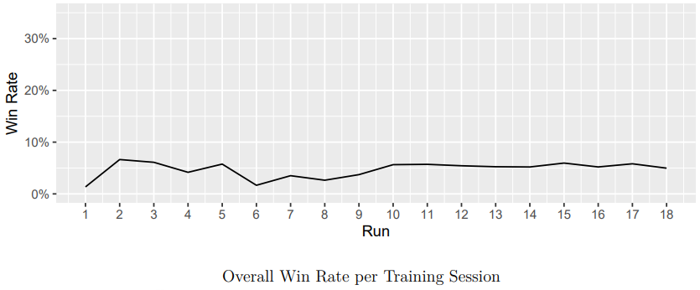
Results

Slide 14
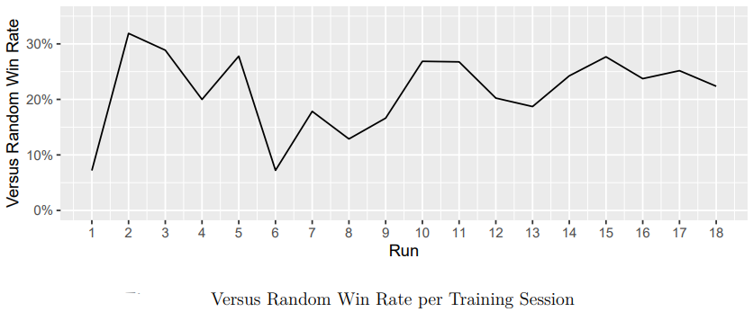
Results

Slide 15
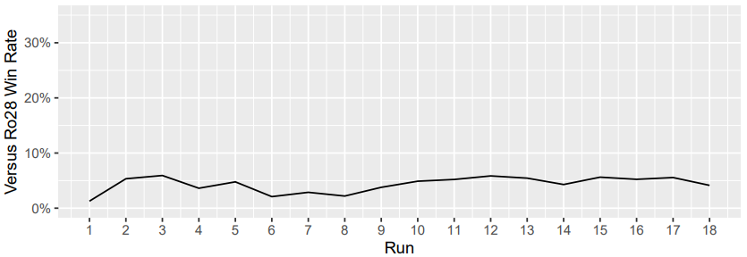
Results

Slide 16
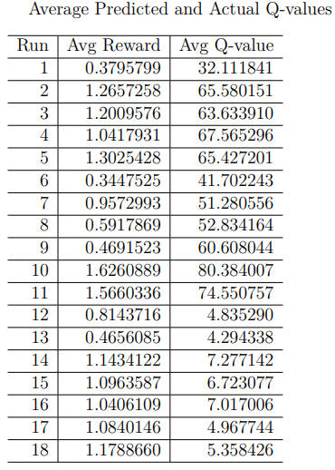
Results
Notes:
Want the 2 values to be almost equal , lowered discount factor at 12

Slide 17
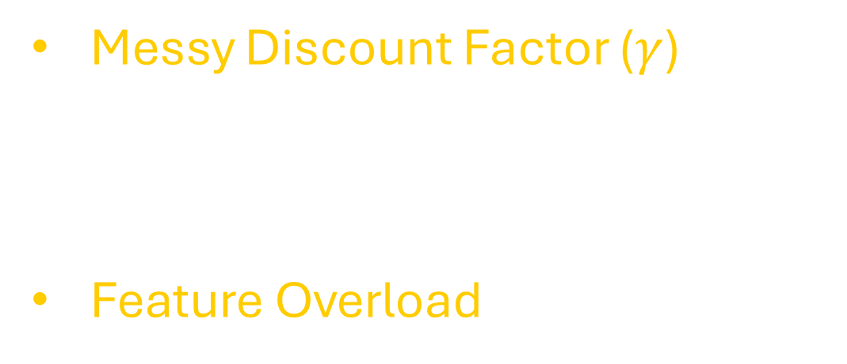
Error Analysis
Messy Discount Factor ($γ$)
Too Many Opponents
Feature Overload

Slide 18
Future Work
Double DQN + Bagging or Boosting
Simple Training Environment
Better Parameterization

Slide 19
The End!
Questions?

