Slide 1

Pokemon: Trading Card Game
Rules and Cards

Slide 2
Contents
Decks
How To Play
Cards Involved
Final Notes

Slide 3
The Essence of
Deck building
Back to TOC

Slide 4
Deck building basics
Each deck will contain exactly 60 total cards, with three card types
Pokémon: These cards do battle for you, and contain different move sets that require different kinds of energy.
Energies: These cards are used to allow Pokémon to use different types of moves and abilities.
Trainer Cards: These cards have special effects which alter the state of play.
Items: Most of these cards will affect the Pokémon at play and on the bench/hand.
Supporters: Most of these cards will alter your current hand and deck in play.
Decks cannot contain more that four of the same Pokémon, but do not have a limit to how many variants of Pokémon exist. Each deck MUST contain at least one Basic Pokémon to play.
To ensure viable combat, be sure to include enough energy, around 15 will do!
For Trainer cards, around 25 would be viable, and there is no limit to duplicate Trainer cards.

Slide 5
How to play
Breaking down the rules of the game
Back to TOC

Slide 6
Game Rules
Each player will have three possible outcomes of winning the game:
Take all of the set Prize Cards.
K.O. all of your opponent’s Pokémon in current play.
If your opponent runs out of cards in their deck at the beginning of their turn.
Breaking down the start of each game:
Flip a coin to decide who goes first in the match.
Shuffle your deck and then draw 7 cards.
If you have a Basic Pokémon in your hand, play it as your Active Pokémon face down on the play area.
Put up to 5 more Basic Pokémon on your benched Pokémon area.
Put the top six cards after hand drawing face down as your Prize Cards.
Both players then flip their Active and Benched Pokémon to start the game!

Slide 7
Game Rules continued: Turns
Each turn has 3 components:
Draw a card to your hand.
Do any of the following in any order:
Put Basic Pokemon Cards from your hand onto your Bench, any amount is allowed (up to 5 max)
Evolve your Pokemon (as many times necessary)
Attach an Energy card from your hand to your Pokemon (only once per turn)
Play Trainer cards (as many necessary, but only one Supporter card can be used per turn.)
Retreat your Active Pokemon (only once per turn(CAREFUL! This costs energy!))
Use Abilities (as many necessary)
Attack. Then end your turn once you attack.

Slide 8
Cards used in this deck
Pokémon, energies, and trainer cards
Back to TOC

Slide 9
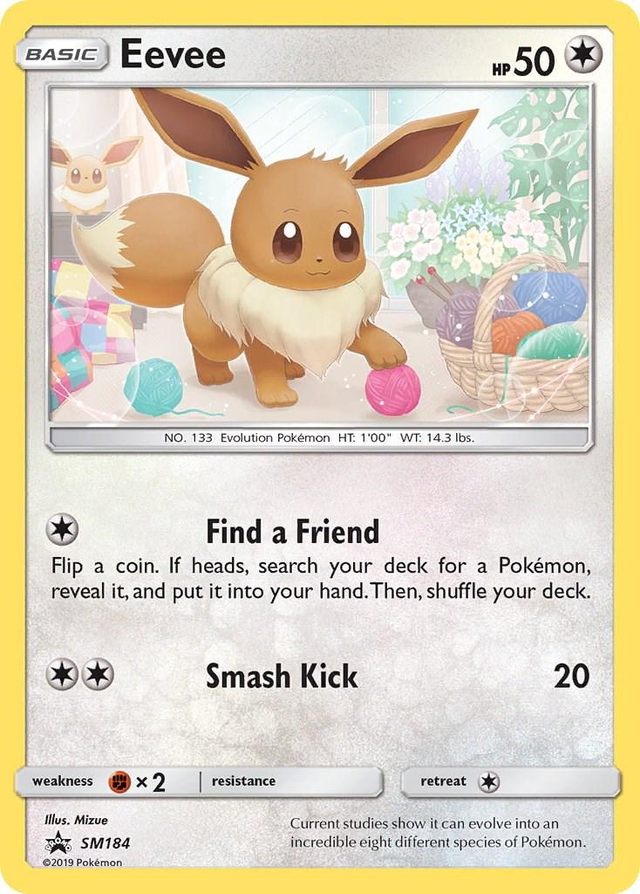
Eevee
Has 50 base health
Find a Friend: Flips a coin, then if heads lets you search your deck for a Pokémon, and you now reveal it and add it to your hand. Once complete, you shuffle your deck. Uses one energy.
Smash Kick: Deals 20 damage. Uses two energy.

Slide 10
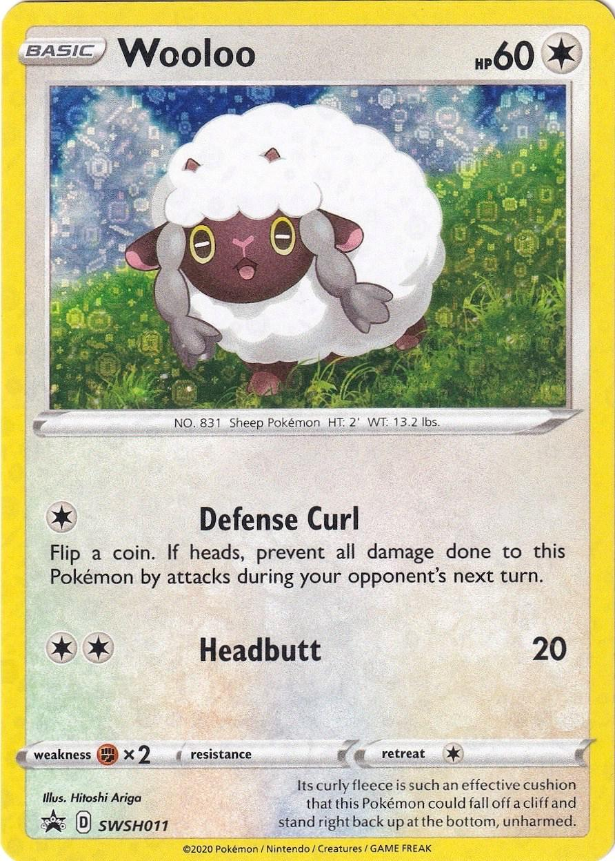
Wooloo
Has 60 base health
Defense Curl: If a coin lands on heads, negates all incoming damage on opponent’s next turn. Uses one Energy.
Headbutt: Deals 20 damage. Uses two Energy.

Slide 11
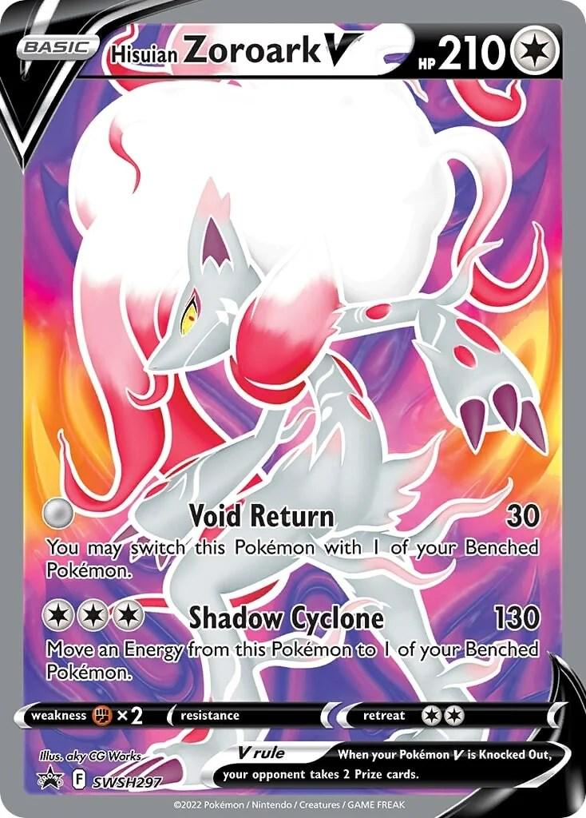
Hisuian zoroark v
Has 210 base health
Void Return: When used, you may switch this Pokémon with one of your current Bench Pokémon. Deals 30 damage. Does not use any Energy.
Shadow Cyclone: Deals 130 damage. Moves one energy from this Pokémon to one of your current Bench Pokémon. Uses three Energy.

Slide 12
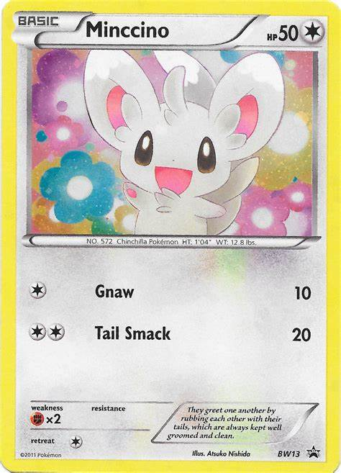
Minccino
Has 50 base health
Gnaw: Deals 10 damage. Uses one Energy.
Tail Smack: Deals 20 damage. Uses two Energy.

Slide 13
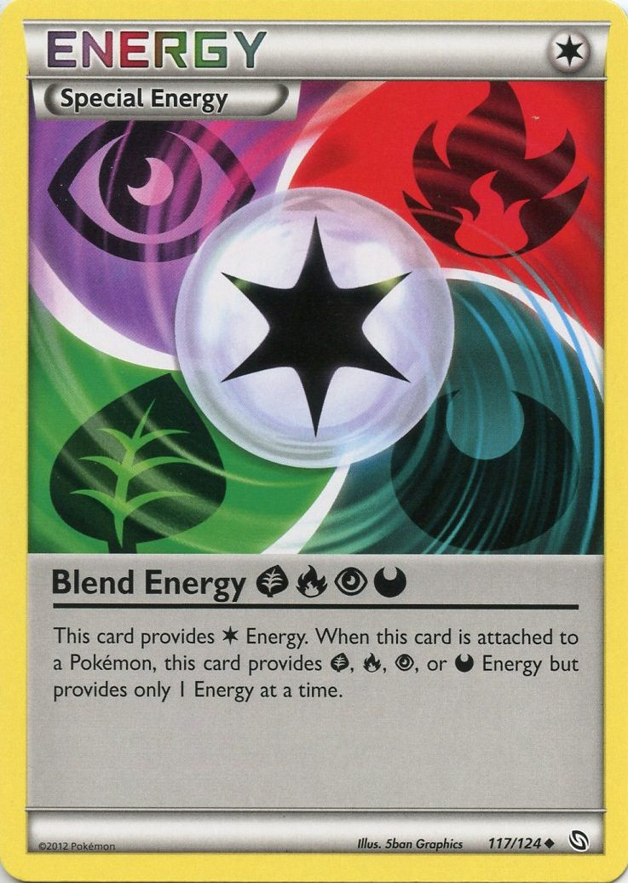
Energies
For the sake of this deck, all Energy is treated as Colorless Energy. Typically, moves require specific types of Energy to work, but these four Pokémon only need Colorless, so any given Energy card will work.

Slide 14
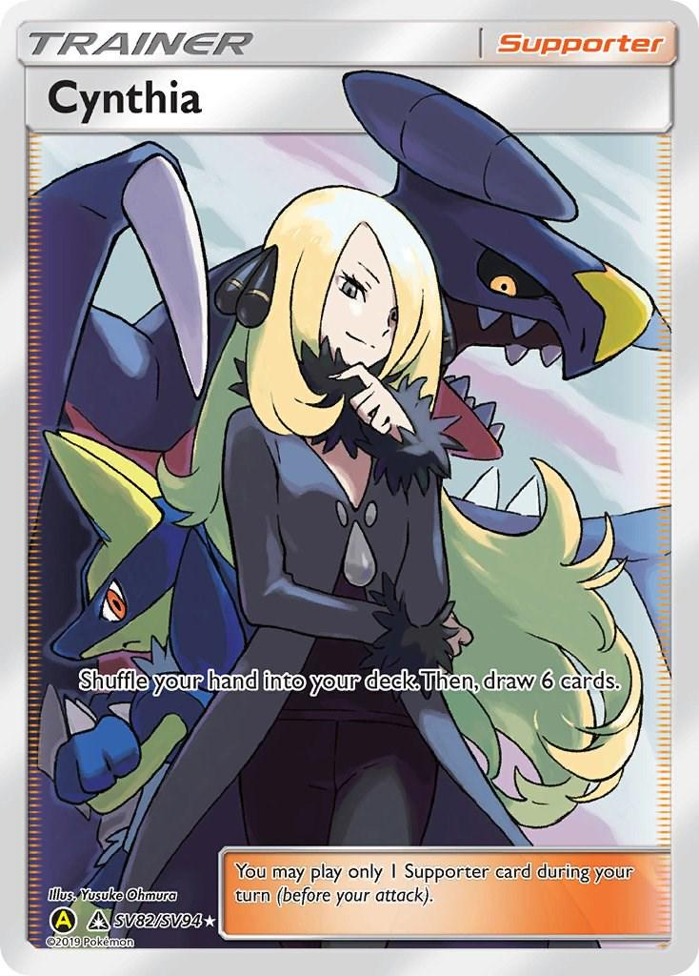
Cynthia
Cynthia’s Ability: Shuffles your hand back into your deck, and then draws 6 new cards.

Slide 15

Professor’s research: Professor Willow
Professor’s Research Ability: Discards your current hand into the discard pile, and then draw 7 new cards.

Slide 16
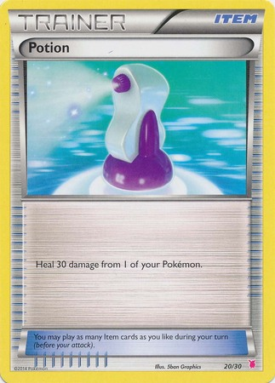
Potion
Potion Ability: Heals 30 damage to one of your current Pokémon (Active or Benched)

Slide 17
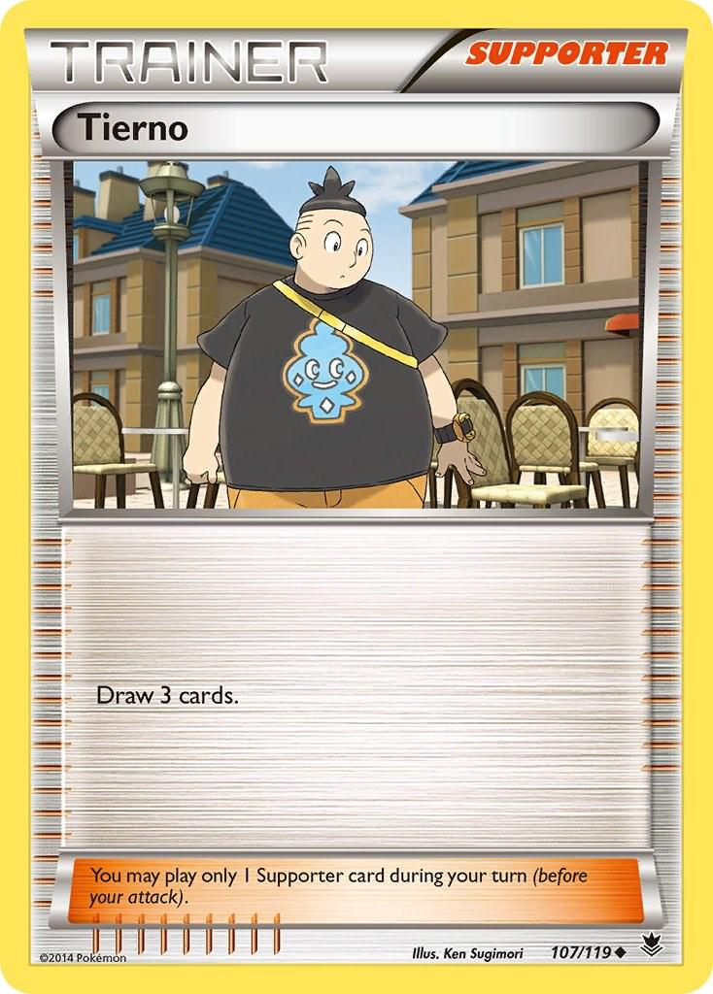
Tierno
Tierno’s Ability: Draw 3 cards into your hand.

Slide 18
Thanks for playing!
Best of luck using these rules and enjoy battling against other Pokémon Trainers to become the Pokémon Champion!
Back to TOC

