Slide 1
Task-Aware Image Decorruption
Input
Can a learned restoration front end preserve the visual information that semantic segmentation needs in adverse driving conditions?
Adverse-condition driving image
Project aim
Improve road-scene segmentation under rain, fog, snow, and nighttime conditions.
Compare raw input, classical enhancement, reconstruction-only restoration, and task-aware restoration.
Optimize not only for a visually clean image, but for downstream segmentation utility.
Decorrupter
Lightweight learned restoration front end
Frozen segmenter
Evaluates whether restoration helps the target task
Primary outcome: held-out semantic segmentation mIoU, supported by PSNR/SSIM and efficiency measures.
Task-Aware Image Decorruption | 1

Slide 2
Experiment configuration
Current saved artifacts are one-epoch smoke tests: they validate the pipeline, not final comparative performance.
Data and corruption
Restoration model
Restoration objective
Dataset: ACDC driving imagery Input size: 256 x 512 Batch size: 1 Synthetic severity range: 0.25-0.80 Random seed: 42
Residual decorrupter Base channels: 24 Residual scale: 0.25 1 epoch; learning rate: 2e-4 AMP + gradient clipping
L1 reconstruction: 1.00 SSIM: 0.25 Smoothness: 0.01 Smoke-test composite loss: 0.1363
Segmentation backbone
Planned evaluation
SegFormer-B0, initialized from Cityscapes-pretrained weights; 19 classes. One-epoch smoke test: training loss 0.3749 and validation mIoU 0.4942.
Hold the segmenter fixed while training restoration variants. Evaluate raw, classical, reconstruction-only, task-aware, and regularized task-aware methods on the same held-out set.
Interpretation guardrail: no task-aware checkpoint or shared-condition comparison is available yet, so improvement claims are premature.
Task-Aware Image Decorruption | 2

Slide 3
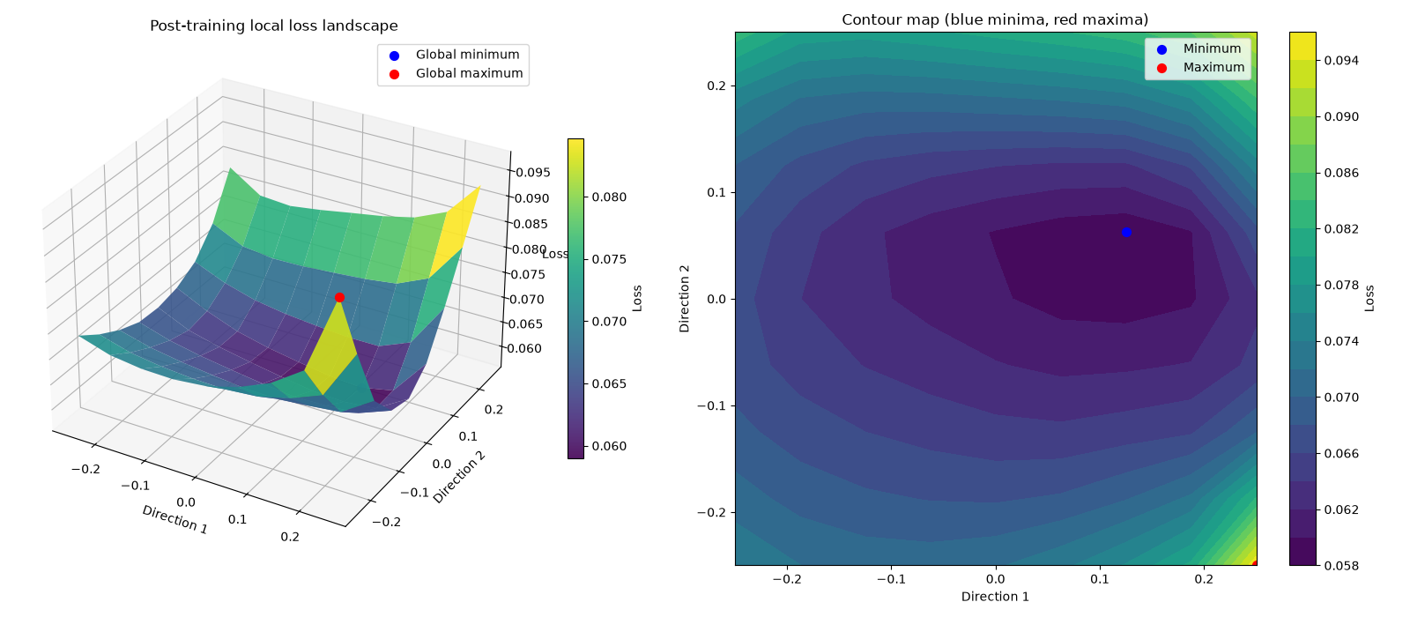
What the local loss landscape shows
Post-training reconstruction-loss slice around the restoration checkpoint
How it is computed
The model is perturbed along two normalized random parameter directions. At each grid point, the reconstruction objective is evaluated on a fixed synthetic batch.
How to read it
Purple/blue regions are lower loss; green/yellow regions are higher loss. The blue marker is the sampled global minimum; the red marker is the sampled global maximum.
What this plot suggests
Observed sampled loss range: approximately 0.058 to 0.096. Directions 1 and 2 are abstract parameter-space directions, not image features or input axes.
The sampled neighborhood contains a broad low-loss basin, with sharper increases toward the edges and one localized high-loss region. This is a local diagnostic, not a proof of global optimality or generalization.
Task-Aware Image Decorruption | 3

Slide 4
Takeaway and next experiment
The infrastructure is working; the scientific comparison is the next milestone.
What has been demonstrated
What is still required
End-to-end segmenter and reconstruction training, checkpointing, and visualization are operational.
The local loss surface provides a repeatable view of optimization behavior around a trained checkpoint.
Recorded reconstruction, activation, and loss-landscape animations are available for qualitative reporting.
Train the reconstruction-only and task-aware variants to convergence.
Run every method on the same held-out adverse-condition images.
Report mIoU overall/by class/by condition, PSNR/SSIM, and runtime tradeoffs.
Decision criterion: task-aware decorruption is successful only if it improves held-out segmentation quality while retaining acceptable visual quality and latency.
Task-Aware Image Decorruption | 4

