Slide 1
IT4793 CAPSTONE · MILESTONE 1 PROGRESS
Telco Customer Churn Prediction
Predicting at-risk customers with machine learning to protect recurring revenue
Joshua Chuhran · Doris Onyeanula · Alex Clark · Salman Baig · Marshall Marlow
Kennesaw State University · College of Computing and Software Engineering · Fall 2026

Slide 2
Project Overview
Customer churn — when a subscriber cancels service — directly erodes recurring telecom revenue. This project builds a predictive analytics pipeline that flags at-risk customers early, so retention teams can intervene before they leave.
7,000+
3
2
customer records
ML models planned
success metrics
Data source: Kaggle Telco Customer Churn dataset (IBM), covering customer demographics, account tenure, and subscribed services.
Analytical Approach
Logistic Regression, Random Forest, XGBoost
Evaluated on F1-Score & PR-AUC
Python: Pandas, NumPy, Scikit-Learn
Jupyter Notebooks + GitHub version control
Telco Customer Churn Prediction | Milestone 1
2

Slide 3
Project Team & Roles
JC
DO
AC
SB
MM
Joshua Chuhran
Doris Onyeanula
Alex Clark
Salman Baig
Marshall Marlow
Team Leader & Project Management
Data Acquisition & Results Visualization
Exploratory Data Analysis & Documentation
Preprocessing & ML Model Tuning
Feature Engineering & Model Evaluation
Advisor: Arindam Khanda · Weekly syncs via Microsoft Teams · 24-hour response expectation
Telco Customer Churn Prediction | Milestone 1
3

Slide 4
Milestone Roadmap
Milestone #1
Milestone #2
Milestone #3
Sep 25, 2026
Oct 20, 2026
Nov 10, 2026
Project Plan · Repo Setup · Preliminary Exploration
Feature Engineering · Baseline Model · Diagnostics
Advanced Tuning · Evaluation (F1 / PR-AUC) · Draft Docs
WE ARE HERE
Telco Customer Churn Prediction | Milestone 1
4

Slide 5
Progress by Work Area
From the project workload tracker & Gantt chart
Project Planning & Governance
100%
Milestone 1 Snapshot
Project Plan
Data Engineering & EDA
17%
Complete
Repo Setup
Complete
Predictive Modeling & Evaluation
0%
Gantt Chart
Complete
Dataset Acquisition
Results Analysis & Final Documentation
0%
In Progress
Data Exploration
Not Started
Telco Customer Churn Prediction | Milestone 1
5

Slide 6
Milestone 1 Deliverables
Complete
Complete
Project Plan
GitHub Repository Setup
Scope, team roles, communication plan, and milestone schedule finalized and published to the repo.
Repository structured with Data, Deliverables, and Project_Planning folders; version control active.
Complete
In Progress
Gantt Chart & Workload Tracker
Preliminary Data Exploration
Task breakdown with owners and weekly hour allocations tracked in the WBS/Gantt document.
Kaggle Telco Churn dataset identified; acquisition and initial cleaning underway.
Telco Customer Churn Prediction | Milestone 1
6

Slide 7
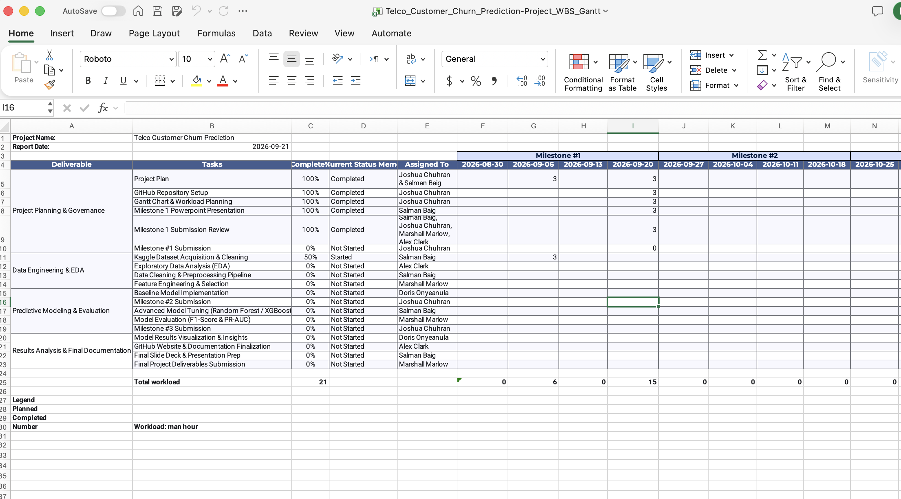
Updated Gantt Chart & Workload Tracker
Project_Planning/01WBS_Gantt.md · Report date: Sep 21, 2026 · Total planned workload: 21 hrs
Two tasks were added since the original plan — Milestone 1 PowerPoint Presentation and Milestone 1 Submission Review — both now marked complete.
Telco Customer Churn Prediction | Milestone 1
7

Slide 8
GitHub Repository
Live project repository, version-controlled and updated weekly
github.com/JChuhran/telco-customer-churn-prediction
KSU
JChuhran / telco-customer-churn-prediction
Public
33 commits · 1 branch · IT4793 Capstone
Data/
Notebooks, cleaning & EDA scripts (in progress)
Deliverables/
Milestone reports & final presentation
Project_Planning/
Project Plan, WBS & Gantt tracker
README.md
Project overview, team, tech stack & links
Latest commit
"Add preliminary WBS & Gantt tracker updates" — Joshua Chuhran, Sep 21, 2026
Telco Customer Churn Prediction | Milestone 1
8

Slide 9
Next Steps Toward Milestone 2
Due October 20, 2026
1
Finish Dataset Acquisition & Cleaning
Salman Baig
2
Exploratory Data Analysis (EDA)
Alex Clark
3
Build Preprocessing Pipeline
Salman Baig
4
Feature Engineering & Selection
Marshall Marlow
5
Implement Baseline Model
Doris Onyeanula
Telco Customer Churn Prediction | Milestone 1
9

