Slide 1
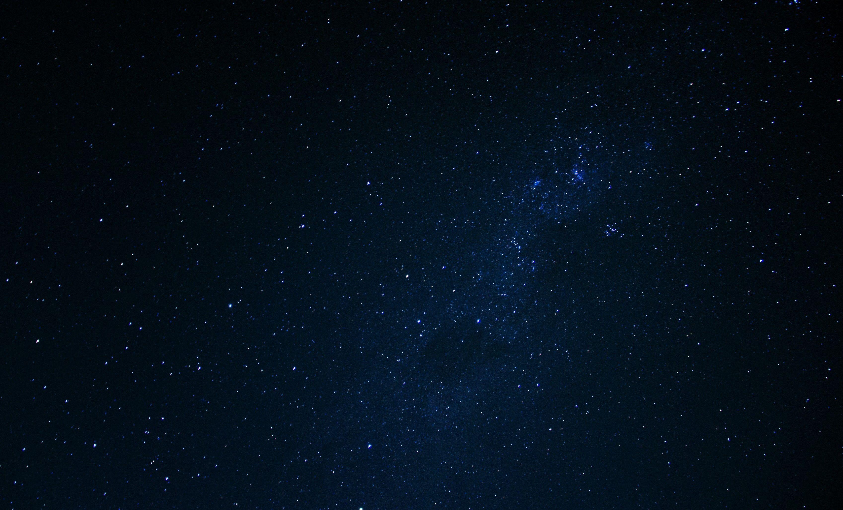
Detecting Gamma-Ray Bursts Originating from Star Explosions
Jaiden Lin
Institute for Computing in Research
August 4, 2023

Slide 2
Why am I here?
Space is vast!
Planet, stars, black holes, galaxies... oh my!
The data informs us.
What if it's automated?

Slide 3
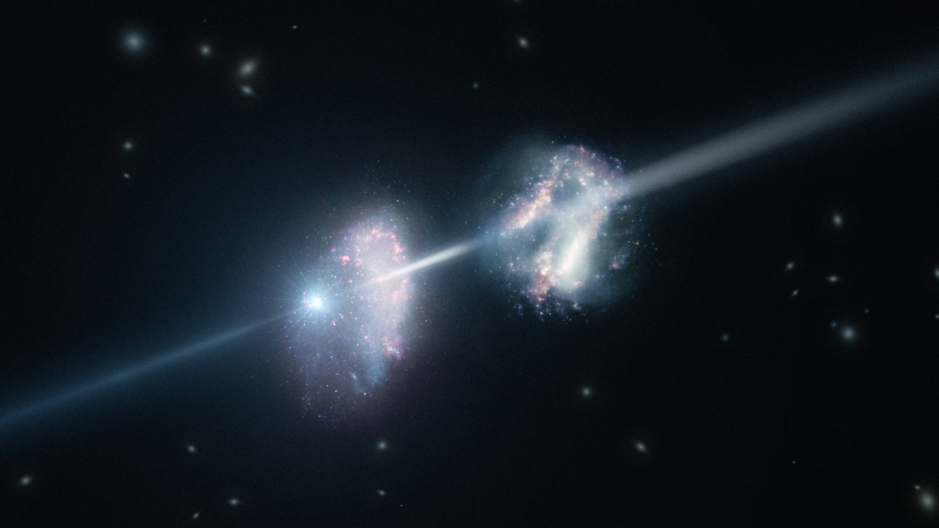
Part I of III
----
Background Information
Credit: ESO/L. Calçada

Slide 4
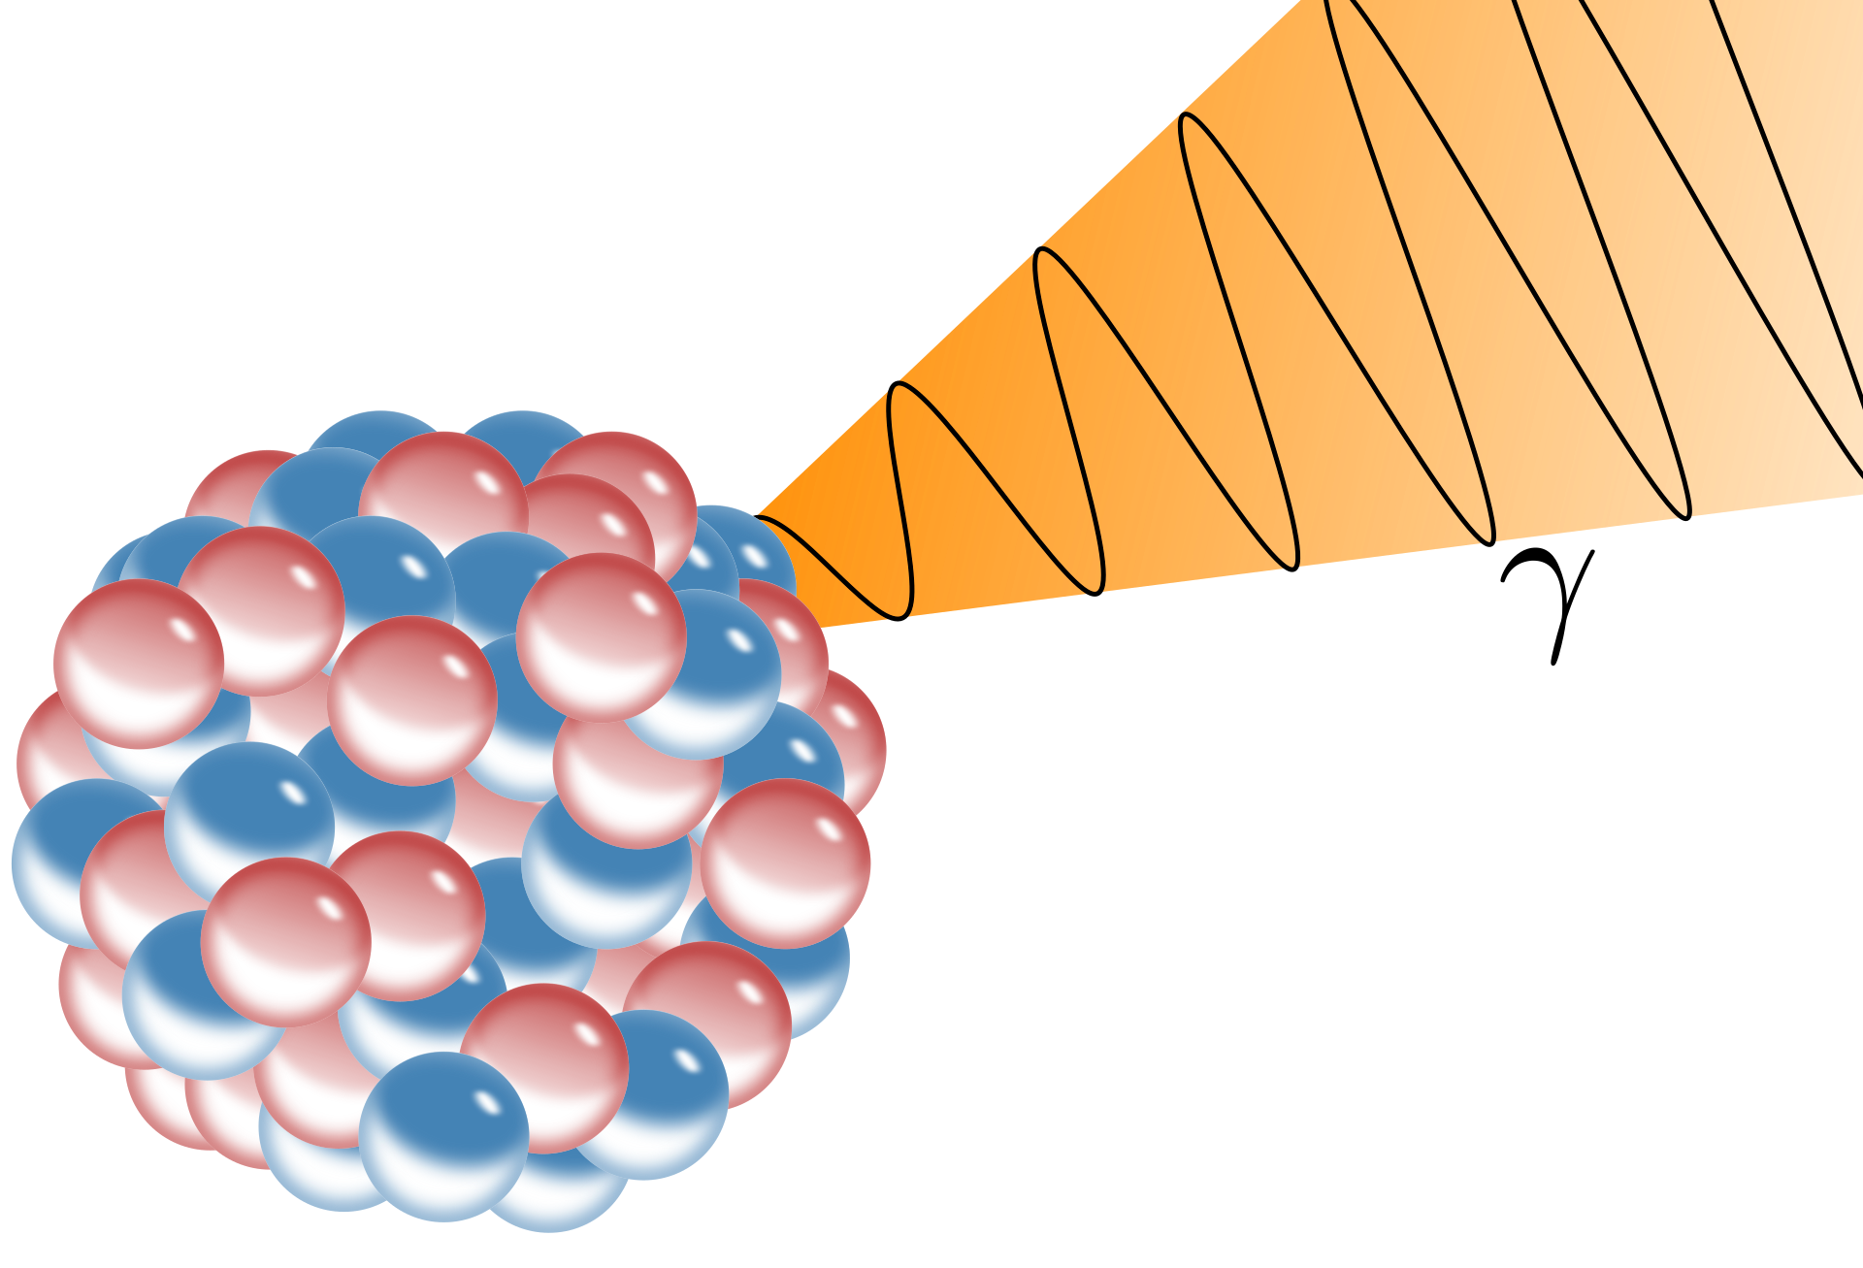

Smallest wavelengths
Highest frequencies
γ
Credit: Universal Pictures

Slide 5

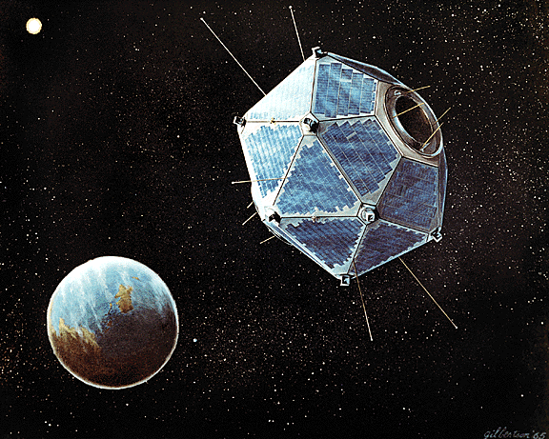
← USSR and US signed the Nuclear Test Ban Treaty (1963)
VELA from Los Alamos monitored gamma-rays →

Slide 6
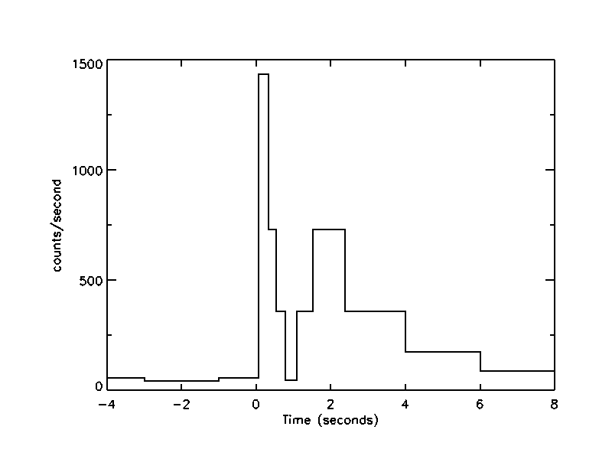
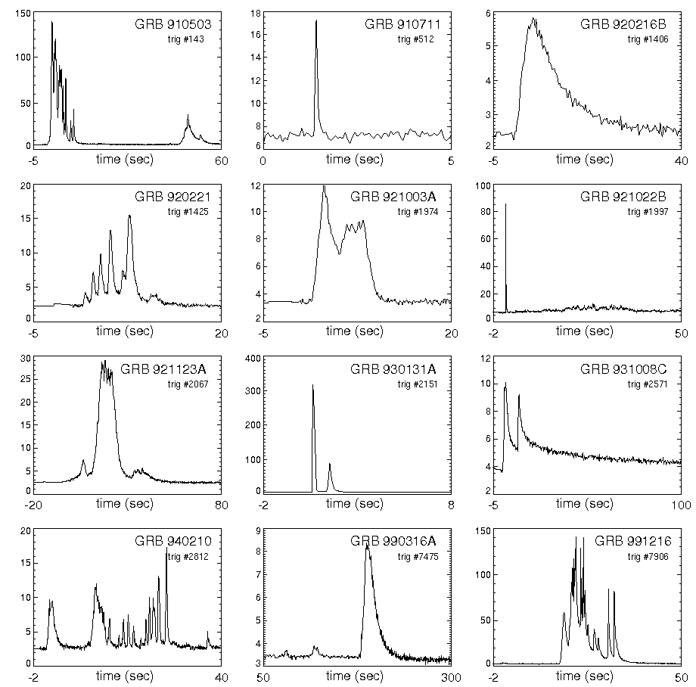
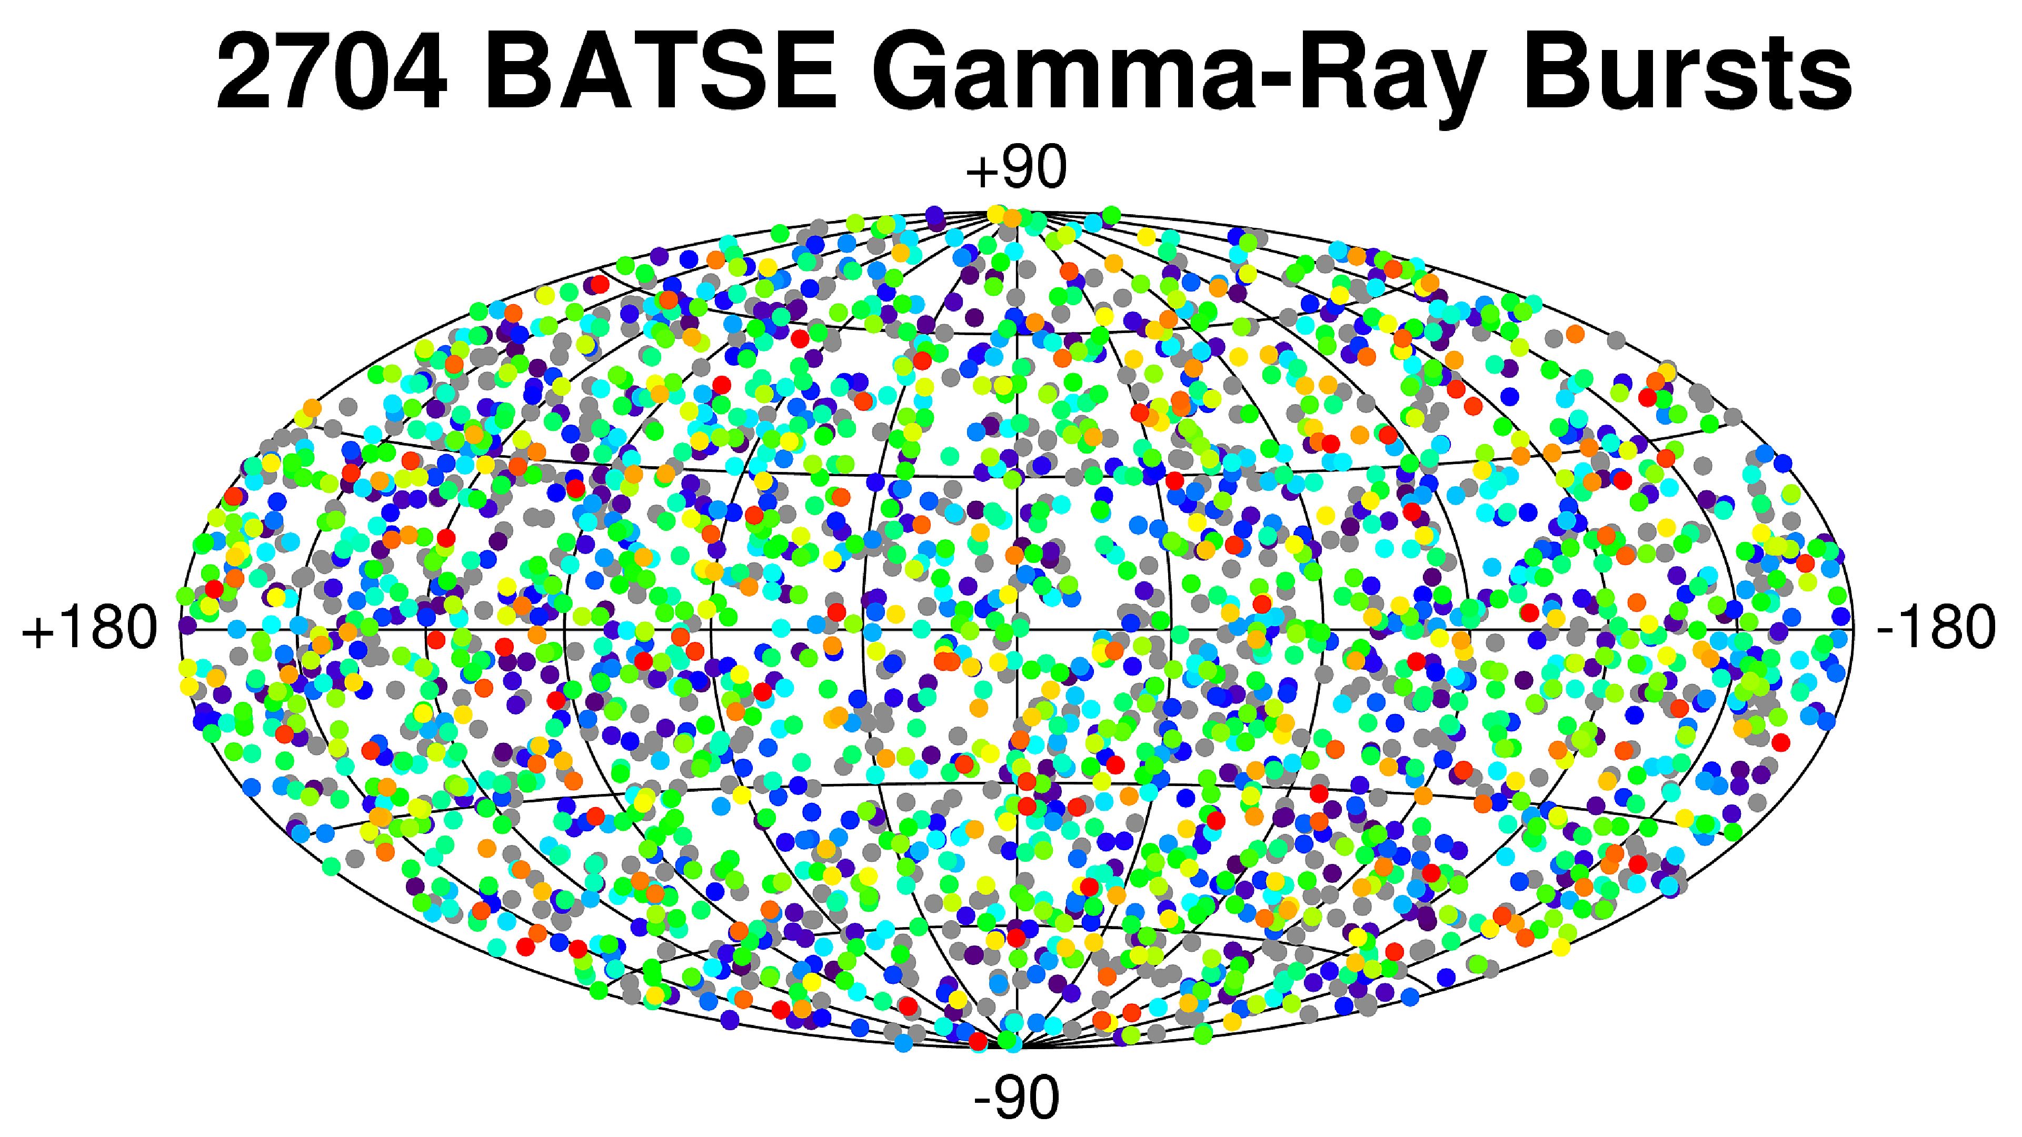
Long?
What is this???
Why so different?
Short?
Why so much?
Credit: Klebesadel, Strong and Olson, 1973
Credit: NASA/BATSE Team

Slide 7
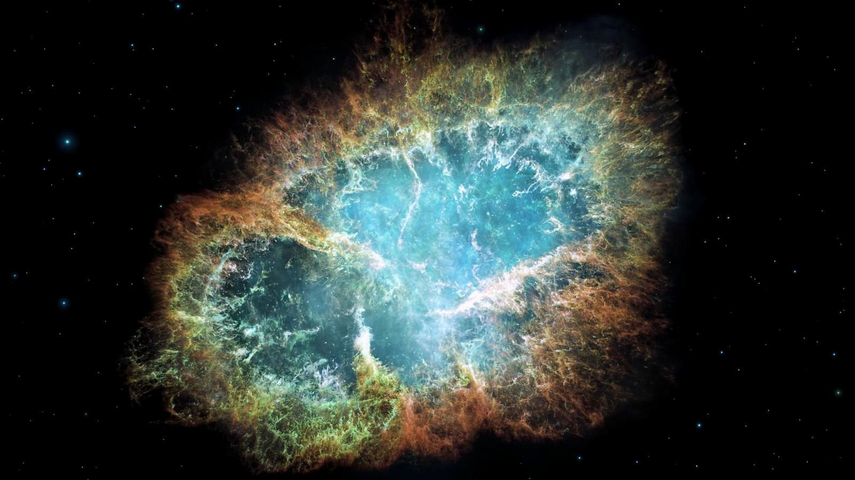
Type II supernova: collapse and explosion (death) of a massive star
Credit: NASA

Slide 8
But wait, there’s more!
Neutron star
or
Black hole
...is based on initial mass.

Slide 9
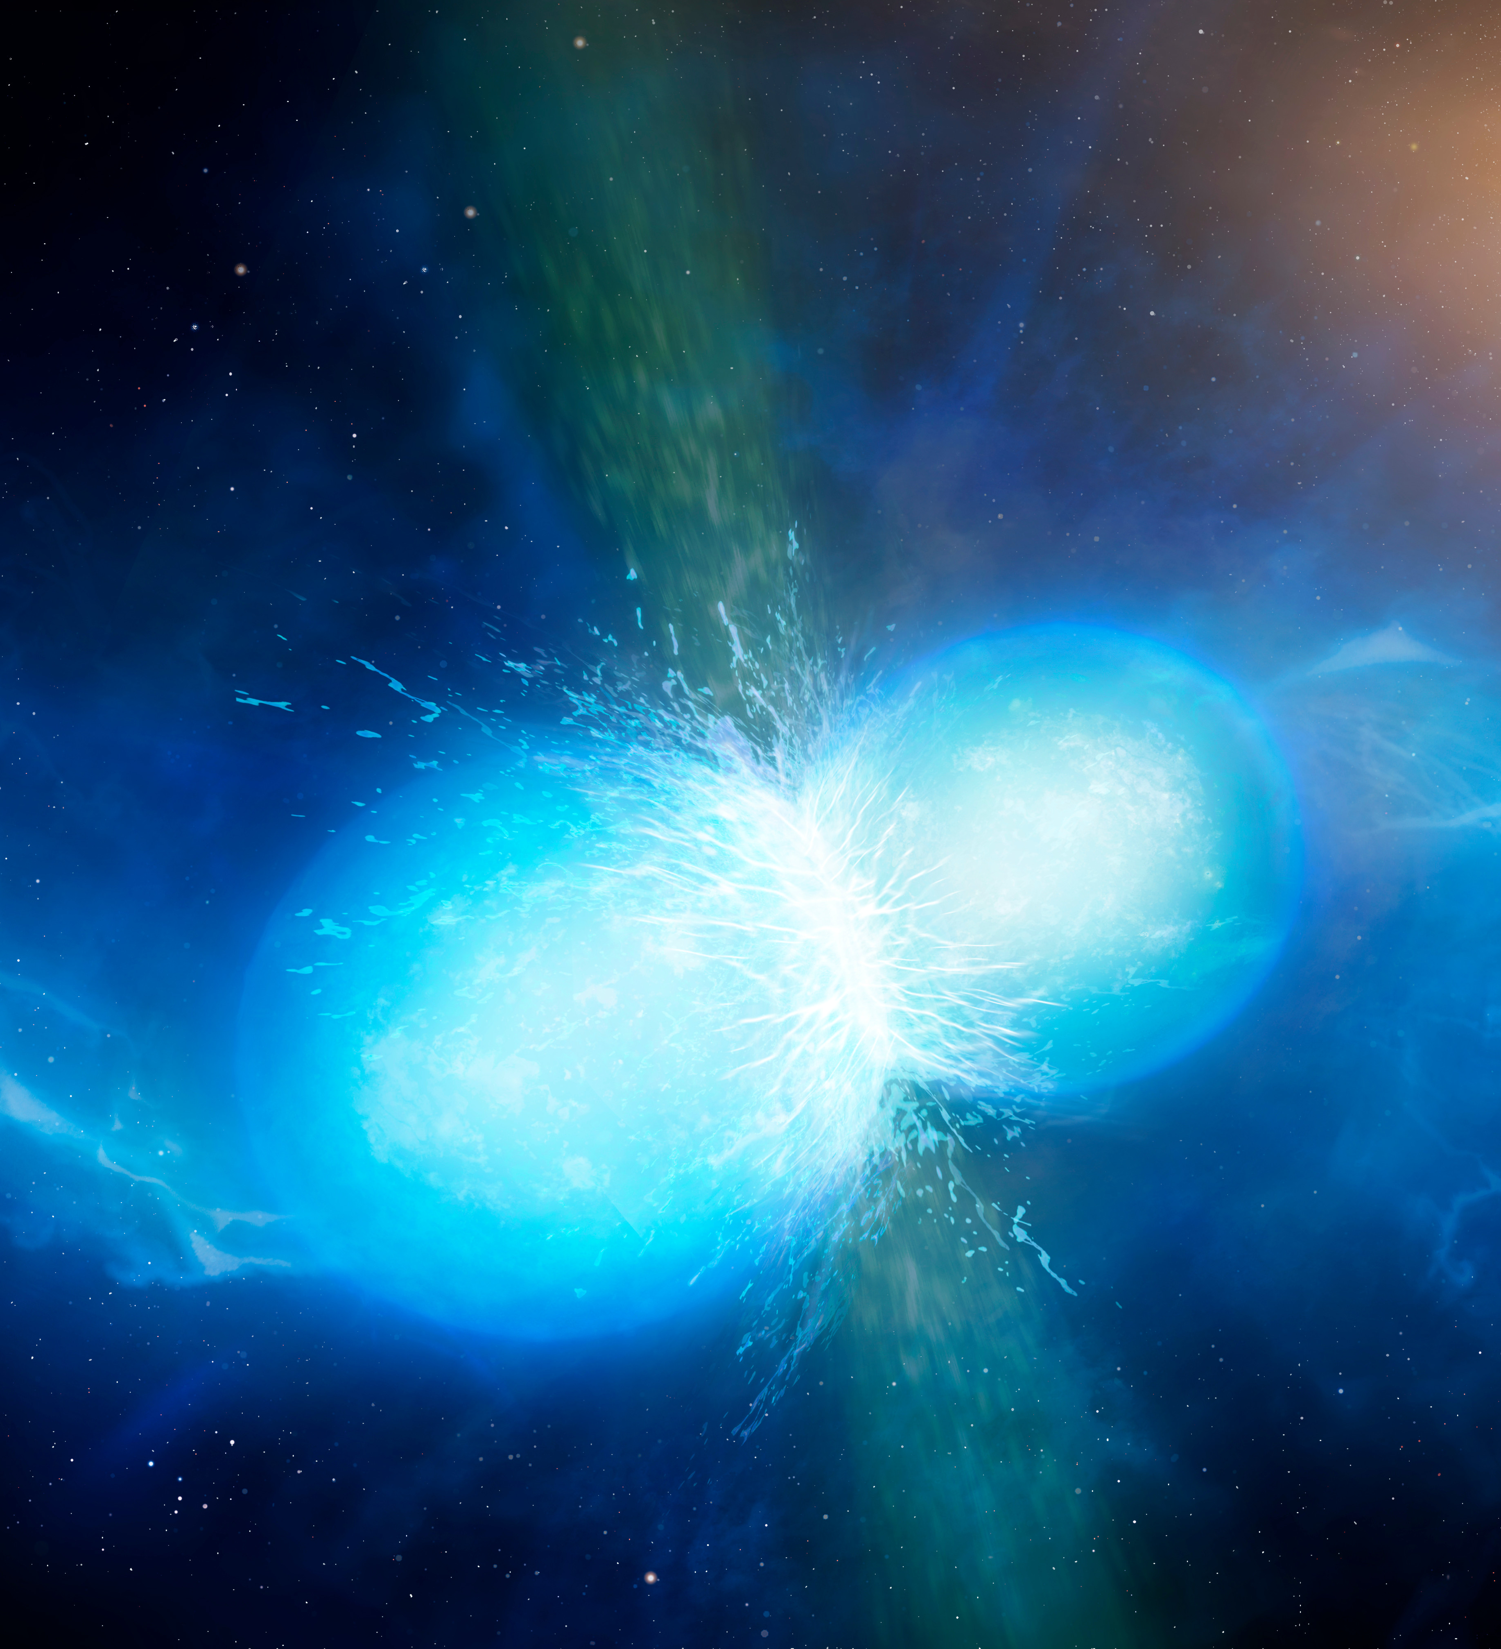
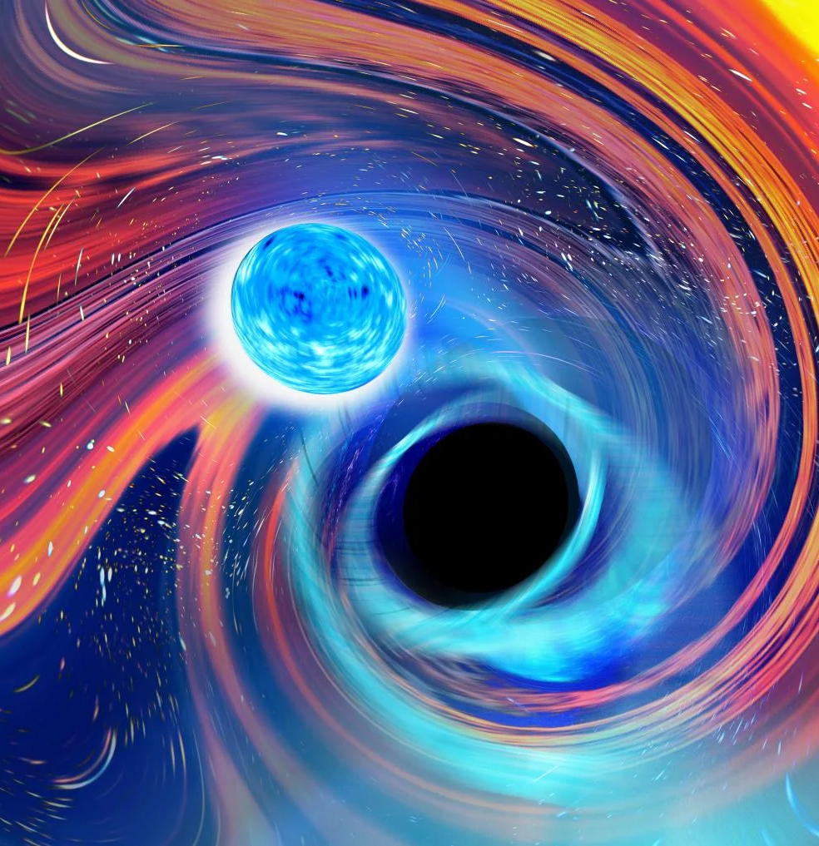
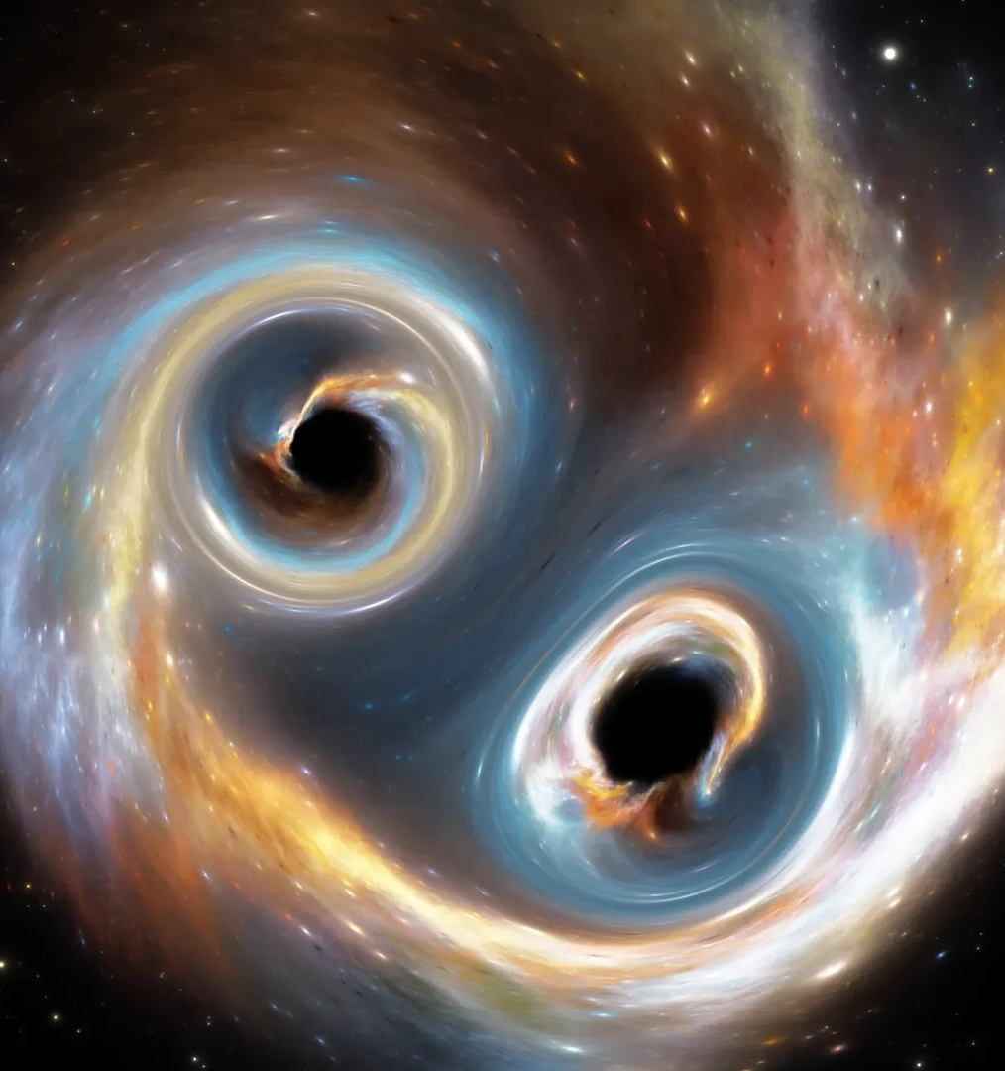
Short GRBs come from “mergers”:
Neutron star-neutron star
Neutron star-black hole
Black hole-black hole
Credit: University of Warwick/Mark Garlick
Credit: Carl Knox
Credit: Jurik Peter/Shutterstock.com

Slide 10
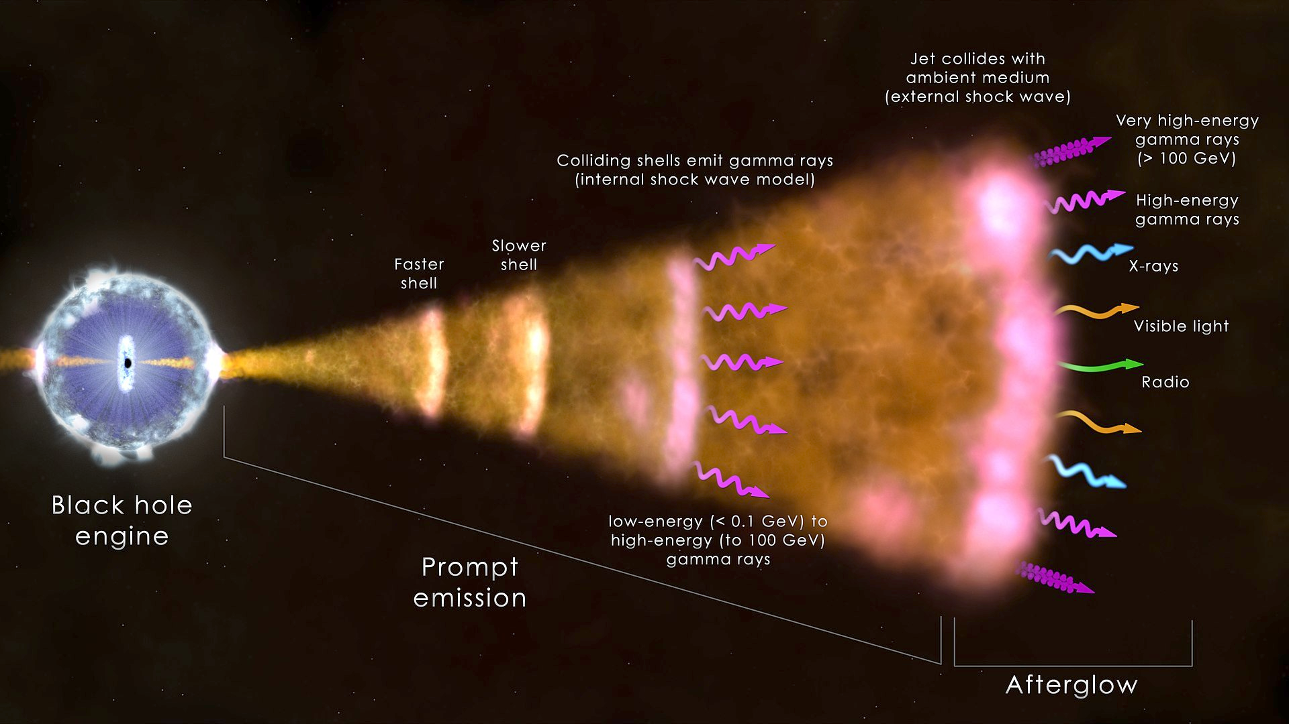
GRBs come from the resulting “energized” black holes, NOT the explosion.

Slide 11
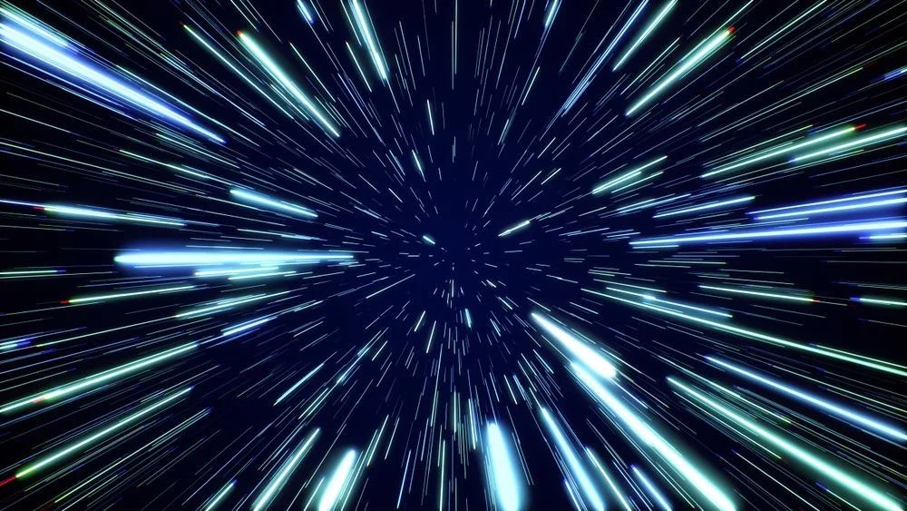
Part II of III
----
Visualizations

Slide 12
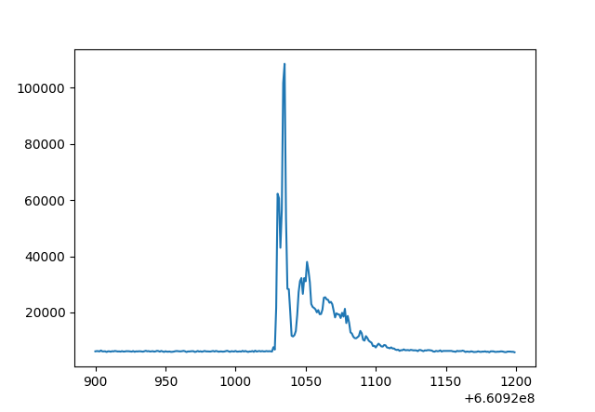
The Time Series
Time series: data set that tracks a sample over time.
# of photons per second
From NASA’s satellite, Swift
Time (seconds)
Start: 660920900
End: 660921200

Slide 13
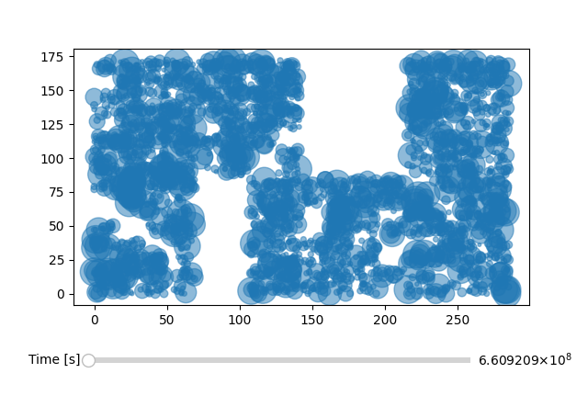
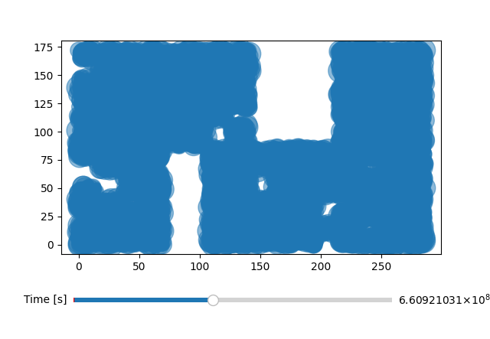
Scatter Plots
DETY
DETY
DETX
DETX
Initial
Estimated Start of Burst

Slide 14
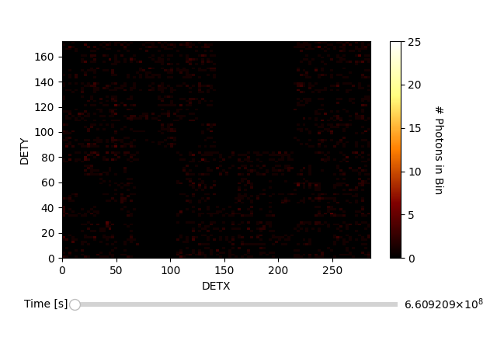
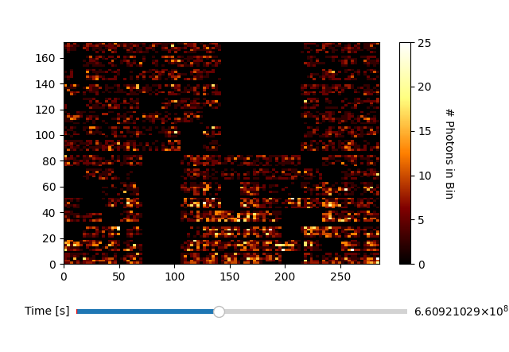
2D Histograms
DETY
DETY
DETX
DETX
Initial
Estimated Start of Burst

Slide 15
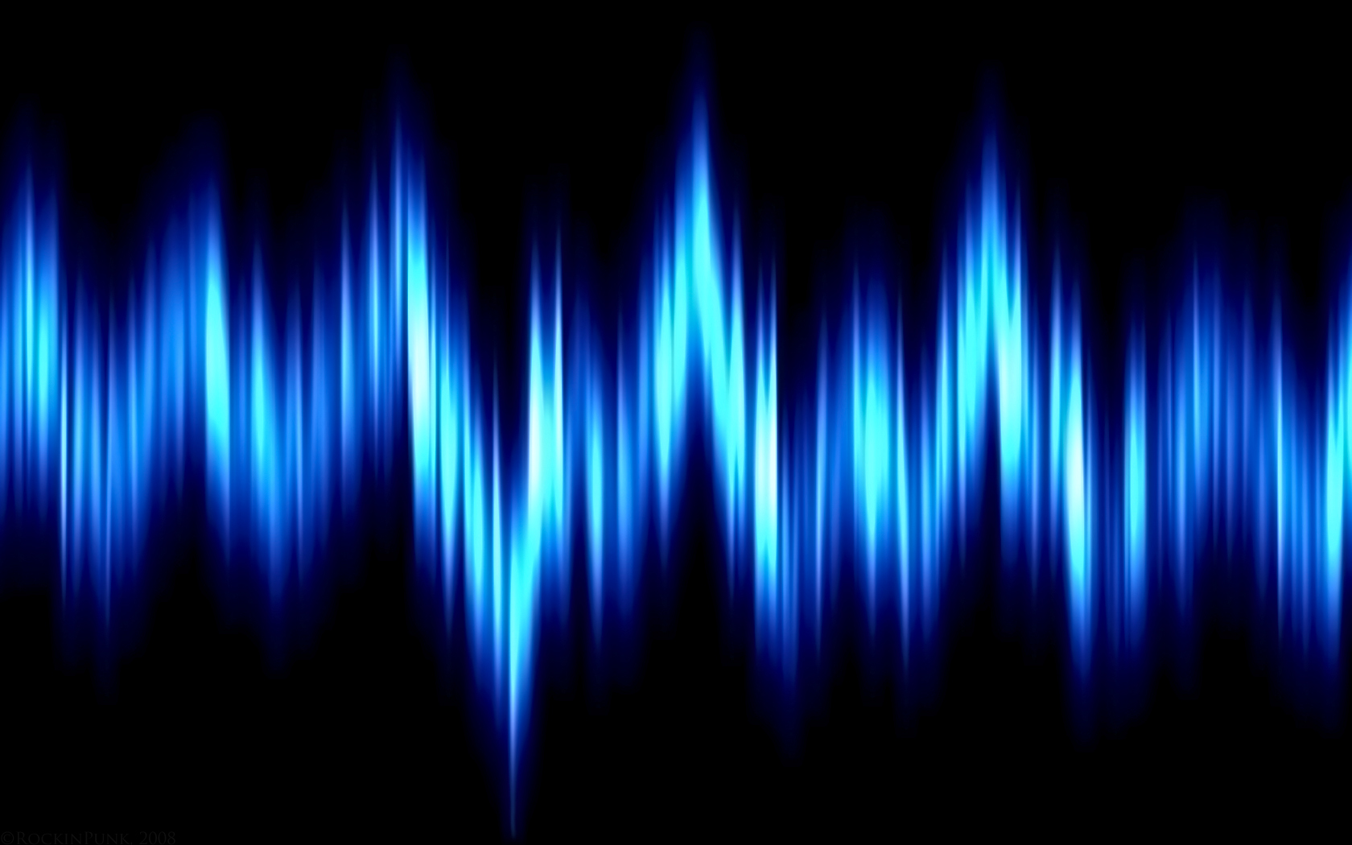
Part III of III
----
Detection Methods

Slide 16
The Time Series (again)
# of photons per second
Time (seconds)
Start: 660920900
End: 660921200

Slide 17
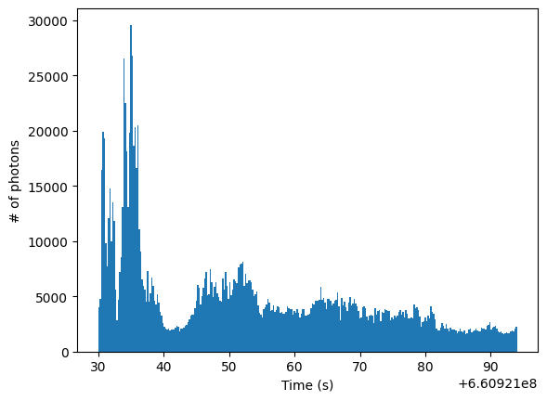
Method 1: Finding Slopes
Results
Start: 660921030
End: 660921094
(time + 1, count2)
(time, count1)
If (count2 – count1) > 2000, the point is considered an anomaly.

Slide 18
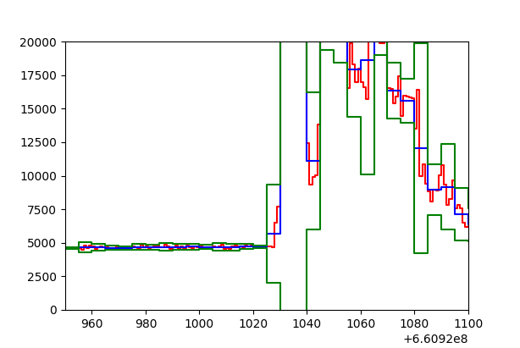
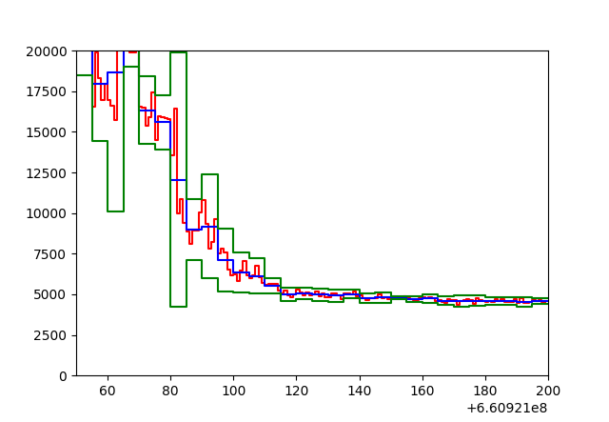
Standard Deviations
# of photons per second
# of photons per second
Time (seconds)
Time (seconds)
Red is the data; blue is the mean of the 5-second intervals; green is the mean +/- three times the standard deviation

Slide 19
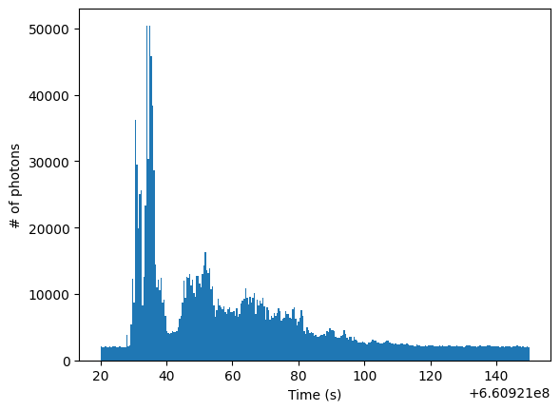
Method 2: Comparing to Previous STD
# of photons per second
Time (seconds)
Results
Start: 660921020
End: 660921150

Slide 20
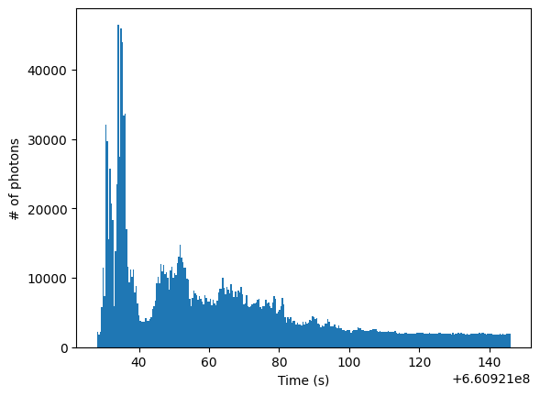
Method 3: Assuming the Background
# of photons per second
Time (seconds)
Results
Start: 660921028
End: 660921113

Slide 21
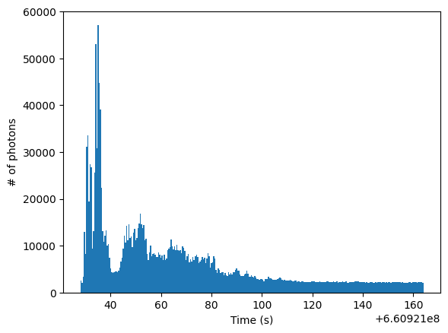
Method 4: Sliding Timeframe
# of photons per second
Time (seconds)
Results
Start: 660921028
End: 660921164

Slide 22
Discussion
Method 1 and 3 both make assumptions
Method 2 finds starting time well, but not ending time
Method 4 finds both starting and ending time, but only applicable to singular long GRBs
Next steps: applying Method 4 to other time series and multiple GRBs

Slide 23
Why do we care?
Easier process of detecting GRBs, long and short
How stars work, live, die
Unique cases: binary and singular star systems, mergers, black holes
More experimentation of cosmological technology helps future

Slide 24
Thank you!
Credit: ESO/L. Calçada

