Slide 1
Object Design
Dr. Adrian Heinz
ITEC 3860

Slide 2
Goals of Object Design
Reuse
Identify off-the-shelf components and design patterns
Service specification
Precisely describe each class interface
Occur concurrently first
Object model restructuring
To improve understandability and extensibility
Object model optimization
To address performance criteria
Occur concurrently later

Slide 3
Reuse

Slide 4
How to achieve reuse?
Use off-the-shelf components/libraries
Use design patterns

Slide 5
Specification Inheritance
Classify objects into taxonomies
Differentiate between common behavior of base class and specific behavior of derived class
All animals make a sound. Dog says “woof”, cat says “meow”
Interfaces/abstract classes provide set of responsibilities, but no implementation details
Abstract methods

Slide 6
Implementation Inheritance
Reduce redundancy, enhance extensibility
Reuse code
Inherit implementation (behavior code)

Slide 7
Liskov Substitution Principle
Should be used in deciding specification inheritance
If an object of type S can be substituted in all the places where an object of type T is expected, then S is a subtype of T.

Slide 8
Classic Example
Square is often considered a specification of rectangle
But should square inherit from rectangle?
LSP:
If Square inherits from Rectangle
Any code that uses Rectangle object, should be able to use a Square object
Rectangle should allow both length and width to be set independently
However, Square should only allow one attribute to be set, as length and width should be the same

Slide 9
Delegation
Promotes reuse by “delegating” responsibilities to another class
Sends a message to another class to implement
Allows reuse without inheritance
Example:
A Window class could inherit the rectangular properties of a Rectangle class
Or maintain a pointer to Rectangle class and calls to rectangle-like methods would be delegated to Rectangle class
Advantage:
Implementation inheritance results in tight coupling between superclass and subclasses
Delegation can be changed at run time
Disadvantage:
No language built-in support like inheritance
Selection criteria:
If a class already inherits one class, but needs functionality of another class in addition, delegation could be useful

Slide 10
Design Patterns
Template solutions for recurring problems

Slide 11
Adapter Design Pattern
An adapter between two incompatible interfaces
Use when client expects interface of type x, but is provided with interface of type y

Slide 12
Adapter Design Pattern
Example:
A card reader that allows different types of memory and SD cards to be connected to the laptop
Uses both inheritance and delegation
Quite common
Useful when there is a new vendor, new technology or new implementation

Slide 13
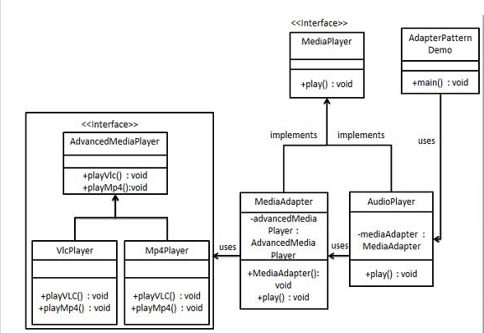
Adapter Design Pattern
http://www.tutorialspoint.com/design_pattern/adapter_pattern.htm
http://www.studytrails.com/java/design-patterns/adapter_pattern/
Notes:
MediaPlayer: Legacy interface
AdvancedMediaPlayer: New interface
MediaAdapter

Slide 14
Bridge Design Pattern
Used to decouple an abstraction from its implementation
Allows both to vary independently
Use if future changes are expected
Useful when there is a new vendor, new technology or new implementation

Slide 15
Bridge Design Pattern
http://www.journaldev.com/1491/bridge-pattern-in-java-example-tutorial

Slide 16
Bridge Design Pattern
http://www.journaldev.com/1491/bridge-pattern-in-java-example-tutorial

Slide 17
Strategy Design Pattern
Behavioral design pattern
Use when there are multiple algorithms for a specific task and implementation is to be decided at run time

Slide 18
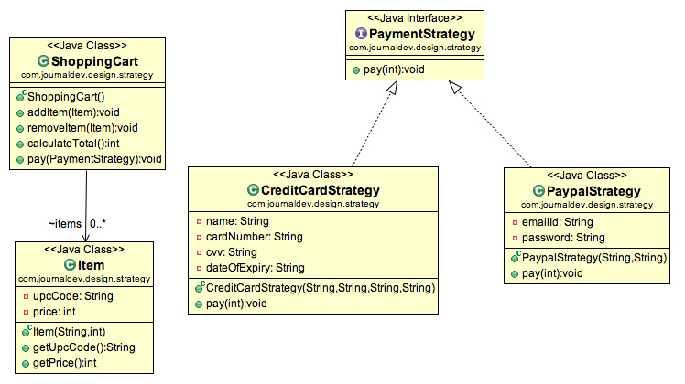
Strategy Design Pattern
http://www.journaldev.com/1754/strategy-design-pattern-in-java-example-tutorial

Slide 19
Abstract Factory Pattern
Provides an interface for creating families of related objects without specifying their concrete classes
Allows to support multiple platforms
Factory objects create objects, clients do not
Use if platform independence is desired

Slide 20
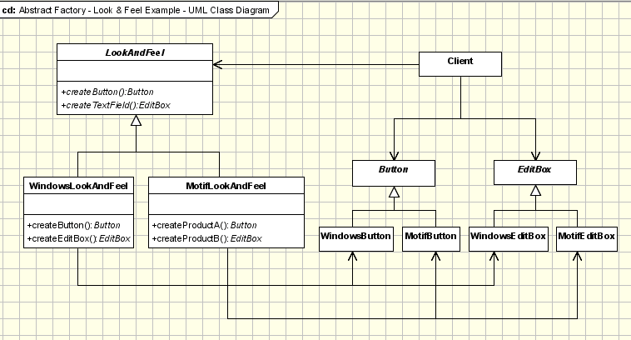
Abstract Factory Design Pattern
http://www.oodesign.com/abstract-factory-pattern.html
https://dzone.com/articles/design-patterns-abstract-factory

Slide 21
Composite Design Pattern
Allows individual objects and collection of objects to be treated uniformly
Use when you want client code to treat them the same

Slide 22
Composite Design Pattern
https://dzone.com/articles/composite-design-pattern-java-0

Slide 23
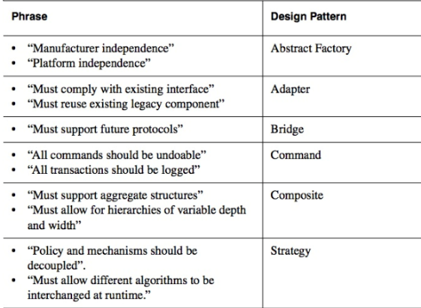
Selecting Design Patterns

Slide 24
References
http://www.jguru.com/faq/view.jsp?EID=27916
https://www.cs.unc.edu/~dewan/comp401/current/Class%20Notes/22_Delegation_Notes.pdf

