Slide 1
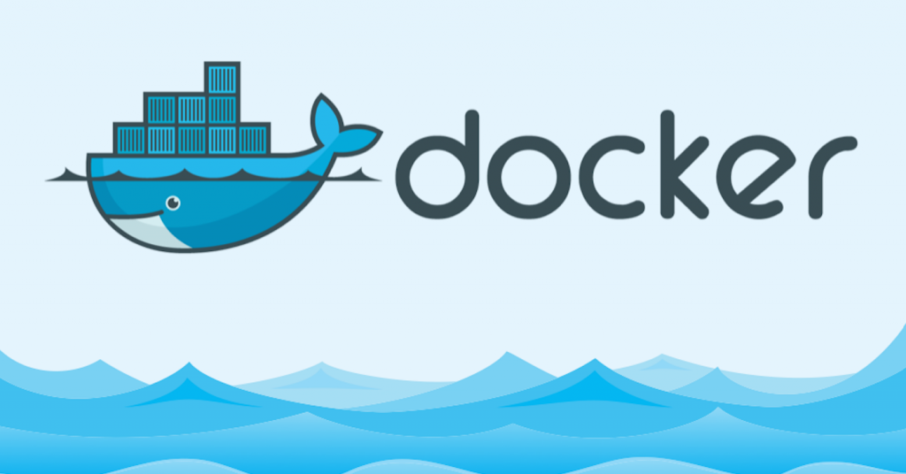
Project

Slide 2
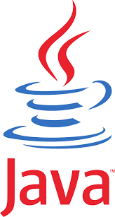
Tools with Java dependencies
Nexus, TomCat, Jenkins, UrbanCode-Deploy
Decided it would be useful to make a java image which could be continually built on top off rather than install java for each tool

Slide 3

Issues
Had a few difficulties getting it to stay open even after it was daemonised
Solutions
Found tail –F command which writes to a log and continually appends errors as the container runs

Slide 4

Issues
Had a few issues with the ports and automating the custom setup
Solutions
Used printf to input my answers into the setup

Slide 5

Issues
I added unnecessary steps
While attempting to connect to the port it would issue a time out error
Solutions
Simplified the process and removed some unnecessary steps
Improving the office network speed

Slide 6

Issues
Configuring the network to allow access
mySQL
Keeping the service running
Solutions
Changed the timezone to UTC
Added a port number to the zabbix.conf file

Slide 7

Issues
Can’t login as a user
Solutions
There is a workaround with inserting the host ip-address into a config file but this didn’t seem appropriate to the principles of docker

Slide 8

Issues
Plenty
Solutions
None

Slide 9
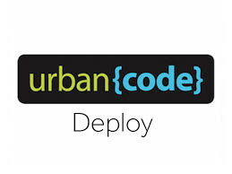
Issues
Barely got started
IBM restrictions
Solutions
Made a IBM account to get download file
There are no solutions!

Slide 10
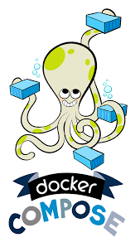
Issues
Had a few issues with my java base image
Solutions
Changed the name of the java image in the dockerfiles which used it

Slide 11
Summary
Jenkins, Jira, Nexus, Zabbix and TomCat were all fairly straightforward to configure
Postfix and UrbanCode need to be boxed and hidden somewhere
Now understand the basics of docker!

