Slide 1
COLL 400 Project
Creating models to effectively determine network traffic from popular websites
Matthew Berthoud, Lake Bradford, Justin Cresent, Will Katabian

Slide 2
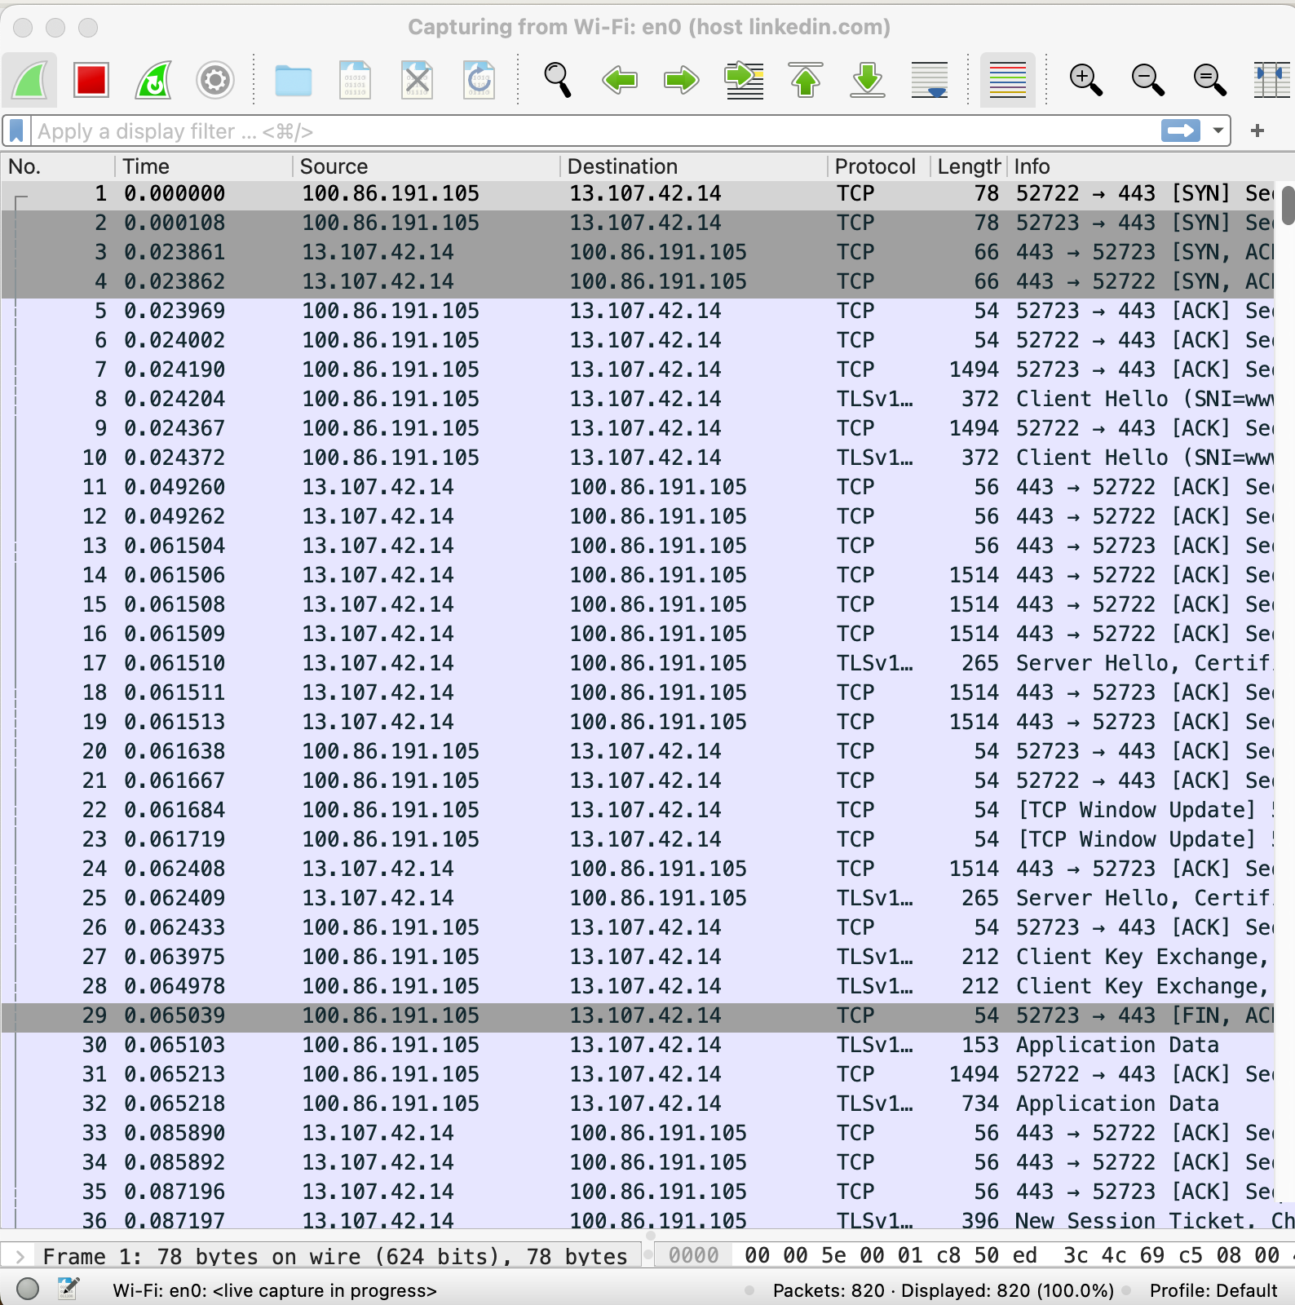
Process & Features
Used Wireshark to capture packet data
Filters for each website: Black Board, ChatGPT, LinkedIn
Chose to use 3 predictors:
Time, Protocol, Length
Added in all CSV data into a pandas dataframe
Remapped protocols to a corresponding numbers
Created column with each website name to be used as target
Created models to train on data and evaluated performance of each
Checked accuracy, recall, and M1 scores to see how well they classified (predicted) our target
4 models: Logistic Regression (baseline), KNN, RF, NN
Notes:
Talk about process of getting our data a little and what we were using as our features. (Time, Size, etc.)

Slide 3
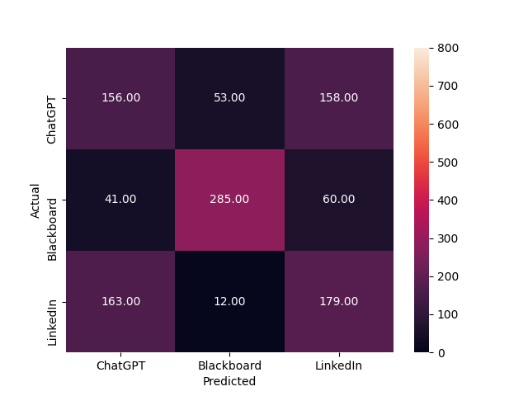
Logistic Regression
process of modeling the probability of a discrete outcome given an input variable
The most common logistic regression models a binary outcome
Not ideal for our purposes, returns an accuracy score of .56
Likely due to our data's multinomial nature
Accuracy = 56%
Notes:
Probably put KNN and RF here

Slide 4
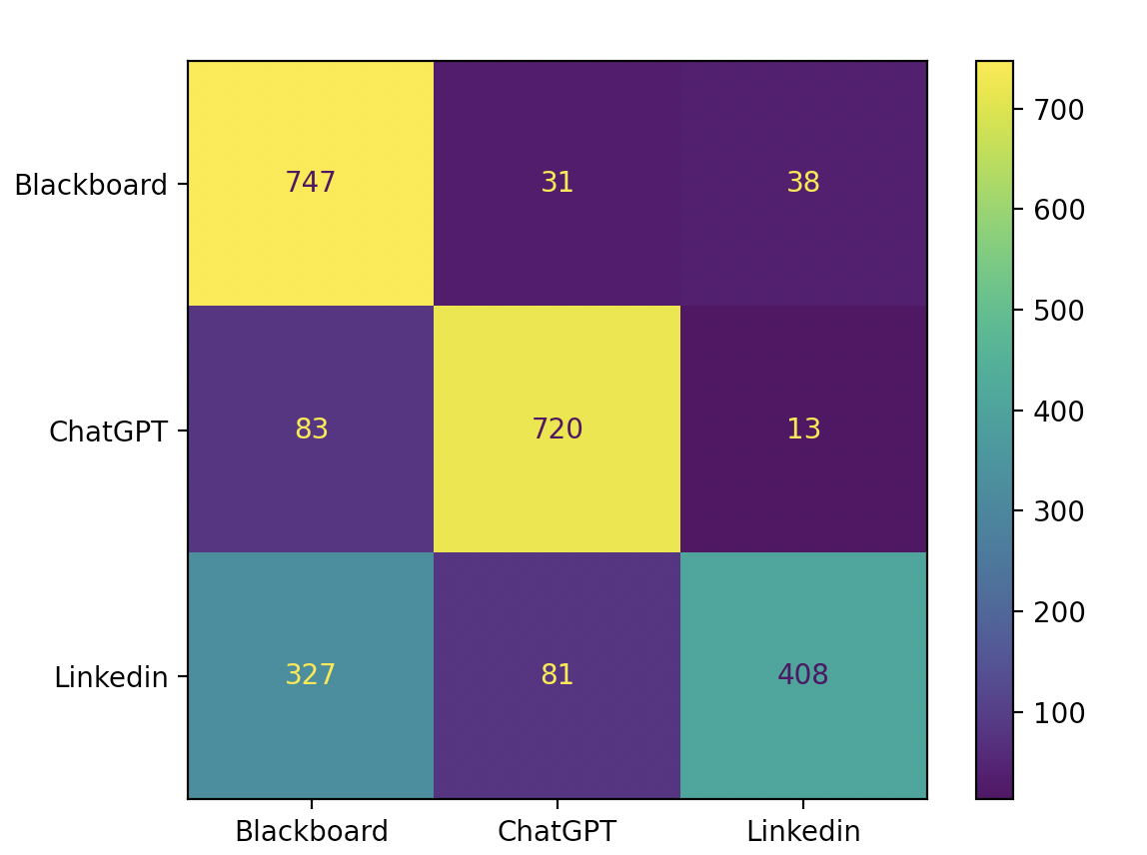
K-Nearest Neighbors
Groups data points (packets) based on how similar each data point is to each other.
Works well With Blackboard and ChatGPT but struggles with differentiating LinkedIn and Blackboard
Accuracy: 77%
Notes:
Probably put Neural network and log reg here

Slide 5
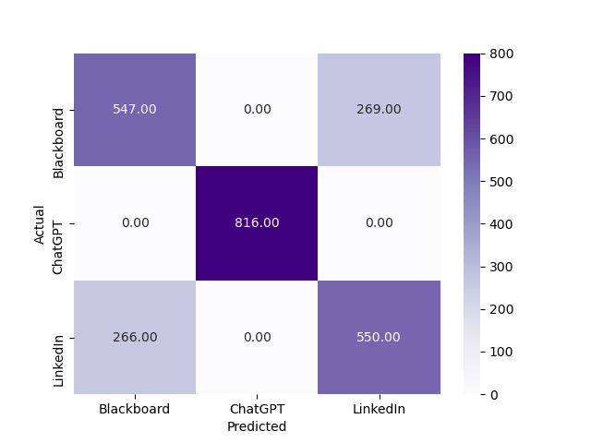
Random Forest
Random Forest
Ensemble Model: utilizes many decision trees to take a majority vote to deduce a classification
Optimized hyperparameters with Grid Search (with Kfold)
Using 500 trees, max depth of 9, and minimum sample split of 5
Works well with ChatGPT but struggles with differentiating Blackboard and LinkedIn
Accuracy = 78%

Slide 6
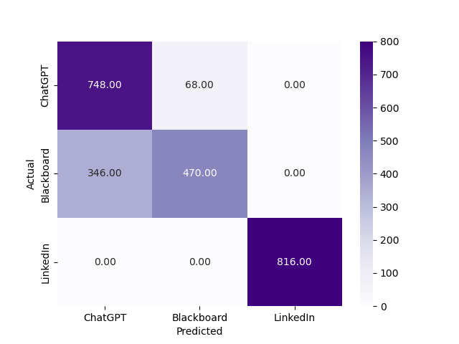
Neural Network
Used larger dataset for train and validation sets, but same test set
relu activation function
lbfgs instead of stochastic gradient descent
One hidden layer with 9 nodes
Before the paper:
More extensive grid searching (hyperparameter tuning)
More data collection?
Input
Layer
Output
Layer
Blackboard
etc…
FULLY
connected
ChatGPT
Accuracy: 80%
LinkedIn

