Slide 1


Sprint 1
Brandon Bejarano, Jacob Carney, Waleed Kambal, Mason Wittkofski, Michal Zajac,

Slide 2
Project Focus
Our project is focused on designing an inventory management system for Guaranty Sheet Metal based in New Orleans, LA.
We're looking to build them a complex web application that they can use to track their current inventory, create and edit incoming and outgoing shipments for jobs and supplies received.
We're also looking into creating a job invoice estimation tool to allow the input of inventory used on a job site to create a cost for the materials of the job.

Slide 3
Sprint Goal
The main goal was to create a simple full-stack application that can persist data such as user login information, but for Sprint 1, these were our main goals:
Allow a user to sign in from the client side
Have a simple working end-to-end application that persists data.
Allow users to browse the current inventory and sort based on different attributes
Get a dashboard setup for analytics purposes
Get database setup on AWS
Get an API setup to work with the frontend and backend

Slide 4
Major Sprint Achievements
Postgres on Docker
Postgres on docker on AWS
Api that allows for transfer of login info from front end and database, both ways
Database Schema was made
Setup react project structure, and made a basic UI
Implemented login page and authentication mechanism
Integrated the web app to the rest API

Slide 5
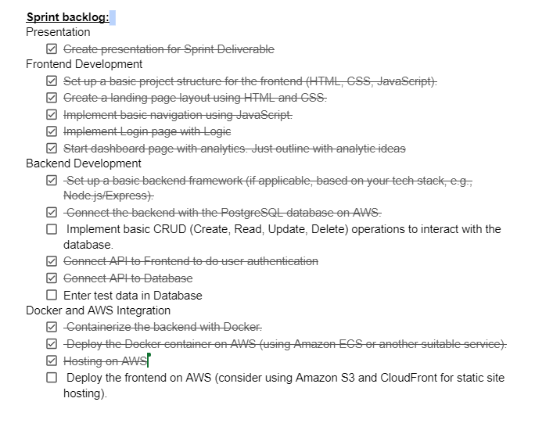
Sprint 1 Backlog

Slide 6
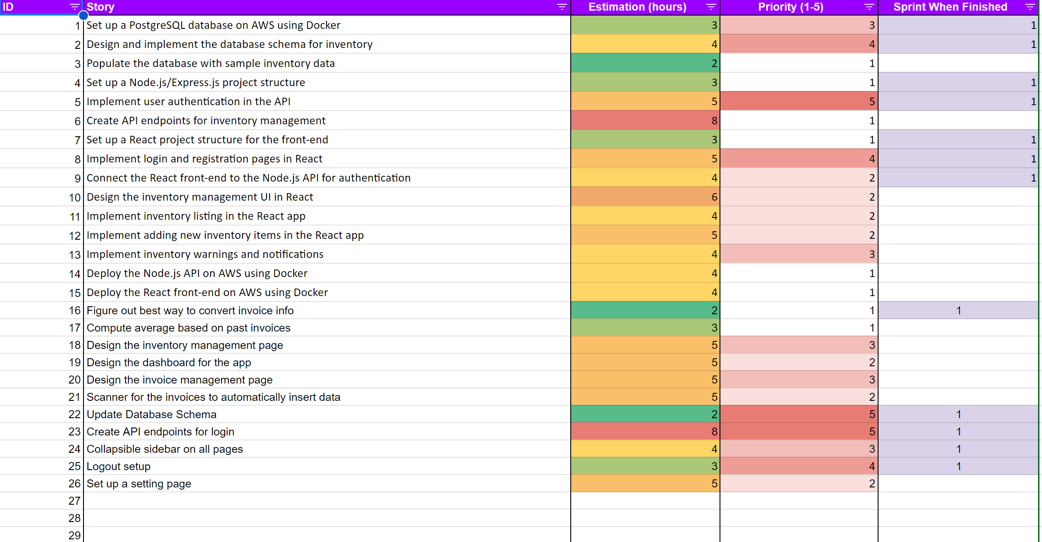
Project Backlog

Slide 7
What we didn't complete/ lessons learned
We were not able to implement and endpoint on the web application that would allow the users to view the current inventory and sort it based on different attributes
Additionally, we were not able to include the analytics on the dashboard because there will be a lot of calculations involved.
Uploading an API and front end to docker, is not a fun task.

Slide 8
