Slide 1
Exploratory Analysis Report

Slide 2
Univariate Analysis

Slide 3
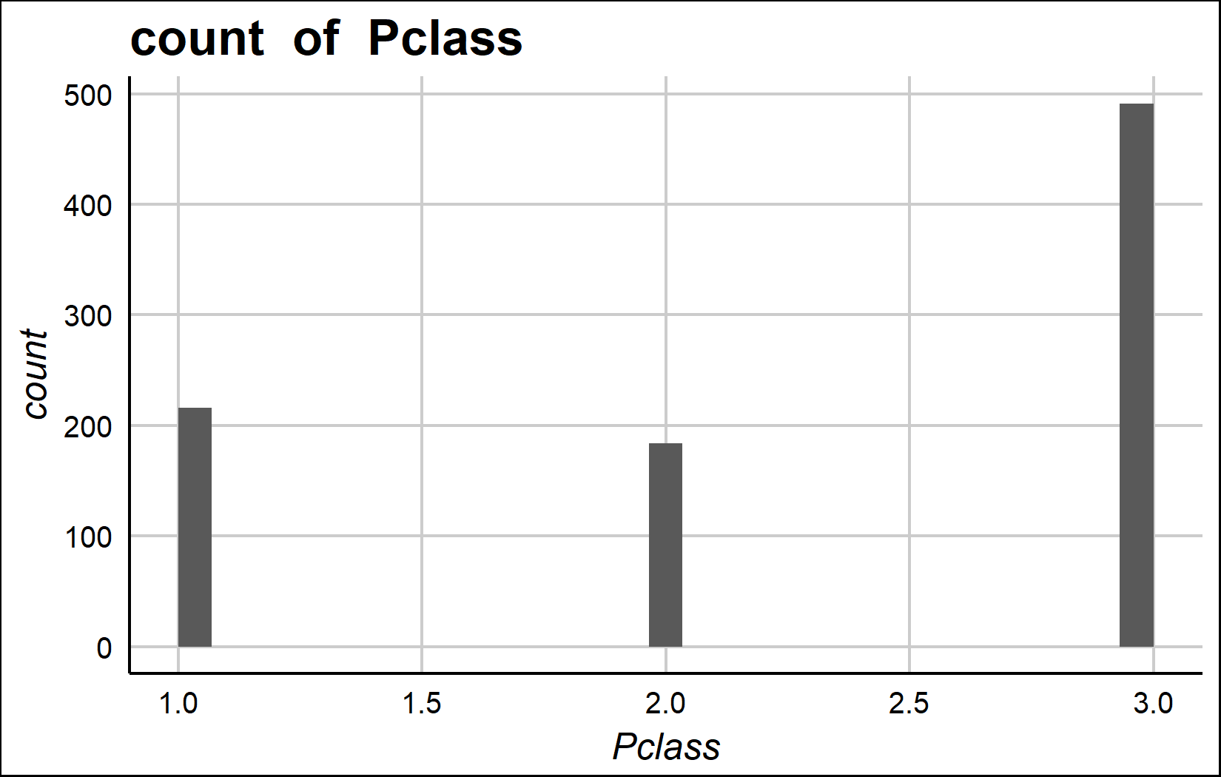
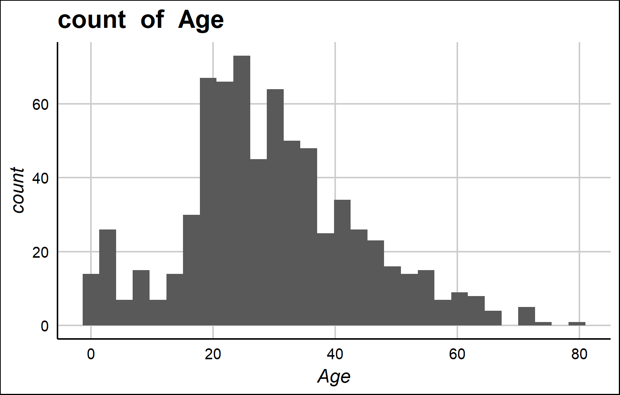
Univariate Analysis Slide 1 of 3
min | 25th | 50th | 75th | max
1 | 2 | 3 | 3 | 3
min | 25th | 50th | 75th | max
0.42 | 20 | 28 | 38 | 80

Slide 4
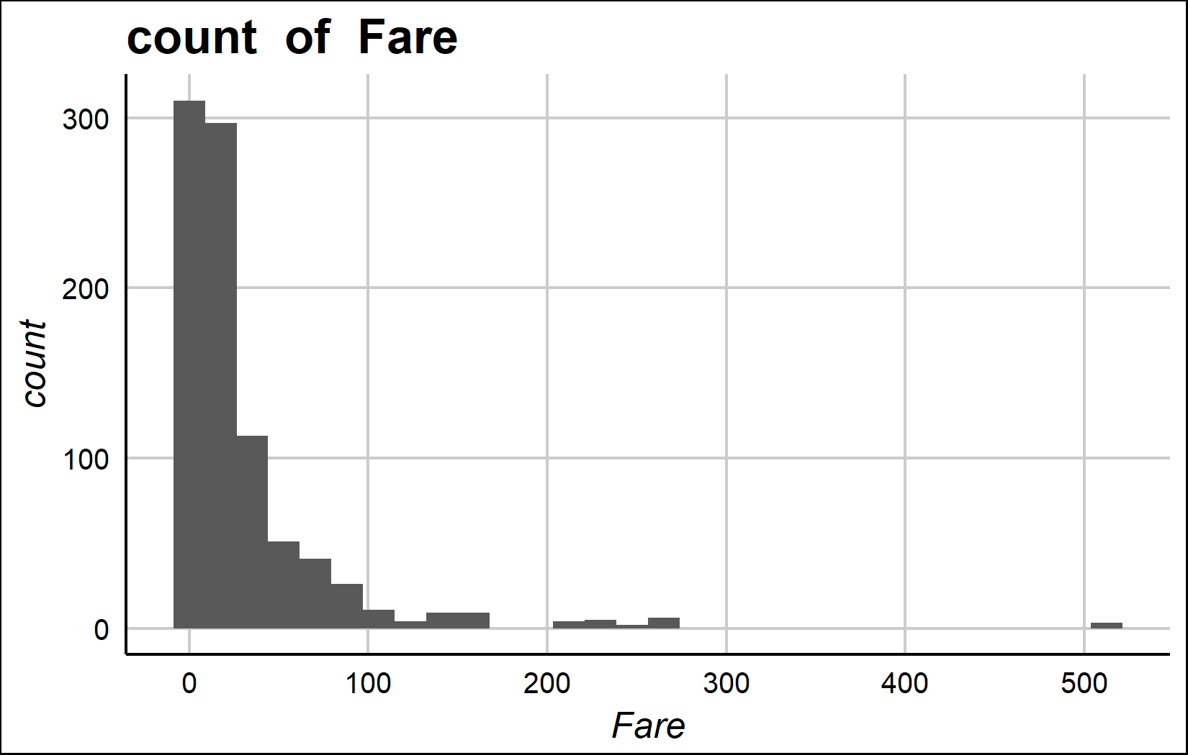
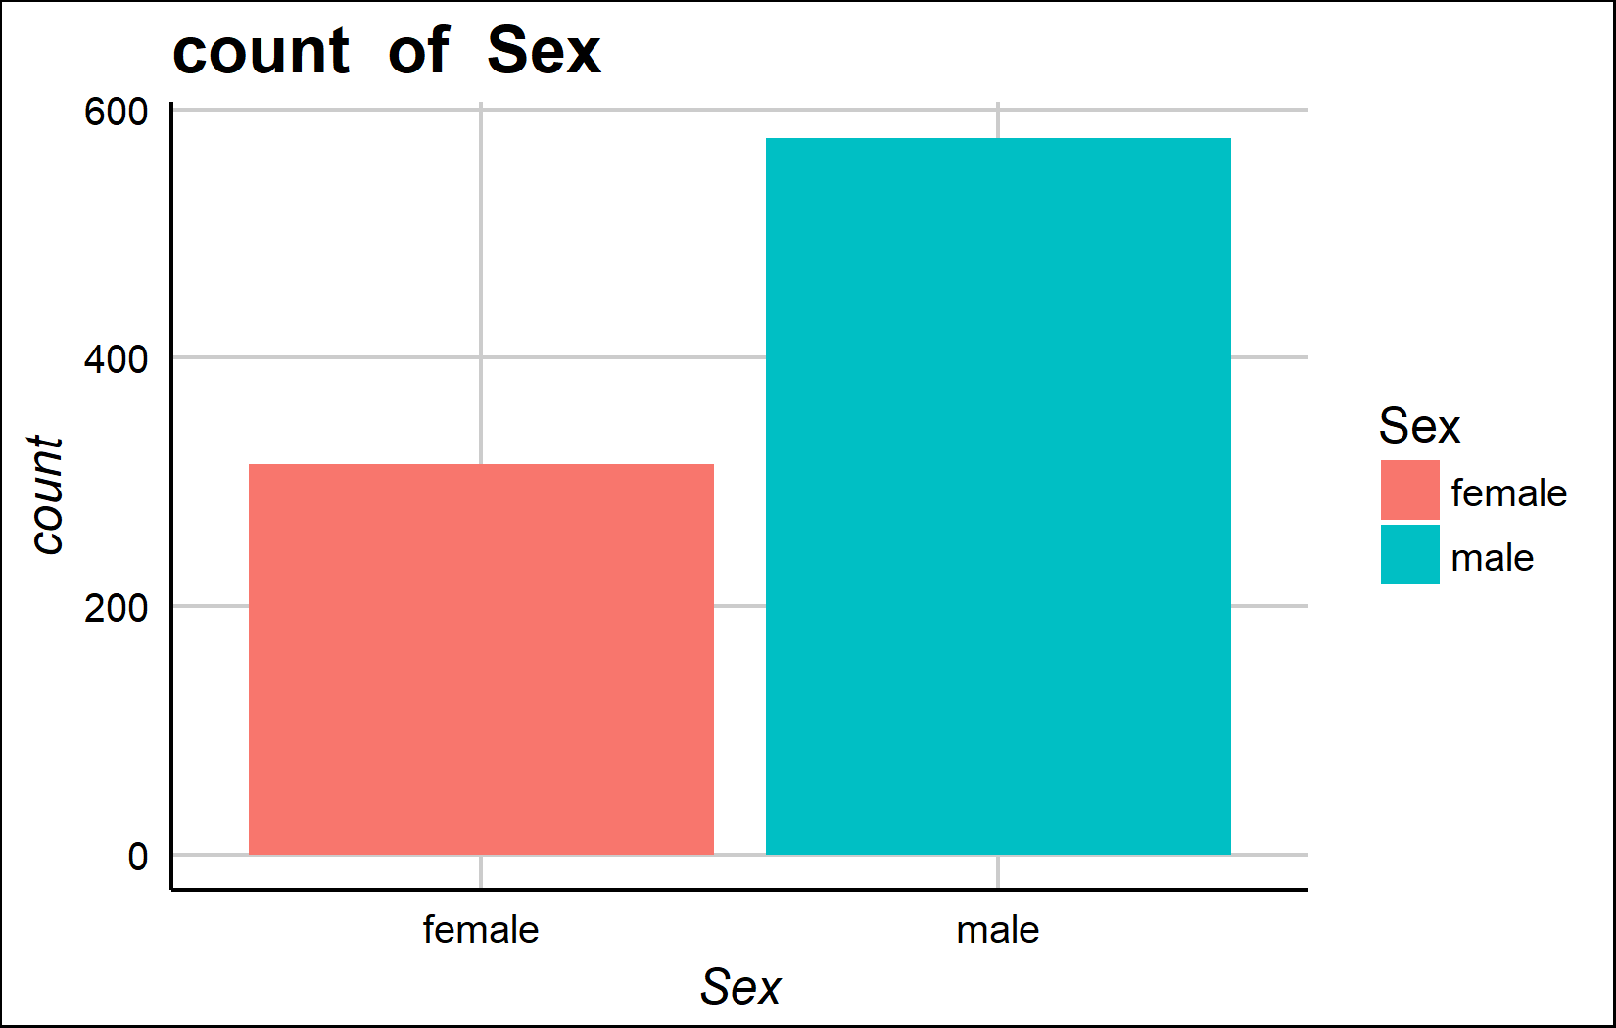
Univariate Analysis Slide 2 of 3
min | 25th | 50th | 75th | max
0 | 7.91 | 14.45 | 31 | 512.33
Metric | female | male
Count | 314 | 577
Perct. | 35.24% | 64.76%

Slide 5
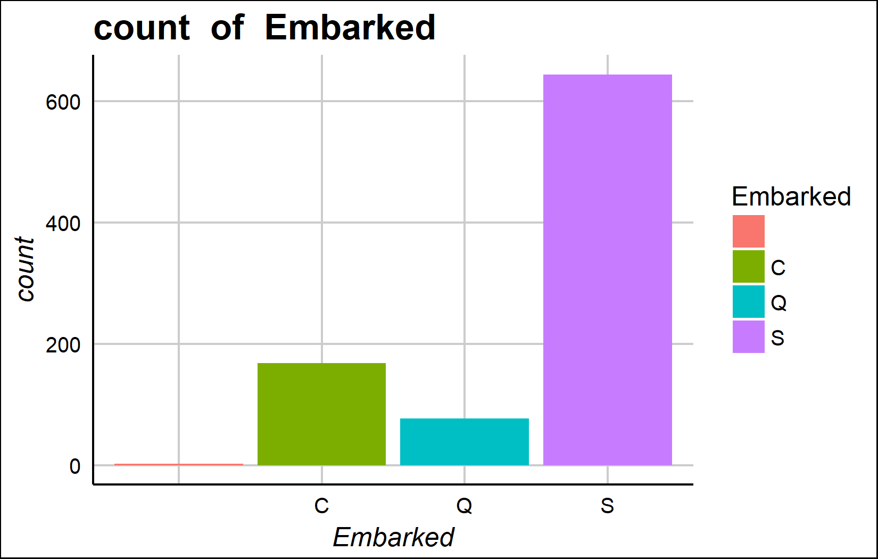
Univariate Analysis Slide 3 of 3
Metric | V1 | C | Q | S
Count | 2 | 168 | 77 | 644
Perct. | 0.22% | 18.86% | 8.64% | 72.28%

Slide 6
Bi-variate analysis

Slide 7
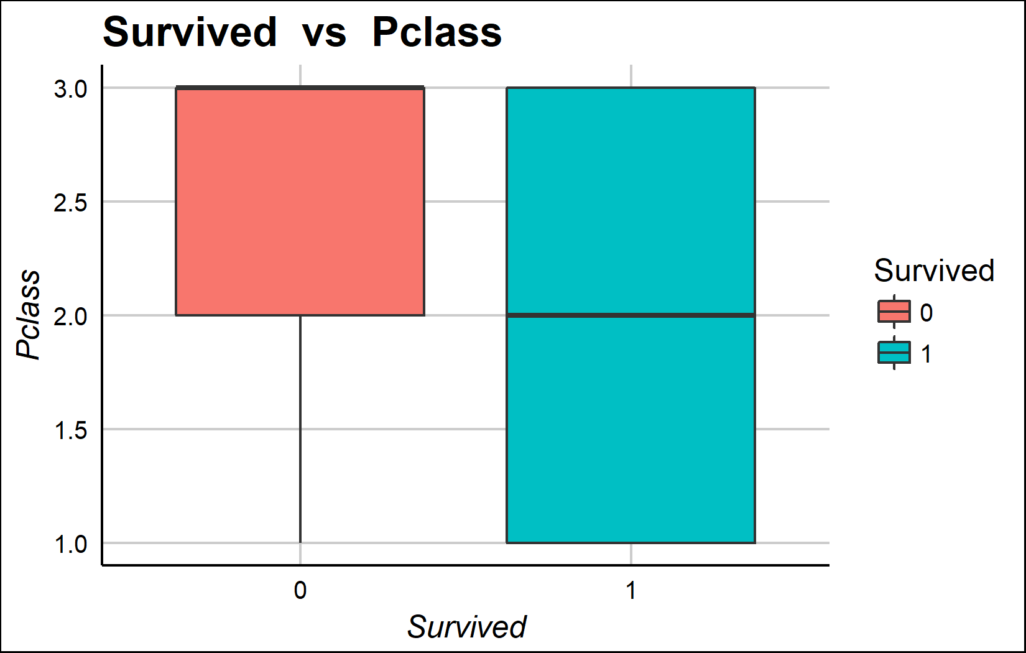
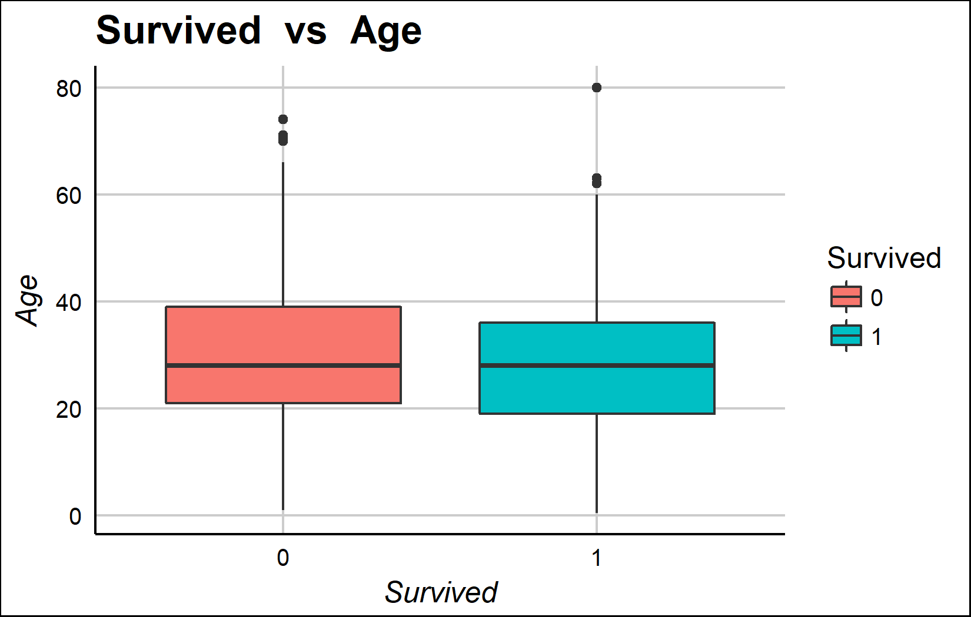
Bi-variate analysis Slide 1 of 3
Survived | mean - Pclass | median - Pclass
0 | 2.53 | 3
1 | 1.95 | 2
Survived | mean - Age | median - Age
0 | 30.63 | 28
1 | 28.34 | 28

Slide 8
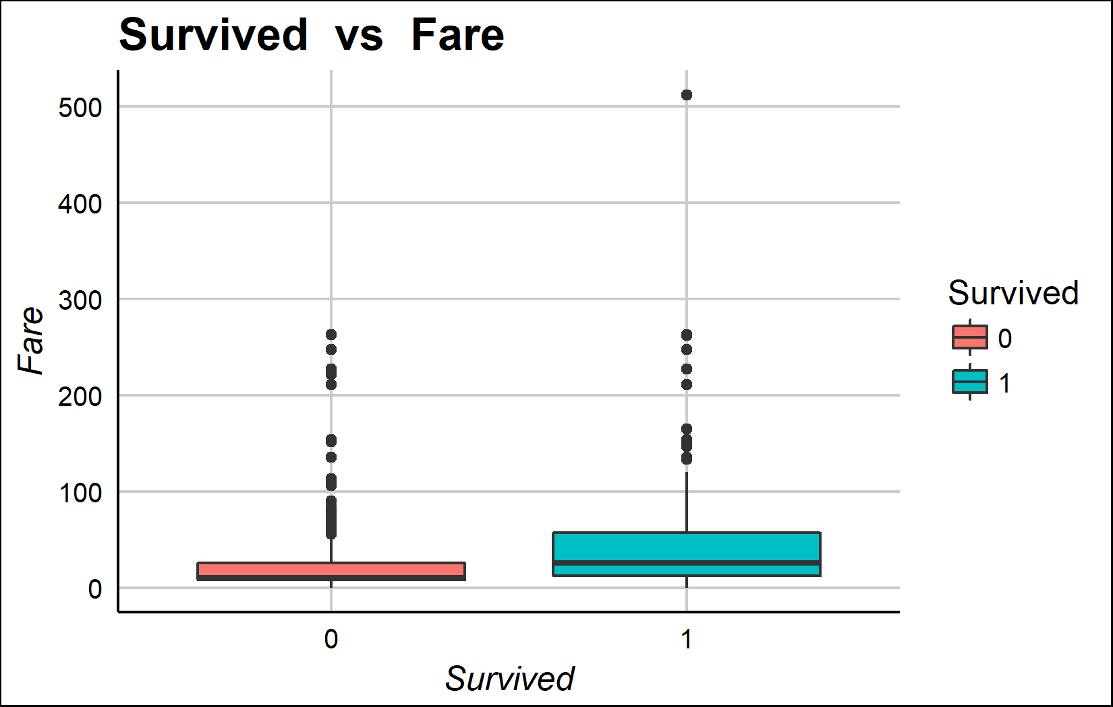
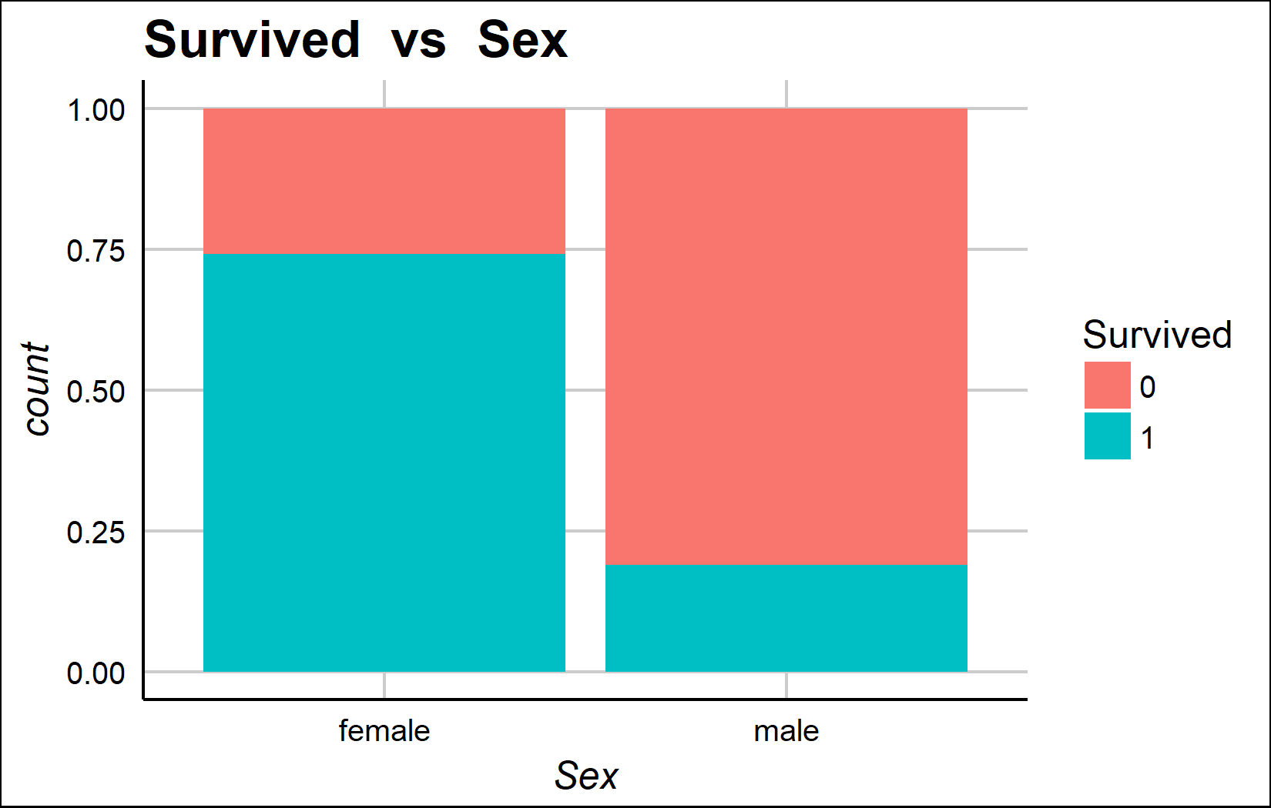
Bi-variate analysis Slide 2 of 3
Survived | mean - Fare | median - Fare
0 | 22.12 | 10.5
1 | 48.40 | 26.0
Survived | female | male | female | male
0 | 81 | 468 | 25.8% | 81.11%
1 | 233 | 109 | 74.2% | 18.89%

Slide 9
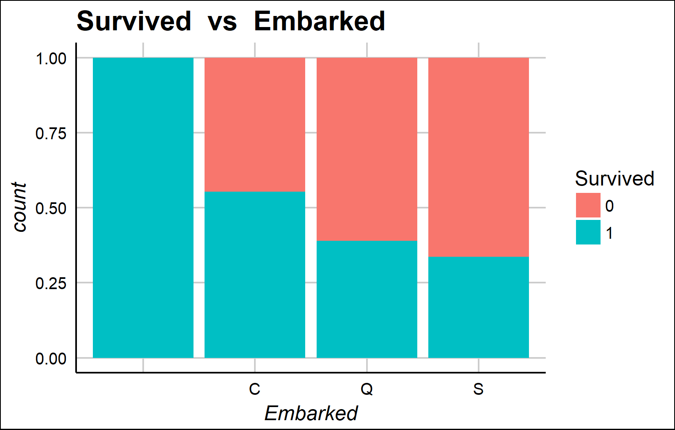
Bi-variate analysis Slide 3 of 3
Survived | Var.2 | C | Q | S | V1 | C | Q | S
0 | 0 | 75 | 47 | 427 | 0% | 44.64% | 61.04% | 66.3%
1 | 2 | 93 | 30 | 217 | 100% | 55.36% | 38.96% | 33.7%

Slide 10
Bi-variate with Group_var

Slide 11
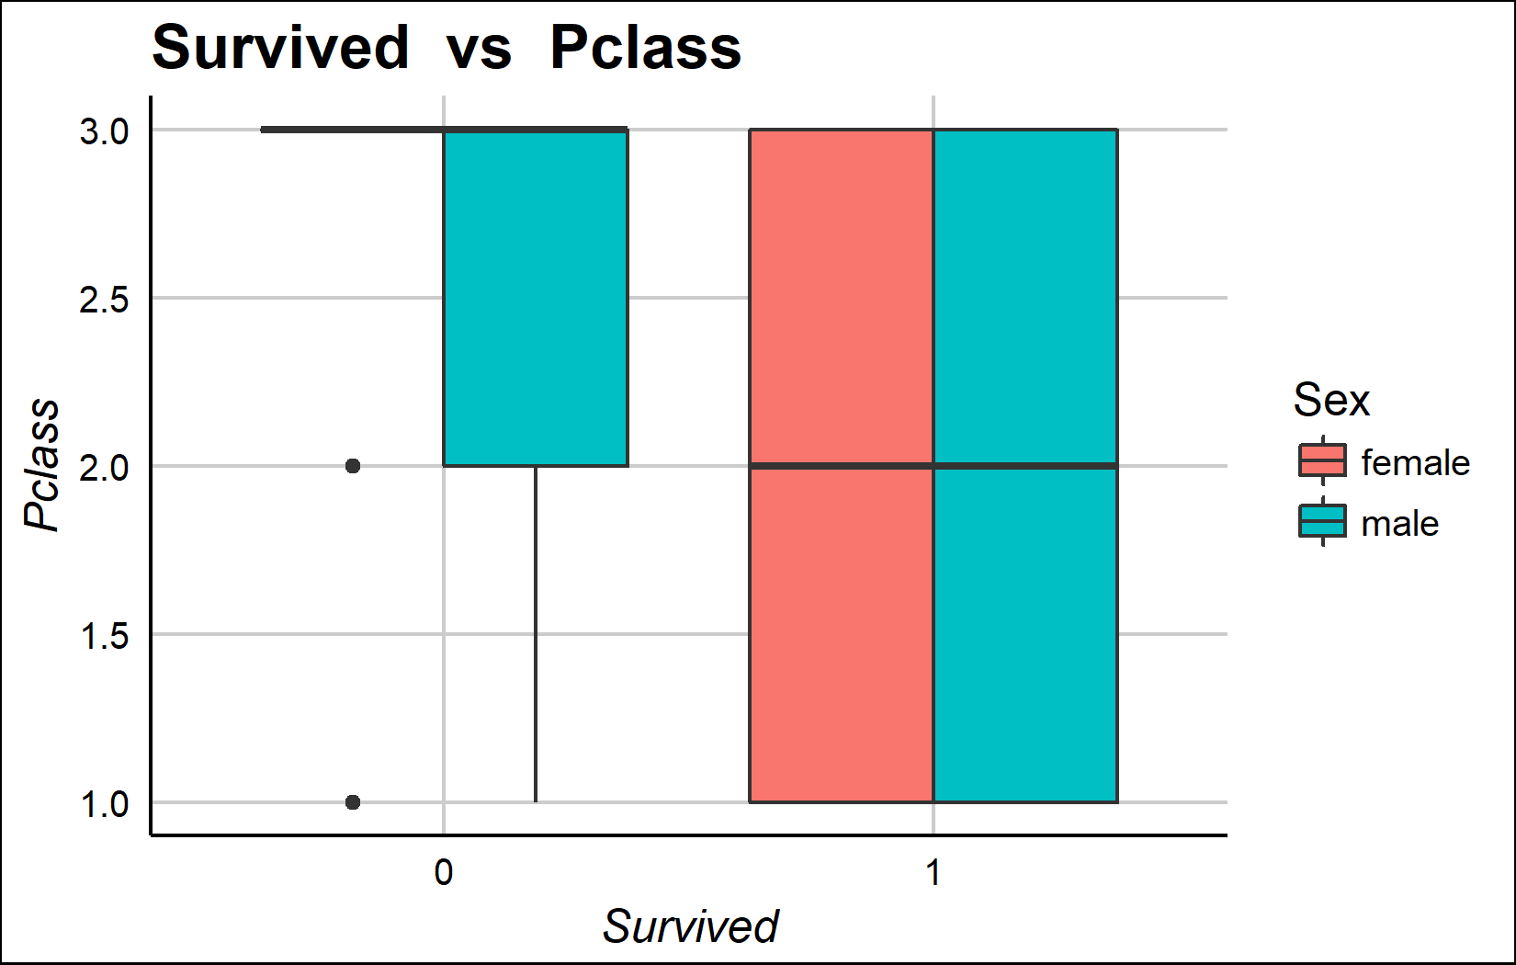
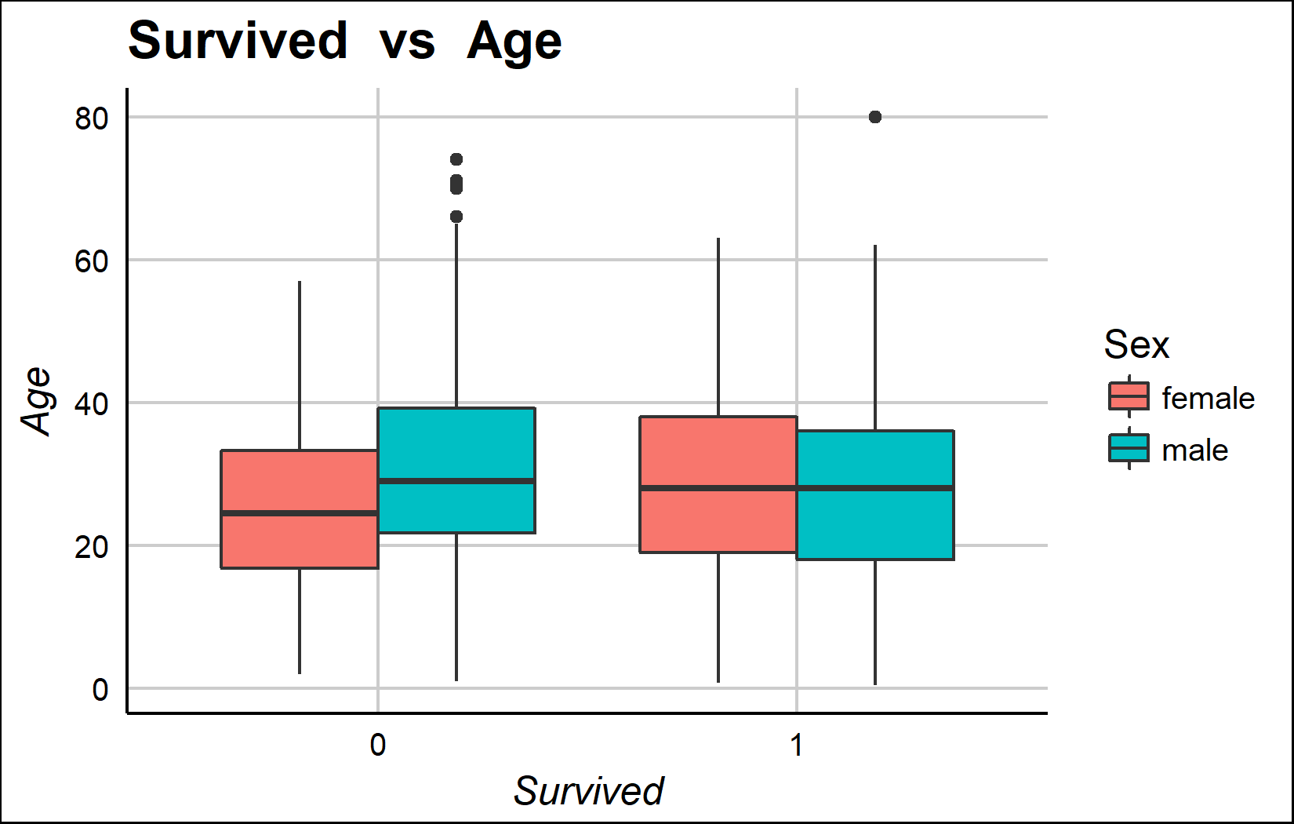
Bi-variate with Group_var Slide 1 of 2
Survived | Sex | mean_val | median_val
0 | female | 2.85 | 3
0 | male | 2.48 | 3
1 | female | 1.92 | 2
1 | male | 2.02 | 2
Survived | Sex | mean_val | median_val
0 | female | 25.05 | 24.5
0 | male | 31.62 | 29.0
1 | female | 28.85 | 28.0
1 | male | 27.28 | 28.0

Slide 12
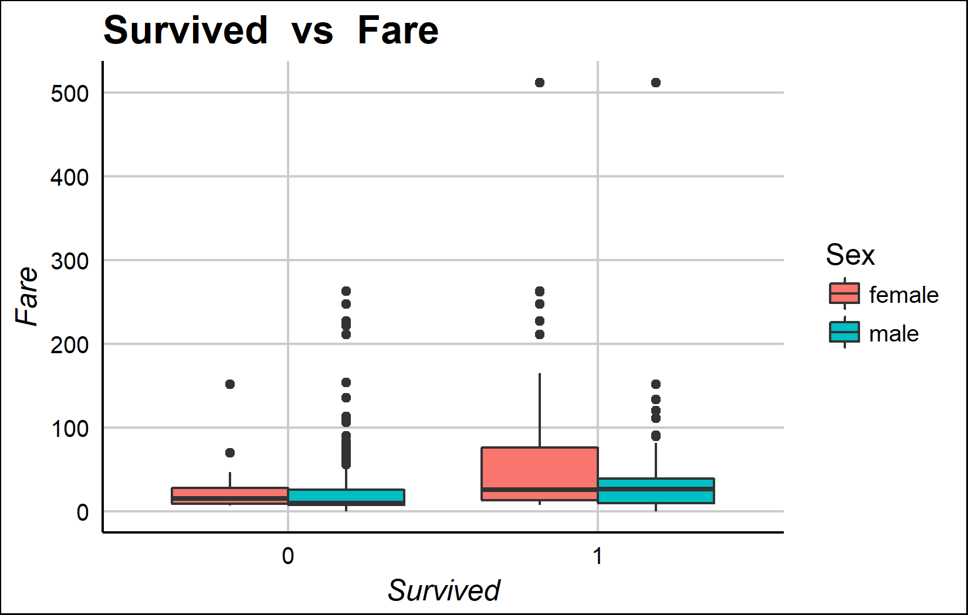
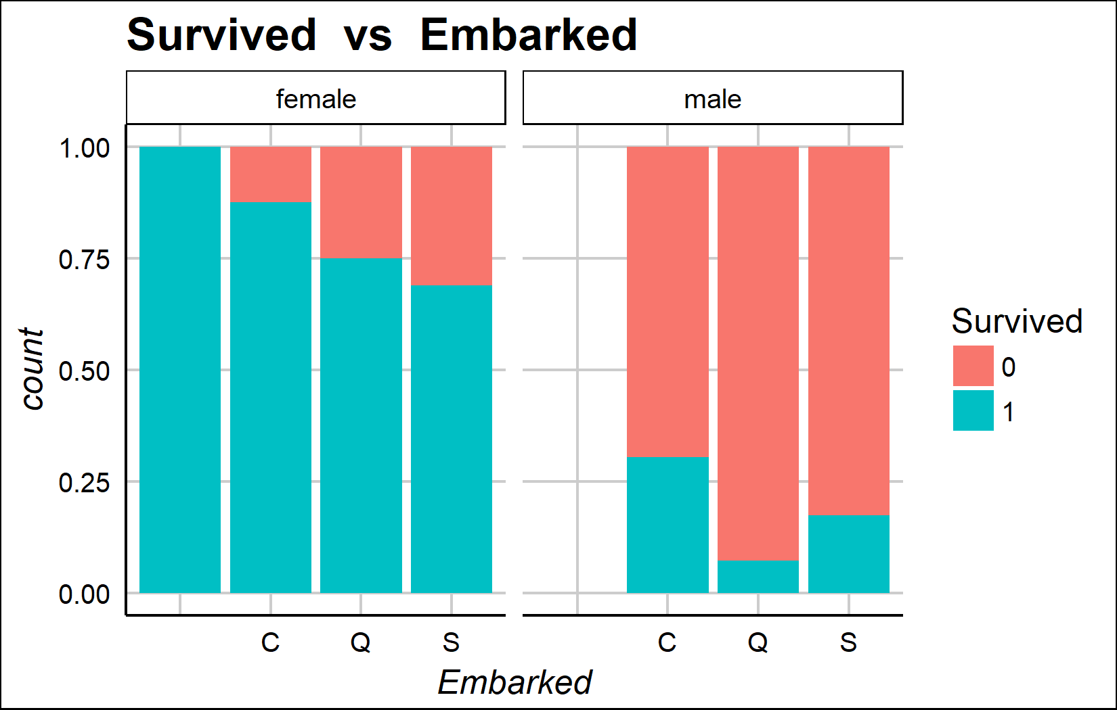
Bi-variate with Group_var Slide 2 of 2
Survived | Sex | mean_val | median_val
0 | female | 23.02 | 15.25
0 | male | 21.96 | 9.42
1 | female | 51.94 | 26.00
1 | male | 40.82 | 26.29
Survived | Sex |  | C | Q | S
0 | female | 0 | 9 | 9 | 63
0 | male | 0 | 66 | 38 | 364
1 | female | 2 | 64 | 27 | 140
1 | male | 0 | 29 | 3 | 77

