Slide 1

IPL DATABASE
MADE BY
-Jash Desai(B269)
-Amay Thakkar(B256)
-Chaitanya Shethiya(B204)
Guided BY: Dr Hemant Gianey

Slide 2

CONTENTS -
Introduction
Schema
ER diagram
Relational model
Constraints
Queries

Slide 3
INTRODUCTION
Our database aims to produce logical and physical design model of IPLManagement system .
Our database holds the details of players,coach,stadium etc..

Slide 4

SCHEMA
Tables In Database:
HeadCoach
Players
Stadium
TeamOwner
Teams
Umpire

Slide 5
ATTRIBUTES
Players
Player_id
nationality
Name
DOB
Role
Strick_rate
Bowling_style
Batting_style
Stadium
Stadium_name
City
Country
Capacity
Rent_amount
Team_Owner
Proffession
Country
Company_name_
HeadCoach
Coach_id
Coach_name
Years_of_experience
DOB
Country

Slide 6
ATTRIBUTES
Teams
Team_id
Team_name
Owner_company
Umpire
Umpire_id
Years_of_experience
Name
Country
Team_Details
Team_id
Coach_id
Year
Sposer_company
Amount

Slide 7
ATTRIBUTES
Yearwise_details
Player_id
Year
Team_id
Total_wickets
Total_runs
Max_wickets
Max_runs
Player_price
Out_notout
Played
Team_id
Match_id
Team_runs
Wickets
4s
6s
Winner
Title_sponsor
Company_name
Business_domain
Country

Slide 8
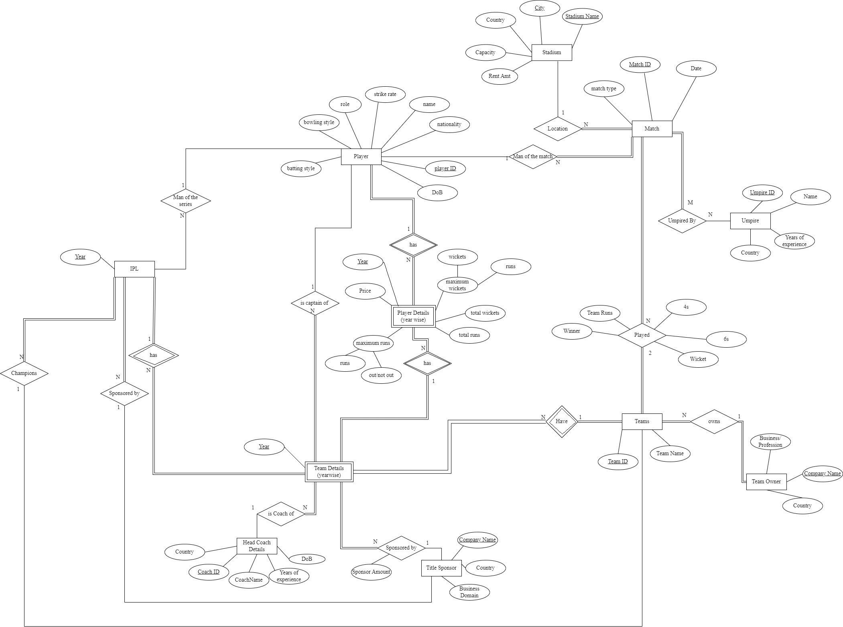
ER DIAGRAM

Slide 9
ER-DIAGRAM LINK:
https://app.diagrams.net/

Slide 10
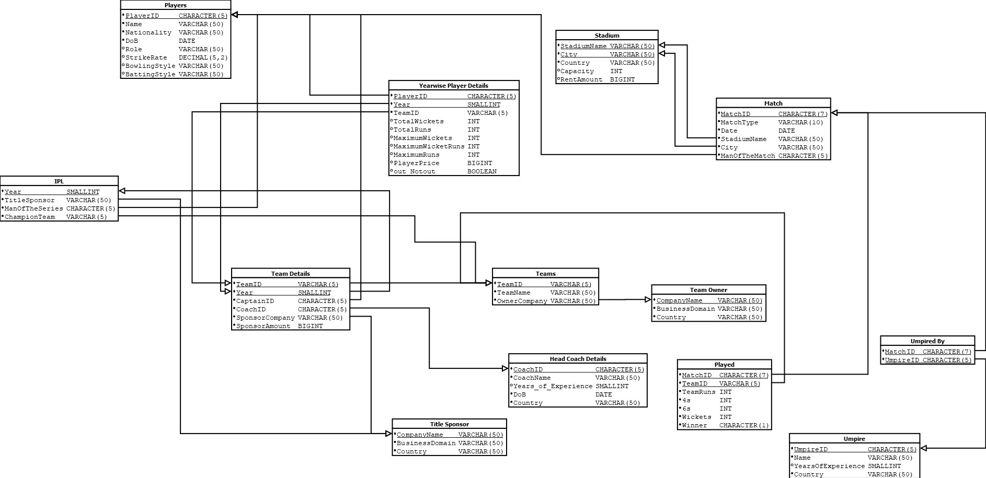
RELATIONAL MODEL-

Slide 11
Commands -
CREATE TABLE Players(
PlayerID CHARACTER(5) PRIMARY KEY,
‘Name’ VARCHAR(50) NOT NULL,
Nationality VARCHAR(50) NOT NULL,
DoB DATE NOT NULL,
‘Role’ VARCHAR(50),
StrikeRate DECIMAL(5,2),
BowlingStyle VARCHAR(50),
BattingStyle VARCHAR(50)
);

Slide 12
CREATE TABLE TeamOwner(
CompanyName VARCHAR(50) PRIMARY KEY,
BusinessDomain VARCHAR(50) NOT NULL,
Country VARCHAR(50) NOT NULL
);
CREATE TABLE TitleSponsor(
CompanyName VARCHAR(50) PRIMARY KEY,
BusinessDomain VARCHAR(50) NOT NULL,
Country VARCHAR(50) NOT NULL
);
CREATE TABLE HeadCoach(
CoachID CHARACTER(5) PRIMARY KEY,
CoachName VARCHAR(50) NOT NULL,
Years_of_Experience SMALLINT,
DoB DATE NOT NULL,
Country VARCHAR(50) NOT NULL
);

Slide 13
CREATE TABLE Teams(
TeamID VARCHAR(5) PRIMARY KEY,
TeamName VARCHAR(50) UNIQUE NOT NULL,
OwnerCompany VARCHAR(50) NOT NULL,
FOREIGN KEY(OwnerCompany) REFERENCES TeamOwner
ON DELETE CASCADE ON UPDATE CASCADE
);
CREATE TABLE Umpire(
UmpireID CHARACTER(5) PRIMARY KEY,
‘Name’ VARCHAR(50) NOT NULL,
YearsOfExperience SMALLINT,
Country VARCHAR(50) NOT NULL
);
CREATE TABLE Stadium(
StadiumName VARCHAR(50),
City VARCHAR(50),
Country VARCHAR(50) NOT NULL,
Capacity INT,
RentAmount BIGINT,
PRIMARY KEY (StadiumName, City)
);

Slide 14
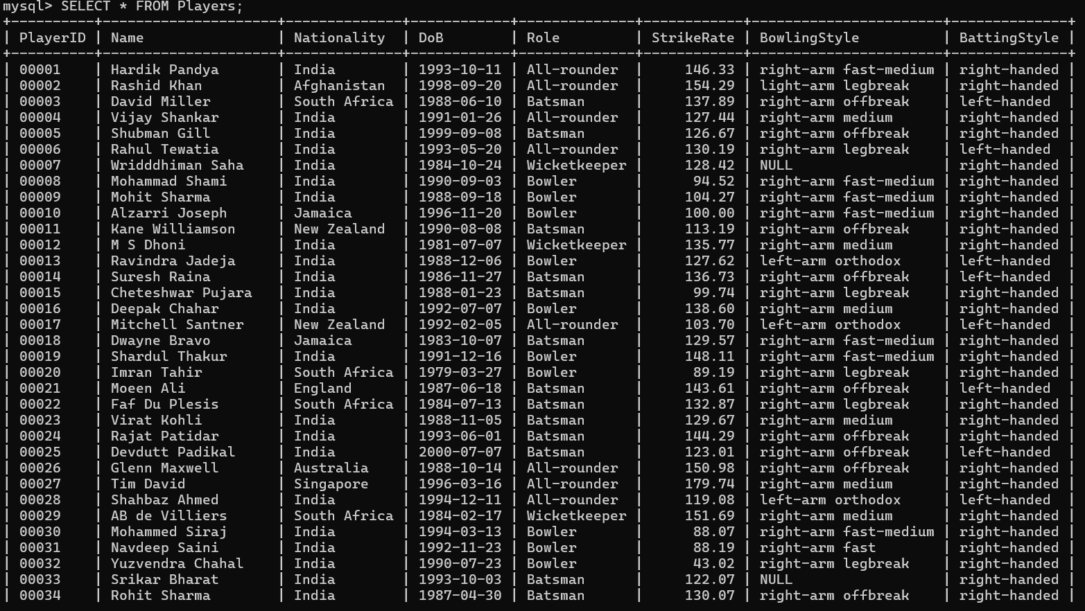

Slide 15
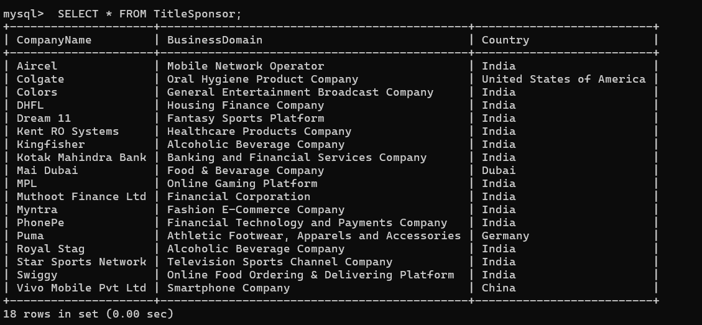

Slide 16
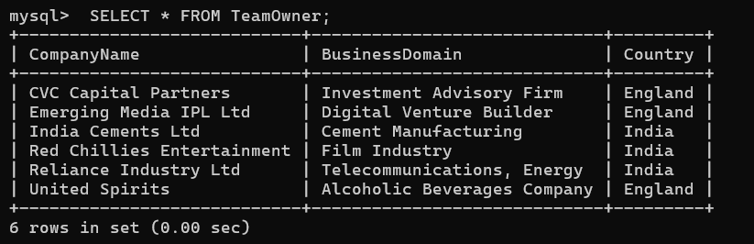

Slide 17
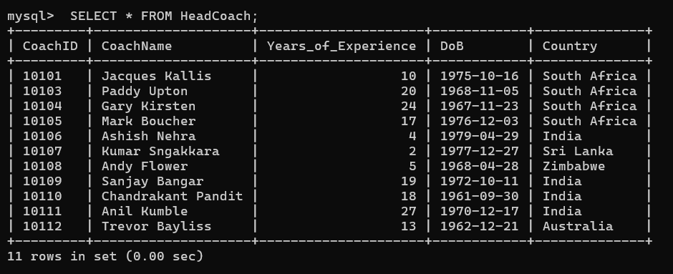

Slide 18
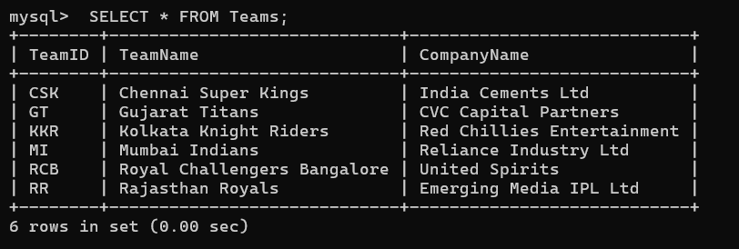

Slide 19
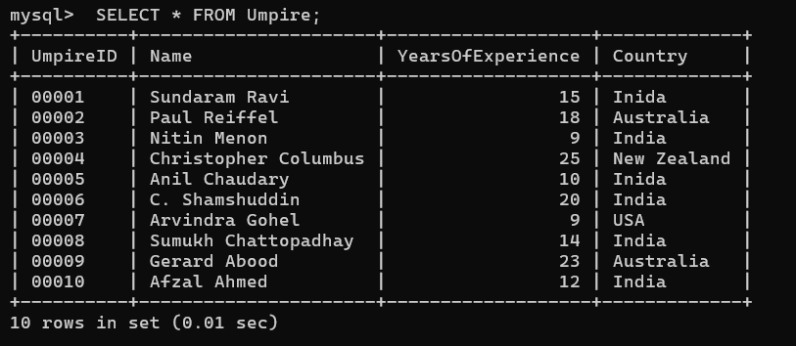

Slide 20
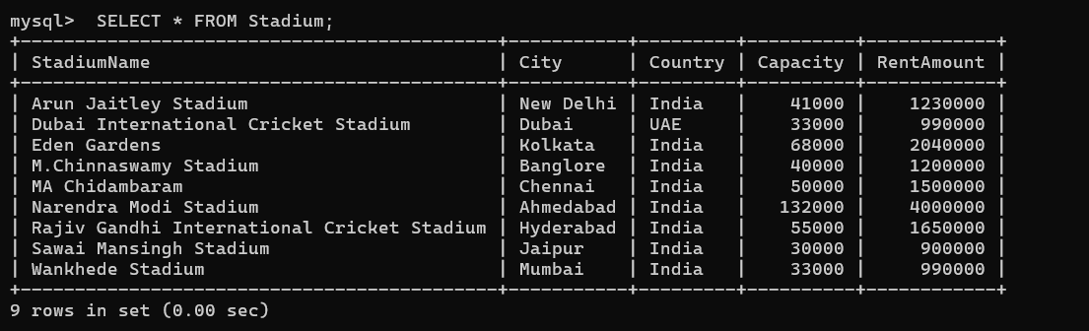

Slide 21
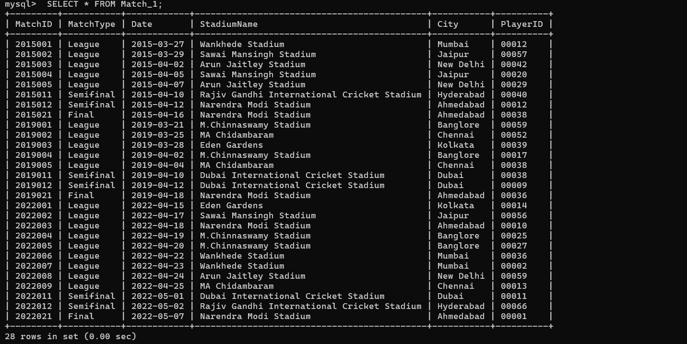

Slide 22
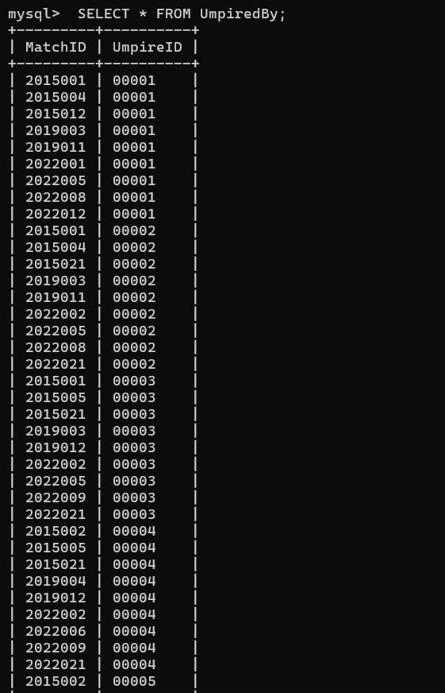

Slide 23
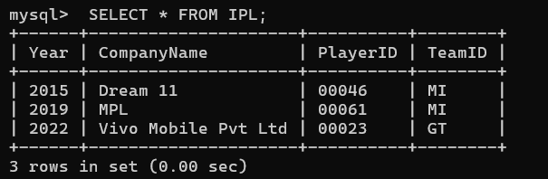

Slide 24
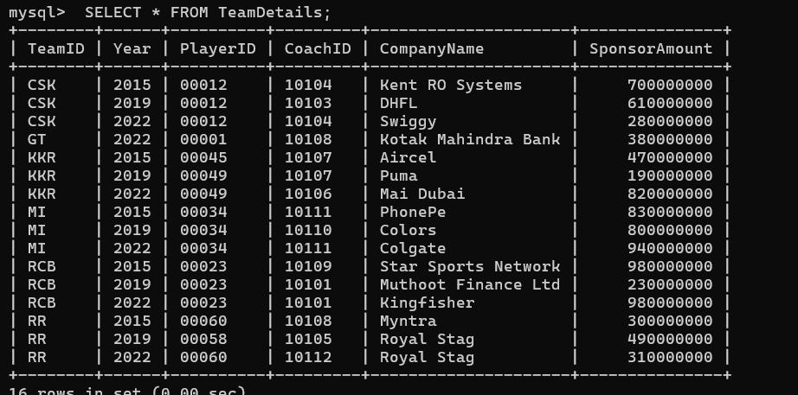

Slide 25
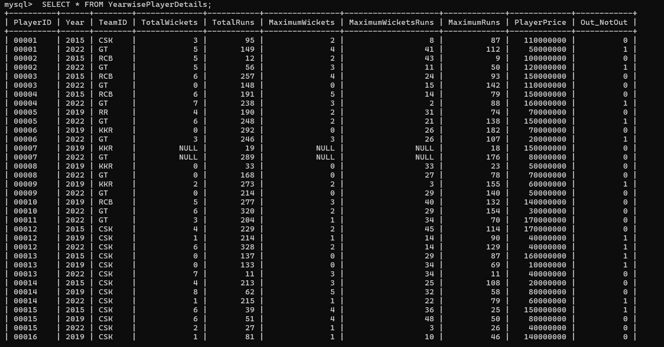

Slide 26
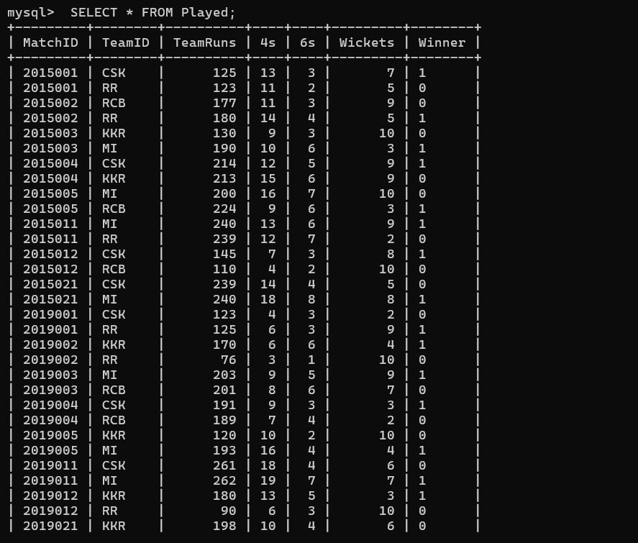

Slide 27


Slide 28
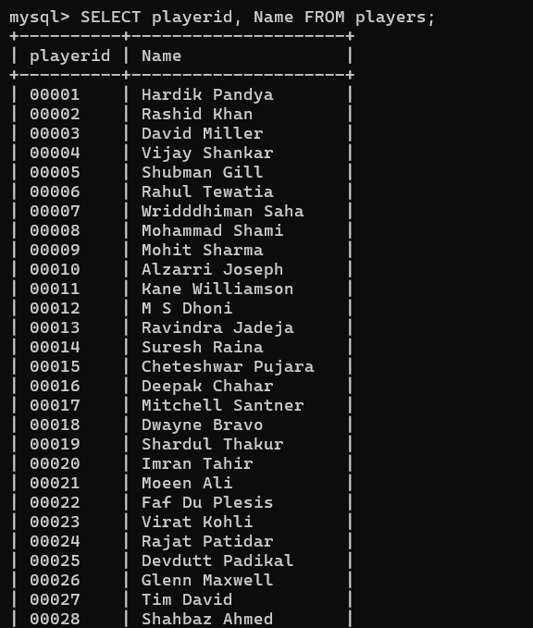

Slide 29
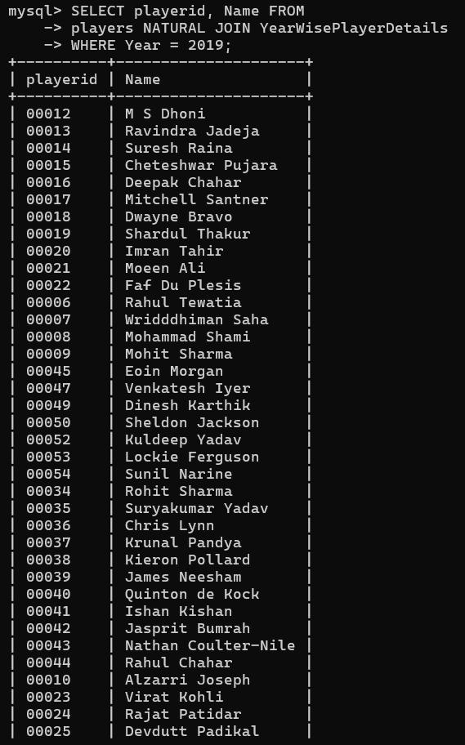

Slide 30
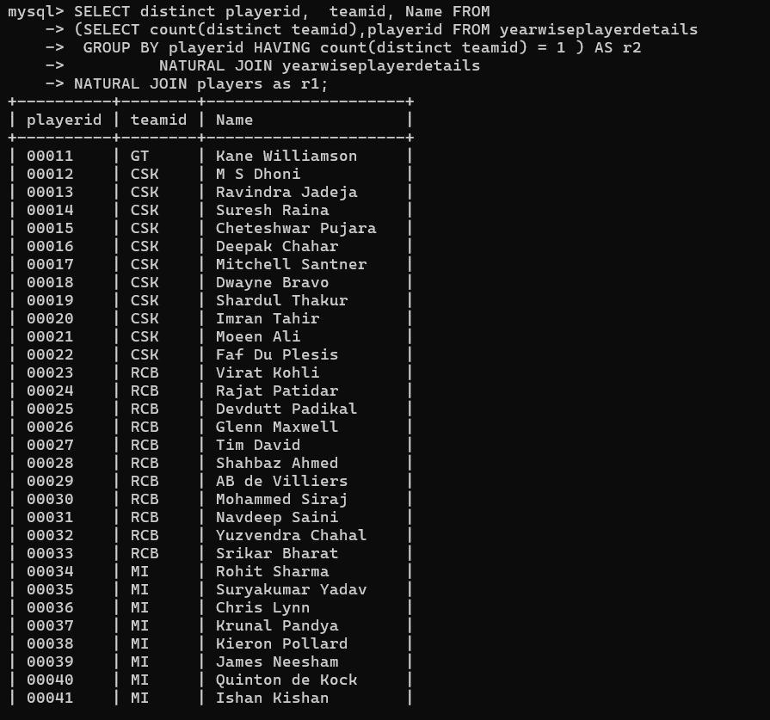

Slide 31
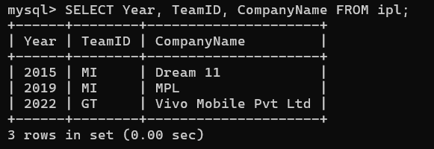

Slide 32
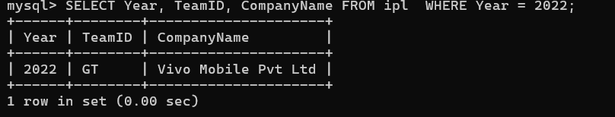

Slide 33
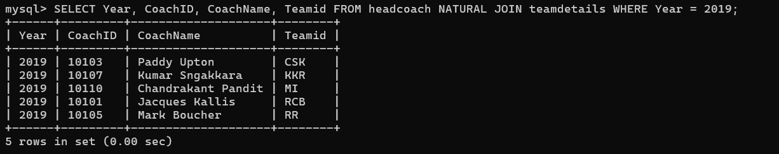

Slide 34
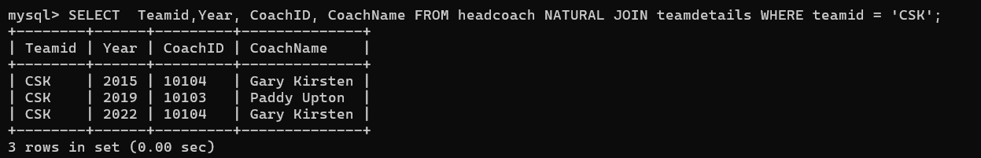

Slide 35


Slide 36
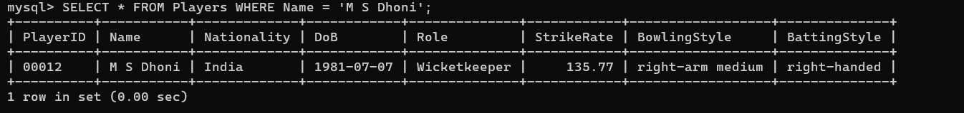

Slide 37
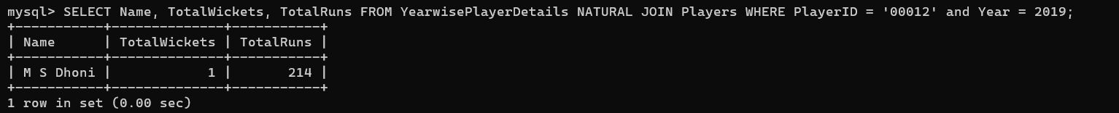

Slide 38
THANK YOU…

