Slide 1
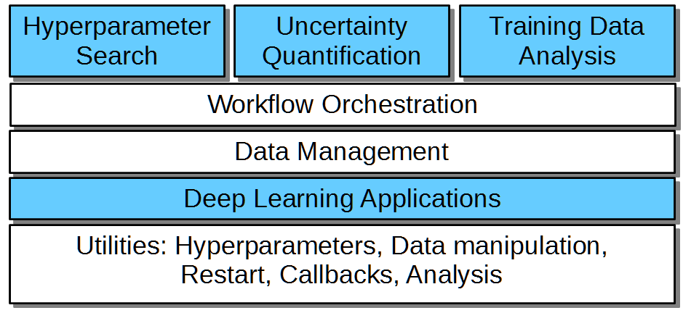
CANDLE/Supervisor overview
CANDLE/Supervisor consists of several high-level workflows:
Capable of modifying/controlling application parameters dynamically as the workflow progresses and training runs complete
Distribute work across large computing infrastructure, manage progress
Underlying applications are Python programs that use Keras/TensorFlow
“User code” shown in blue
“Utilities” shown in white
New studies would be developed by modifying the blue sections

