Slide 1
OLIVER VIDALS QURIES

Slide 2
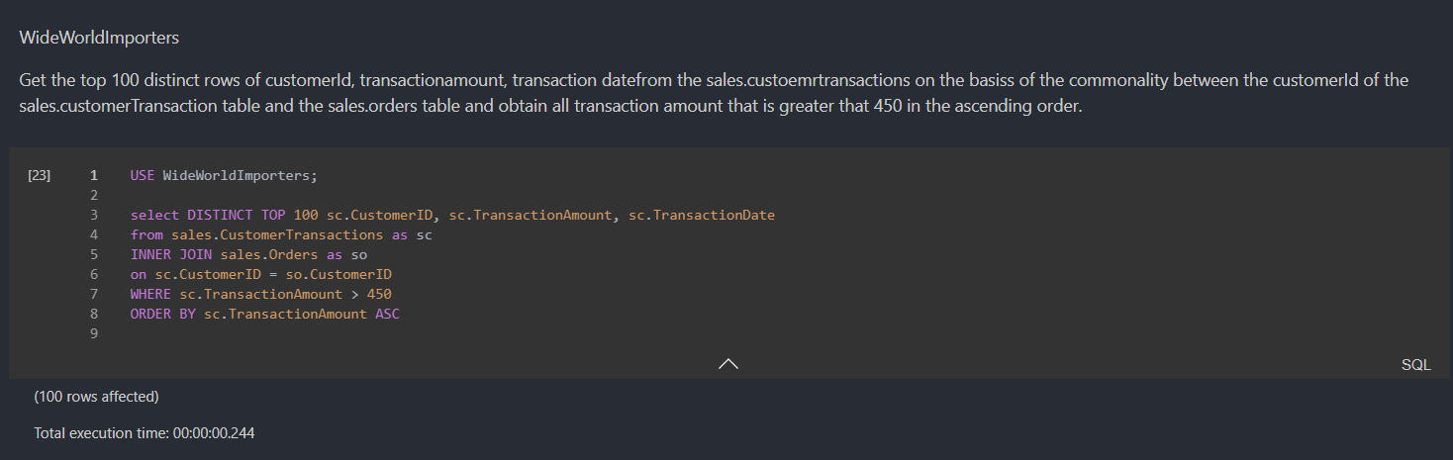
OLIVER: BEST (Simple)
Notes:
The reason this is the best out of all simple queries is because it is the fastest query that returns very specific values like transaction amount > 450 allowing us to pin point charages that were greater than 450. We also use not only the where clause but also the order by clause

Slide 3
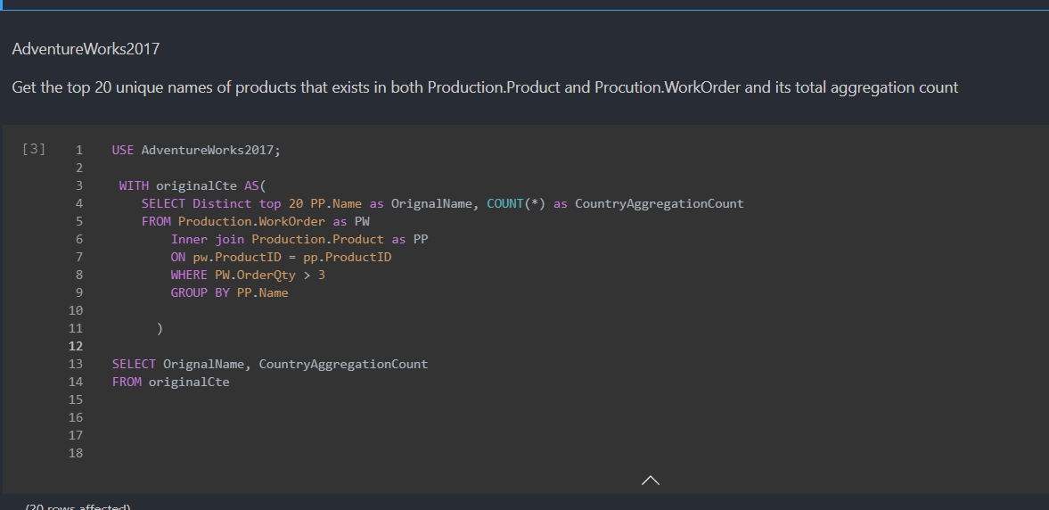
OLIVER : BEST (Medium)
Notes:
The reason this is the best out of all medium queries is because it is the fastest query that returns how many times is found within all the data while applying all the necessary rules for a medium query in a simple fashion

Slide 4
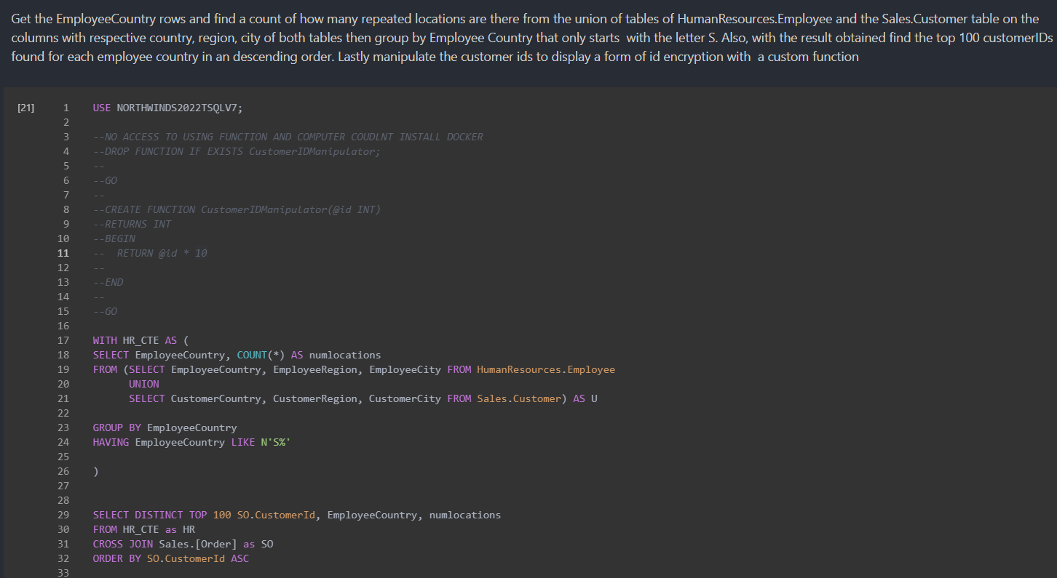
OLIVER : BEST (Complex)
Notes:
The reason this is the best out of all complex queries is because it is the fastest query that returns customer ID as well as employee country and num locations that’s within that one specific country while applying cross joins to show all customer ids

Slide 5
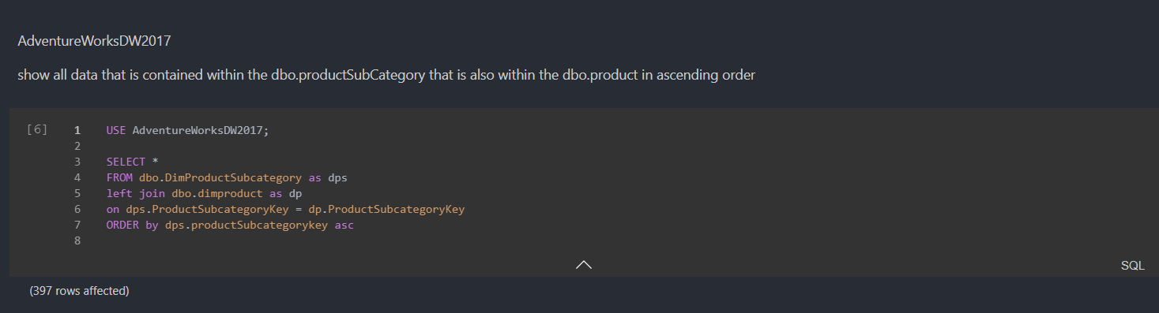
OLIVER : WORST EASY()
Notes:
The reason this is the worst out of all simple queries is because it is the slowest query that returns all rows and because of the unspecified nature of this we get a slow model. To make this faster we can select top 100 and also specify the columns

Slide 6
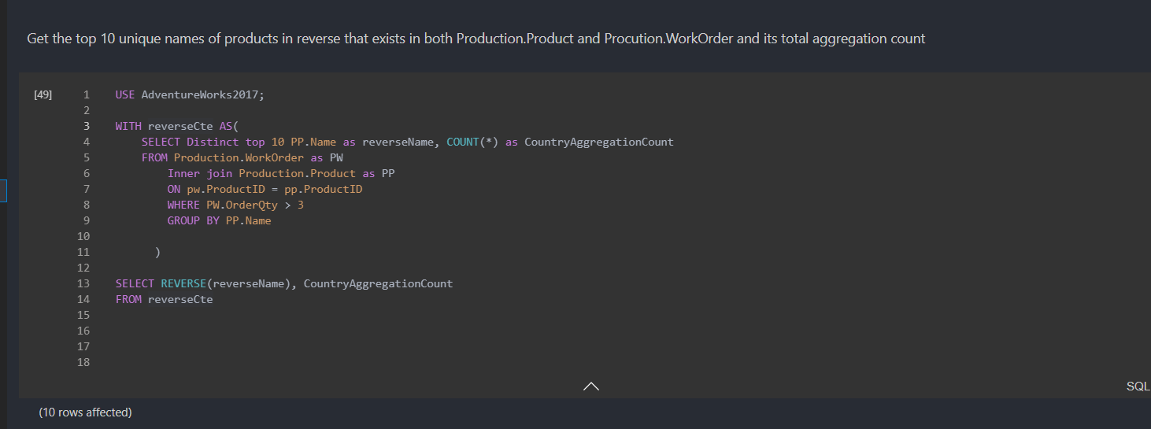
OLIVER : WORST MEDIUM()
Notes:
The reason this is the worst out of all simple queries is because although this is fairly fast however it returns information that is not useful such as reversal of the name. This query would be more useful if it returned more fruitful information such as the actual name and maybe a specific type of name

Slide 7
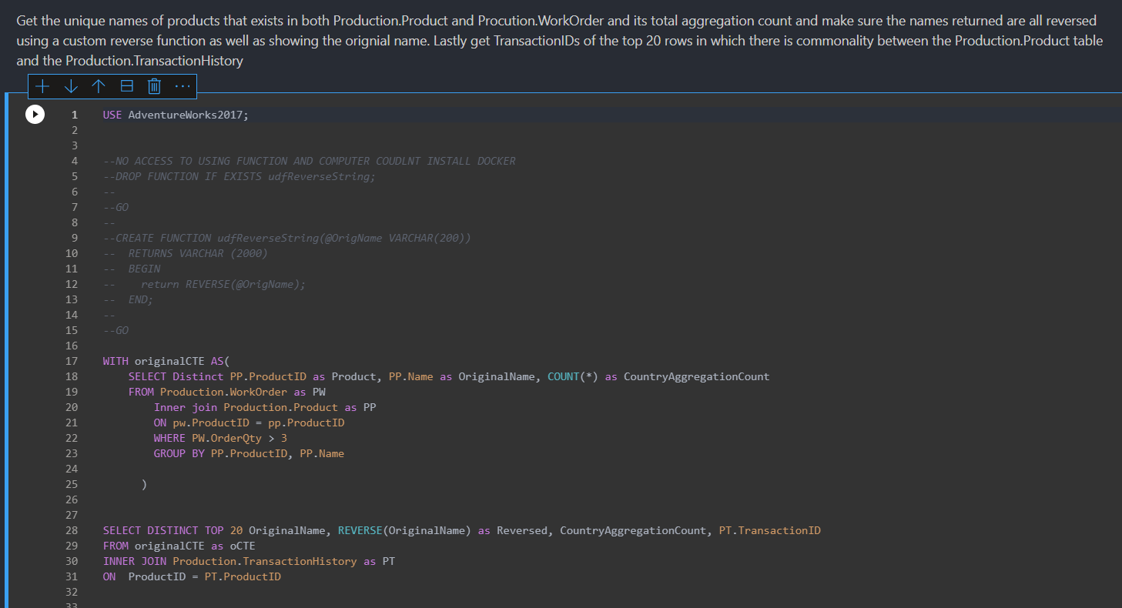
OLIVER: WORST COMPLEX()
Notes:
The reason this is the worst out of all simple queries is because it is a slow query although not the slowest query. It takes in the CTE which goes over all distinct rows however there is still many rows within the table. What makes this the worst however is the lack of usage of Having clause and the only a single name repeats with different transaction ID. It would be preferred to see all the distinct names and their transaction id which could have been done through the set operator

