Slide 1
Jasmine Kim’s Queries

Slide 2
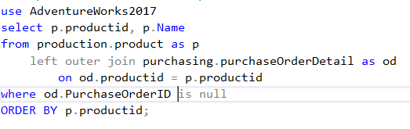
Jasmine: BEST (Simple)
Proposition: Find out the list of products that have never been sold using AdventureWorks2017.
Notes:
The product table is joined with the purchaseOrderDetail table using the LEFT OUTER JOIN. Doing so preserves all of the data from the product table. There won’t be any purchaseOrderID for products that have never been ordered so this where clause is used.

Slide 3
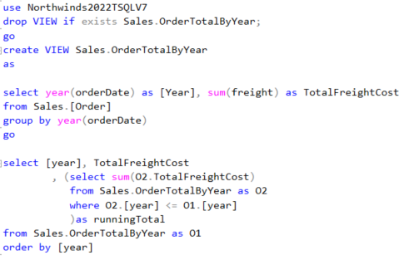
Jasmine: BEST (Medium)
Proposition: Get the running total of the orders by year using NorthWinds2022TWQLV7.
Notes:
To get the running total, first create a VIEW that summarizes the sales total by year. In this VIEW, use GROUP BY YEAR (OrderDate) and use the SUM function to get the total of the sales. In the outer query, use a subquery in the SELECT clause. The main query will join the VIEW to itself in the SELECT clause. The subquery will join the VIEW to itself using the variable, “year” because we want to see the total sales by year. The operator in the WHERE clause of the running total queries will be <= to add current and all the previous years’ sales with the SUM function.

Slide 4
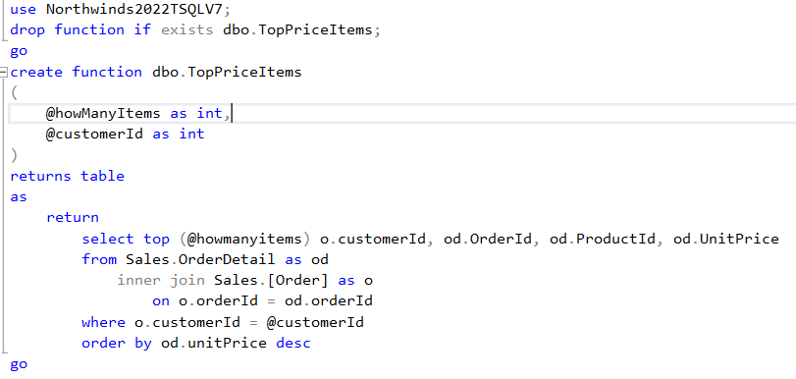
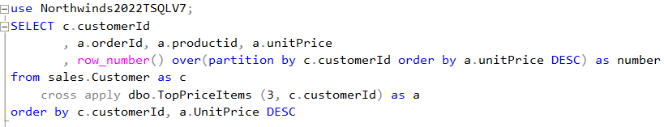
Jasmine: BEST (Complex)
Proposition: Find the top 3 most expensive items each customer has ever purchased.
Notes:
Create an Inline Table-Valued Function that takes in as parameters the number of items to display and the CustomerID. This function performs a join with the Sales.OrderDetail and Sales.Order tables to output the ProductId data with the customers who ordered those products (OrderDetail table does not have the CustomerID). It does a filter/WHERE by an individual customer. ORDER BY is essential here in order to output the three most expensive products instead of every products the customer has ever purchased. The main/outer query, which uses the Inline Table-Valued Function, will perform an cross apply with the Customer table to output all customers (who placed an order) and their products. The ROW_NUMBER() function is used to specify that there are 3 products per each customer.

Slide 5
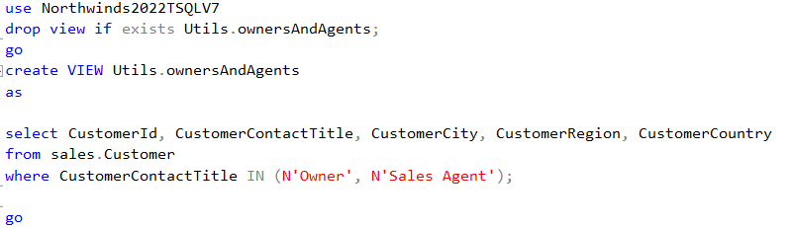
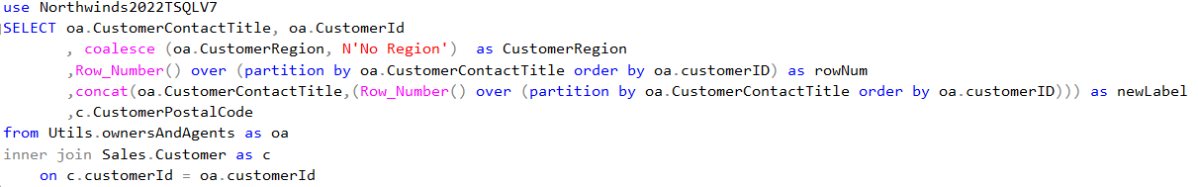
Jasmine: WORST (Medium)
Proposition: Find the CustomerContactTitle, CustomerId, CustomerRegion, and CustomerPostalCode. Give the owners and sales agents their own number. Replace the empty/null customer region with more information.
Notes:
I am starting off with the MEDIUM query because it is easier to make a mistake in a more complicated query.
First, create a VIEW that filters for the Owners and Sales Agents. In the main/outer query, use the ROW_NUMBER() function to generate a unique number for each Owners and Sales Agents. Use COALESCE function to display “No Region” instead of NULLs. Use CONCAT function to generate a new label for Owners and Sales Agents. Do an INNER JOIN with the Customer table to obtain the postal code. Even though this query essentially uses a single table, you see VIEW and INNER JOIN. So many instances of Customer table is used here. Unnecessary clutter.

Slide 6
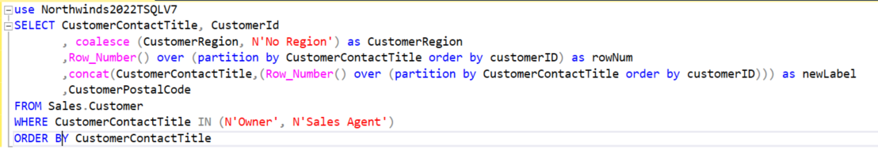
Jasmine: CORRECTION (Medium)
Notes:
Instead of invoking the same table inside the table expression then joining the original table to the table expression, the original table is invoked once in the query. The MEDIUM complexity is now reduced to a SIMPLE query.

Slide 7
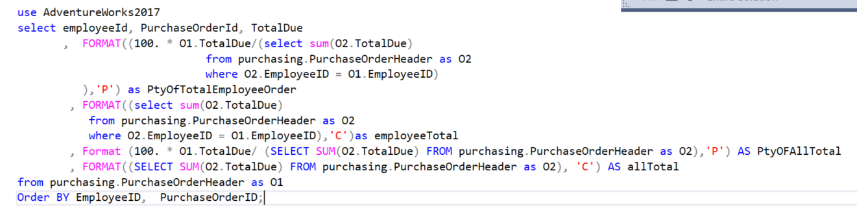
Jasmine: WORST (Complex I)
Proposition: Show percentage of each employee’s order total as a ratio of the employee’s total orders serviced. Also show percentage of the employee’s order against all orders.
Notes:
There are four subqueries in the SELECT clause in this query. These are two subqueries that are invoked two times each. The first subquery obtains the total sales amount serviced by each employee. The second query obtains the total sales amount of the entire company. The amount returned by the first query divides each sales order then it is multiplied by 100. The amount returned by the second query divides each sales order then it is multiplied by 100. This query shows the impact each order and each employee has toward the company’s overall profit. The number of times the subqueries invoked clouds the overall query.

Slide 8
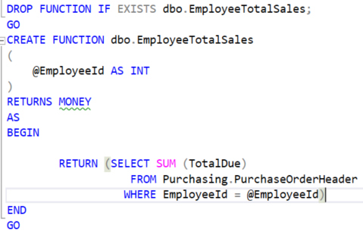
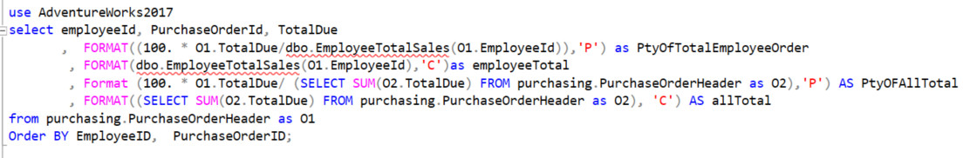
Jasmine: CORRECTION (Complex I)
Notes:
I decided to make a scalar function that returns the totalSales amount for each employee. The use of the scalar function reduced several lines from the original query.

Slide 9
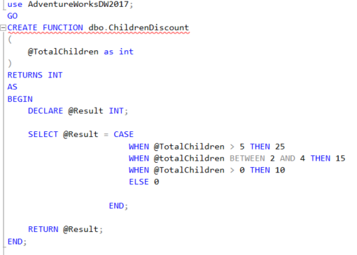
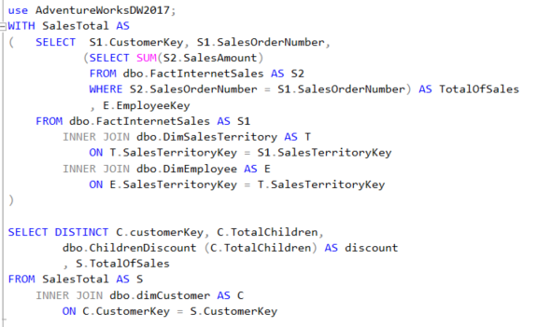
Jasmine: WORST (Complex II)
Proposition: Our company is having a special discount for families with children. The discount varies by the number of children. Show how much discount each family will receive.
Notes:
Proposition is at fault here. The discount period has not been specified, implying that we give discount for ALL orders ever placed. This would surely lead a company to bankruptcy.
This query uses a scalar function that returns the appropriate discount amount that varies by the customer’s number of children and common table expression (CTE) that calculates the total sales amount ordered by each customer. It performs two INNER JOINs to obtain EmployeeKey from FactInternetSales. The most grave mistake I made here is the WHERE clause of the subquery of the CTE. We have to get totals per customer not per each order! The query looks very cluttered with so many joins.
There was a special challenge working with this database because it only had Sales Details table without the Sales summary table like Sales.Order in NorthWinds. When trying to calculate the total Orders per each customer, duplicates printed because there are multiple product details for each order. I had to use the DISTINCT clause to rule these out.
The query simply outputs the discount percentage and does not calculate the actual amount of money the customers will receive discount on. So it does not fulfill the proposition.

Slide 10
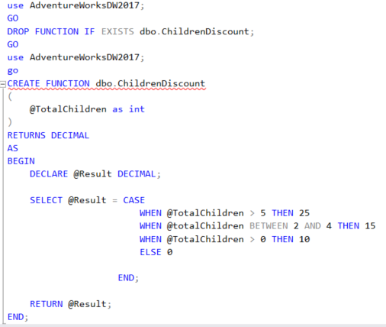
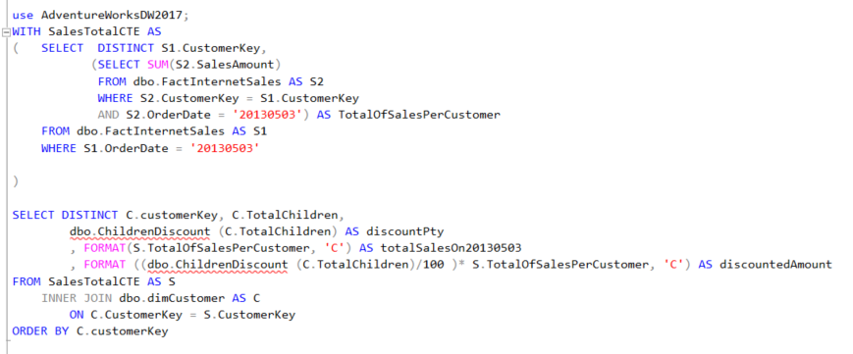
Jasmine: CORRECTION (Complex II)
Revised Proposition: Apply family discount of varying amount depending on the number of children for orders placed on May 3rd, 2013.
Notes:
First of all, the proposition of this query was not practical because it attempted to give discounts to families with children for all orders they have ever purchased. The company will lose so much money like that. So I had to specify the proposition to apply the discount on a single day: May 3rd, 2015. The two INNER JOINs inside the Common Table Expression was not necessary for EmployeeKey is not a necessary information to figure out how much discount the family will receive on the orders placed on 05/03/2015.
I was also making a grave mistake in the subquery’s WHERE clause. I was incorrectly obtaining total sales for each order instead of each customer! So I fixed it by specifying the join condition with the customer.
While trying to specify the query to only obtain the total for only 05/03/2015, I first tried to specify that in the outer query of SalesTotalCTE only. Even though the date was specified on the outer query, the inner query was calculating the total sum of all orders the customer purchased, not just the ones on 05/03/2015. So I had to add a date filter within the subquery of the CTE as well.
So I added that column. This corrected query seems more succinct and gathers accurate data.
I added a column that calculates the actual discounted amount to satisfy the proposition.

