Slide 1
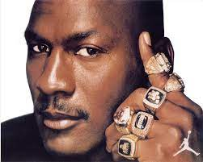
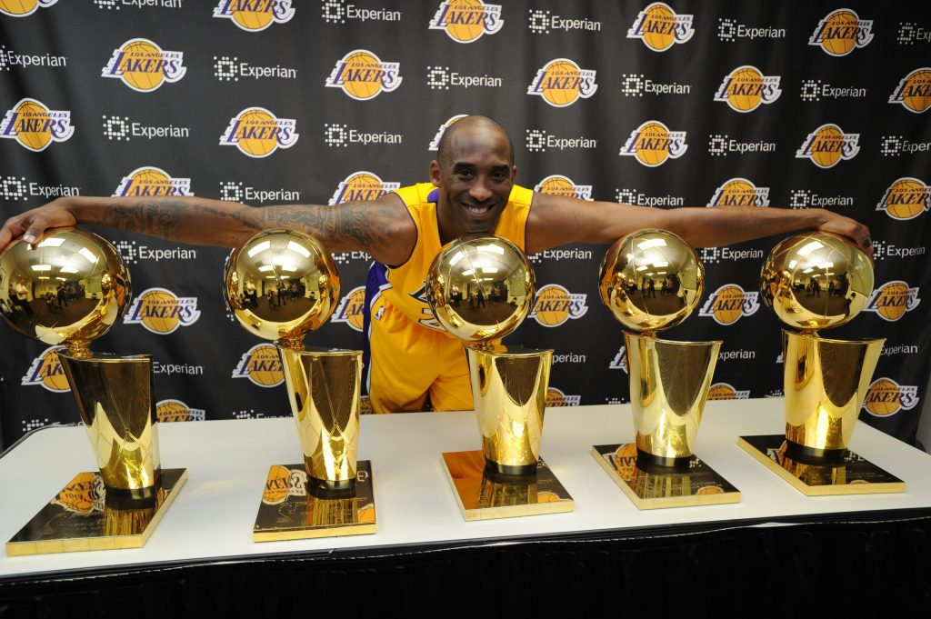


WHO IS THE GOAT?

Slide 2
3 KPI’S TO DETERMINE THE GOAT
TRUE SHOOTING PERCENTAGE
TAKES INTO ACCOUNT ALL FIELD GOALS TAKEN.
FREE THROWS, 2 POINTERS, AND 3 POINTERS AGGREGATED INTO ONE PERCENTAGE
ASSISTS COMPARED TO TURNOVERS
THE GOAL IS TO HAVE TWICE AS MANY ASSISTS AS TURNOVERS
MOST POINTS SCORED IN A GAME

Slide 3
DATASETS
NOTE: THESE DATASETS ARE FROM JORDAN’S ROOKIE SEASON TO THE END OF 2018
ADVANCED STATS FOR THEIR WHOLE CAREER
ADVANCED_STATS.CSV
GAME HIGH STATS FOR THEIR WHOLE CAREER
GAME_HIGHS_STATS.CSV
TOTAL STATS FOR THEIR WHOLE CAREER
TOATALS_STATS.CSV

Slide 4
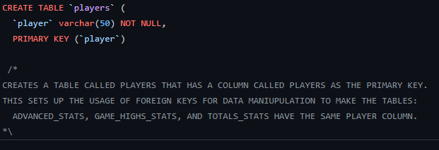

DATA MANIPULATION
THIS SQLSCRIPT WILL HELP ME CREATE A CORRELATION WITH THE OTHER 3 DATA SETS BY CREATING A TABLE WITH A PRIMARY KEY.

Slide 5
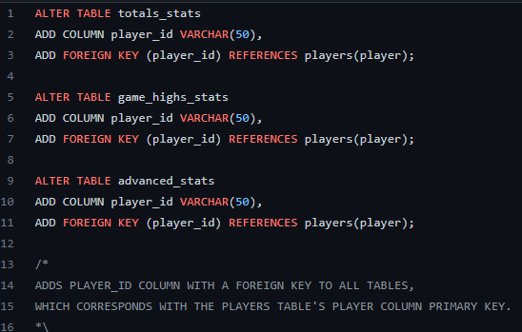
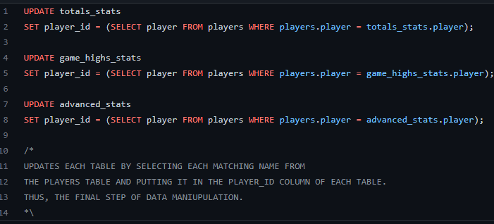
DATA MANIUPULATION CONT.
THESE 2 SCRIPTS EDIT ALL 3 OF THE OTHER DATASETS TO HAVE IDENTICAL COLUMNS ADDED (FOREIGN KEYS) THAT CORRESPOND TO THE PRIMARY KEY PREVIOUSLY CREATED IN THE PLAYERS TABLE.

Slide 6
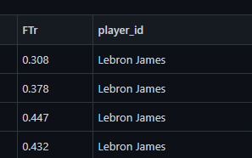
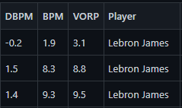
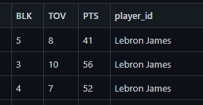
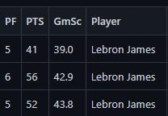
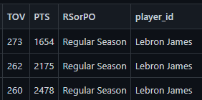
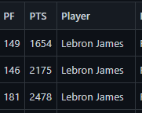
RESULTS OF DATA MANIPULATION
DATASET | CHANGE | RESULT
ADVANCED_STATS.CSV | PLAYER_ID
GAME_HIGHS_STATS.CSV | PLAYER_ID
TOTALS_STATS.CSV | PLAYER_ID

Slide 7
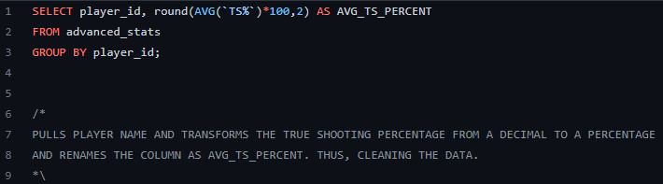

CAREER TRUE SHOOTING PERCENTAGE ASSESSMENT
LEBRON HAS THE HIGHEST TRUE SHOOTING PERCENTAGE OF THE 3 PLAYERS.
TRUE SHOOTING PERCENTAGE IS A KPI BECAUSE THIS MEANS THAT THROUGHOUT THEIR CAREER, ON ANY GIVEN SHOT THEY TAKE THEY HAVE A 50%+ CHANCE OF SCORING.

Slide 8
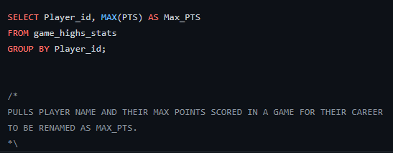

CAREER MAX POINTS ASSESSMENT
KOBE HAS THE MOST POINT SCORED IN A SINGLE GAME BETWEEN THE 3 PLAYERS.
THIS IS A KEY PERFORMANCE INDICATOR FOR ME BECAUSE MY GOAT WILL HAVE THE MOST ABSURD NUMBER OF POINTS SCORED IN A SINGLE GAME. (BESIDES WILT OF COURSE)

Slide 9
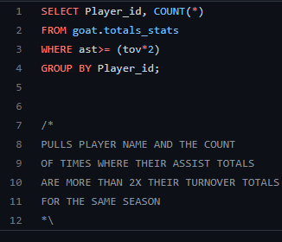

CAREER ASSISTS ASSESSMENT
LEBRON HAS THE MOST SEASONS WHERE HE HAD MORE ASSISTS THAN 2X HIS TURNOVERS.
THIS IS A KPI BECAUSE THE GOAT HAS TO BE A TEAM PLAYER AS WELL AS A GREAT INDIVIDUAL PLAYER. WHATS A BETTER WAY TO SHOW YOU ARE A TEAM PLAYER THAN TO HAVE DOUBLE YOUR TURNOVERS IN ASSISTS?

Slide 10
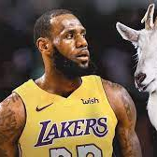
GOAT BASED ON DATA ANALYSIS
BASED ON MY 3 KPI’S, LEBRON IS THE GOAT BECAUSE HE LEADS IN 2 OF THE 3 KPI’S.

Slide 11
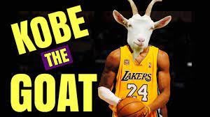
GOAT BASED ON MY OPINION
KOBE IS MY GOAT. (I MAY BE BIASED BECAUSE MY NAME JACOBY IS DERIVED FROM MY PARENT’S FASCINATION WITH THE REAL GOAT KOBE “BEAN” BRYANT)

