Slide 1
> Hay una demanda importante de entrenamiento en habilidades básicas de programación
> Los libros de texto de ingeniería de software no son apropiados para enseñar a programar a la mayoría de los científicos.
Historia:
https://software-carpentry.org/scf/history/
Notes:
In the Beginning...
In 1995-96, Greg Wilson organized a series of articles in IEEE Computational Science & Engineering titled, "What Should Computer Scientists Teach to Physical Scientists and Engineers?" These articles grew out of his frustration working with scientists who wanted to parallelize complex programs but didn't know what version control was, how to write a unit test, or even why they should break their programs down into functions.
In response, John Reynders (then director of the Advanced Computing Laboratory at Los Alamos National Laboratory) invited Wilson and Brent Gorda (now at Intel) to teach a week-long course to LANL staff. The course ran for the first time in July 1998, and was repeated nine times over the next four years. It eventually wound down as the principals moved on to other projects, but taught us two valuable lessons:
There is tremendous pent-up demand for training in basic skills.
Textbook software engineering is not the right thing to teach most scientists.

Slide 2

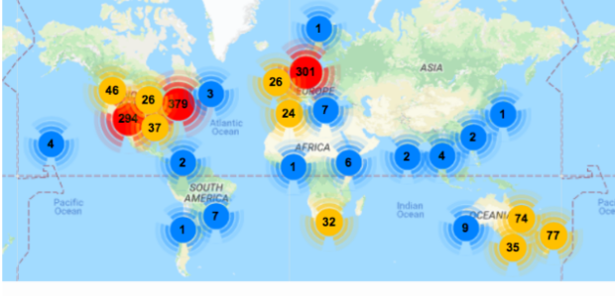
Somos una comunidad global que enseña habilidades básicas de computación y ciencia de datos a investigadores en
el mundo académico,
la industria
y el gobierno.
https://twitter.com/thecarpentries
https://carpentries.org
Organización sin fines de lucro
Notes:
In the Beginning...
In 1995-96, Greg Wilson organized a series of articles in IEEE Computational Science & Engineering titled, "What Should Computer Scientists Teach to Physical Scientists and Engineers?" These articles grew out of his frustration working with scientists who wanted to parallelize complex programs but didn't know what version control was, how to write a unit test, or even why they should break their programs down into functions.
In response, John Reynders (then director of the Advanced Computing Laboratory at Los Alamos National Laboratory) invited Wilson and Brent Gorda (now at Intel) to teach a week-long course to LANL staff. The course ran for the first time in July 1998, and was repeated nine times over the next four years. It eventually wound down as the principals moved on to other projects, but taught us two valuable lessons:
There is tremendous pent-up demand for training in basic skills.
Textbook software engineering is not the right thing to teach most scientists.

Slide 3

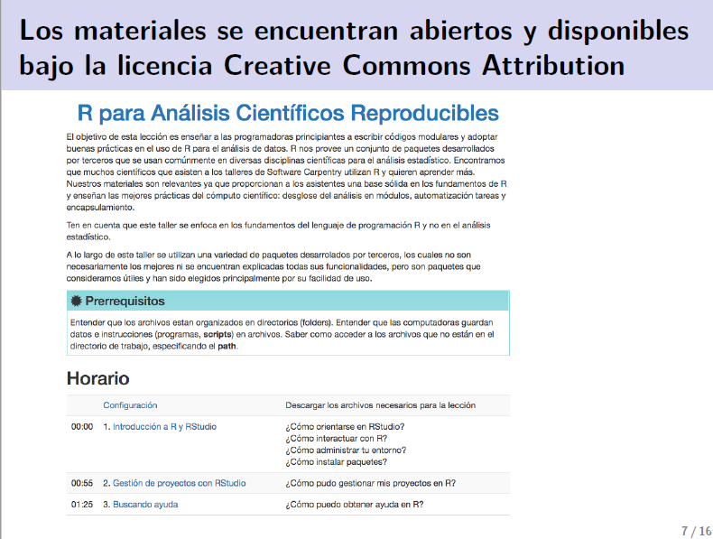
The Carpentries está creciendo en Latinoamérica por el esfuerzo de la comunidad
Traducción de las lecciones al español
http://swcarpentry.github.io/r-novice-gapminder/
Notes:
http://swcarpentry.github.io/r-novice-gapminder/

Slide 4
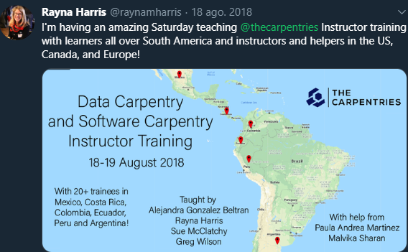
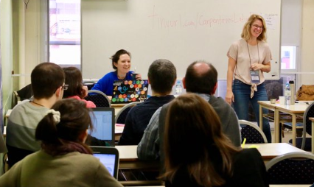
Primeros instructores latinoamericanos certificados
LatinR 2018
¿Te gustaría participar?
slack
swcarpentry.slack.com
twitter
@thecarpentries
Notes:
http://swcarpentry.github.io/r-novice-gapminder/

