Slide 1
UPVAAS-Twin
A festival-aware metabolic digital twin for Indians with type 2 diabetes
Predicting hypoglycaemia and glucose spikes two hours ahead, and rehearsing a patient's
religious fast before the patient lives it.
Happiest Health · Reimagining and Reforming Healthcare in India Summit 2026
Digital Twin Challenge
Breakpoint Consulting · Symbiosis Institute of Management Studies, Pune

Slide 2
Half of Indian T2D patients fast for religion, most take a drug that does not stop
The dangerous combination is scheduled, so it can be predicted
The scale
The drug
The behaviour
101 million adults with diabetes in India.
136 million more with prediabetes.
ICMR-INDIAB, Lancet Diab Endo 2023
57% of one North Indian clinic cohort take a sulfonylurea.
It keeps releasing insulin even when no food arrives.
49% had fasted for religion in the past year.
4% checked their glucose during the fast.
1.35% asked a doctor first.
Navratri · Ekadashi · Karva Chauth (nirjala) · Ramadan roza
A morning glimepiride followed by a thirteen hour fast produces a hypoglycaemia that was predictable the day before. The festive thali that breaks the fast produces a spike that was equally predictable.
Existing digital twins treat those days as noise. They predict meal responses, assume the patient wears a CGM, and never look at the calendar.
What we predict
Adverse event
Threshold
Horizon
Who it matters for
Hypoglycaemia
< 70 mg/dL for 15 min
2 hours ahead
Sulfonylurea patients during a fast
Hyperglycaemia
> 250 mg/dL for 15 min
2 hours ahead
Everyone, after the fast breaks
Problem
Solution
Results
Evidence
Deployment
2

Slide 3
Commercial twins answer a different question, and assume hardware most Indians lack
Where UPVAAS-Twin sits against what already exists
Twin Health / January AI
Academic hybrid twins
UPVAAS-Twin
Predicts
food to glucose response
glucose trajectories, mostly T1D
adverse events 2 h ahead, plus what-if
Model
gradient boosting / RF
physics-constrained neural net
mechanistic ODE + particle filter + calibrated GBM
Uncertainty
not published
sometimes, marginal only
conformal, reported by glucose range
Needs a CGM?
yes
yes
no, three sensor tiers evaluated
Validated against
not published
the same model family
a structurally different body model
India specific
food database
no
festival calendar, thin-fat prior, SU pharmacogenomics, ASHA workflow
Fairness audit
no
rarely
yes, led by fasting tradition
A 2026 review of 28 diabetes digital twin studies found one that addressed fairness and three with a human in the loop. None forecast adverse events.
Problem
Solution
Results
Evidence
Deployment
3

Slide 4
Static data sets the prior, live data updates the posterior, the calendar says what is coming
Five layers, from raw streams to a clinician's screen
1 Data in
2 Twin core
3 Intelligence
4 Decision
5 Governance
India-localised synthetic EHR:
labs, meds, eGFR, CYP2C9, TCF7L2
CGM or 2 fingersticks a day
watch: HR, HRV, steps, sleep
festival calendar + PM2.5
EHR to physiology prior (ridge)
SU-Bergman-Gut ODE
particle filter, 64 candidate
physiologies per patient
2 h forecast on the calendar plan
gradient boosting on fused
EHR + stream + calendar + twin
isotonic calibration
Mondrian conformal bands
counterfactual drivers
clinician console, ranked roster
Vrat Rehearsal what-if
ASHA pre-festival recall list
FHIR R4 RiskAssessment
DPDP: consent ID, purpose limit
ABDM: HIE-CM consent artefact
CDSCO draft: informs a doctor,
likely Class B
ICMR: human in the loop
▶
▶
▶
▶
What makes it a twin rather than a classifier
The particle filter keeps 64 candidate physiologies per patient and re-weights them on every glucose reading, so the model follows the patient instead of scoring them once.
Those same posterior particles are replayed forward under a changed plan. That is the Vrat Rehearsal: the doctor asks what happens if the glimepiride moves to the fast-breaking meal, and gets an answer before the fast.
Problem
Solution
Results
Evidence
Deployment
4

Slide 5
The model knows why a fast plus a morning glimepiride is dangerous
Mechanistic core, so every alert can be explained to the patient
SU-Bergman-Gut model, per minute
Why that combination harms people
Bergman minimal model for glucose and remote insulin action.
Two-compartment gut, absorption set by the food's glycaemic index and fat.
Sulfonylurea PK/PD that keeps secreting insulin at low glucose.
Fasting clock: hepatic output falls after about 11 hours without food.
Counter-regulation blunted by autonomic neuropathy.
CYP2C9 genotype and eGFR lengthen the drug half-life prior.
The tablet is taken at 08:30 on a normal schedule.
No carbohydrate arrives for the next thirteen hours.
Insulin secretion continues anyway.
After eleven hours the liver has less glycogen to release.
In a patient with neuropathy the warning symptoms are blunted.
Glucose falls in the late afternoon, hours before moonrise.
The twin turns that mechanism into four things a doctor can act on
Risk now
A virtual patient
A rehearsal
A recall list
Calibrated probability of an event in the next two hours, with the drivers behind it.
Personalised insulin sensitivity, beta-cell gain, hepatic set-point and drug half-life, each next to its EHR-only prior.
Tomorrow's fast replayed under four drug plans before the patient lives it.
Every faster in the ward ranked before the festival, with language, ward and an action script.
Problem
Solution
Results
Evidence
Deployment
5

Slide 6
The twin earns its keep where there is no CGM, which is most of India
200 synthetic patients x 28 days, 5-fold patient-grouped cross-validation
Tier B: two fingersticks a day and a basic smartwatch. No CGM.
0.08 → 0.13
5.4 → 2.7
26%
hypoglycaemia AUPRC
false alarms per patient-day
precision of a 20-name worklist
1.6x by adding the twin
the twin filters as well as ranks
against a 0.9% base rate
Of the 20 patients the twin flags each morning, about 5 really do have an event within two hours.
Sensor tier
AUROC
AUPRC [95% CI]
Without twin
P@20
Recall
False alarms/day
A CGM + watch
0.959
0.220 [0.10-0.34]
0.171
0.36
56%
1.00
B 2 fingersticks + watch
0.911
0.132 [0.05-0.23]
0.080
0.26
58%
2.69
C EHR + phone only
0.792
0.071 [0.02-0.14]
0.034
0.26
62%
6.87
Forecasting, tier A
How it was scored
Twin RMSE 27 / 33 / 38 mg/dL at 30 / 60 / 120 min.
Persistence 29 / 44 / 55 mg/dL.
Clarke error grid zones A+B: 97.2%.
Every patient scored by a model that never saw them, in the dashboard as well as the metrics.
Patient-clustered bootstrap intervals on every headline number.
Only 40 of 200 patients ever had a hypoglycaemic event, so the intervals are wide and we print them.
Problem
Solution
Results
Evidence
Deployment
6

Slide 7
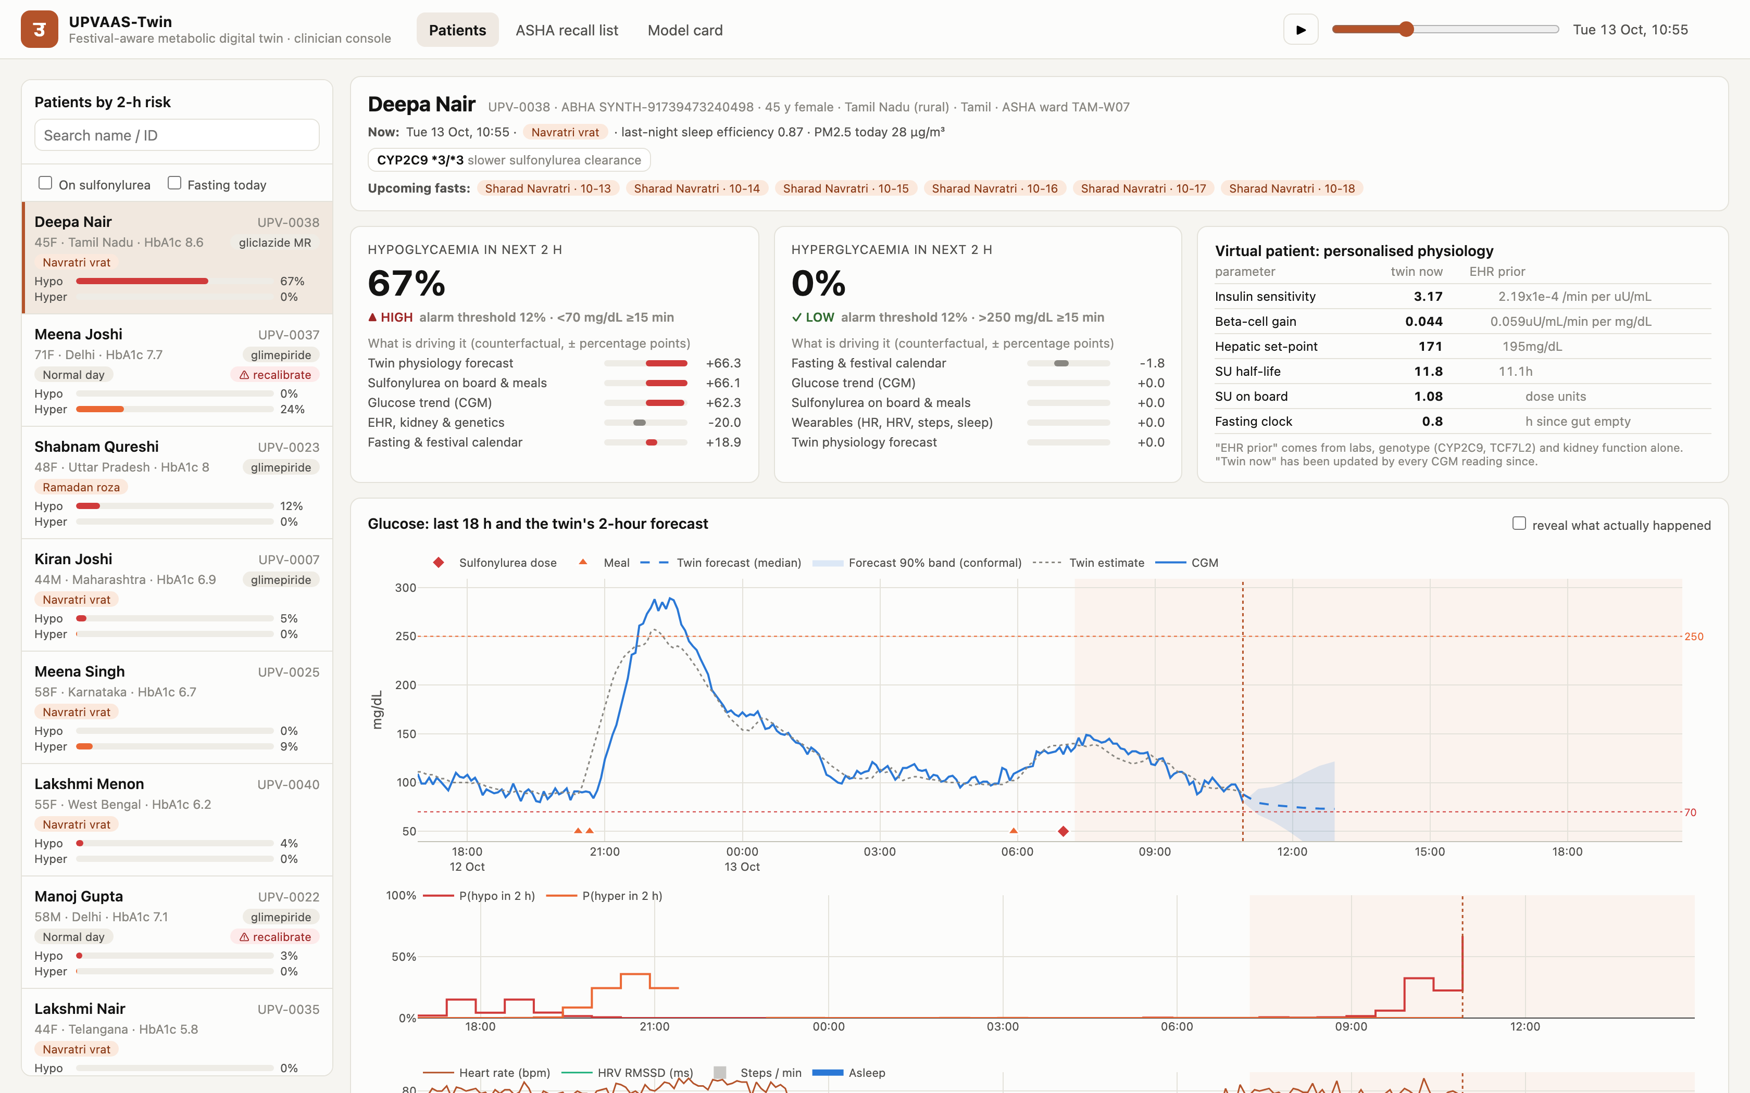
The doctor sees the risk, the reason, and the patient's own physiology
Clinician console, built for a ten-minute OPD consultation
Risk, with its drivers
Calibrated probability and the alarm threshold.
Counterfactual attribution shows which feature group moved it.
The virtual patient
Insulin sensitivity, beta-cell gain, hepatic set-point, drug half-life.
Each shown against its EHR-only prior, so the doctor sees what the data changed.
Forecast band
Mondrian conformal, so the band widens where the twin is least reliable.
A reveal toggle shows what actually happened, for teaching.
Roster ranked by two-hour risk, with today's vrat type and a recalibrate flag
Problem
Solution
Results
Evidence
Deployment
7

Slide 8
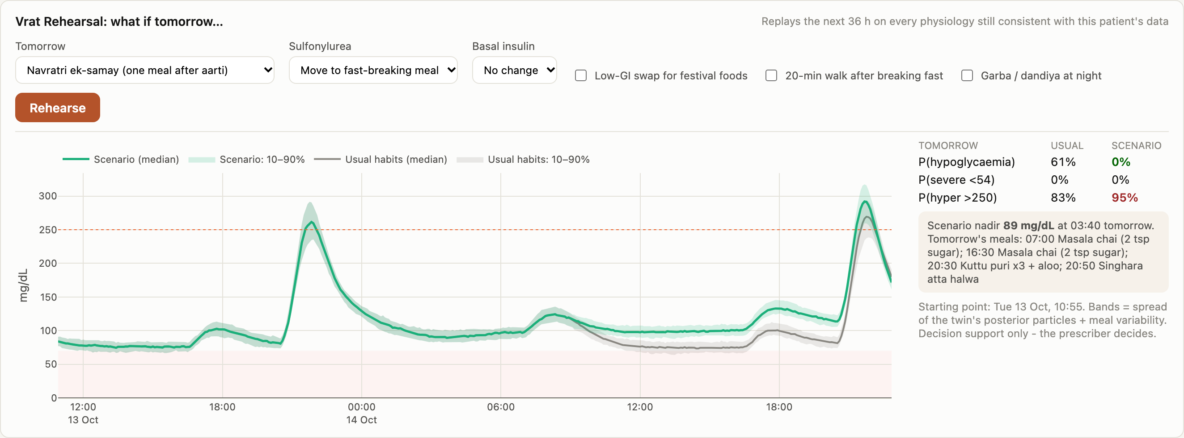
Moving the tablet to the fast-breaking meal takes this patient from 61% to 0%
Vrat Rehearsal: a 36-hour counterfactual on the posterior particles
What the doctor changes
Which fast tomorrow is: Karva Chauth, roza, Navratri phalahar or ek-samay.
Sulfonylurea: as usual, halved, skipped, or moved to the fast-breaking meal.
Basal insulin, a low-GI swap, a walk after iftar, garba at night.
What comes back
P(hypo), P(severe), P(hyper) and the predicted nadir time.
Across all sulfonylurea-treated fasters, moving the dose lowers predicted hypoglycaemia from 28% to 10%.
Read as a ranking, not a calibrated probability. The rehearsal over-predicts how often a fast ends in hypoglycaemia.
Grey is the patient's usual habit, green is the proposed change
Problem
Solution
Results
Evidence
Deployment
8

Slide 9
We made the benchmark hard on purpose, and published the baseline that beats us
A result you cannot break is a result you cannot trust
The virtual body is not the twin
Eating is messy on purpose
The body runs a different model: three-compartment gut, interstitial insulin delay, circadian insulin sensitivity, renal glucose excretion, an incretin term.
The twin has an equation for none of them, so the error we report includes model misspecification and not only parameter error.
Correlation between the festival meal plan and what was actually eaten: 0.55.
23% of food intake was never on the plan.
Wide meal-time jitter, skipped meals, unplanned snacks. The calendar is a prior, not an oracle.
The baseline that keeps us honest
Four features: planned carbohydrate in the next two hours, HbA1c, and time of day. No glucose reading, no wearable, no twin. It reaches hyperglycaemia AUPRC 0.30 against 0.60 for the full tier-A model.
We publish it so a reader can see how much of the task is physiology and how much is a meal timetable.
Null results we report rather than bury
Number
The festival calendar as model features adds nothing
0.218 vs 0.220
The drift self-check does not work well enough to deploy
AUROC 0.53
Forecast bands cover far less than 90% above 250 mg/dL
58% vs 90% target
The hypoglycaemia signal rests on a minority of patients
40 of 200
Problem
Solution
Results
Evidence
Deployment
9

Slide 10
We took it to real patients, it did not beat persistence, and the failure explains itself
ShanghaiT2DM: 107 real CGM recordings, no retraining. Beyond what the brief asks for
2-hour forecast on real patients
Twin
Persistence
Can a better prior fix it? (59 held-out patients)
Ratio to persistence
RMSE
52 mg/dL
46 mg/dL
Original prior, as submitted
1.10
Clarke zones A+B
91.4%
95.5%
Original prior, simply widened
1.01
On our own simulator
38 mg/dL, ahead of persistence
55 mg/dL
Prior refitted on real patients
1.10
The finding is worth more than a fixed number
Refitting the prior on real patients changed nothing. Merely widening it reached parity with persistence and no further.
The refit told us why. Its residual spread exploded: hepatic set-point SD went from 8 to 40 mg/dL and ln insulin sensitivity from 0.22 to 1.26. In a real cohort the routine EHR fields barely predict these physiological parameters. In our simulator they predict them well because the simulator generated the labs from those parameters in the first place.
What this changes
What would have to happen next
Not the design. The mechanistic core, the filter, the rehearsal and the sensor ladder are unchanged.
It puts a number on the warning the README already carried: the simulated results are an upper bound.
Fit the prior against real physiological reference data, from clamp or OGTT studies, not routine labs.
Handle sparse 15-minute sampling directly instead of upsampling.
Then repeat this same script and see whether the numbers move.
Problem
Solution
Results
Evidence
Deployment
10

Slide 11
Audited first on the axis this project is built on
Fairness, uncertainty and the Indian regulatory path
Fasting tradition
AUROC
Events
Uncertainty that keeps its promise
Also audited
karva chauth
0.980
76
A single conformal margin covers 47% of outcomes above 250 mg/dL while claiming 90%.
Mondrian conformal, calibrated per predicted-glucose band, raises that to 58% with a narrower band overall.
Both are published, by outcome range.
Sex, urban and rural, age, eGFR, region.
A model card ships inside the dashboard.
The tier C path still works for a patient who refuses or cannot afford a wearable.
navratri
0.938
1245
none
0.981
673
ramadan
0.973
404
Requirement
How UPVAAS-Twin meets it
DPDP Act 2023 / Rules 2025
Synthetic data only. Production design keeps a consent ID on every record, enforces purpose limitation, deletes on expiry.
ABDM
Registers as a Health Information User. Consent artefact via HIE-CM. FHIR R4 bundles validated against the R4 schema.
CDSCO draft software guidance, Oct 2025
Informs a registered practitioner rather than directing treatment, so likely Class B. Drift monitor is the hook an Algorithm Change Protocol would attach to.
ICMR 2023 AI ethics
Human in the loop, Indian-representative priors, subgroup audit, published model card, a working path for patients without devices.
Problem
Solution
Results
Evidence
Deployment
11

Slide 12
It runs on a clinic laptop, and reaches the patient through an ASHA
Where this goes next, and what it would take
1. Two weeks before
2. Home visit or call
3. Teleconsult
4. During the fast
The ASHA app receives a ranked recall list for every faster in the ward, with language, ward and an action script.
The highest-risk patients are nudged to see a doctor before the fast, not after an ambulance call.
The doctor runs a Vrat Rehearsal in clinic or over eSanjeevani and picks a drug plan.
The patient has a dose-timing plan in their own language. The twin keeps scoring risk every 30 minutes.
▶
▶
▶
Where it would run
How we would prove it
NP-NCD screening at Ayushman Arogya Mandirs, which carry about 25 million people on diabetes treatment under the 75 by 25 initiative.
Private diabetology clinics and CGM programmes.
One clinic server can cover a district. Tiers B and C need no CGM.
Fit the prior on real physiological reference data, then repeat the external validation.
IRB-approved observational pilot during Navratri 2027, 100 sulfonylurea-treated fasters on Libre CGMs.
Cluster-randomised ASHA recall-list trial, outcomes being hypoglycaemia events and ER visits.
The fast is on the calendar. The hypoglycaemia does not have to be a surprise.
Research prototype on synthetic data. Not a medical device. It informs a registered medical practitioner and decides nothing.
MIT licence. Every number in this deck regenerates from reports/metrics.json.
Problem
Solution
Results
Evidence
Deployment
12

