Slide 1
A Framework for High Level Synthesis using TED
(Taylor Expansion Diagram)
Prepared by
Daniel Gomez-Prado
Aug 10 - 2011

Slide 2
Outline
Introduction
  Overview of Taylor Expansion Diagrams (TED)
  Optimizing DFGs for HW Implementations
  Functional Retiming
  Computational Accuracy
Overview of the data structures used
Other Projects

Slide 3
Current CAD Flow
Algorithm
High Level Description of the design (VHDL, c++)
Parsing and elaboration
Compiler like optimizations
Structural DFG
DFG₁
Data Flow Graph
Tree balancing
Common sub-expression elimination
High Level Synthesis
Scheduling, Allocation, Binding
Logic & Physical Synthesis
Library mapping, Routing
Architecture
All possible Architectures reachable from DFG₁

Slide 4
But some DFGs produce better Architectures
No automation
DFG₁
Minimum delay
Requires:
2 MPYs
1 ADD
DFG₂
Minimum delay
Requires:
1 MPY
2 ADDs
Architecture
Architecture
How do we find the best DFG?
How do we generate another functionally equivalent DFG?

Slide 5
Taylor Expansion Diagrams
TED captures the functional representation of a DFG.
TED can modify the DFG
preserving its functionality.
TED
DFG₄
Variable order 1
DFG₁
Variable order 2
DFG₂
Variable order 3
DFG₃
Variable order 4
Architecture
Architecture

Slide 6
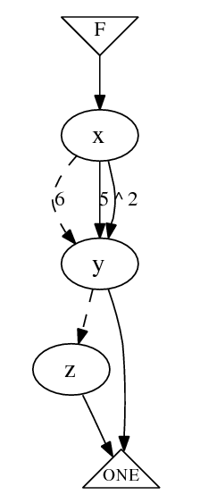


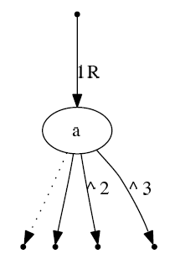
TED Graph Notation
Follows Taylor decomposition:
FIG2
FIG1
Additive edge
Multiplicative
or linear edge
It is a canonical data structure

Slide 7
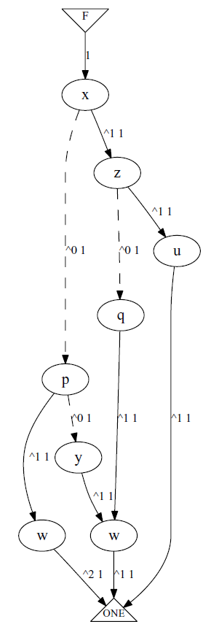
TED Construction
TED & TDS Overview
x(zu+qw)
(zu+qw)
+
Canonical for the given order:
x,z,u,q,p,y,w
+
zu
Notation:
+
X
qw
pw
2
5x³×f
^3 5
f
yw

Slide 8
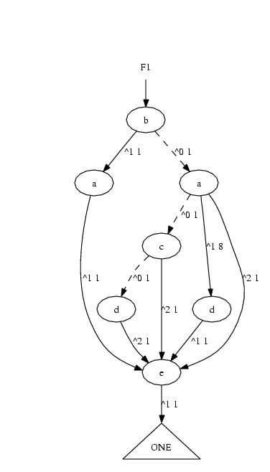
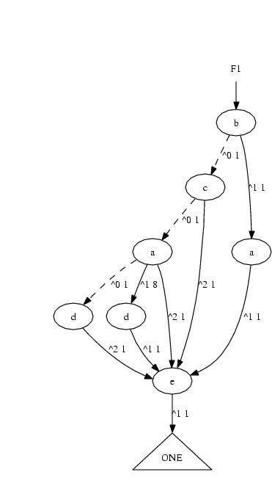
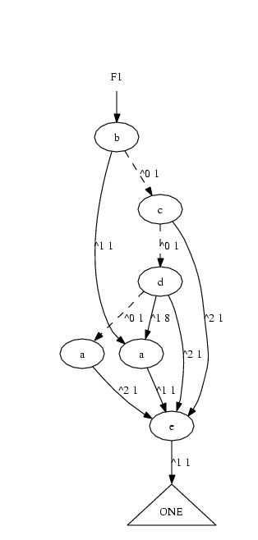
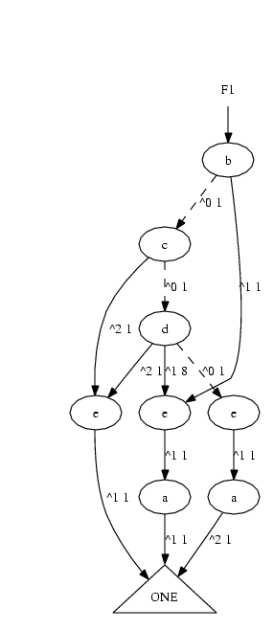
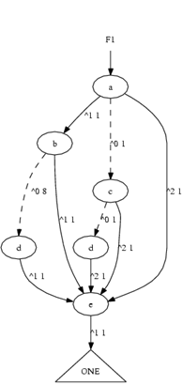
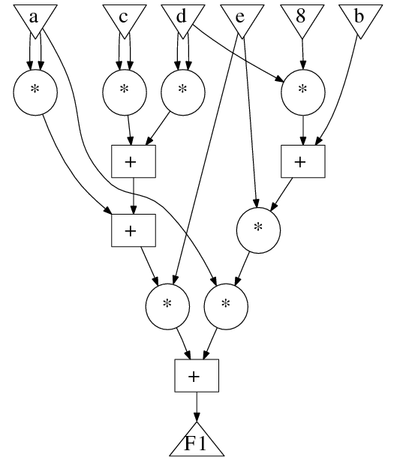
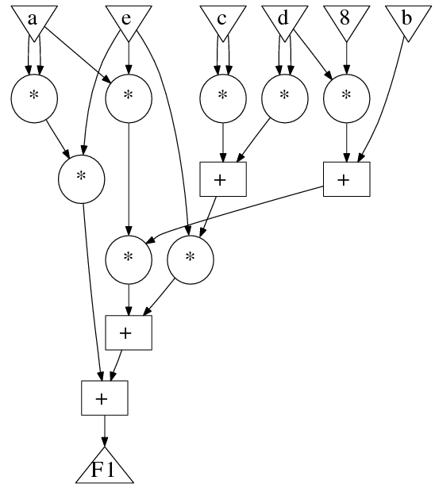
TED Variable Ordering

Slide 9
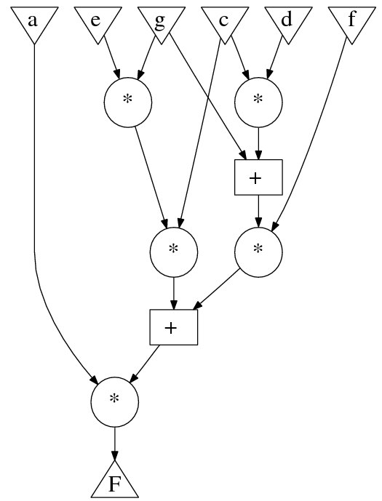
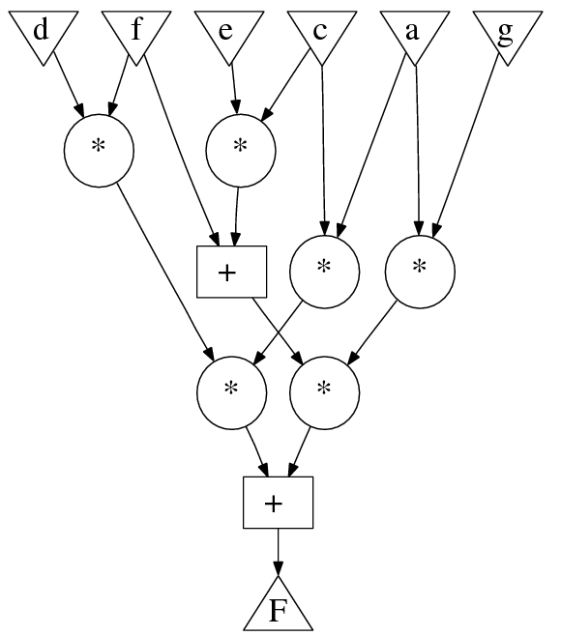
TED optimizes HW not operation count
5MUL,2ADD
6MUL,2ADD
FIG2
TED
optimizes
HW objectives
CSE
optimizes
operations
FIG1
Critical path: 3d_{MPY}+2d_{ADD}
Critical path: 2d_{MPY}+2d_{ADD}
Latency: 5 steps
Latency: 4 steps
Resources: 2MPY
1ADD
Resources: 2MPY
1ADD

Slide 10
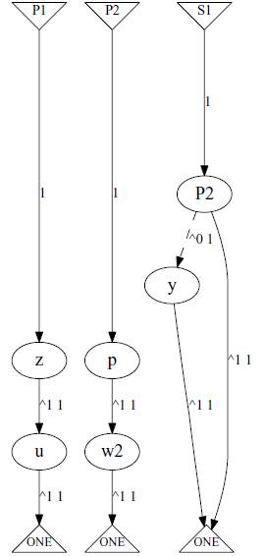
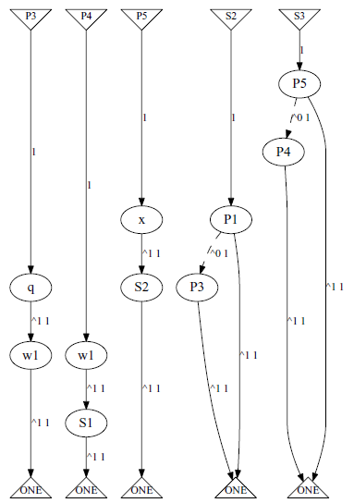
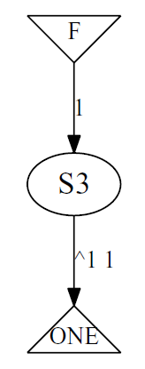
Optimizing DFGs for HW (TED Decomposition)
FIG1
FIG2
Product term extraction
Sum term extraction
dynamic factorization
reordering
+
additive
edge
+
X
+
X
X
X
X
linear
edge
DFG ASAP schedule
Resources: 3MPY
2ADD
1
2
3
4
Latency: 4

Slide 11
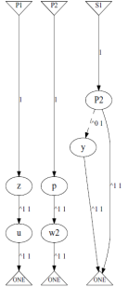

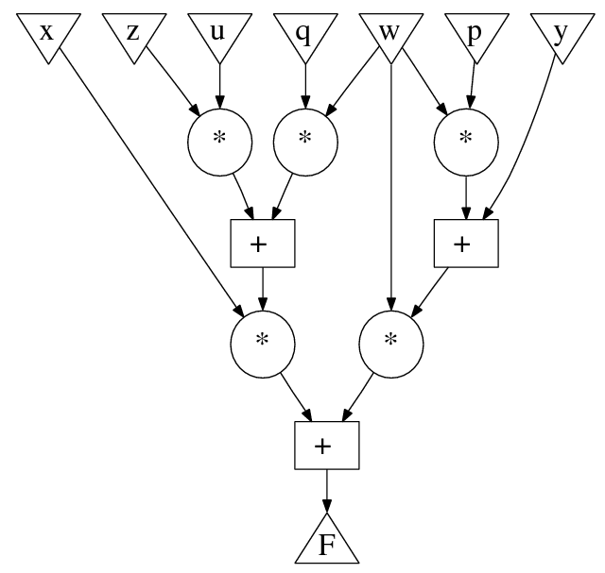
Data Flow Graph
NFF
total: 5× , 3+
Reordering cost
Path delay 2d_{MPY}+2d_{ADD}
Latency 4 steps
Resource 3MPY & 2ADD

Slide 12


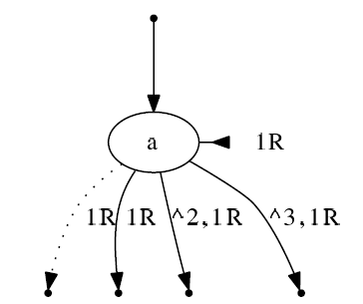
Functional Retiming in TED
The retime operator ()^{R} is lineal because it is the convolution * with
the time delayed delta Dirac δ.
Because ()^{R} is a lineal operator, it can be applied to the TED graph.
Taylor decomposition:
Lineal operator ()^{R}:

Slide 13
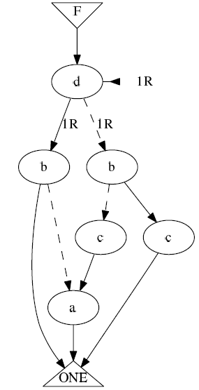
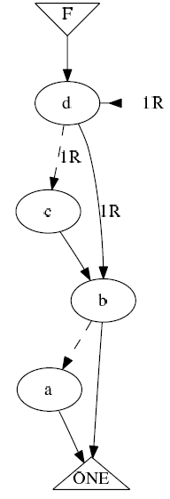
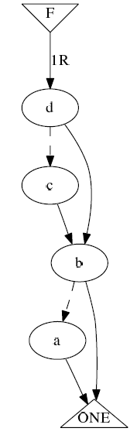
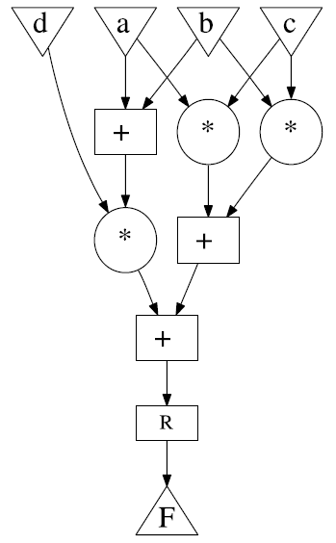
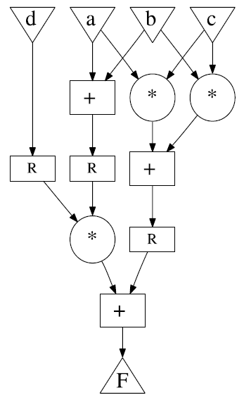
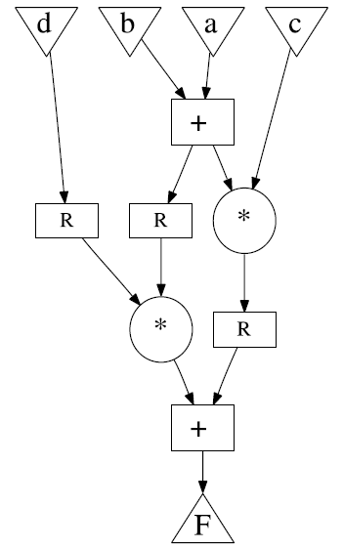
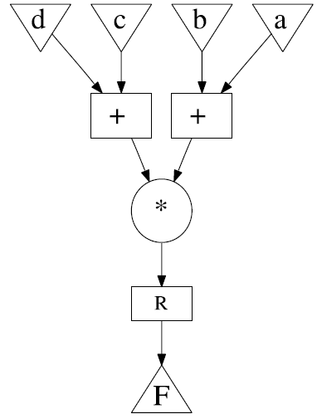
Example of Functional Retiming
ordering
retiming
Classic data
path retiming
FIG4
FIG1
FIG2
FIG3

Slide 14
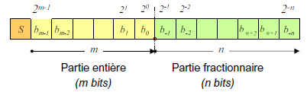
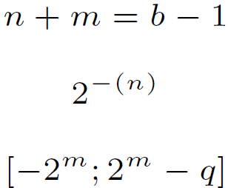




Fixed Point Arithmetic
=
Integer part Fractional part
=
Addition
a Q(ma,na)
+
c
b Q(mb,nb)
Multiplication
a Q(ma,na)
x
c
b Q(mb,nb)

Slide 15
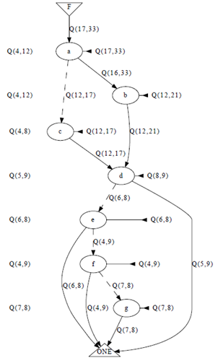
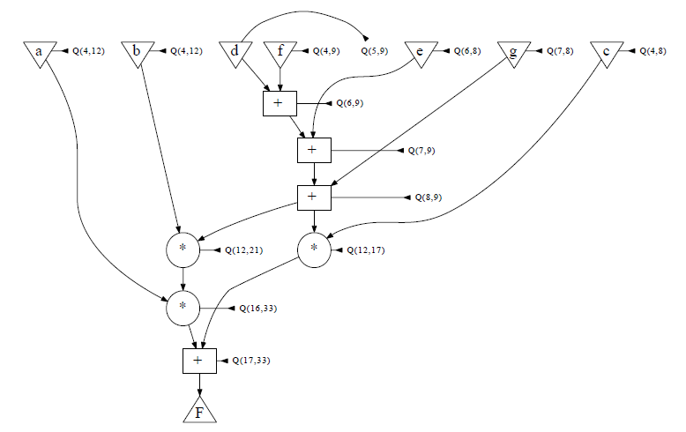
TED With Fixed Point Arithmetic
Bit-accurate
computation
Bit-width
minimization
Uses Gappa:
arithmetic property tool
DFG optimization under accuracy constraints
HW accuracy certification

Slide 16
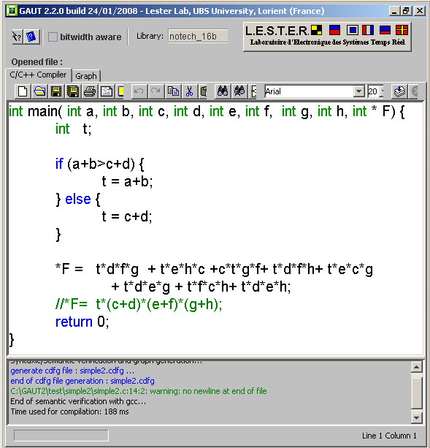
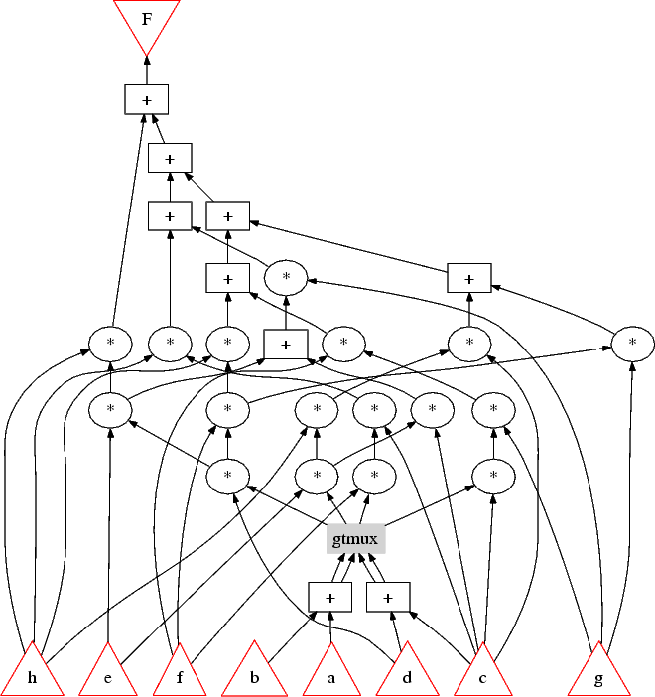
Integration with GAUT
Primary output
Functional operations
Structural element
Primary inputs
Example behavioral design in C
Initial TDS network

Slide 17
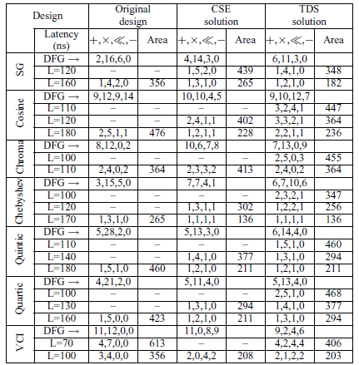
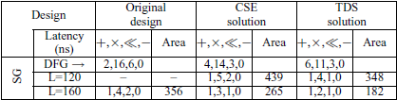
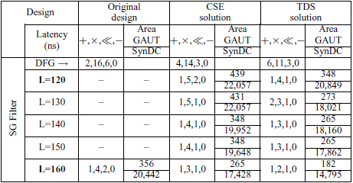
Experiments & Results

Slide 18
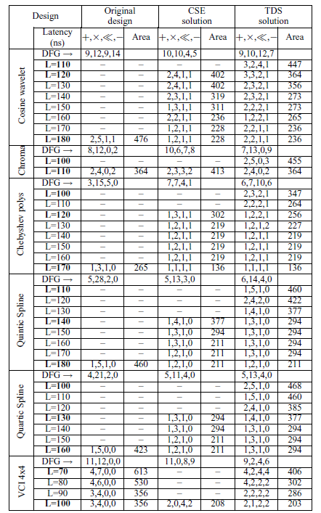
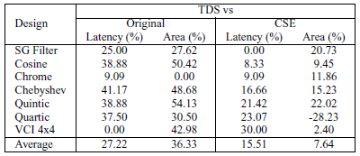
Improvement over CSE and Original Design

Slide 19
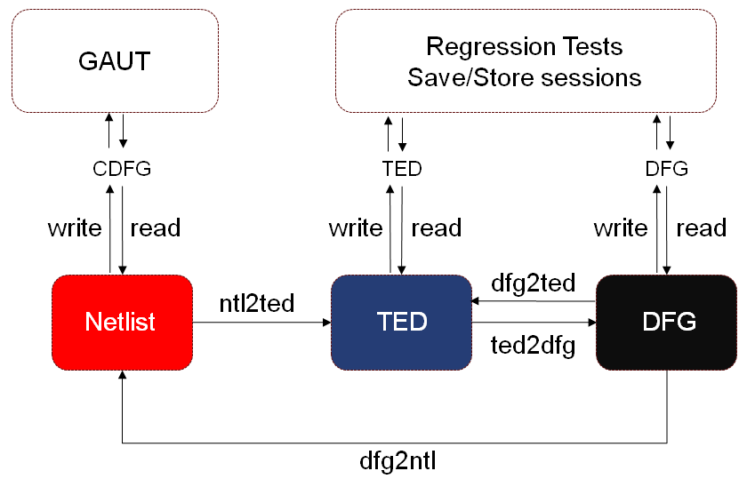
Part II: Data Structure
VHDL
c/c++
tcl
Manager
Manager
Manager
Quartus
Decompose
Convert
Retime
Reorder
Cost
Shell +
History
Command Facilities

Slide 20
Ted Manager
Viewer
Functor:
collect Parents
Parents
BFS iterator, DFS iterator
Convert
Primary Outputs
root1
root2
Ted Container
Reorder
node
kids
var1
Linearization
Retiming
Binary
Constant
Variable
Grouping
Mux
Area
Nodes
Edges
delay
kid
kid
kid
Primary Inputs
Cost
node
kids
var2
Strategy
kid
kid
Annealing
Sift
Exhausive
node

Slide 21

Thanks …

