Slide 1
CORNELL FINTECH CLUB · SPRING 2026
{{ INSERT_HERO_PRODUCT_SCREENSHOT }}
LoanApproval
Full-stack lending platform for borrower intake, automated credit policy, document workflows, and underwriter review.
LIFECYCLE
DECISION MODES
STACK
Apply → Fund
Rules · ML · LLM
Next.js + FastAPI
LoanApproval
01

Slide 2
CORE THESIS
Product At A Glance
LoanApproval turns a fragmented SMB loan process into a structured credit file with a transparent policy decision.
Borrower
Underwriter
Self-serve application, document upload, confirmation and status views.
Portfolio KPIs, pipeline, sortable application queue, detailed credit review.
Borrowers complete a guided multi-step application.
Underwriters review every deal in a portfolio dashboard.
Rules engine produces deterministic approve, decline, or manual-review outcomes.
ML scoring and LLM extraction are wired as risk and productivity layers.
Policy
Platform
Weighted core ratios, industry tracks, amount-based thresholds, hard stops.
FastAPI, PostgreSQL, Supabase Storage, swappable OpenAI or Anthropic client.
{{ INSERT_PRODUCT_OVERVIEW_COMPOSITE }}
LoanApproval
02

Slide 3
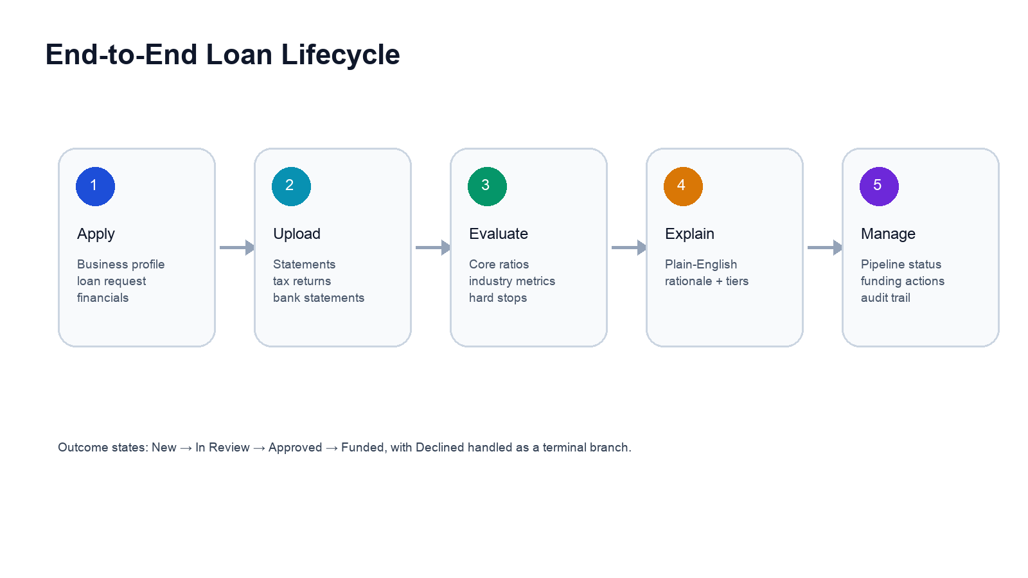
WORKFLOW
Loan Lifecycle
LoanApproval
03

Slide 4
FRONTEND
Borrower Entry Point
The landing page positions the product around speed, transparency, and no hard credit pull.
{{ INSERT_SCREENSHOT: Landing page / financing options }}
Primary CTA routes directly to `/apply/step/1`.
Financing options include term loans, lines of credit, equipment finance, and bridge loans.
Eligibility copy sets basic borrower expectations before intake begins.
LoanApproval
04

Slide 5
BORROWER FLOW
Guided Application Intake
{{ INSERT_SCREENSHOT: Multi-step application form }}
1. Business Profile
Legal name, DBA, industry, structure, EIN, address, and years in operation.
2. Loan Request
Amount, purpose, optional use-of-funds detail, and desired term.
3. Review & Submit
Certified application payload creates borrower and application records.
LoanApproval
05

Slide 6
CREDIT FILE
Financial Data Capture
The borrower workflow collects financial statements as structured values before underwriting.
DSCR
LTV
EBITDA / annual debt service
loan amount / collateral
Core fields: revenue, EBITDA, debt, assets, collateral, annual debt service, bankruptcies.
Optional fields improve ratio coverage: current assets, liabilities, EBIT, interest expense.
The UI calculates DSCR, LTV, and leverage while the user enters data.
Leverage
Liquidity
existing debt / EBITDA
current assets / liabilities
{{ INSERT_SCREENSHOT: Financials step with calculated ratios }}
LoanApproval
06

Slide 7
EVIDENCE
Document Workflow
Document collection supports the credit file without forcing everything into manual email threads.
{{ INSERT_SCREENSHOT: Document upload drop zones }}
Required slots: financial statements, tax returns, and bank statements.
Optional slots: AR aging and collateral documentation.
Upload endpoint records metadata and storage path, then writes an audit event.
LoanApproval
07

Slide 8
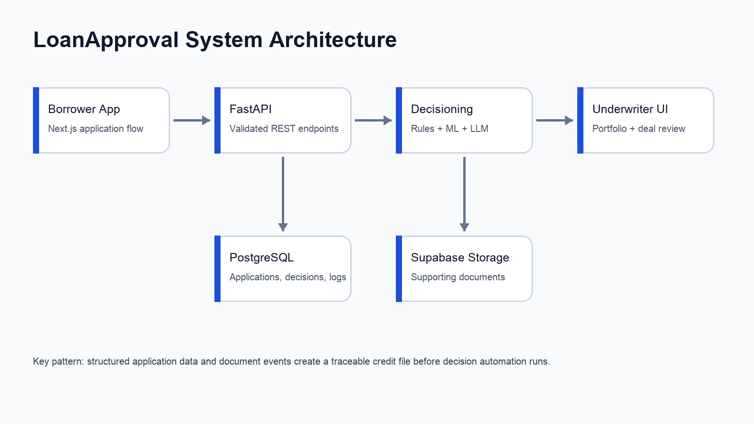
PLATFORM
Backend Architecture
LoanApproval
08

Slide 9
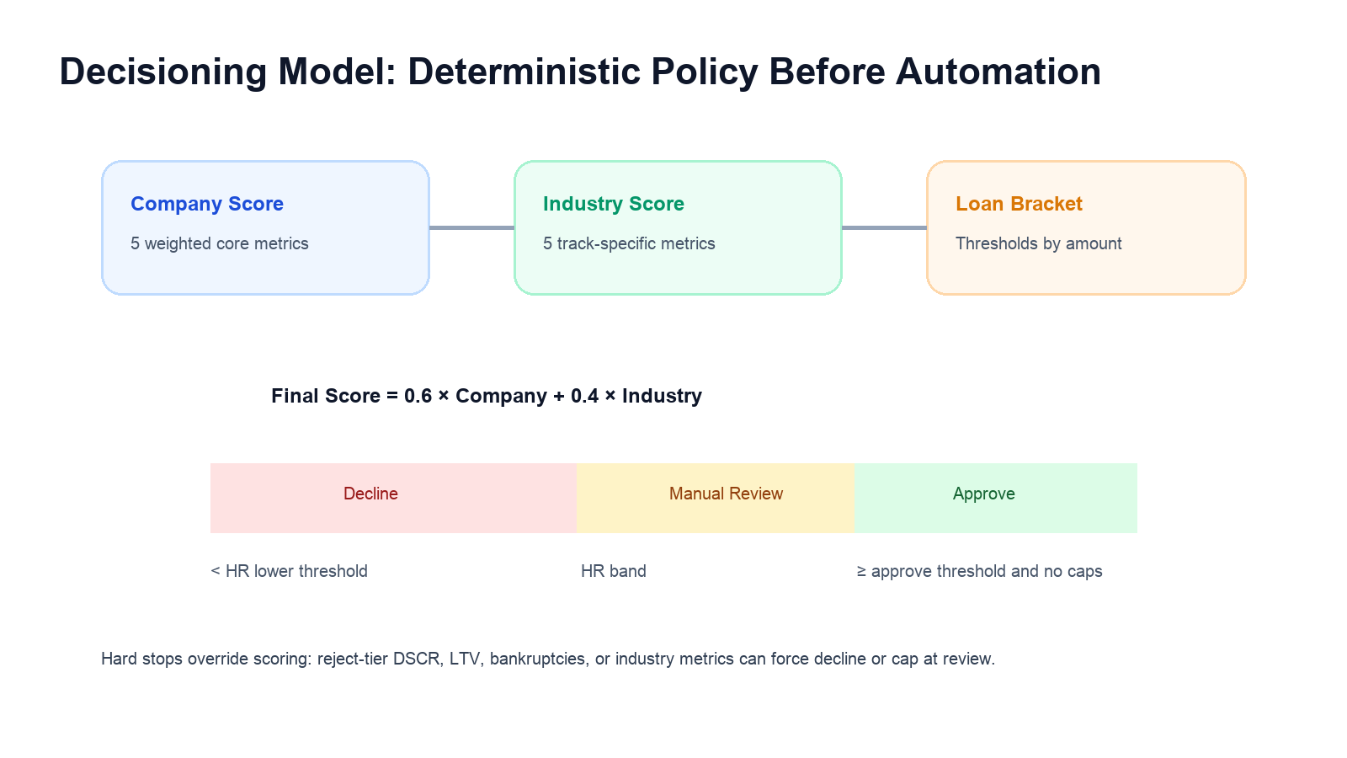
DECISIONING
Credit Policy Engine
Company score: weighted 0–2 score across five core metrics.
Industry score: average 0–2 score across the selected industry track.
Final score: 60% company score and 40% industry score.
Loan brackets tighten approval thresholds as requested amount increases.
LoanApproval
09

Slide 10
RISK SEGMENTATION
Industry-Specific Underwriting
Tech
Hospitality
Retail
growth, margin, concentration, burn coverage, NRR
RevPAR, GOP/room, occupancy, cap rate, current ratio
sales/sqft, GMROI, inventory turns, gross margin, same-store sales
Healthcare
Industrials
operating margin, cash on hand, AR days, payer mix, collections
asset turnover, interest coverage, margin, OCF, backlog
The important design choice is traceability: each industry metric produces a tier label, score, and triggered-rule payload that can be displayed to analysts.
LoanApproval
10

Slide 11
RISK MODEL
ML Default Probability
The ML layer is designed as an additional signal, not a black-box replacement for policy.
{{ INSERT_IMAGE: ROC curve / feature importance / model card }}
Training script supports LendingClub CSV input or synthetic fallback data.
Feature set mirrors the application schema plus engineered ratios.
Model pipeline combines logistic regression and gradient boosting through soft voting.
API stores probability on the existing decision and logs the scoring event.
LoanApproval
11

Slide 12
AUTOMATION
LLM-Assisted Operations
{{ INSERT_SCREENSHOT: Analyst explanation panel }}
Document Extraction
Financial statements and tax returns route to `/llm/extract/{doc_id}` for structured field extraction.
Decision Explanation
Decision outcomes can be translated into plain-English rationale using the same triggered-rule payload.
Provider Abstraction
OpenAI and Anthropic are swappable through `LLM_PROVIDER` and provider-specific API keys.
LoanApproval
12

Slide 13
PORTFOLIO VIEW
Underwriter Dashboard
KPI cards summarize exposure, active deals, approval rate, and average loan size.
Charts show monthly originations and status breakdown.
Recent applications link directly into the credit file.
Application table supports search, status filter, sorting, and pagination.
{{ INSERT_SCREENSHOT: Dashboard overview and applications table }}
LoanApproval
13

Slide 14
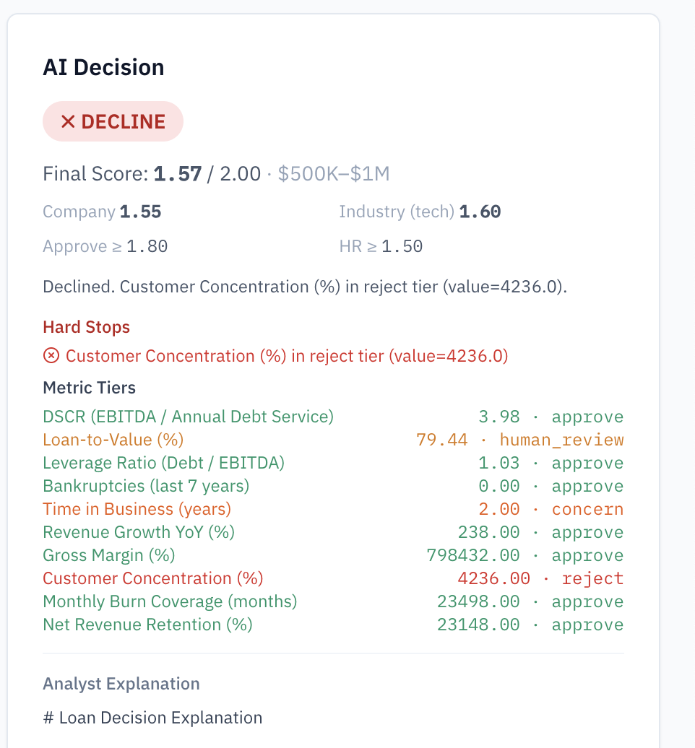
ANALYST WORKSPACE
Decision Detail & Audit Trail
Application detail page combines loan request, borrower profile, financial ratios, radar chart, decision panel, and audit log.
Analysts can run evaluation, approve, decline, flag for review, or mark approved deals as funded.
Every material event is written to `audit_log` for traceability.
LoanApproval
14

Slide 15
CLOSE
Roadmap & Demo Narrative
The current build is a credible end-to-end platform foundation. The next work should harden production readiness and decision quality.
Recommended Demo Path
Landing page → application steps → decision evaluation → application detail → pipeline board → audit log.
Seed realistic portfolio data for dashboard demos.
Persist uploaded files in local/dev storage before Supabase handoff.
Add analyst-facing model card and validation metrics.
Expand test coverage around policy thresholds and edge cases.
Investor / Judge Message
The platform demonstrates workflow depth, policy explainability, and a path from prototype to regulated lending operations.
{{ INSERT_FINAL_SCREENSHOT_OR_TEAM_LOGO }}
LoanApproval
15

