Slide 1
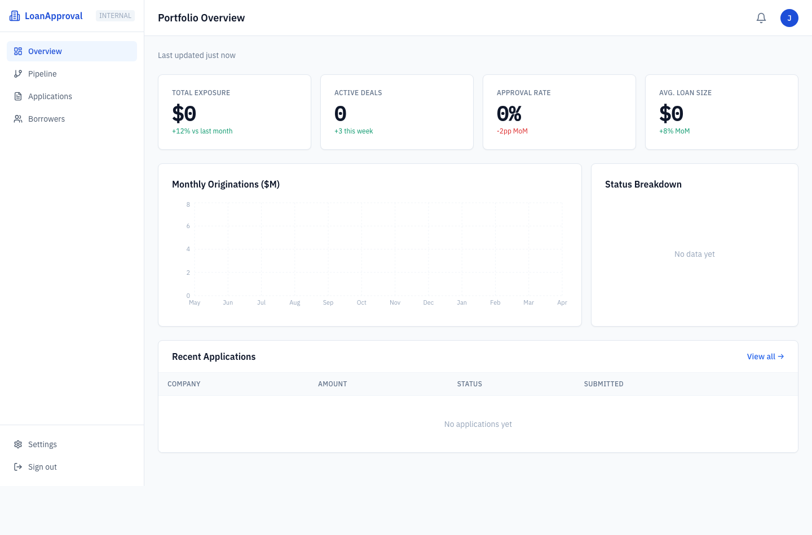
CORNELL FINTECH CLUB | SPRING 2026
LoanApproval
A full-stack lending platform for borrower intake, credit policy automation, document workflows, and underwriter review.
LIFECYCLE
DECISIONING
STACK
Apply to fund
Rules + ML + LLM
Next.js + FastAPI
LoanApproval
01

Slide 2
CORE THESIS
Product At A Glance
LoanApproval converts fragmented SMB lending workflows into a structured credit file and a transparent underwriting decision.
Borrower
Underwriter
Guided application, document staging, confirmation, and status lookup.
Portfolio overview, pipeline, queue, detail page, and action buttons.
- Borrower-facing application flow collects business, loan, financial, and document data.
- Underwriter dashboard turns submissions into a searchable, status-driven pipeline.
- Credit policy is deterministic first, with ML and LLM layers supporting risk review and productivity.
Policy
Platform
Weighted ratios, industry tracks, loan brackets, hard stops, and caps.
FastAPI, PostgreSQL, Supabase Storage, OpenAI or Anthropic.
INSERT OVERVIEW COMPOSITE
LoanApproval
02

Slide 3
WORKFLOW
End-to-End Loan Lifecycle
Apply
Financials
Documents
Evaluate
Manage
Borrower profile and loan request
>
Core values and calculated ratios
>
Statements, returns, bank records
>
Rules engine and model scoring
>
Pipeline, actions, audit log
Application state model
New
In Review
Approved
Funded
Declined
Submitted and awaiting review
>
Manual review or capped decision
>
Credit decision accepted
>
Post-approval funding state
>
Terminal rejection branch
LoanApproval
03

Slide 4
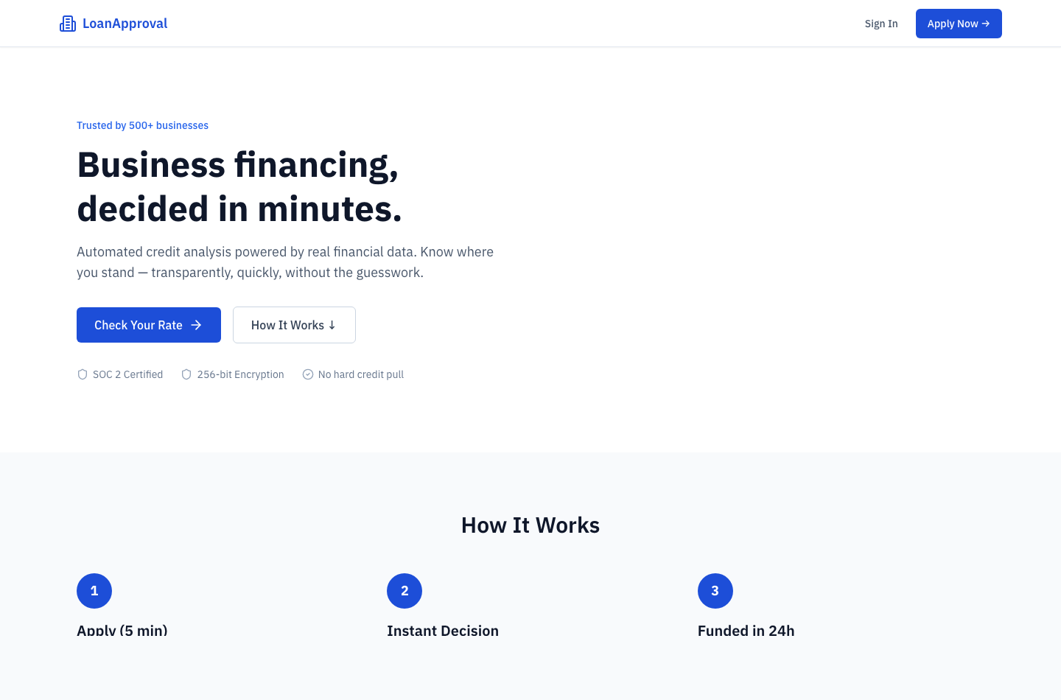
FRONTEND
Borrower Entry Point
The landing page is simple: explain the offer, set expectations, and route directly into the application.
- CTA points to the first application step.
- Loan products cover term loan, line of credit, equipment finance, and bridge loan.
- Eligibility copy reduces low-quality submissions before intake begins.
LoanApproval
04

Slide 5
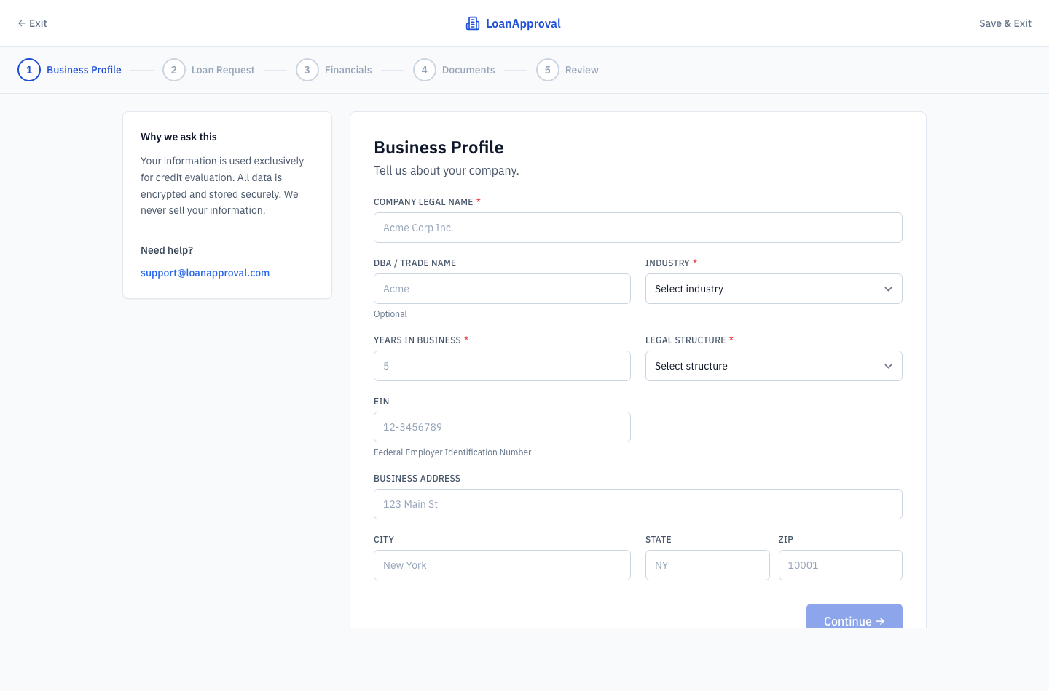
BORROWER FLOW
Guided Application Intake
Business Profile
Company name, DBA, industry, legal structure, years in operation, EIN, and address.
Loan Request
Amount, purpose, optional details, and desired term.
Review and Submit
Certified payload creates borrower and application records.
LoanApproval
05

Slide 6
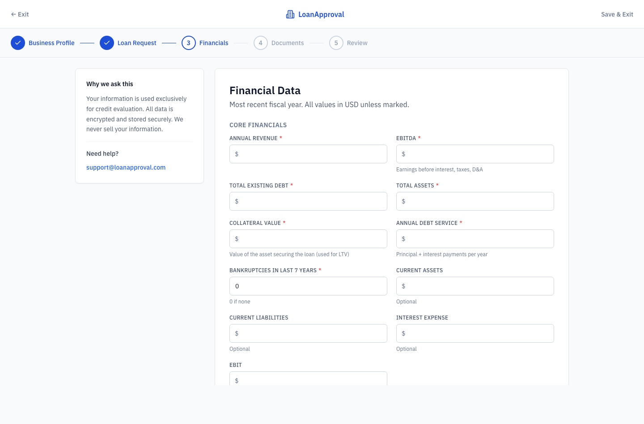
CREDIT FILE
Financial Data Capture
Structured financial data gives the backend enough information to calculate policy metrics without manual spreadsheet work.
DSCR
LTV
EBITDA / annual debt service
loan amount / collateral
- Required fields include revenue, EBITDA, debt, assets, collateral, debt service, and bankruptcies.
- Optional fields support current ratio and interest coverage.
- The frontend calculates DSCR, LTV, and leverage while the borrower types.
Leverage
Liquidity
existing debt / EBITDA
current assets / current liabilities
LoanApproval
06

Slide 7
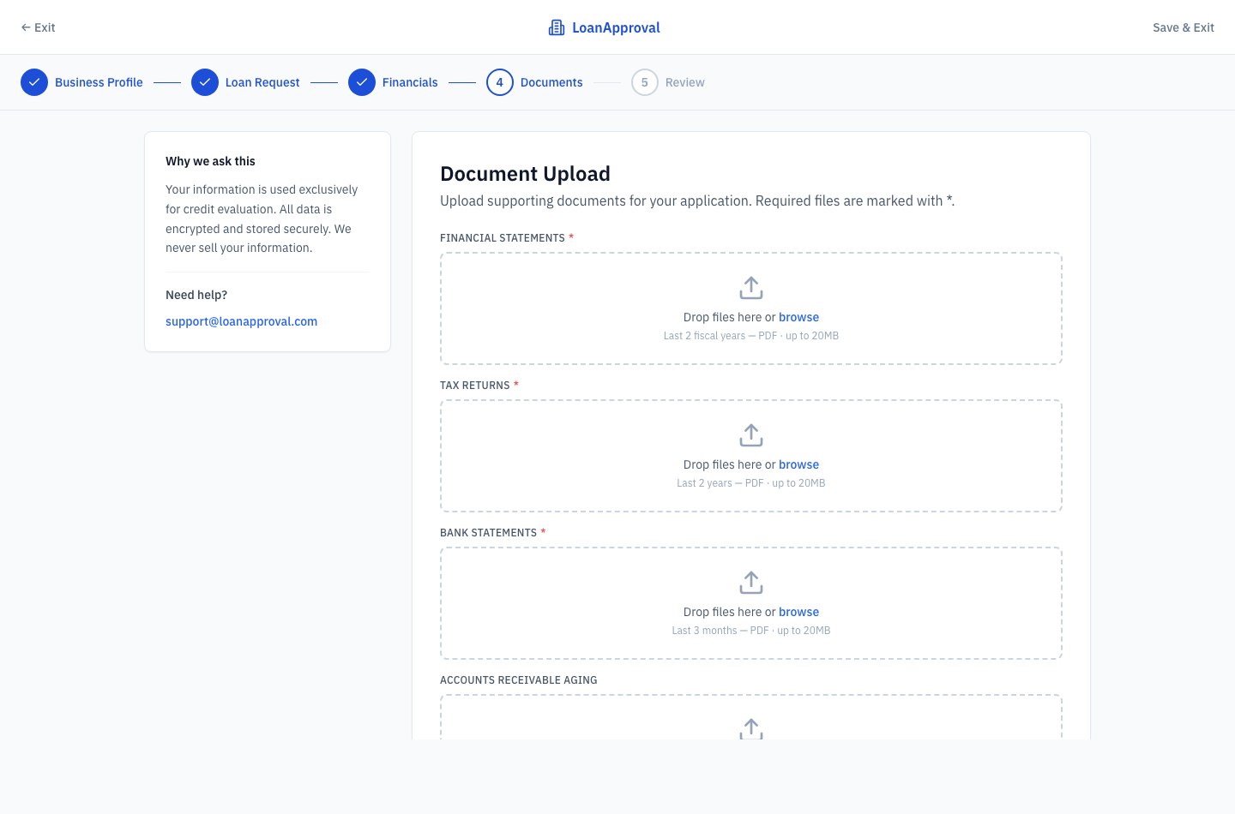
EVIDENCE
Document Workflow
Document handling is modeled as part of the application record, not as an external email process.
- Required: financial statements, tax returns, and bank statements.
- Optional: accounts receivable aging and collateral documents.
- Upload records metadata, storage path, and an audit event.
LoanApproval
07

Slide 8
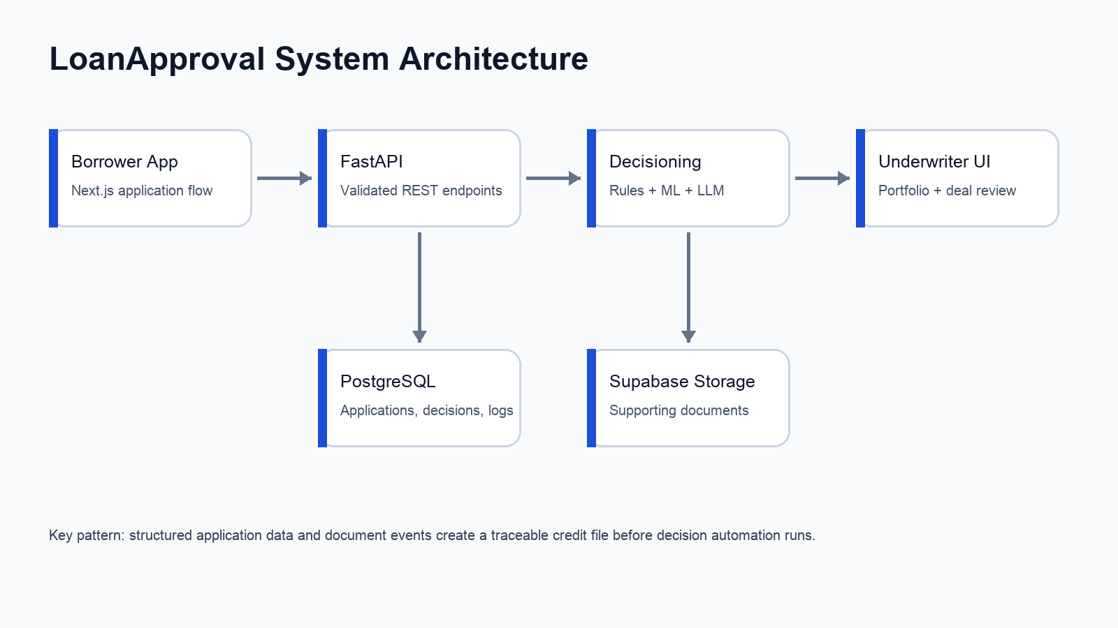
PLATFORM
Backend Architecture
LoanApproval
08

Slide 9
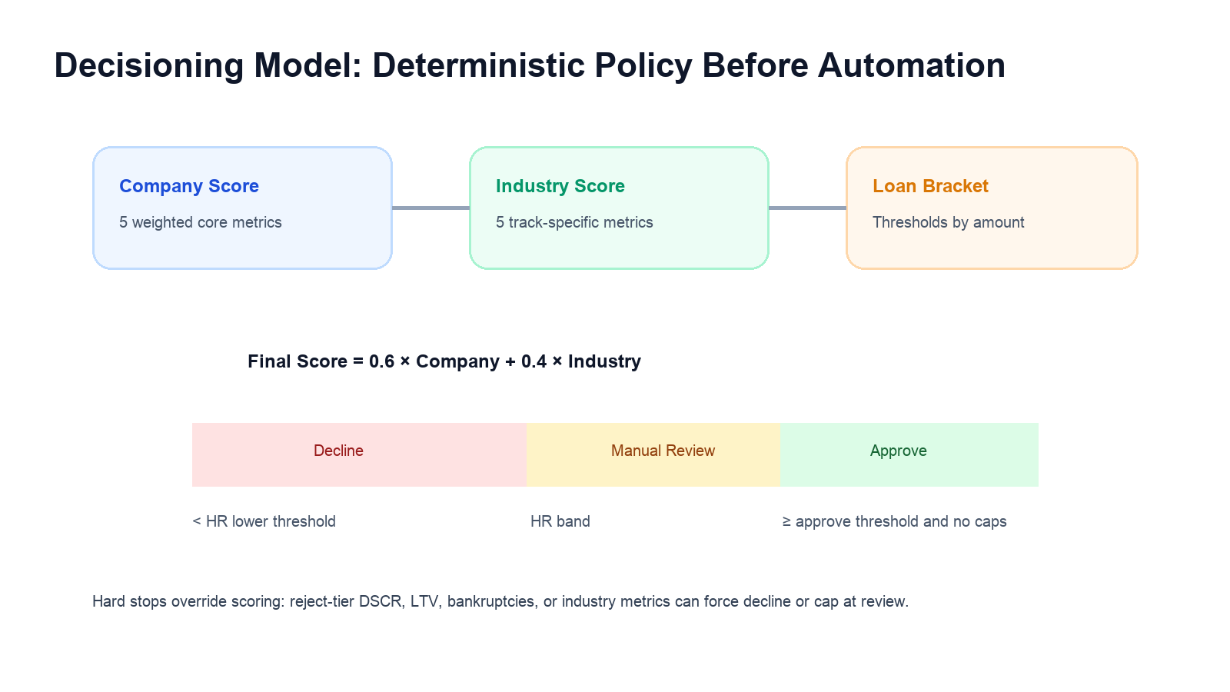
DECISIONING
Credit Policy Engine
- Company score: five weighted core metrics on a 0 to 2 scale.
- Industry score: five metrics for the selected industry track.
- Final score: 60 percent company, 40 percent industry.
- Loan brackets raise approval thresholds for larger requests.
LoanApproval
09

Slide 10
BA PLACEHOLDER
Manual Credit Formula Workbench
Blank working slide for business-analysis notes behind the manual credit formulas and analyst-facing rationale.
Rough outline to fill in later
Formula name
Manual definition
Inputs
Thresholds
Example: DSCR, LTV, leverage, industry metric, hard stop, or cap.
Plain-English BA definition and any source notes.
Required fields, fallback logic, and missing-data handling.
Approve / review / concern / reject tiers by bracket or segment.
Decision impact
Applicant explanation
Validation notes
Does this affect company score, industry score, final score, hard stop, or review cap?
How the rule should be described in the LLM-generated explanation.
Test cases, edge cases, owner, and approval status.
LoanApproval
10

Slide 11
RISK SEGMENTATION
Industry-Specific Underwriting
Tech
Hospitality
Retail
growth, gross margin, concentration, burn coverage, NRR
RevPAR, GOP per room, occupancy, cap rate, current ratio
sales per square foot, GMROI, inventory turns, gross margin
Healthcare
Industrials
operating margin, cash on hand, AR days, payer mix
asset turnover, interest coverage, margin, OCF, backlog
Each metric produces a tier label, numeric score, and triggered-rule payload so analysts can see exactly why the policy engine reached its result.
LoanApproval
11

Slide 12
RISK MODEL
ML Default Probability
The model score is a supplemental risk signal. It does not replace policy thresholds or hard stops.
INSERT IMAGE: MODEL CARD OR ROC CURVE
- Training supports LendingClub input or synthetic fallback data.
- Features mirror application fields plus debt-to-equity, DSCR, and revenue-to-loan.
- Pipeline combines logistic regression and gradient boosting through soft voting.
- API writes probability to the decision record and logs the scoring event.
LoanApproval
12

Slide 13
AUTOMATION
LLM-Assisted Operations
INSERT SCREENSHOT: ANALYST EXPLANATION
Extraction
Financial statements and tax returns route to the LLM extraction endpoint.
Explanation
Triggered rules and score context become plain-English rationale.
Provider Choice
OpenAI and Anthropic are swappable through environment configuration.
LoanApproval
13

Slide 14
PORTFOLIO VIEW
Underwriter Dashboard
- KPI cards summarize exposure, active deals, approval rate, and average loan size.
- Charts show monthly originations and status breakdown.
- Recent applications link directly to the credit file.
- Application table supports search, status filtering, sorting, and pagination.
LoanApproval
14

Slide 15
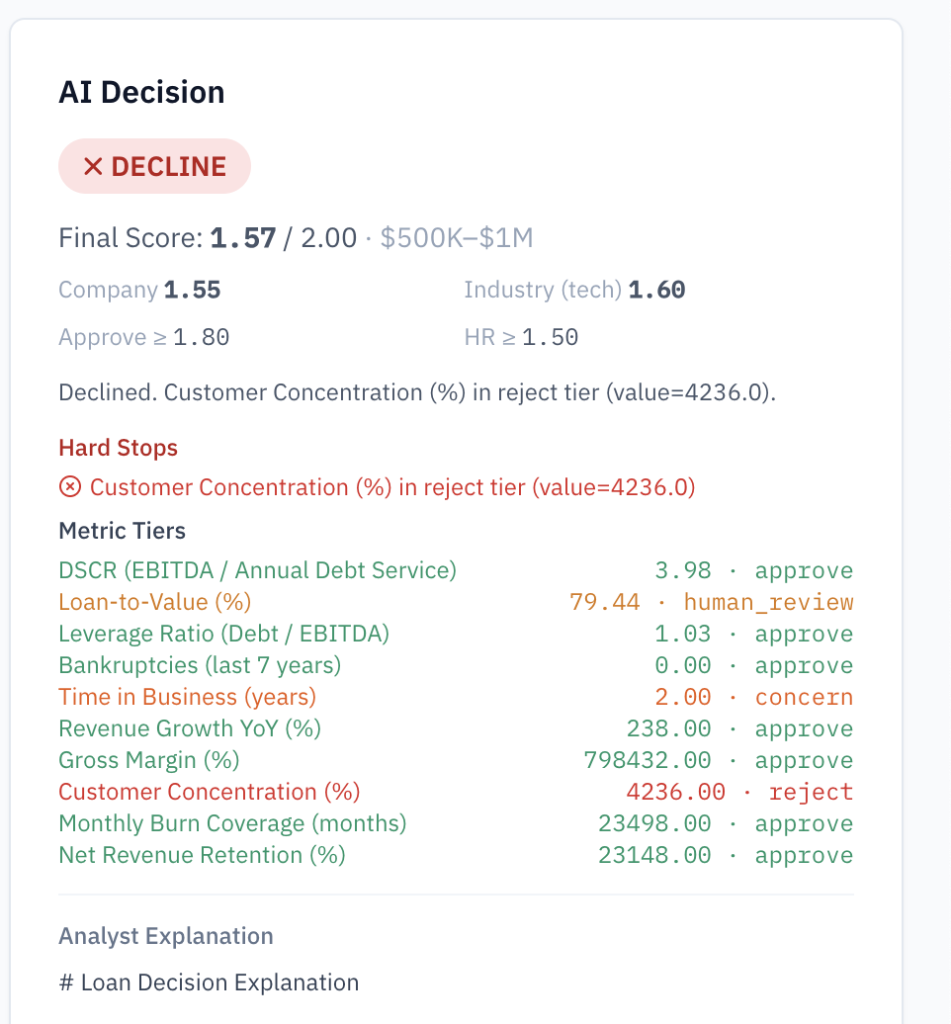
ANALYST WORKSPACE
Decision Detail and Audit Trail
- Detail page combines loan request, borrower profile, financial ratios, decision panel, and audit log.
- Analysts can evaluate, approve, decline, flag for review, or mark approved deals as funded.
- Audit events preserve the application lifecycle and decision rationale.
LoanApproval
15

Slide 16
CLOSE
Roadmap and Demo Narrative
The current build demonstrates a credible end-to-end lending workflow. Next steps should focus on production hardening and richer evidence.
Demo Path
Landing page -> application steps -> evaluation -> decision detail -> pipeline -> audit log.
- Seed realistic portfolio data for demos.
- Harden local and production document storage.
- Add model validation metrics and an analyst-facing model card.
- Expand tests around threshold boundaries and policy edge cases.
Takeaway
Workflow depth, policy explainability, and an extensible path toward regulated lending operations.
INSERT FINAL SCREENSHOT OR TEAM LOGO
LoanApproval
16

