Slide 1



Slide 2
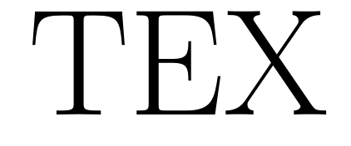

Slide 3


Slide 5
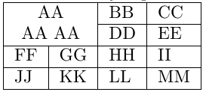


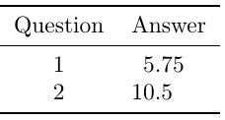
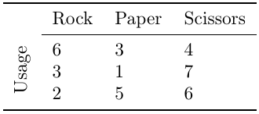

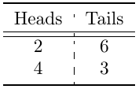



Features
Merge and split cells
B
Text alignment and basic text styling
Slashboxes and cells with two diagonals separators
Align cells with a character like a period or a comma
Rotated cells
Set background color for odd-even rows or for each cell
Multiple border types (normal, double, booktabs and dashed)
Set borders’ width
Improved double borders via hhline package
Set cell’s margins
CSV
JSON
Text
Import from CSV, JSON and plain text (with a tool to split columns and rows)
LaTeX
HTML
CSV
JSON
Text
Export to LaTeX, HTML, CSV, JSON and text
And more…
(including long tables, rotated tables, captions, labels, floating position…)

Slide 6
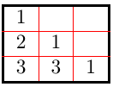
Goals
1500 CA$
Thank you ! The LaTeX Table Generator will be released under four months !
2500 CA$
LaTeX
Import tables from LaTeX
2800 CA$
Easytable package support
3700 CA$
HTML
Import tables from HTML
4200 CA$
TeX
Export tables to plain TeX (basic support)
5000 CA$
Set cell border’s color
Switch from WYSIWYG editor to LaTeX source code editor for each cell
7000 CA$
ConTeXt
Export tables to ConTeXt (basic support)
8000 CA$
Spreadtab package support
(Calculation inside cells, like Excel)
9000 CA$
ConTeXt
Import tables from ConTeXt (basic support)
15 000 CA$
ConTeXt
Export tables to ConTeXt (Most features)

Slide 7


Slide 8
Features
Merge and split cells
B
Text alignment and basic text styling
Slashboxes and cells with two diagonals separators
Align cells with a character like a period or a comma
Rotated cells
Set background color for odd-even rows or for each cell
Multiple border types (normal, double, booktabs and dashed)
Set borders’ width
Improved double borders via hhline package
Set cell’s margins
CSV
JSON
Text
Import from CSV, JSON and plain text (with a tool to split columns and rows)
LaTeX
HTML
CSV
JSON
Text
Export to LaTeX, HTML, CSV, JSON and text
And more…
(including long tables, rotated tables, captions, labels, floating position…)

