Slide 1
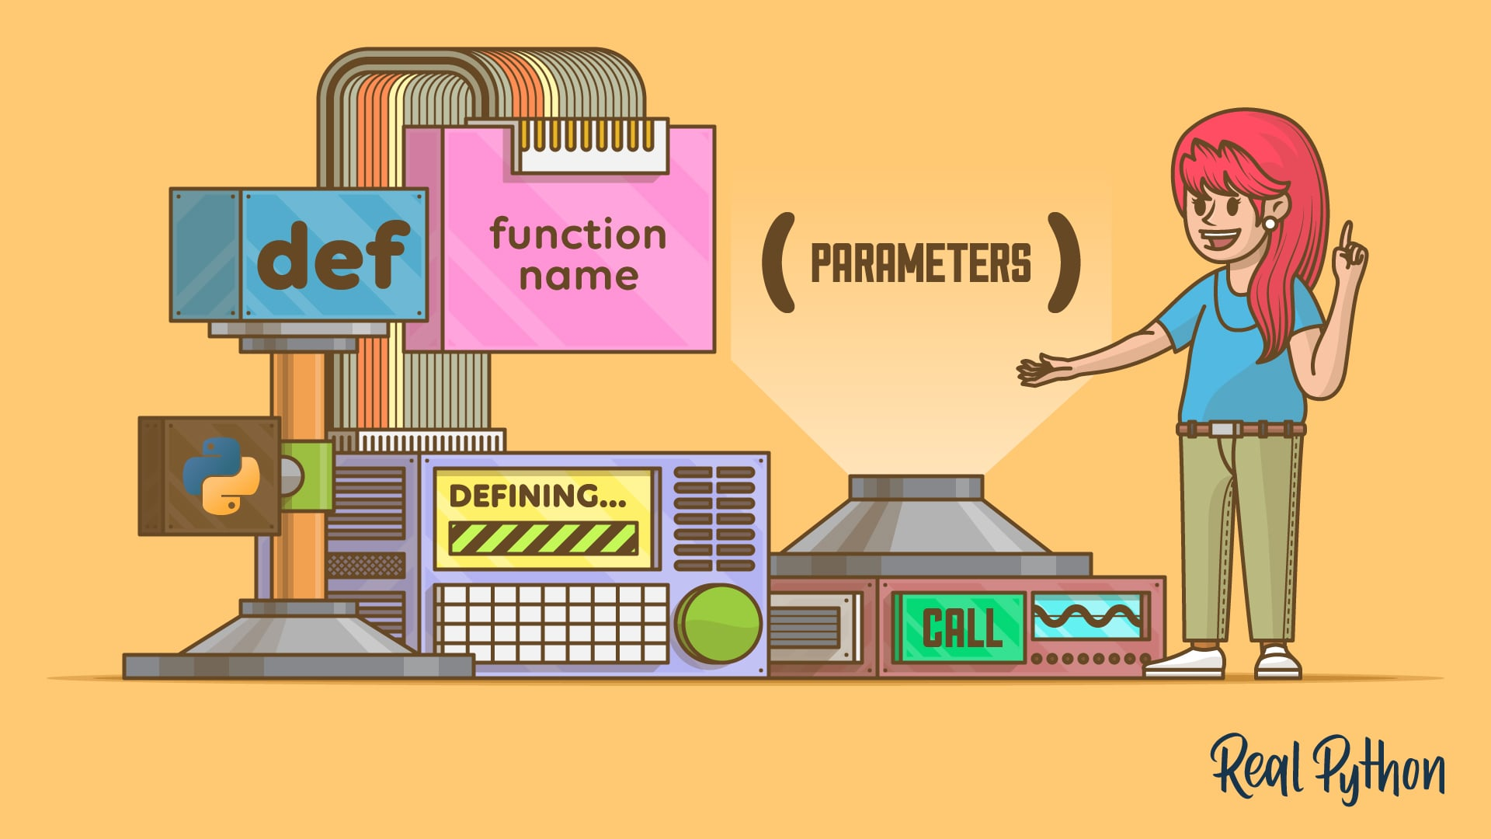
Introduction to Python and AI Assisted Coding Anatomy of a Function

Slide 2
Functions we have used so far
print()
len()
type()
int()
float()
str()
*But what if I wanted to make my own function?*

Slide 3
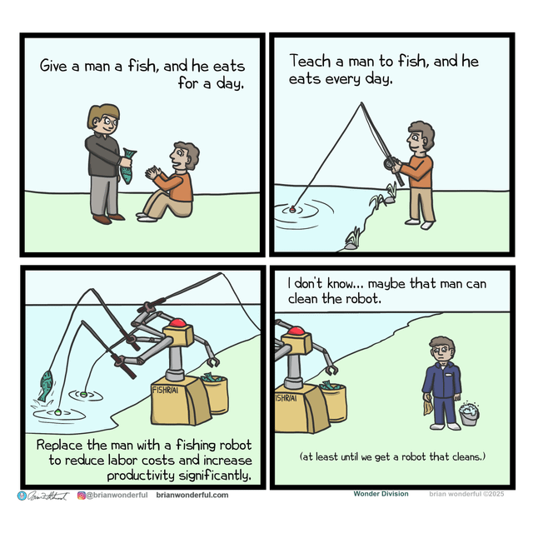
How would we function without functions?
Give a developer a working script, and the task gets done once.
Teach a developer to write functions, and they reuse code forever.
I don’t know… maybe that developer can write prompts for the AI.
Replace the developer with an AI that writes Python functions automatically to maximize productivity and eliminate human error.
At least until the AI learns to think for itself.

Slide 4
How would we function without functions?
Getting the average of a list of numbers WITHOUT functions:
my_numbers = [10, 20, 30, 40, 50]
sum_numbers = 0
length_numbers = 0
for i in my_numbers:
sum_numbers += I
length_numbers +=1
average = sum_numbers / length_numbers
print(average)

Slide 5
How would we function without functions?
Getting the average of a list of numbers WITHOUT functions:
my_numbers = [10, 20, 30, 40, 50]
sum_numbers = 0
length_numbers = 0
for i in my_numbers:
sum_numbers += I
length_numbers +=1
average = sum_numbers / len(my_numbers)
print(average)
my_numbers_2 = [1, 2, 3, 4, 5]
sum_numbers = 0
length_numbers = 0
for i in my_numbers:
sum_numbers += I
length_numbers +=1
average = sum_numbers / len(my_numbers)
print(average)
my_numbers_3 = [6, 7, 8, 9, 10]
sum_numbers = 0
length_numbers = 0
for i in my_numbers:
sum_numbers += I
length_numbers +=1
average = sum_numbers / len(my_numbers)
print(average)
my_numbers_3 = [6, 7, 8, 9, 10]
sum_numbers = 0
length_numbers = 0
for i in my_numbers:
sum_numbers += I
length_numbers +=1
average = sum_numbers / len(my_numbers)
print(average)
Getting the average of a list of numbers WITH functions:
average(numbers)

Slide 6
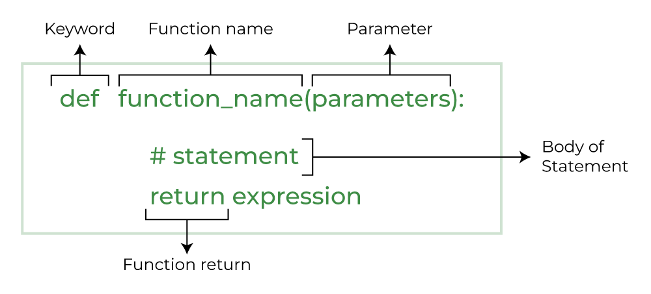
Anatomy of a Function

Slide 7
Anatomy of a Function
The trickiest part!
def average(parameters):
#using the parameters, take the average of the numbers
return the average of the numbers

