Slide 1

An Exploration of Data Science in the Federal Register
Joel Nantais – DATA 601

Slide 2
Project Overview
My project uses a REST API to access the Federal Register containing Federal Register Notices and Regulatory Rules since 1994 to find instances where federal agencies have posted publications which involve data science techniques.

Slide 3
Introduction to the APA
The Administrative Procedures Act (APA) of 1946:
to require agencies to keep the public informed of their organization, procedures and rules;
to provide for public participation in the rulemaking process, for instance through public commenting;
to establish uniform standards for the conduct of formal rulemaking and adjudication; and
to define the scope of judicial review

Slide 4
Data Set Methods
Using Python requests, I connected to the Federal Register REST API.
My get request payload pulled columns of:
Document Identification Numbers
Title
Agency Name
Publication Dates
Type of Document (i.e., Notice, Rule) and subtype
Topic Tags
Abstracts
I also used different search terms to pull the above columns for document which contained any of the following:
Artificial Intelligence, Big Data, Business Intelligence, Data Analytics, Data Mining, Data Science, and Machine Learning

Slide 5
Data Set Summary
The Dataset created contains 758 federal register documents, 638 are unique.
The earliest document has a publication date of February 17, 1994 and the latest was published on November 12, 2019 (the data was pulled on November 12, 2019).
There are 48 unique agencies represented.
Between 1994 and November 12, 2019, there have been 819,160 documents published in the federal register.
The proportion of documents containing a data science search term is 0.00078 percent, very small!

Slide 6
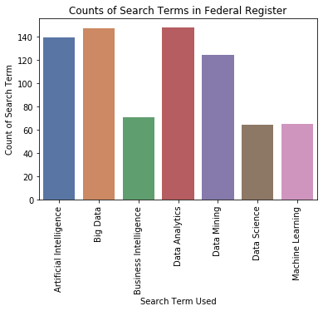

Slide 7
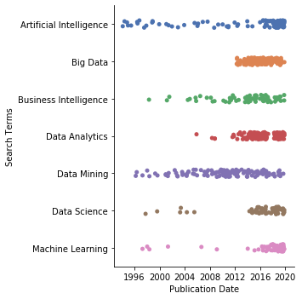
Use of Data Science Terms over Time

Slide 8
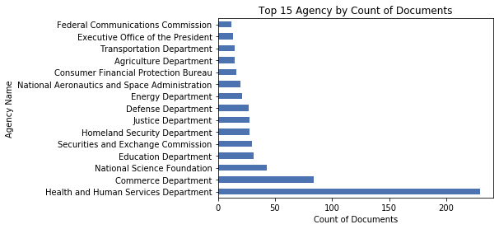

Slide 9
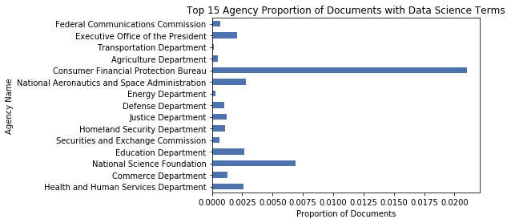

Slide 10
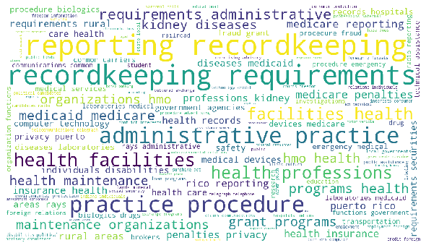
TOPICS WORDCLOUD

Slide 11
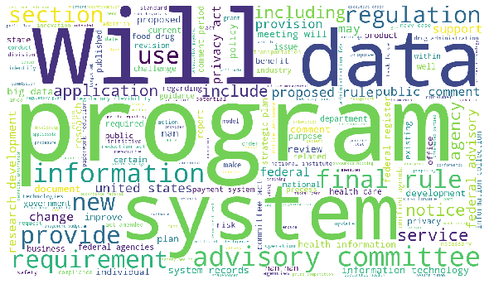
ABSTRACT WORDCLOUD

