Slide 1
AI Hackathon
Data Physicists Up
Manuel Eduardo Barredo Alamilla
Sahory Andrea Canseco Jiménez
José David Romo López

Slide 2
Goal
Satellite images are more available than ever.
This data could be valuable for sectors like energy, real state, environmental, etc.
For that reason, we propose to build a terrain classification model using satellite images.

Slide 3
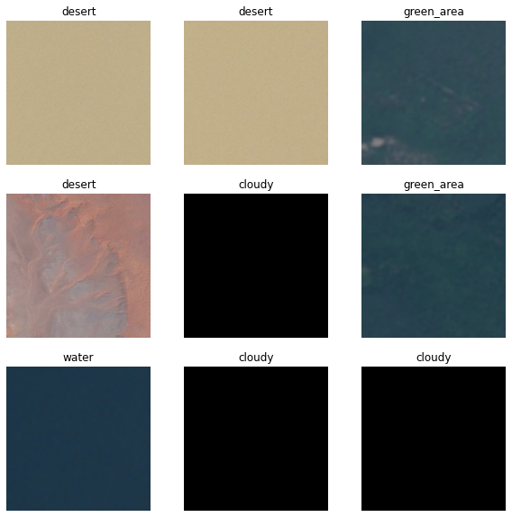
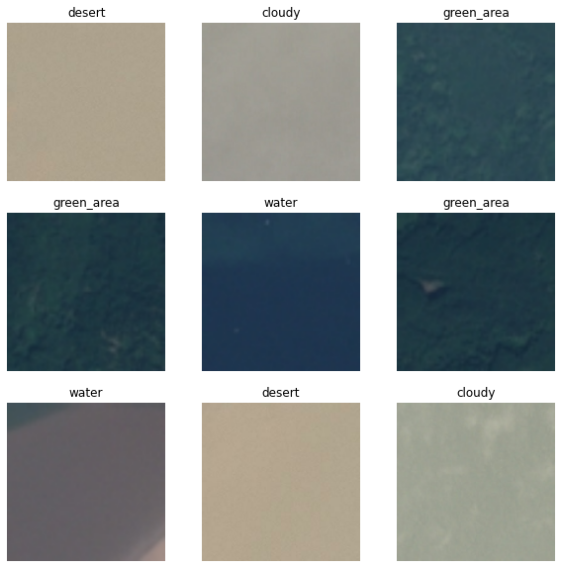
Data Preprocessing
Read the 5631 images from Satellite image Classification Dataset-RSI-CB256 in Kaggle.
Convert data from RGBA to RGB
Divide between training, validation and testing datasets.
Four different labels “cloudy, desert, green area, water”

Slide 4
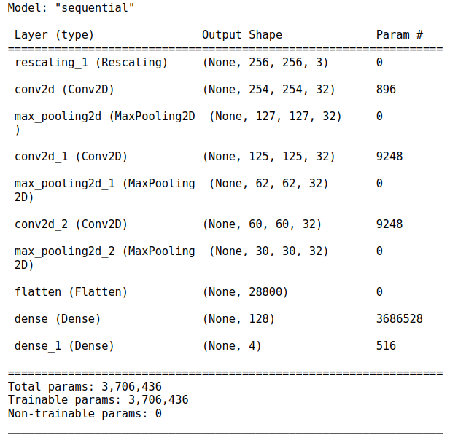
Model Training Results
Convolutional 2D Neural Network (Keras)
num_classes: 4
Epoch: 50
Validation accuracy: 90.60%
Testing accuracy: 89.81 %

Slide 5

Model Training Results
Convolutional 2D Neural Network (Keras)
num_classes: 4
Epoch: 50
Validation accuracy: 90.60%
Testing accuracy: 89.81 %

Slide 6
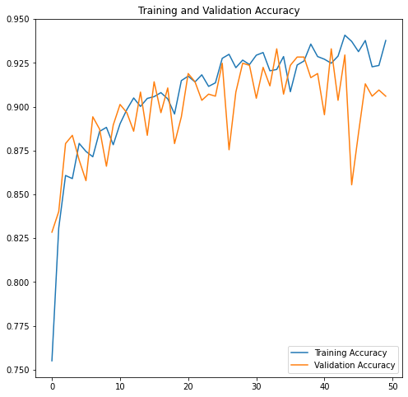
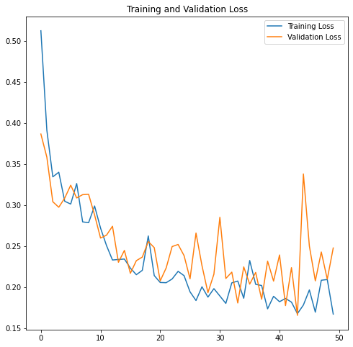
Model Training Results
All training data
Loss function: Categorical Cross-entropy

Slide 7
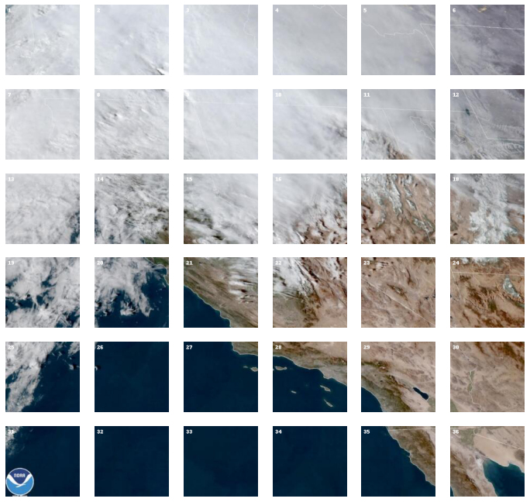
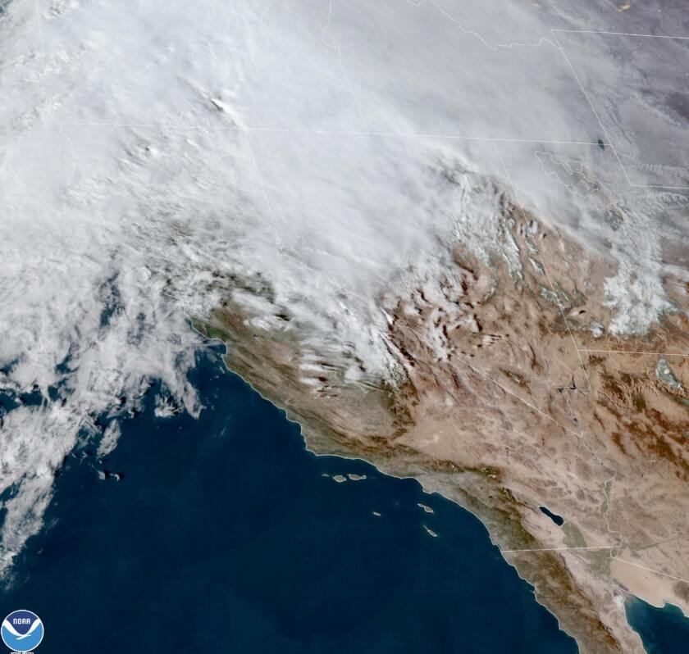
Grid search implementation
Building a grid search to analyze the terrain composition by tiles. We use a grid of 6x6. Every tile is analyze with the trained model using the max score value.
This image has 65.625 percentage of cloudy, a 12.5 percentage of desert, a 6.25 percentage of green_area and a 15.625 percentage of water

Slide 8
In the near future…
What could be added?
With this model we are able to search suitable areas for clean energy such solar energy (looking for cloud patterns) and others.
The model could identify opportunities in the real estate sector.
We’ll be able to determine the climate change effects as long we have access to the time-evolving data sets.
Adding data sets of other types of terrain like snow, forest, and gray clouds (contamination) can improve our model significantly enhancing the possible use cases.

Slide 9
Conclusions
We build a DL classification model, from a database of satellite images, able to classify the land into four different categories: [cloudy, desert, green area, water] with a test accuracy of 89.81 %.
We perform grid searches to analyze the terrain of satellite images and compute the approximate percentage of the four categories of land composition.

Slide 10
Thanks!

