Slide 1
Android “Master” Class 2013
Lecture 1, October 10, 2013

Slide 2
Admistration
No homework or tests
No attendence taking
Purely for your benefit
Pay attention and follow along to succeed
Have fun!

Slide 3
Admistration
Lectures will be recorded
Check Ctools for annoucements and resources
Check Github for code samples

Slide 4
Agenda
Intro to Android
Useful Tools
Application Components
Activities
Views and ViewGroups
Component Communication
“Hello, world!”

Slide 5
Agenda
Intro to Android
Useful Tools
Application Components
Activities
Views and ViewGroups
Component Communication
“Hello, world!”

Slide 6
Intro to Android
Android, Inc. created by Andy Rubin in 2003
Acquired by Google in 2005

Slide 7
Intro to Android
Android, Inc. created by Andy Rubin in 2003
Acquired by Google in 2005
Lawsuit trouble with Sun
Dalvik JVM vs Sun JVM

Slide 8
Intro to Android
Android 1.0
1.5 Cupcake
1.6 Donut
2.0-2.1 Éclair
2.2 Froyo
2.3 Gingerbread
3.0-3.2 Honeycomb
4.0 Ice Cream Sandwich
4.1-4.3 Jelly Bean
4.4 KitKat

Slide 9
Intro to Android
Android 1.0
1.5 Cupcake
1.6 Donut
2.0-2.1 Éclair
2.2 Froyo
2.3 Gingerbread
3.0-3.2 Honeycomb
4.0 Ice Cream Sandwich
4.1-4.3 Jelly Bean
4.4 KitKat
First proprietary naming

Slide 10
Intro to Android
Why Android?
Over half a billion Android devices activiated¹
Over half of smartphones in US and worldwide run Android
Not just smartphones run Android; watches, cameras, even cars!
Mobile is the future
1 According to CNET News
2 According to comScore study

Slide 11
Intro to Android
Android development is fun!
The system is open source
Very few developer restrictions and limitations
Notes:
Developers who participate in online communities

Slide 12
Intro to Android
Android development is fun!
The system is open source
Very few developer restrictions and limitations
Android development is challenging
Multi-threaded environment
Very few developer restrictions and limitations

Slide 13
Intro to Android
Android development is fun!
The system is open source
Very few developer restrictions and limitations
Android development is challenging
Multi-threaded environment
Very few developer restrictions and limitations
Easy to write poor-performing, data-sucking, battery-draining apps

Slide 14
Intro to Android
Java
The all the libraries and frameworks are all written in Java (almost)

Slide 15
Intro to Android
Java
The all the libraries and frameworks are all written in Java
Notes about Java

Slide 16
Intro to Android
Java
The all the libraries and frameworks are all written in Java
Notes about Java
Everything is a pointer, but called reference

Slide 17
Intro to Android
Java
The all the libraries and frameworks are all written in Java
Notes about Java
Everything is a pointer, but called reference
Garbage collection

Slide 18
Intro to Android
Java
The all the libraries and frameworks are all written in Java
Notes about Java
Everything is a pointer, but called reference
Garbage collection
Memory leaks DO occur

Slide 19
Agenda
Intro to Android
Useful Tools
Application Components
Activities
Views and ViewGroups
Component Communication
“Hello, world!”

Slide 20
Useful Tools
developer.android.com
Most useful
Not just Javadoc
Many great tutorials

Slide 21
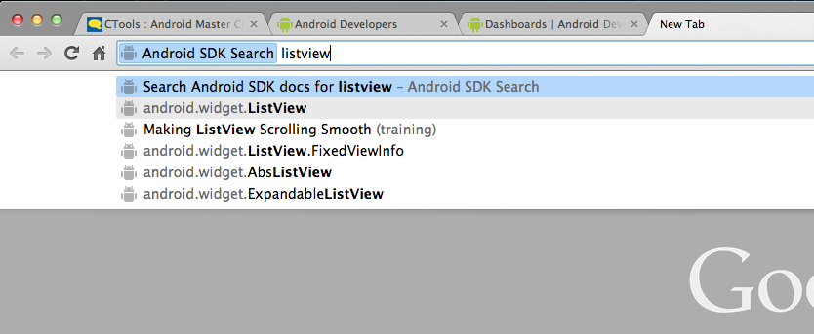
Useful Tools
Android SDK Reference Search
Awesome Chrome extension
Searches the developer site directly

Slide 22
Android Open Source Project
Known as AOSP
Whole OS and framework is publicly available
Code for built-in apps (phone, email, SMS, etc.)
Not Google apps (Gmail, Play Store, etc.)
Acess through developer site or github.com/android

Slide 23
Useful Tools
Emulator is PAINFULLY slow
Genymotion is a great alternative
Uses VirtualBox to run an emulator on a very fast machine

Slide 24
Useful Tools
Others
Stack Overflow
YouTuve
Google I/O talks
Android Developer Blog

Slide 25
Agenda
Intro to Android
Useful Tools
Application Components
Activities
Views and ViewGroups
Component Communication
“Hello, world!”

Slide 26
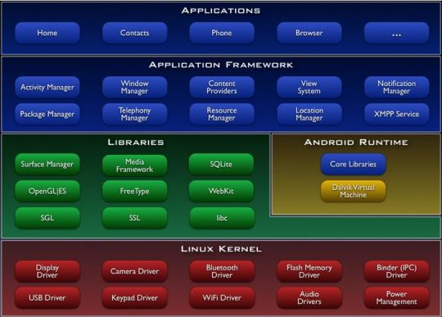
Application Components

Slide 27
Application Components

Slide 28
Application Components
Application
Activity
Service
ContentProvider
SyncAdapter
BroadcastReceiver

Slide 29
Application Components
How does the system know which components belong to which applications?

Slide 30
Application Components
How does the system know which components belong to which applications?
AndroidManifest.xml

Slide 31
Application Components
AndroidManifest.xml
Application’s registry for its components
How to interperet Intents (more on this later)
Configure default events on launch, on broadcast, etc.

Slide 32
Application Components
Activity now, others later

Slide 33
Agenda
Intro to Android
Useful Tools
Application Components
Activities
Views and ViewGroups
Component Communication
“Hello, world!”

Slide 34
Activity
android.app.Activity
Developer page

Slide 35
Activity
Part of app user can do and/or see
One Activity on screen
Holds View in a Window object

Slide 36
Activity
Must have Activity to launch
Must be registered in AndroidManifest.xml
Can respond to Intents via IntentFilters (nore on this later)

Slide 37
Activity
Quick note about Context
Fromt the developer page:
“Interface to global information about an application environment.”
Needed by many actions to coordinate between components at a low level
i.e. Making sure things run in the Context of the main thread (more on this later)
Activity extends Context (kinda)

Slide 38
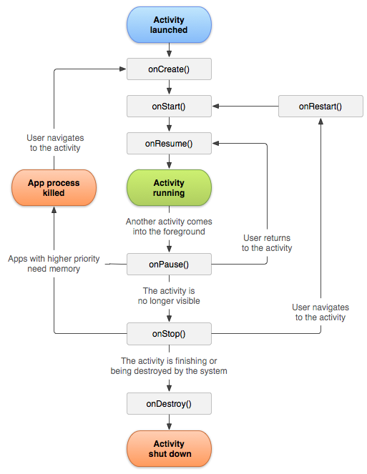
Activity
Life cycle:

Slide 39
Activity
Subtle, but important, quirks about life cycle
Recreated on configuration change
Leave screen -> only state is saved, not entire instance
This can lead to memory leaks (Java-style)
Why is this a big deal?

Slide 40
Activity
Subtle, but important, quirks about life cycle
Recreated on configuration change
Leave screen -> only state is saved, not entire instance
This can lead to memory leaks (Java-style)
Why is this a big deal?
Entire View hierarchy is often recreated!

Slide 42
Agenda
Intro to Android
Useful Tools
Application Components
Activities
Views and ViewGroups
Component Communication
“Hello, world!”

Slide 43
View and ViewGroup
android.view.View
Developer page
android.view.ViewGroup
Developer page

Slide 44
View and ViewGroup
A View is a rectangular space to draw on screen

Slide 45
View and ViewGroup
A ViewGroup is a special View that can hold other Views

Slide 46
View and ViewGroup
A ViewGroup is a special View that can hold other Views
Can see relationship in xml

Slide 47
View and ViewGroup
Views must live inside a Context, i.e. an Activity
Only in Activity

Slide 48
View and ViewGroup
Views must live inside a Context, i.e. an Activity
Only in Activity
Cannot be modified from any thread besides main thread
More on this when we talk about multi threading

Slide 49
View and ViewGroup
Can extend View and ViewGroup yourself

Slide 50
View and ViewGroup
Can extend View and ViewGroup yourself
Often unnecessary

Slide 51
View and ViewGroup
Can extend View and ViewGroup yourself
Often unnecessary
Framework includes many useful classes
LinearLayout
RelativeLayout
FrameLayout
GridLayout
TextView
ImageView
ListView
GridView
Many more…

Slide 52
View and ViewGroup
How do we create Views and ViewGroups?

Slide 53
View and ViewGroup
How do we create Views and ViewGroups?
Normally, like any other class

Slide 54
View and ViewGroup
How do we create Views and ViewGroups?
Normally, like any other class
Inflate from XML

Slide 55
View and ViewGroup
How do we create Views and ViewGroups?
Normally, like any other class
Inflate from XML
Best for beginners

Slide 56
View and ViewGroup
Basic layout structure
<ViewGroup>
<View />
<!-- Notice the nested ViewGroup -->
<ViewGroup>
<View />
<!-- Can have multiple Views in a ViewGroup -->
<View />
</ViewGroup>
</ViewGroup>

Slide 57
View and ViewGroup
Basic layout structure
We’ll see a specific sample in the demo
<ViewGroup>
<View />
<!-- Notice the nested ViewGroup -->
<ViewGroup>
<View />
<!-- Can have multiple Views in a ViewGroup -->
<View />
</ViewGroup>
</ViewGroup>

Slide 58
View and ViewGroup
What if we have this?
<LinearyLayout xmlns:android=“http://schemas.android.com/apk/res/android“
android:layout_width=“match_parent”
android:layout_height=“match_parent”>
<Button
android:id=“@+id/my_btn”
android:layout_width=“wrap_content”
android:layout_height=“wrap_content”
android:text=“Press” />
</LinearLayout>

Slide 59
View and ViewGroup
What if we have this?
How can the Activity tell if the Button is clicked?
<LinearyLayout xmlns:android=“http://schemas.android.com/apk/res/android“
android:layout_width=“match_parent”
android:layout_height=“match_parent”>
<Button
android:id=“@+id/my_btn”
android:layout_width=“wrap_content”
android:layout_height=“wrap_content”
android:text=“Press” />
</LinearLayout>

Slide 60
View and ViewGroup
What if we have this?
How can the Activity tell if the Button is clicked?
Listener design pattern
<LinearyLayout xmlns:android=“http://schemas.android.com/apk/res/android“
android:layout_width=“match_parent”
android:layout_height=“match_parent”>
<Button
android:id=“@+id/my_btn”
android:layout_width=“wrap_content”
android:layout_height=“wrap_content”
android:text=“Press” />
</LinearLayout>

Slide 61
Agenda
Intro to Android
Useful Tools
Application Components
Activities
Views and ViewGroups
Component Communication
“Hello, world!”

Slide 62
Component Communication
Intercomponent communication
Intracomponent communication

Slide 63
Component Communication
Intercomponent communication
Intracomponent communication

Slide 64
Component Communication
Activty displays View with a Button

Slide 65
Component Communication
Activty displays View with a Button
Want to respond to Button clicks

Slide 66
Component Communication
Activty displays View with a Button
Want to respond to Button clicks
Activity is said to be “listening” for a click

Slide 67
Component Communication
Listener design pattern

Slide 68
Component Communication
Listener design pattern (a.k.a. callbacks)

Slide 69
Component Communication
Listener design pattern
Define Listener interface

Slide 70
Component Communication
Listener design pattern
Define Listener interface
Object that is listening implements the interface

Slide 71
Component Communication
Listener design pattern
Define Listener interface
Object that is listening implements the interface
Target objects notifies listeners when an event occrs

Slide 72
Component Communication
Listener design pattern
Define Listener interface
Object that is listening implements the interface
Target objects notifies listeners when an event occrs
Listener responsds to event

Slide 73
Component Communication
Not limited to Buttons or the like
Any class can define a listener interface
Must notify on certain events

Slide 74
Component Communication
Example
OnClickListener
class MyActivity extends Activity implements OnClickListener {
// … other code
@Override
public void onClick(View v) {
startOtherActivity();
}
}

Slide 75
Component Communication
Intercomponent communication
Intracomponent communication

Slide 76
Component Communication
How do different compponents talk to each other?

Slide 77
Component Communication
How do different compponents talk to each other?
They don’t

Slide 78
Component Communication
How do different compponents talk to each other?
They don’t
One Activity on the screen at a time

Slide 79
Component Communication
How do different compponents talk to each other?
They don’t
One Activity on the screen at a time
How to start another Activity?
Intents

Slide 80
Component Communication
Intents
App tells the system what you want to do
System can maintain important resources, i.e. Window
App tells system to swap Activities in and out of the Window

Slide 81
Component Communication
Intents are MUCH more powerful than Activity switching
Intents will pop up all the time in the class
This is all we need to know for now

Slide 82
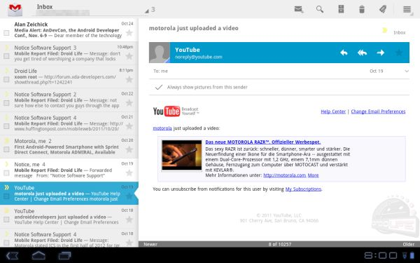
Question?
If only one Activity is allowed on the screen at one time, how can we put more than one user action on the screen?
For example:

Slide 83
Naive Solution
Just have a list and frame side-by-side in a layout

Slide 84
Naive Solution
Just have a list and frame side-by-side in a layout
What if the screen is small?

Slide 85
Proper Solution
Fragments!
Notes:
Been around since 2011 – newbies still don’t learn properly

Slide 86
Proper Solution
Fragments!
Modular pieces of UI with life cycle like an Activity
Doesn’t manage a Window or other system resources

Slide 87
Proper Solution
Fragments!
Modular pieces of UI with life cycle like an Activity
Doesn’t manage a Window or other system resources
Next time

Slide 88
Agenda
Intro to Android
Useful Tools
Application Components
Activities
Views and ViewGroups
Component Communication
“Hello, world!”

Slide 89
“Hello, world!”
We have all the pieces we need

Slide 90
“Hello, world!”
We have all the pieces we need
Code will be in the git repo
Please familiar yourself with:
Github (at least)
Command line git

Slide 91
Thank You
Q&A until 9pm

