Slide 1
Android “Master” Class 2013
Lecture 2, October 24, 2013

Slide 2
Prologue
https://gist.github.com/ajk1311/7145620
Contains some tedius code to use for examples

Slide 3
Agenda
Fragments
LIstViews
ListAdapters
Dialogs

Slide 4
Agenda
Fragments
LIstViews
ListAdapters
Dialogs

Slide 5
Fragments
“A Fragment represents a behavior or a portion of user interface in an Activity”¹
1. http://developer.android.com/guide/components/fragments.html

Slide 6
Fragments
Activity can have multiple Fragments
Fragments belong to one Activity

Slide 7
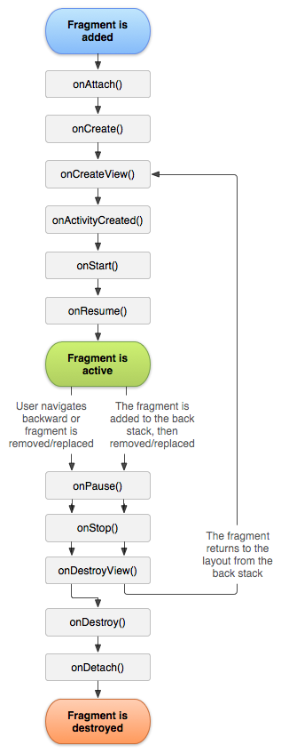
Fragments
Similar lifecycle to Activiy:

Slide 8
Fragments
Similar lifecycle to Activiy:
New callbacks
onAttach/onDetach
onCreateView/onDestroyView
onActivityCreated

Slide 9
Fragments
onCreateView is to Fragment as setContentView is to Activity

Slide 10
Fragments
onCreateView is to Fragment as setContentView is to Activity
Must return the View rather than providing an ID

Slide 11
Fragments
onCreateView is to Fragment as setContentView is to Activity
Must return the View rather than providing an ID
onViewCreated callback provided for when View is guarunteed to be ready

Slide 12
Fragments
onCreateView is to Fragment as setContentView is to Activity
Must return the View rather than providing an ID
onViewCreated callback provided for when View is guarunteed to be ready
Let’s start coding!

Slide 13
Fragments
Each Activity has a FragmentManager

Slide 14
Fragments
Each Activity has a FragmentManager
Responsible for keeping track of Fragment states
Can add, find, remove, replace, and attach/detach Fragments
Notes:
How do we add Fragments to the Activity?

Slide 15
Fragments
As a part of XML layout

Slide 16
Fragments
As a part of XML layout
As a part of Java code

Slide 17
Fragments
As a part of XML layout
As a part of Java code
Try it out!

Slide 18
Fragments
How do Fragments talk to their Activities?

Slide 19
Fragments
How do Fragments talk to their Activities?
Just like Views: listener pattern

Slide 20
Fragments
How do Fragments talk to their Activities?
Just like Views: listener pattern
We need to define the interface that Activity must implement

Slide 21
Fragments
How do Fragments talk to their Activities?
Just like Views: listener pattern
We need to define the interface that Activity must implement
Example

Slide 22
Agenda
Fragments
LIstViews
ListAdapters
Dialogs

Slide 23
ListView
Most common element of any mobile application

Slide 24
ListView
Most common element of any mobile application
Simply displays data in a scrollable list

Slide 25
ListView
Each row (or cell) in the list contains a View or ViewGroup

Slide 26
ListView
Each row (or cell) in the list contains a View or ViewGroup
Creates a View for each row…

Slide 27
ListView
Each row (or cell) in the list contains a View or ViewGroup
Creates a View for each row…
Problem?

Slide 28
ListView
ListView is actually a very complicated piece of code

Slide 29
ListView
ListView is actually a very complicated piece of code
“Recycles” Views
Allows efficient scrolling with many, many rows

Slide 30
ListView
ListView is actually a very complicated piece of code
“Recycles” Views
Allows efficient scrolling with many, many rows
Code may be complicated, but easy to use!
Lets see how!

Slide 31
ListView
How do ListViews get the Views associated with backing data?

Slide 32
ListView
How do ListViews get the Views associated with backing data?
Adapters

Slide 33
Agenda
Fragments
LIstViews
ListAdapters
Dialogs

Slide 34
ListAdapters
Adapt the backing data into a View

Slide 35
ListAdapters
Adapt the backing data into a View
ListViews are useless without Adapters

Slide 36
ListAdapters
Adapters implement the Observer design pattern

Slide 37
ListAdapters
Adapters implement the Observer design pattern
They “watch” a set of data and take action when the data set is changed or erased

Slide 38
ListAdapters
Adapters implement the Observer design pattern
They “watch” a set of data and take action when the data set is changed or erased
notifyDataSetChanged(), notifyDataSetInvalidated()

Slide 39
ListAdapters
The SDK offers some convenient classes for using Adapters
SimpleAdapter, ArrayAdapter, CursorAdapter, etc.

Slide 40
ListAdapters
The SDK offers some convenient classes for using Adapters
SimpleAdapter, ArrayAdapter, CursorAdapter, etc.
Reduces code to some one-liners, but hides implementation

Slide 41
ListAdapters
The SDK offers some convenient classes for using Adapters
SimpleAdapter, ArrayAdapter, CursorAdapter, etc.
Reduces code to some one-liners, but hides implementation
Each inherits from BaseAdapter
Seems like a good place to start

Slide 42
ListAdapter
What happens when a row is clicked?

Slide 43
ListAdapter
What happens when a row is clicked?
Use onItemClickListener
Similar to using onClickListener

Slide 44
Agenda
Fragments
LIstViews
ListAdapters
Dialogs

Slide 45
Dialogs
Use DialogFragment

Slide 46
Dialogs
Use DialogFragment
Maintains state and has Fragment lifecycle

Slide 47
Dialogs
Additional lifecycle callback: onCreateDialog

Slide 48
Dialogs
Additional lifecycle callback: onCreateDialog
Override this when using the Dialog interface

Slide 49
Dialogs
Additional lifecycle callback: onCreateDialog
Override this when using the Dialog interface
Could also use onCreateView
Override this when providing some custom layout

Slide 50
Dialogs
onCreateDialog
Pros:
Use AlertDialog.Builder interface for adding all relevant pieces to dialog before showing it
Methods return the Builder instance to allow method chaining
Simple, self-explanatory methods
Cons:
Not enough customization

Slide 51
Dialogs
onCreateView
Pros:
As custom as you want to make it
Familiar when working with other Fragments
Can use DialogFragment as regular Fragment
Cons:
Clunky findViewById calls

Slide 52
Dialogs
Show DialogFragment using FragmentManager differently
DialogFragment.show(FragmentManager manager, String tag)

Slide 53
Thank You
Q&A until 9pm

