Slide 1
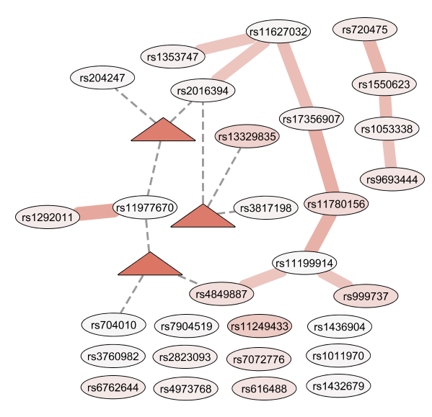

Data set 147
0.00
0.01

Slide 2
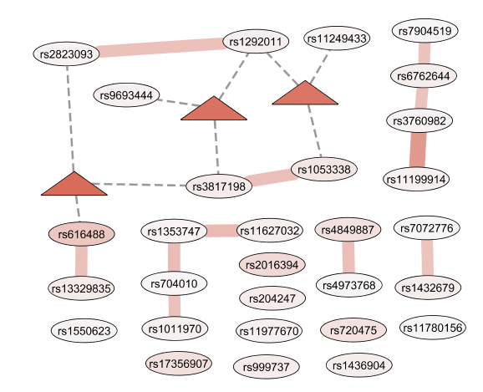
Data set 812

