Slide 1
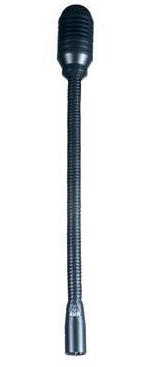
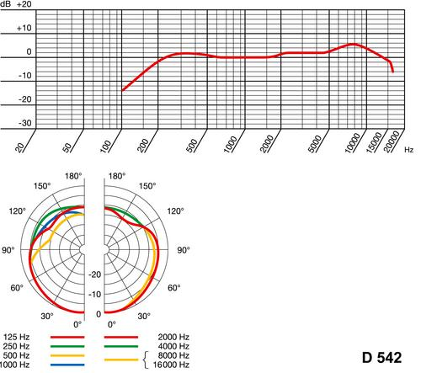
품 명 | MICROPHONE | 제 품 설 명
모델명 | DGN-99E
사 진
제조사 | AKG
가 격
SPECIFICATIONS
Polar pattern : cardioid
Frequency range : 150-15,000 Hz
Sensitivity : 2.2 mV/Pa (-54 dBV)
Max. SPL : 133 dB (1% THD)
Equivalent noise level : 21 dB-A
Signal/noise ratio (A-weighted) : 73 dB
Impedance : 530 ohms
Recommended load impedance : >2,000 ohms
Connector : 3-pin male XLR
Finish : matte black
Net weight : 285 g
Shipping weight : 334 g

