Slide 1



DENVER RTD
PDR
2011. 5. 19

Slide 2
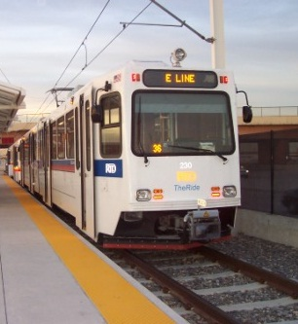
Denver RTD Eagle P3 Communication System

Slide 3
Contents
System Overview
VoIP
Communication Rack A CRA
Communication Control Panel CCP
Passenger Information Display PID
Front Destination Indicator FDI
Side Destination Indicator SDI
Passenger Information Indicator PII
Driver PA Operation Box DPO
Driver PA Handset DPH
Conductor PA Operation Box CPO
Passenger Emergency Intercom PEI
Speakers & ANS Microphone

Slide 4
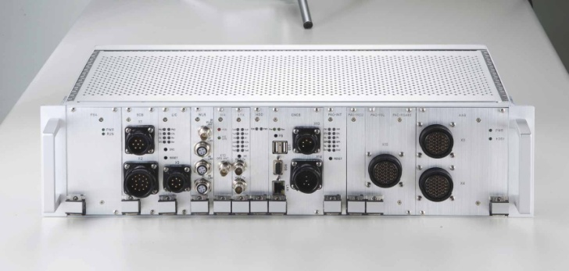
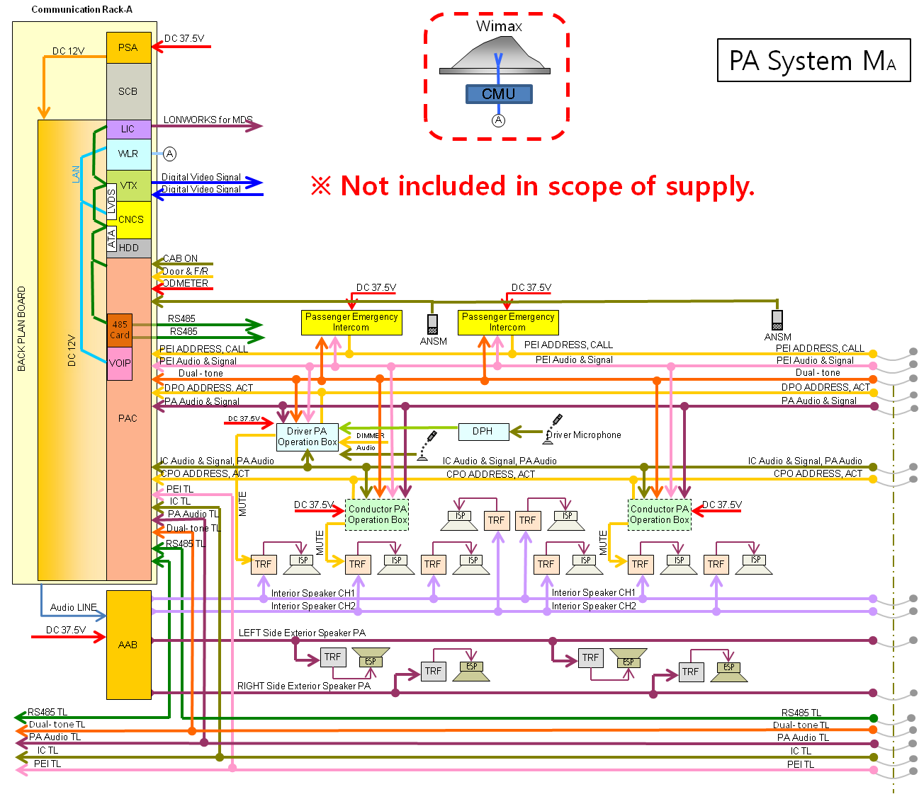
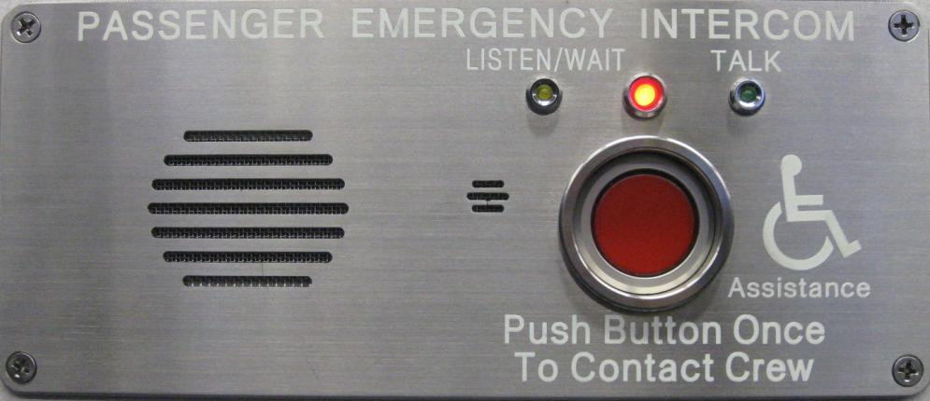
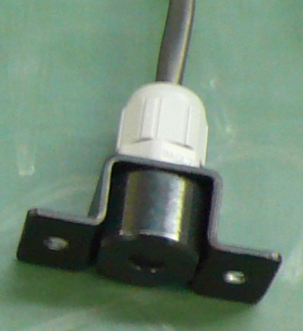
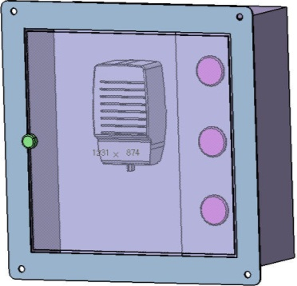
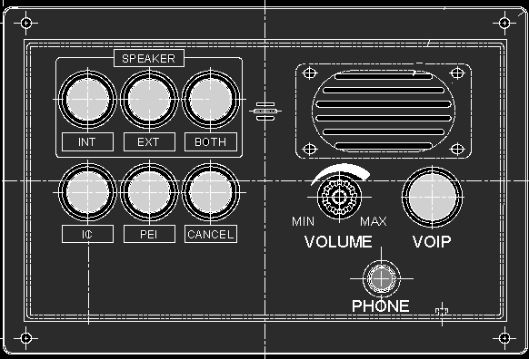
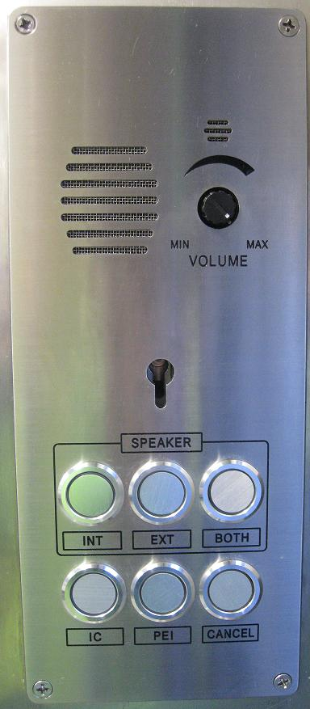
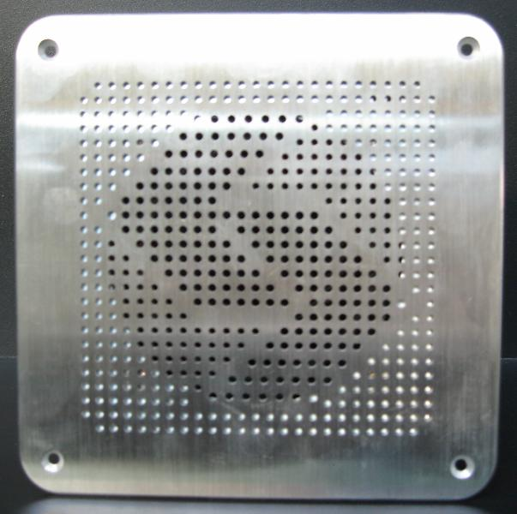

System Overview(PA)

Slide 5
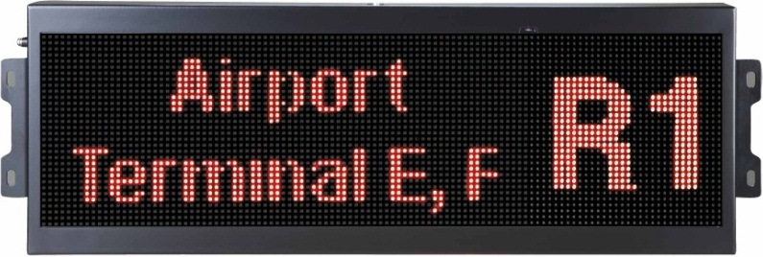
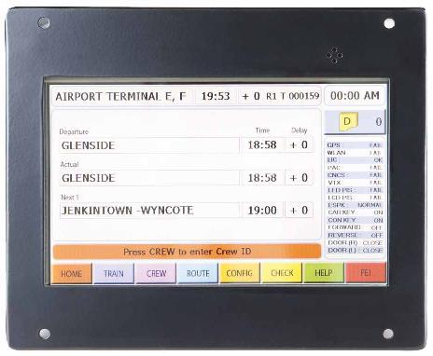
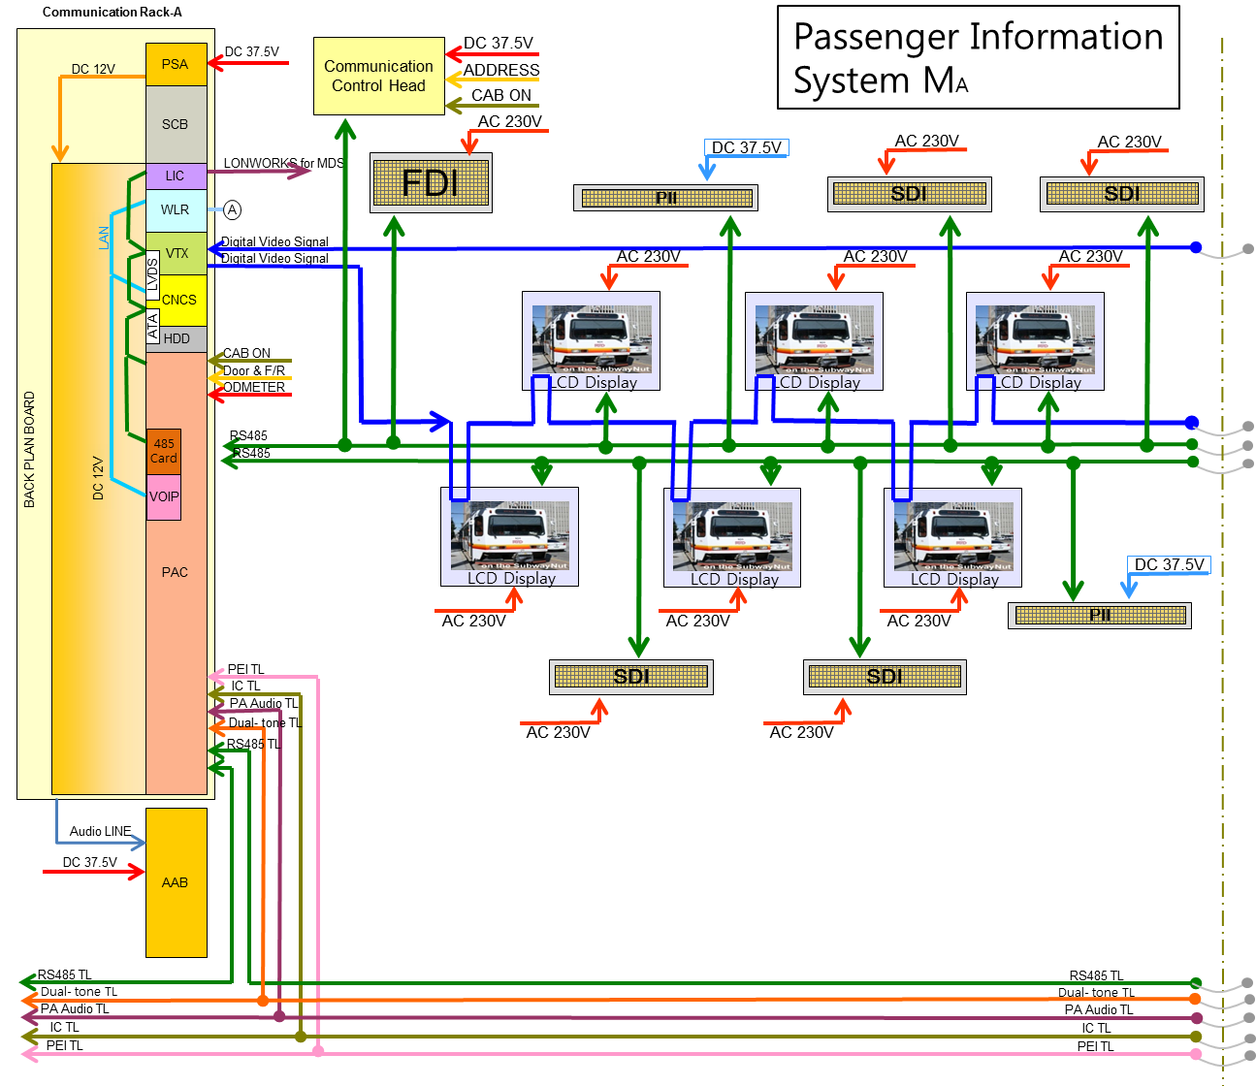
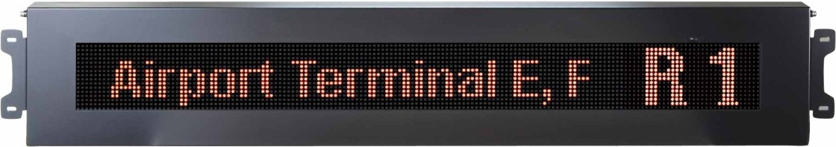
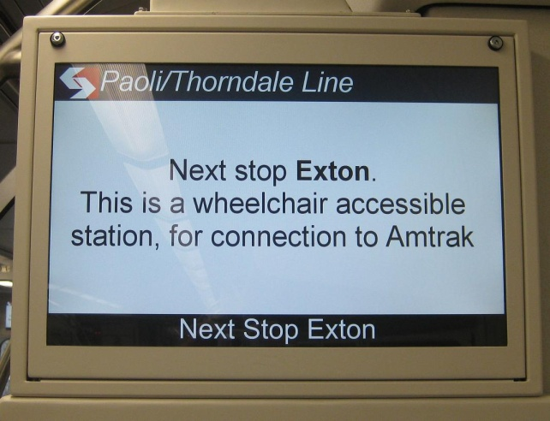
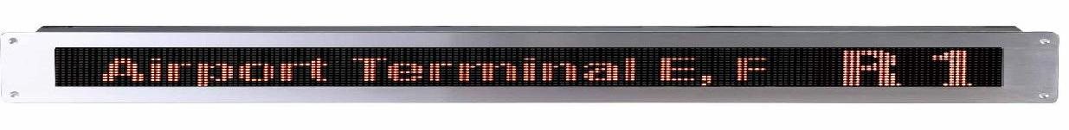
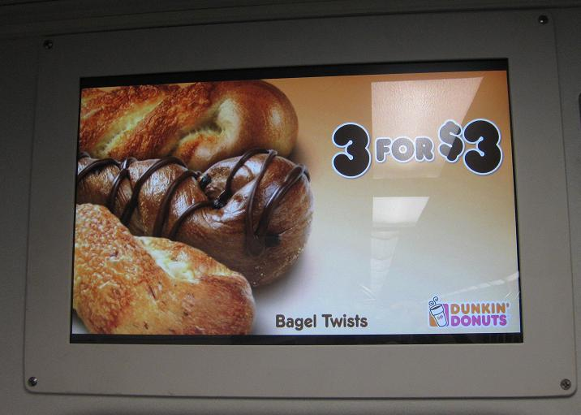
System Overview(PIS)

Slide 6
VoIP
FLASH
SPI
GPIO
Recording
AUDIO
To Recording
ARM926
DSP
BMP
RX AMP
TO RX AUDIO
TX AMP
TO TX AUDIO
TO RS-485 Car Line
UART
RMII
SDI
LDO
LDO
RJ45
Ethernet
SDRAM
Regulator
12V
Mac
*VOIP 회사와 긴밀한 업무 협조를 통한 신뢰성 있는 VOIP 기능 구현.

Slide 7
Communication Rack A (CRA)
Item | Specification
Input Power | DC 37.5V (DC 24V~48V)
Power Load | Max. 375W
Size | 21” 3U Sub-rack case
Weight | About 16 kg (Rack A)
Relative Humidity | 10% ~ 95% (Non Condensing)
Control Switch | Power On/Off, Reset
Operating Temperature | 0°C ~ +45°C
Storage Temperature | -35°C ~ +45°C
Status Indicator | LED indicator for power and status at each module
Material | Aluminum
*CRA AMP 파워 보완을 통한 충분한 용량 확보.

Slide 8
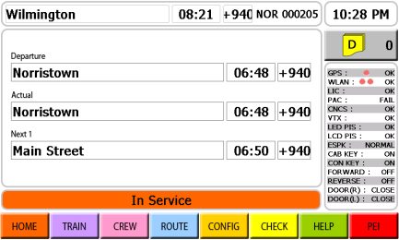
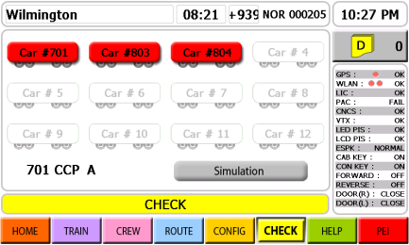
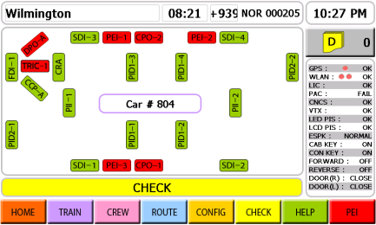
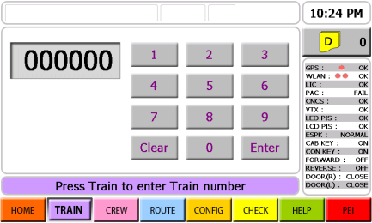
Communication Control Panel (CCP)
Item | Rating and Specification
Power Load | Max. 63W
Input Voltage | DC 37.5V (DC 24V~48V)
Input Method | Touch Screen
Display Method | DISPLAY | GRAPHIC TFT LCD
 | Display resolution | 800 × 480
 | Available Display Area | 6” × 3.6 ”(152.4mm × 91.4mm)
 | Color | 16.7M COLOR
Interface | DATA Transmission Method | CNCS : RS-485 2WIRE LCD touch : RS-232C
 | DATA Transmission speed | CNCS : MAX. 19,200 PS LCD touch: MAX. 9,600 BPS
 | DOOR Signal Input | Train Signal DATA (DC 100V)
 | Odometer Signal Input | Pulse Signal (DC 100V)
 | Train Location Signal Input | RS-485 Train Location Data Signal
Weight | 5 kg
Operating Temperature | 0°C ~ +45°C (LCD: 0°C ~ +40°C)
Storage Temperature | -35°C ~ +45°C
Humidity | 10% ~ 95% (at +35°, Non Condensing)
*정확한 차량 정보와 편리한 UI 화면 구성을 통한 빠르고 정확한 차량 정보 전달.

Slide 9
Passenger Information Display (PID)
Item | Specification
Signal Handling Method | FPGA control
Transmission Speed | 0.6 ～ 1.5Gbps
Digital Video Input | BNC Connector 1Port
Digital Video Output | BNC Connector 1Port
Input Power | AC230V(AC 180V~260V)
Power Load | Max. 125W
Insulation Resistance | 500V, 50MΩ by insulation ohmmeter
Dielectric strength | AC 1200V 60Hz within 1 min.
Operating Temperature | 0° ~ +45°C (LCD: 0° ~ +40°C)
Storage Temperature | -35°C ~ +45°C
Relative Humidity | 10% ~ 95% (at +35°, Non Condensing)
Color | N8.5
Weight | 12.5 kg
*검증된 동영한 제어 기술을 바탕으로 깨끗하고 부드러운 동영상을 정보를 제동할 수 있다.

Slide 10
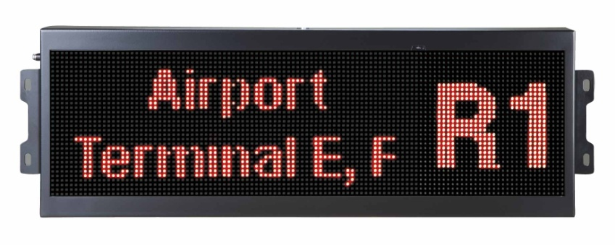
Front Destination Indicator (FDI)
Item |  | Rating and Specification
CPU |  | ARM7TDMI 32-bit RISC CPU
Memory |  | FLASH TYPE (program code, image data)
Power Load |  | Max. 320W
Input Voltage |  | AC 230V(AC 180V~260V)
Operating Temperature |  | 0°C ~ +45°C
Storage Temperature |  | -35°C ~ +45°C
Humidity |  | 30~ 90% (Non Condensing)
Interface | Data Transmission Method | RS-485 2WIRE MULTI-DROP
 | Transmission Speed | MAX. 19,200 BPS
*칼라와 삼색 LED를 이용 탑승자에게 목적지에 대한 쉽고, 정확한 정보 전다.

Slide 11
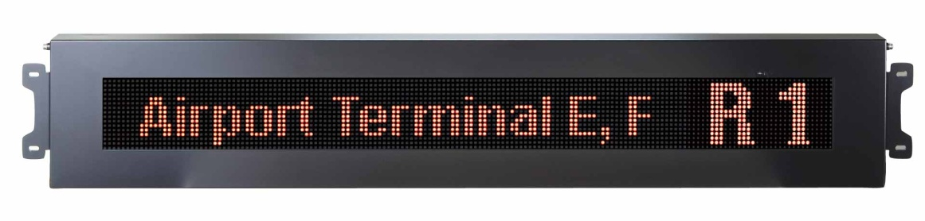
Side Destination Indicator (SDI)
Item |  | Rating & Specification
CPU |  | ARM7TDMI 32-bit RISC CPU
Memory |  | FLASH TYPE (program code, image data)
Power Load |  | Max. 230W
Input Voltage |  | AC230V (AC 180V~260V)
Operating Temperature |  | 0°C ~ +45°C
Storage Temperature |  | -35°C ~ +45°C
Humidity |  | 30~ 90% (Non Condensing)
Interface | Data Transmission Method | RS-485 2WIRE MULTI-DROP
 | Transmission Speed | Max. 19,200 BPS (Modification can be done for performance improvement)
*칼라와 삼색 LED를 이용 탑승자에게 목적지에 대한 쉽고, 정확한 정보 전다.

Slide 12
Passenger Information Indicator (PII)
ITEM |  | RATING AND SPECIFICAITON
CPU |  | ARM7TDMI 32-bit RISC CPU
Memory |  | FLASH TYPE (program code, image data)
Power Load |  | Max 50W
Input Power |  | DC37.5V(DC 24V~48V)
Operating Temperature |  | 0°C ~ +45°C
Storage Temperature |  | -35°C ~ +45°C
Humidity |  | 30~ 90% (Non Condensing)
Interface | Data Transmission Method | RS-485 2WIRE MULTI-DROP
 | Transmission Speed | Max. 19,200 BPS (Modification can be done for performance improvement)
*삼색 LED를 이용 탑승자에게 차량 운행 정보를 빠르고 정확하게 전달 할 수 있다.

Slide 13
Driver PA Operation Box (DPO)
Item | Specification
Power Load | Max. 75W
Input Power | DC37.5V(DC 24V~48V)
Input | ISP, ESP and Both. Conductor member call and communication, Intercom communication, Communication termination, speaker volume adjustment
Control Method | Logic Control
Dimming Control | PWM (Provided by Rotem), (10-100%, 62Hz)
Speaker Output | 3W
Material | AL6061
Color | Black (To Match Cab)
Operating Temperature | 0°C ~ +45°C
Storage Temperature | -35°C ~ +45°C
Dual Tone 을 이용하여 잡음 없고 정확한 음성 신호를 전달 할 수 있다.
DPO/PEI/CPO 와 음성 통화가 가능 하다.

Slide 14

Driver PA Handset (DPH)
Item | Specification
Power Load | Max. 75W
Input Power | DC37.5V(DC 24V~48V)
Input | ISP, ESP and Both. Conductor member call and communication, Intercom communication, Communication termination, speaker volume adjustment
Control Method | Logic Control
Speaker Output | 3W
Material | AL6061
Color | Black (To Match Cab)
Operating Temperature | 0°C ~ +45°C
Storage Temperature | -35°C ~ +45°C

Slide 15
Conductor PA Operation Box (CPO)
Item | Specification
Power Load | Max. 75W
Input Power | DC37.5V(DC 24V~48V)
Input | ISP, ESP and Both. Crew Member Call and Communication, Intercom communication, Communication Termination, Speaker Volume Adjustment
Control Method | Logic Control
Speaker Output | 3W
Material | 304SS
Operating Temperature | 0°C ~ +45°C
Storage Temperature | -35°C ~ +45°C
Dual Tone 을 이용하여 잡음 없고 정확한 음성 신호를 전달 할 수 있다.
DPO/PEI/CPO 와 음성 통화가 가능 하다.

Slide 16

Passenger Emergency Intercom (PEI)
Item | Specification
Power Load | Max. 75W
Input Power | DC37.5V(DC 24V~48V)
Input | Crew member call
Output | Listening and Communication
Control Method | Logic Control
Speaker Output | 3W
Material | Stainless
Operating Temperature | 0°C ~ +45°C
Storage Temperature | -35°C ~ +45°C
Dual Tone 을 이용하여 잡음 없고 정확한 음성 신호를 전달 할 수 있다.
비상시 승객의 위치를 전달하여 신속한 서비스가 이루어 질 수 있도록 한다.

Slide 17
SEPTA 지적 사항.
DENVER 보완 사항.
1. AMP 용량 부족(125W).
1. AMP 용량 증가(300W).
2. PA 장치 하울링.
2. PA 장치 하울링 제거 회로 추가 .
3. PA ANSM 인식 기능.
3. PA ANSM 마이크 추가 .
4. PA Tone 기능 인식 문재.
4. PA Dual Tone 기능으로 변경 .

Slide 18
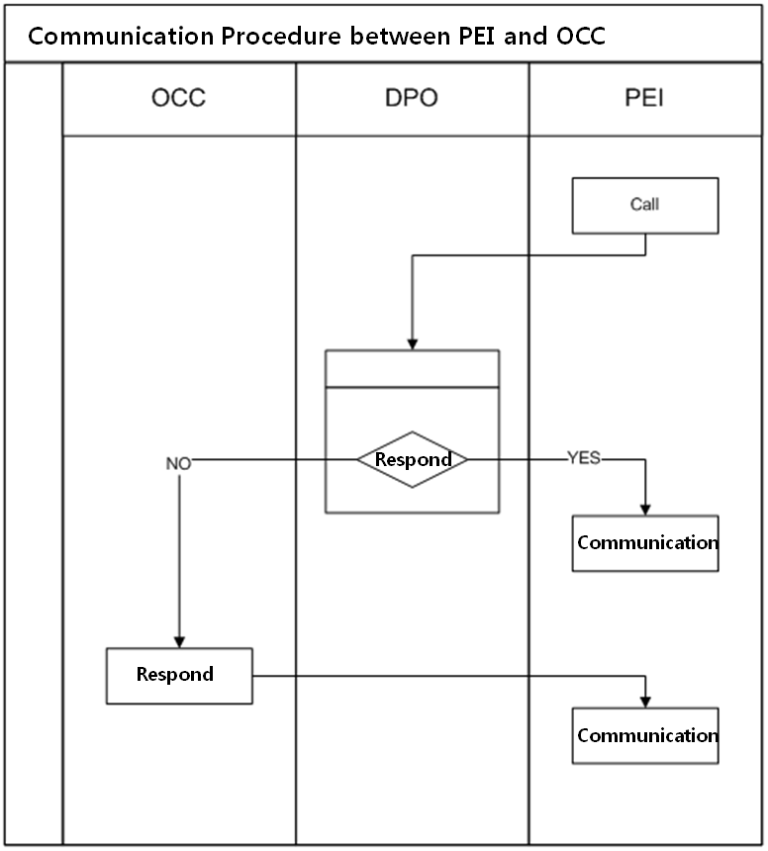
1.3
HR Document REDE113112, Section 4 – The “N/A” in row 2 is incorrect. The operator shall still have the capability of making PA announcements and paging crew in other cabs from the cab communication station.
⇒The operator has the capability of making PA announcements and paging crew in other cabs from the cab communication station.
1.5
HR Document REDE113112, Section 4 – The “N/A” in row 6 is incorrect. The operator shall have the ability to have private two-way intercommunication between communication control panels located in any cab.
⇒The operator has the ability to have private two-way intercommunication with intercoms (DPO) located in any cab.
2.8
HR Document REDE113112, Section 3.12 – Can the LCD screens simultaneously display the same information as the LED signs?
⇒LCD screens are able to simultaneously display the same information as the LED signs within the same car.
2.9
HR Document REDE113112, Appendix 5.1 – A focus of the PDR meeting will be the communications between passenger emergency intercom units and the OCC in the event that the operator does not respond to a call.
⇒The time period can be set as customer requires. (e.g. 10 seconds, 20 seconds, 30 seconds etc.)

Slide 19
THANK YOU !
Questions ?

