Slide 1



DENVER RTD
PDR
2011. 5. 25
Communication System

Slide 2
Contents
System Overview
VoIP
Communication Rack A (CRA)
Communication Control Panel (CCP)
Passenger Information Display (PID)
Front Destination Indicator (FDI)
Side Destination Indicator (SDI)
Passenger Information Indicator (PII)
Driver PA Operation Box (DPO)
Driver PA Handset (DPH)
Passenger Emergency Intercom (PEI)

Slide 3
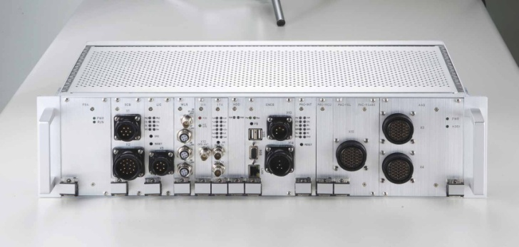
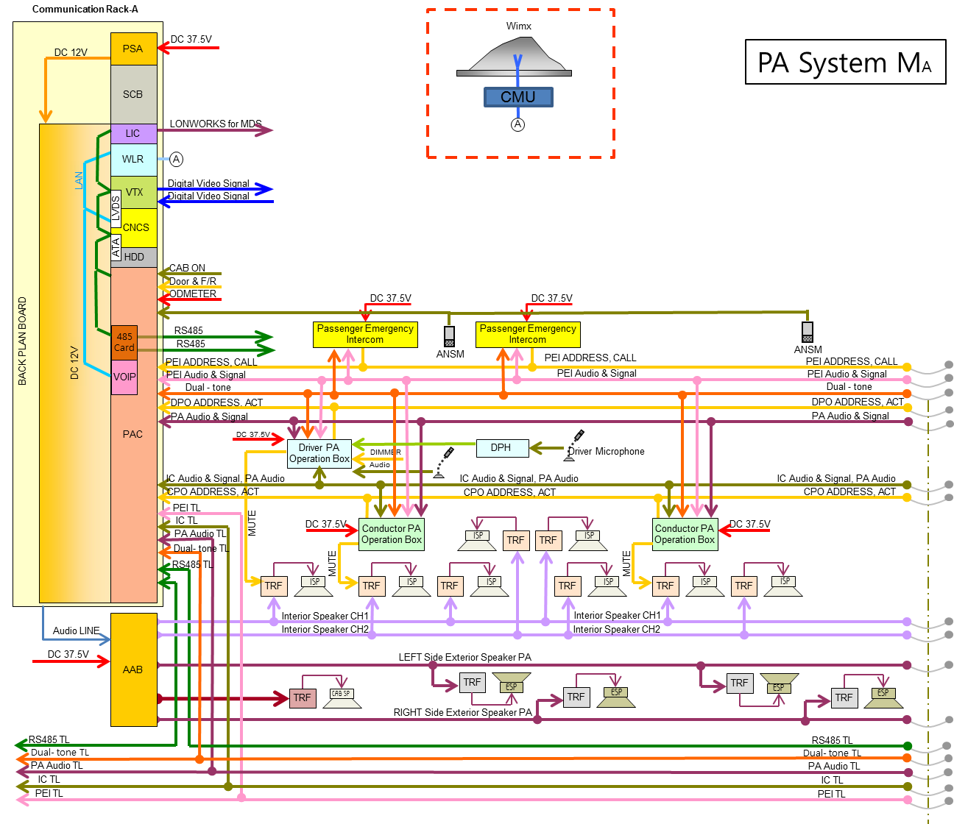
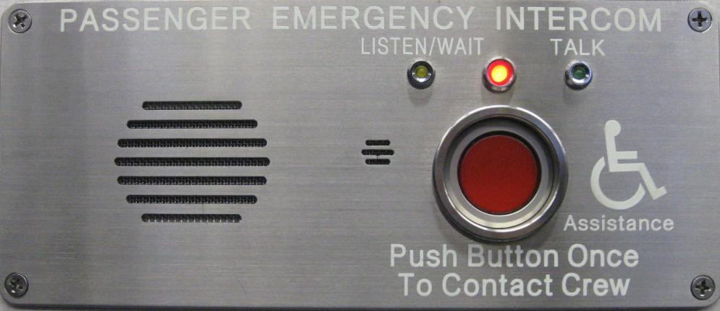
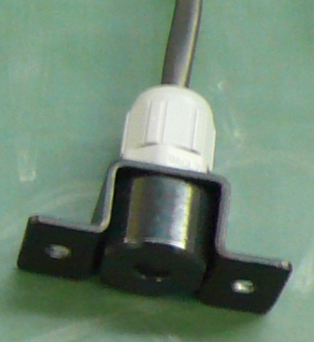
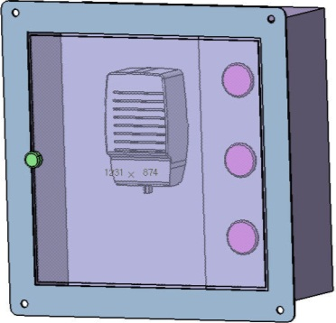
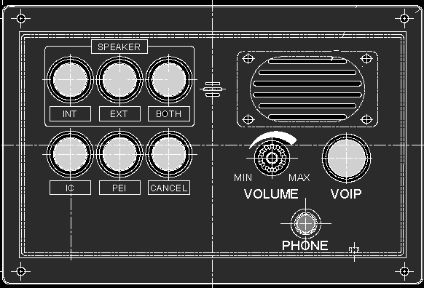
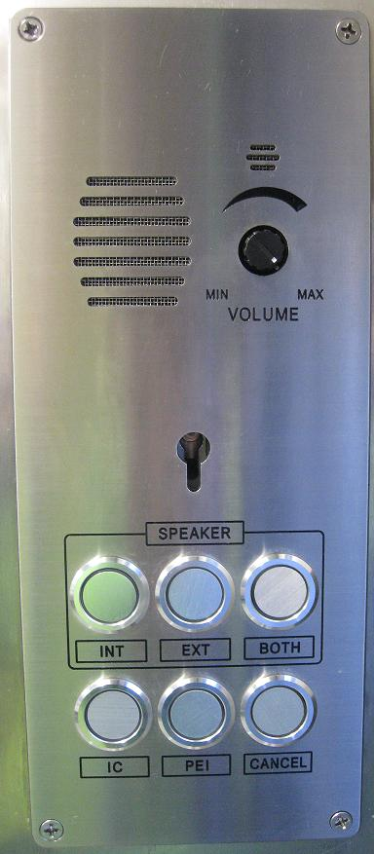
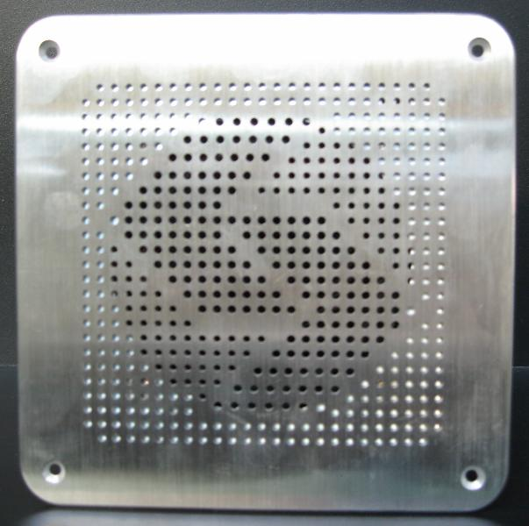

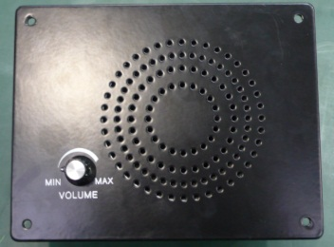
System Overview(PA)

Slide 4
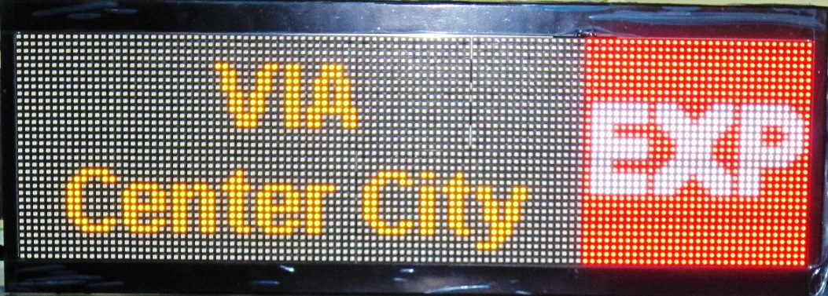
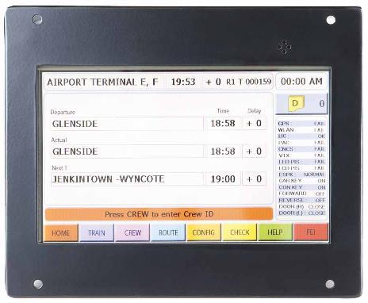
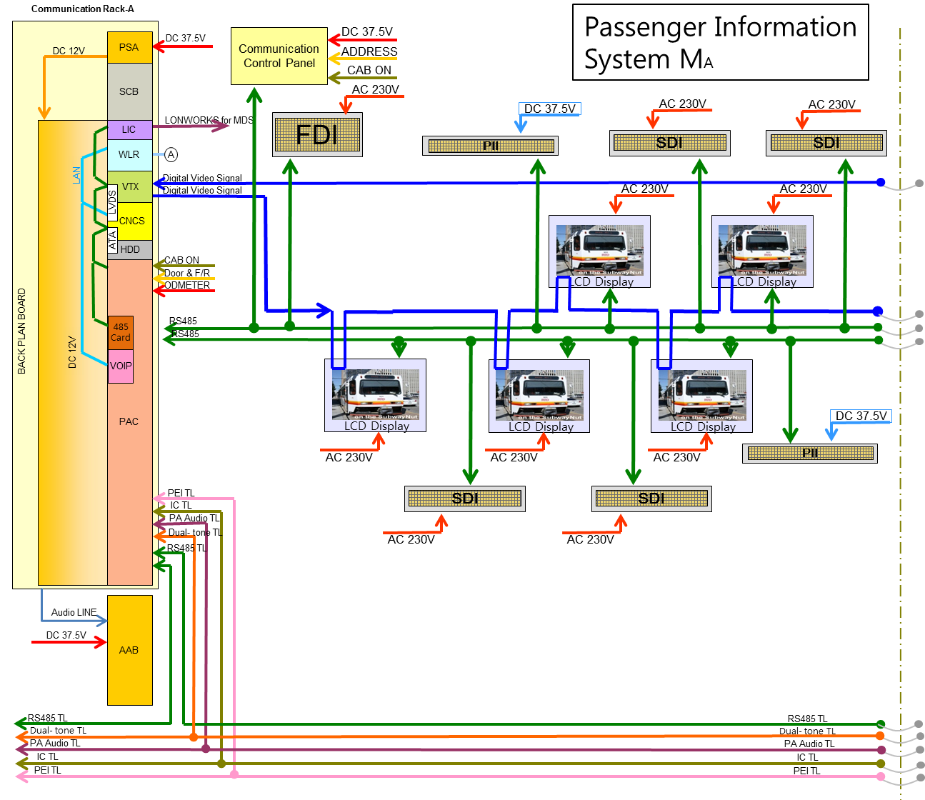
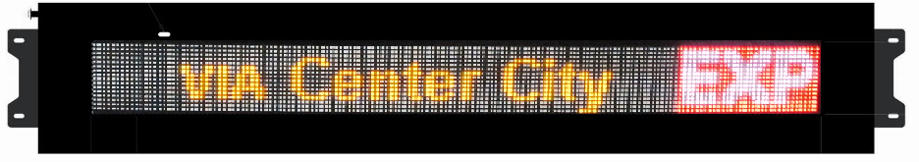
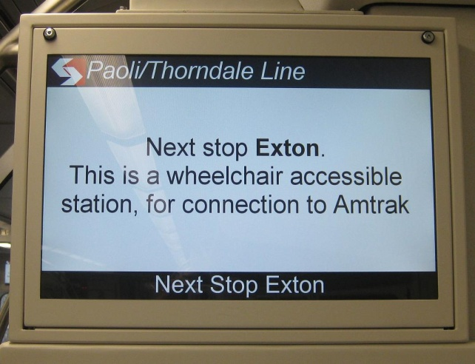
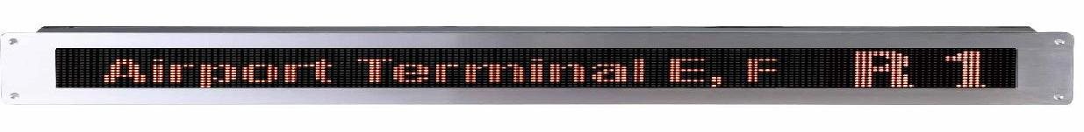
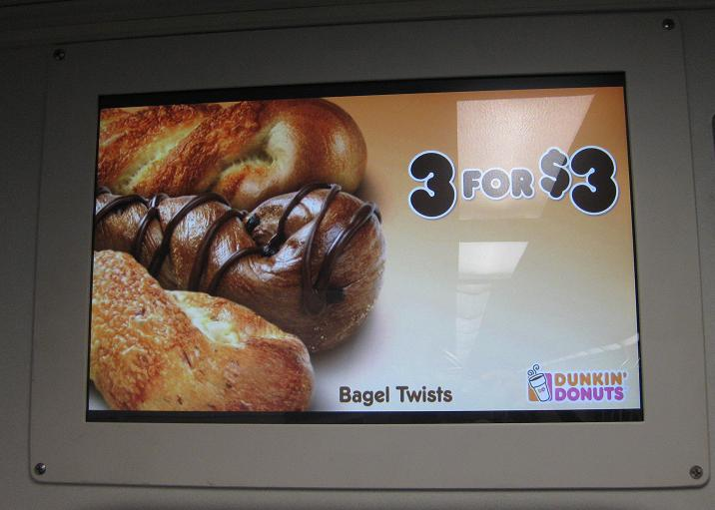
System Overview(PIS)

Slide 5
SEPTA / 덴버 장치 비교
SEPTA | 덴버
CRA-CRB 타입으로 차량 구성. | CRA-CRA 타입으로 차량 구성. 백업동작 관련하여 시스템 구성을 보완.
DPO/PEI | DPO/PEI tone 과 음성 신호를 분리 하여 노이즈 및 처리 속도를 향상 시켰다.

Slide 6
VOIP
FLASH
SPI
GPIO
Recording
AUDIO
To Recording
ARM926
DSP
BMP
RX AMP
TO RX AUDIO
TX AMP
TO TX AUDIO
TO RS-485 Car Line
UART
RMII
SDI
LDO
LDO
RJ45
Ethernet
SDRAM
Regulator
12V
Mac
*Reliable VOIP function could be realized by close cooperation with the VOIP company.

Slide 7
Communication Rack A (CRA)
Item | Specification
Input Power | DC 37.5V (DC 24V~48V)
Power Load | Max. 375W
Size | 21” 3U Sub-rack case
Weight | About 16 kg (Rack A)
Relative Humidity | 10% ~ 95% (Non Condensing)
Control Switch | Power On/Off, Reset
Operating Temperature | 0°C ~ +45°C
Storage Temperature | -35°C ~ +45°C
Status Indicator | LED indicator for power and status at each module
Material | Aluminum
*Ensured sufficient capacity by CRA AMP Power supplementation.

Slide 8
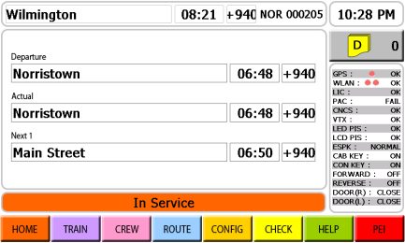
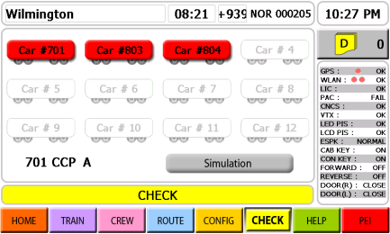
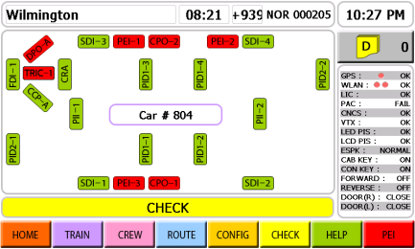
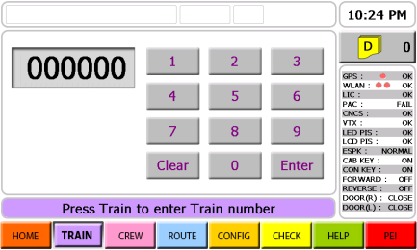
Communication Control Panel (CCP)
Item | Rating and Specification
Power Load | Max. 63W
Input Voltage | DC 37.5V (DC 24V~48V)
Input Method | Touch Screen
Display Method | DISPLAY | GRAPHIC TFT LCD
 | Display resolution | 800 × 480
 | Available Display Area | 6” × 3.6 ”(152.4mm × 91.4mm)
 | Color | 16.7M COLOR
Interface | DATA Transmission Method | CNCS : RS-485 2WIRE LCD touch : RS-232C
 | DATA Transmission speed | CNCS : MAX. 19,200 PS LCD touch: MAX. 9,600 BPS
 | DOOR Signal Input | Train Signal DATA (DC 100V)
 | Odometer Signal Input | Pulse Signal (DC 100V)
 | Train Location Signal Input | RS-485 Train Location Data Signal
Weight | 5 kg
Operating Temperature | 0°C ~ +45°C (LCD: 0°C ~ +40°C)
Storage Temperature | -35°C ~ +45°C
Humidity | 10% ~ 95% (at +35°, Non Condensing)
*Fast and accurate vehicle information transmission by convenient UI (User Interface) display configuration.

Slide 9
Passenger Information Display (PID)
Item | Specification
Signal Handling Method | FPGA control
Transmission Speed | 0.6 ～ 1.5Gbps
Digital Video Input | BNC Connector 1Port
Digital Video Output | BNC Connector 1Port
Input Power | AC230V(AC 180V~260V)
Power Load | Max. 125W
Insulation Resistance | 500V, 50MΩ by insulation ohmmeter
Dielectric strength | AC 1200V 60Hz within 1 min.
Operating Temperature | 0° ~ +45°C (LCD: 0° ~ +40°C)
Storage Temperature | -35°C ~ +45°C
Relative Humidity | 10% ~ 95% (at +35°, Non Condensing)
Color | N8.5
Weight | 12.5 kg
*Controlling clean and smooth video information is available based on the verified video control technology.

Slide 10
Front Destination Indicator (FDI)
Item |  | Rating and Specification
CPU |  | ARM7TDMI 32-bit RISC CPU
Memory |  | FLASH TYPE (program code, image data)
Power Load |  | Max. 320W
Input Voltage |  | AC 230V(AC 180V~260V)
Operating Temperature |  | 0°C ~ +45°C
Storage Temperature |  | -35°C ~ +45°C
Humidity |  | 30~ 90% (Non Condensing)
Interface | Data Transmission Method | RS-485 2WIRE MULTI-DROP
 | Transmission Speed | MAX. 19,200 BPS
*Delivers easy and correct information on destinations to passengers by using multi-color LED and 3-colors LED.

Slide 11
Side Destination Indicator (SDI)
Item |  | Rating & Specification
CPU |  | ARM7TDMI 32-bit RISC CPU
Memory |  | FLASH TYPE (program code, image data)
Power Load |  | Max. 230W
Input Voltage |  | AC230V (AC 180V~260V)
Operating Temperature |  | 0°C ~ +45°C
Storage Temperature |  | -35°C ~ +45°C
Humidity |  | 30~ 90% (Non Condensing)
Interface | Data Transmission Method | RS-485 2WIRE MULTI-DROP
 | Transmission Speed | Max. 19,200 BPS (Modification can be done for performance improvement)
**Delivers easy and correct information on destinations to passengers by using multi-color LED and 3-colors LED.

Slide 12
Passenger Information Indicator (PII)
ITEM |  | RATING AND SPECIFICAITON
CPU |  | ARM7TDMI 32-bit RISC CPU
Memory |  | FLASH TYPE (program code, image data)
Power Load |  | Max 50W
Input Power |  | DC37.5V(DC 24V~48V)
Operating Temperature |  | 0°C ~ +45°C
Storage Temperature |  | -35°C ~ +45°C
Humidity |  | 30~ 90% (Non Condensing)
Interface | Data Transmission Method | RS-485 2WIRE MULTI-DROP
 | Transmission Speed | Max. 19,200 BPS (Modification can be done for performance improvement)
*Delivers fast and correct train service information to passengers by using 3-colors LED.

Slide 13
Driver PA Operation Box (DPO)
Item | Specification
Power Load | Max. 75W
Input Power | DC37.5V(DC 24V~48V)
Input | ISP, ESP and Both. Conductor member call and communication, Intercom communication, Communication termination, speaker volume adjustment
Control Method | Logic Control
Dimming Control | PWM (Provided by Rotem), (10-100%, 62Hz)
Speaker Output | 3W
Material | AL6061
Color | Black (To Match Cab)
Operating Temperature | 0°C ~ +45°C
Storage Temperature | -35°C ~ +45°C
Delivering correct voice signal without noise is available by using the Dual Tone.
Voice communication between DPO and PEI is available.

Slide 14

Driver PA Handset (DPH)
Item | Specification
Power Load | Max. 75W
Input Power | DC37.5V(DC 24V~48V)
Input | ISP, ESP and Both. Conductor member call and communication, Intercom communication, Communication termination, speaker volume adjustment
Control Method | Logic Control
Speaker Output | 3W
Material | AL6061
Color | Black (To Match Cab)
Operating Temperature | 0°C ~ +45°C
Storage Temperature | -35°C ~ +45°C

Slide 15

Passenger Emergency Intercom (PEI)
Item | Specification
Power Load | Max. 75W
Input Power | DC37.5V(DC 24V~48V)
Input | Crew member call
Output | Listening and Communication
Control Method | Logic Control
Speaker Output | 3W
Material | Stainless
Operating Temperature | 0°C ~ +45°C
Storage Temperature | -35°C ~ +45°C
Delivering correct voice signal without noise is available by using the Dual Tone.
Rapid service is available by transmitting the location of passenger in emergency.

Slide 16
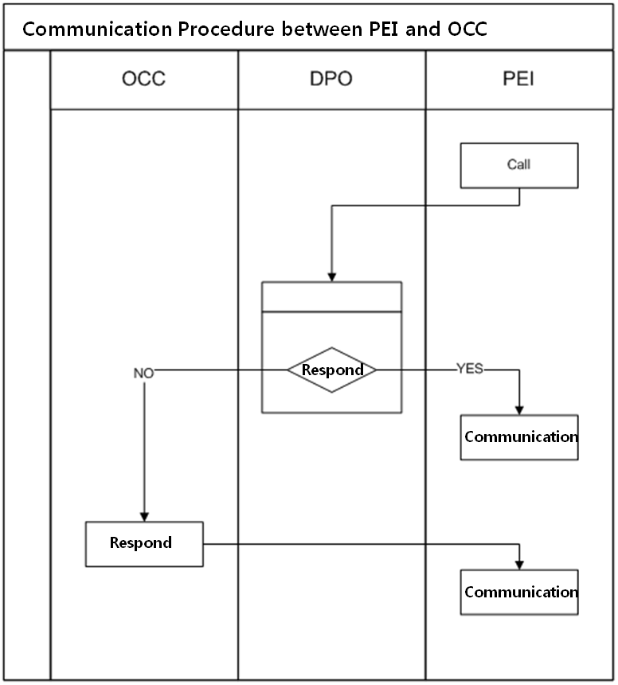
Communications & CCTV PDR Design Package REPLY SHEET
1.3
HR Document REDE113112, Section 4 – The “N/A” in row 2 is incorrect. The operator shall still have the capability of making PA announcements and paging crew in other cabs from the cab communication station.
⇒The operator has the capability of making PA announcements and paging the other operator in other cab from the cab communication station.
1.5
HR Document REDE113112, Section 4 – The “N/A” in row 6 is incorrect. The operator shall have the ability to have private two-way intercommunication between communication control panels located in any cab.
⇒The operator has the ability to have private two-way intercommunication with intercoms (DPO) located in any cab.
2.8
HR Document REDE113112, Section 3.12 – Can the LCD screens simultaneously display the same information as the LED signs?
⇒LCD screens are able to simultaneously display the same information as the LED signs within the same car.
2.9
HR Document REDE113112, Appendix 5.1 – A focus of the PDR meeting will be the communications between passenger emergency intercom units and the OCC in the event that the operator does not respond to a call.
⇒The time period can be set as customer requires. (e.g. 10 seconds, 20 seconds, 30 seconds etc.)

Slide 17
Interface Document
We would like to receive software interface document from the Wimax company.
(VOIP, GPS protocol, Ethernet connection method)
Wimx 회사에서 사용 할 VOIP 칩 종류 ?

Slide 18
THANK YOU !
Questions ?

