Slide 1
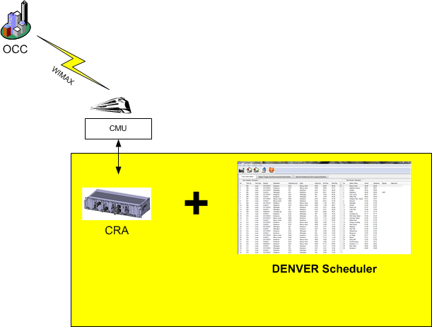
Woojin’s Scope of Supply for wayside
자동 방송에 대한 공급 범위
OCC 공급 범위
- 자동 방송을 위한 GPS DATA
- Woojin’s scope of supply for Wayside are the on-board communications system and the software which edits the schedule data needed for operating.
(Supplies the scope colored with yellow.)
- 덴버 시행청은 자동 방송을 위해 필요한 GPS 데이터를 누가 제공 하는지 우진에게 알려 주어야 한다.
WOOJIN

Slide 2

Woojin’s Scope of Supply for wayside MDS DATA 관리에 대한 공급 범위
OCC 공급 범위
MDS DATA를 보관할 서버.
MDS 파일을 관리 프로그램
-> SEPTA에서는 시행청이 지정한 업체에서 제작 하였다.
- Woojin’s scope of supply for Wayside are the on-board communications system. (Supplies the scope colored with yellow.)
CMU
- 덴버 시행청은 MDS 파일을 보관할 OCC 서버를 누가 공급 하는지 정해야 한다.
- 덴버 시행청은 OCC 서버에서 MDS 파일을 관리할 응용 프로 그램을 누가 제작 할지 정해야 한다.
MDS

Slide 3
Woojin’s Scope of Supply for wayside
Content DATA에 대한 공급 범위
OCC 공급 범위
Content DATA를 보관할 서버.
Content
관리 S/W
- Woojin’s scope of supply for Wayside are the on-board communications system.
- 우진은 OCC 서버에서 Content 파일을 관리할 응용 프로그램을 제공 한다.
(Supplies the scope colored with yellow.)
CMU
- 덴버 시행청은 MDS 파일을 보관할 OCC 서버를 누가 공급 하는지 정해야 한다.

Slide 4
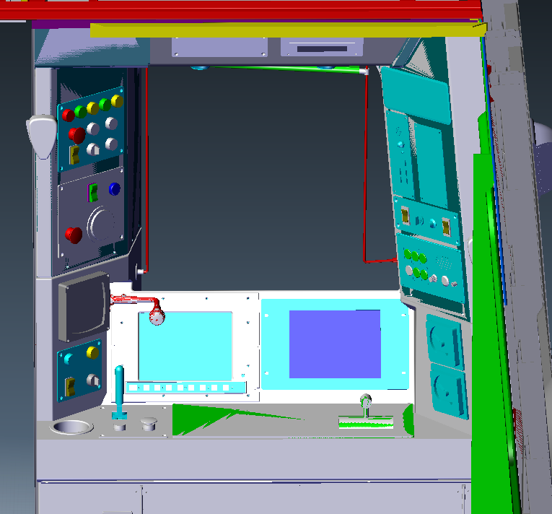
Method proposal for Operator using the Gooseneck microphone with his left hand
Gooseneck Use Order
- Press PUSH BUTTON Switch with left hand.
- Speaker Select switch will be automatically selected. (No need to select switch)
- Speaker will output when the operator talks.
** Speaker Select Criteria
- Remembers the final status of use.
- Press the Push Button switch and select the switch with right hand if trying to change the direction of the speaker output.
PUSH BUTTON

Slide 5
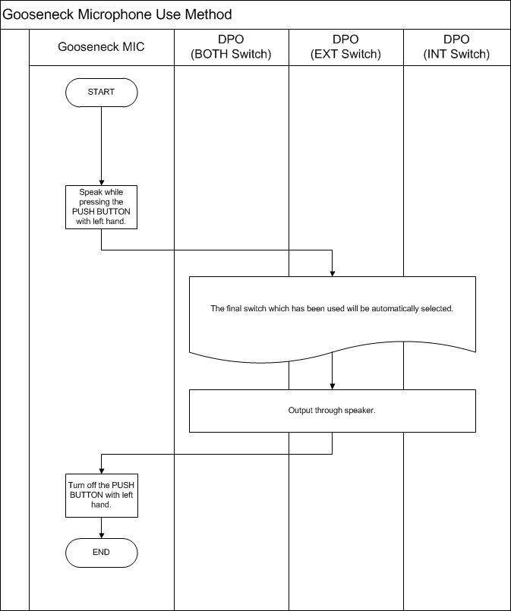
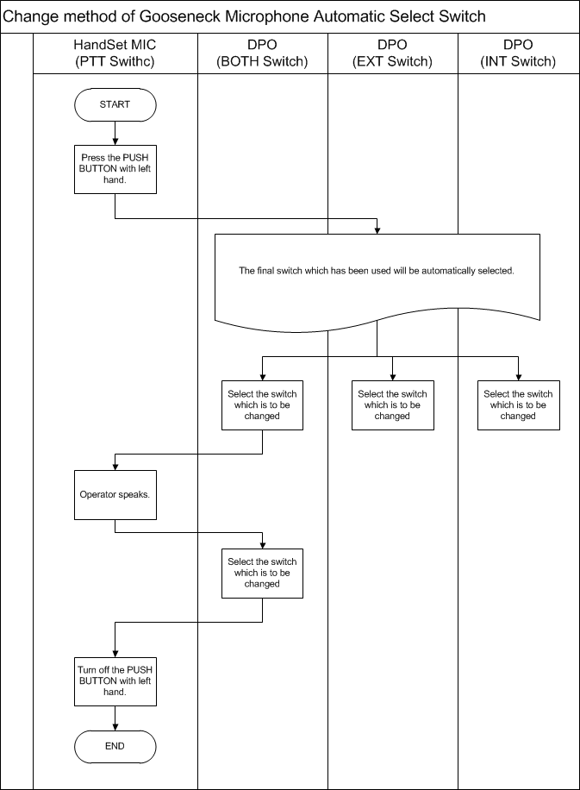

Slide 6
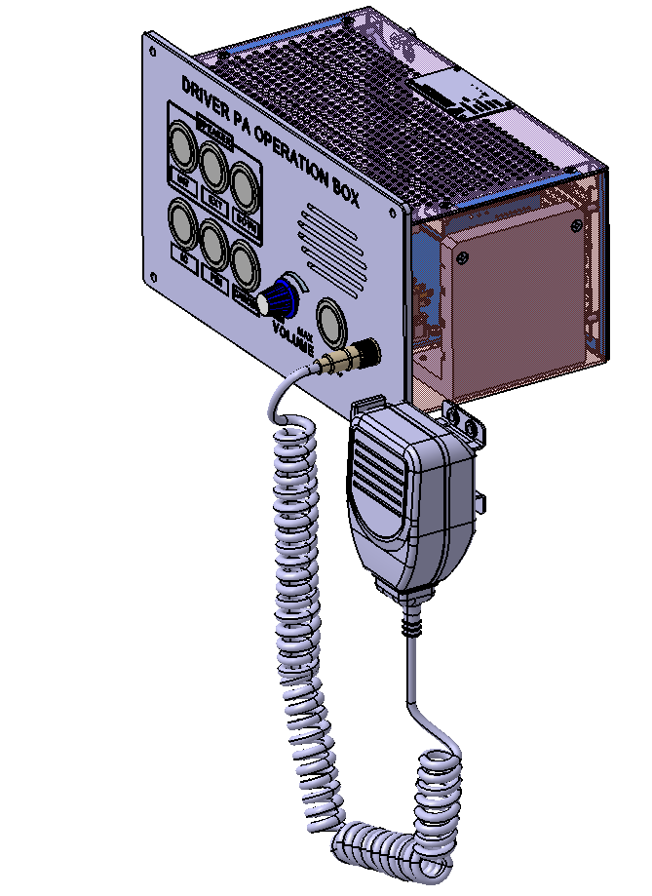
Operation procedure for driver to use DPO microphone
DPO Use order
②
- Hold the Handset Microphone with right hand.
- Press the PTT Switch.
- Speaker Select switch will be automatically selected. (No need to select switch)
- Speaker will output when the operator talks.
** Speaker Select Criteria
- Remembers the final status of use.
- Press the PTT switch and select the switch with left hand if trying to change the direction of the speaker output.
①
③

Slide 7
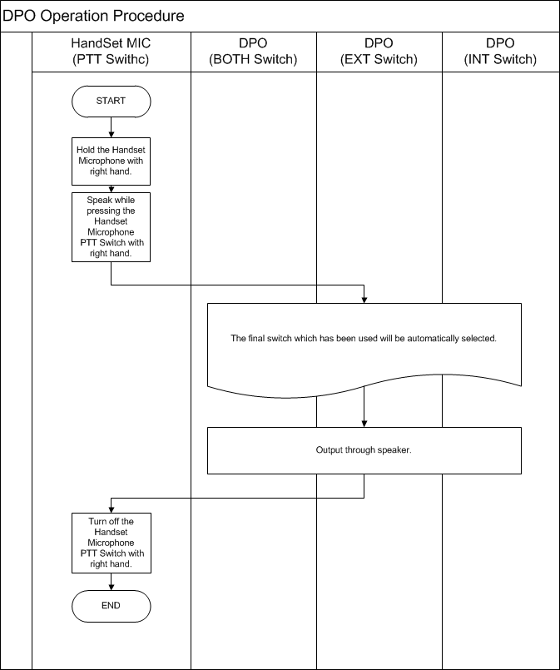
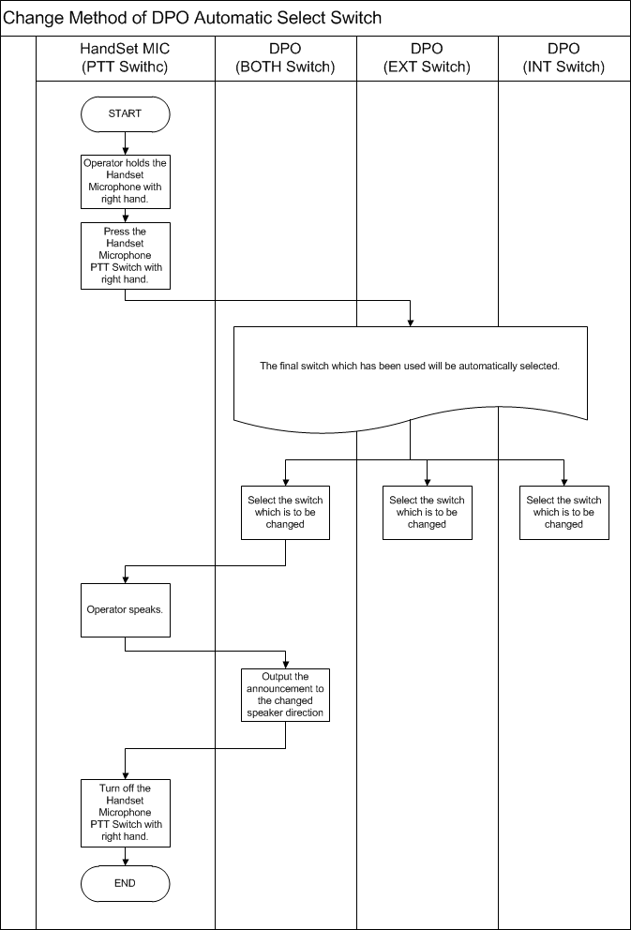
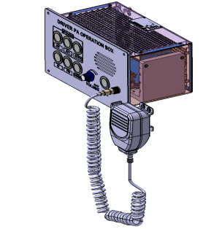

①
②
①
②
③

Slide 8
IC Identification Request
Item | Typ | Qty | Part Name | Value | TEMP | STORAGE
WLR | IC | 1 | RTL8309SB, | RTL8309SB(RTL8309SC) | 0~+70 | -55~+150
VOIP | IC | 1 | AC494, BGA | AC494 | 0~+70 | -65~+150
LIC | IC | 1 | W5100 | W5100 | 0~+80 | -55~+120
SSD | MEMORY | 1 | OWC | OWC 120G | 0~ +70 | -55 ~ +150
CPU | CPU | 1 | CONGA-X945/ | CONGA-X945/ | 0 ~ +60 | -20 ~ +80
- These contents are included in the IC temperature list which we submitted during the FDR meeting.
- All PCB IC meets the temperature specification of -20 ℃.
However, we would like Denver to identify above 5 ICs.
- These 5 ICs are necessary for realizing the function and we have also received the approval from SEPTA project.

Slide 9
Equipment Interior Cable Specification
Woojin’s product will use Tyco Electronics cable for the equipment internal wiring.
We would like Denver to use following information as references.
Use for Power : 100G1121-0.75-– 0/9
Use for Communication : 100G1121 – 0.5 – 0/9
Use for Voice : 100G1141 – 0.5 – 0/2/6/9
Etc. : 100G0111 – 0.5 - o

