Slide 1

Woodworking Order Management System
Final Project Demo
Presented by: Justin Verrick
INFO-C451

Slide 2
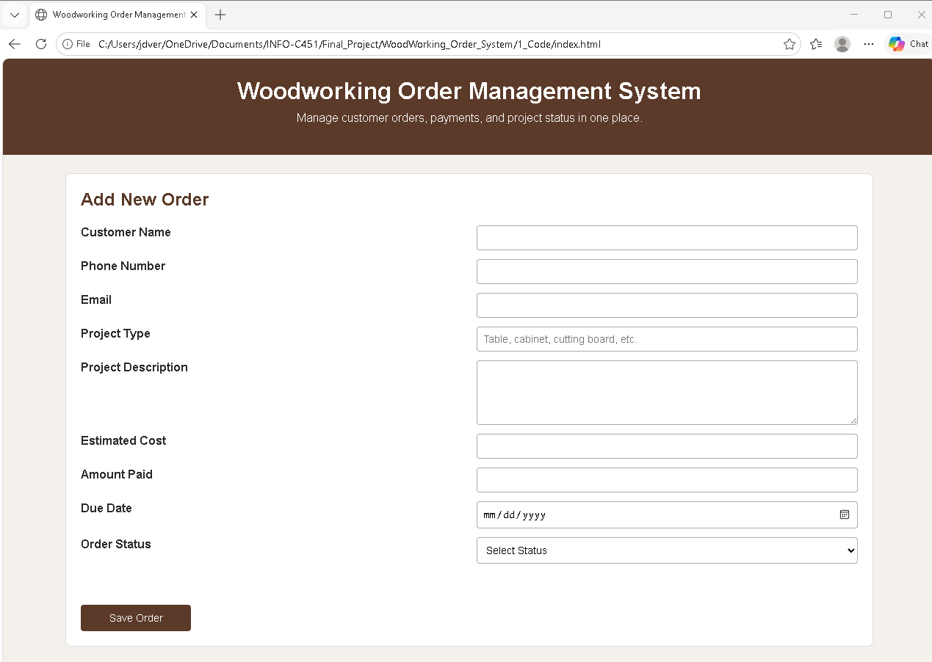
Who is this system for?
A small custom woodworking shop that is moving away from paper notes and scattered order tracking.
The business tracks customers, project details, payments, and due dates manually.
Manual tracking can lead to missed payments, lost notes, and/or forgotten due dates.
The system gives the users a simple place to manage orders.

Slide 3
Roadmap for demo
Open the system: Launch the page from the index.html.
Add an order: Enter information for required fields.
Save and review: The order is saved with localStorage and displayed in the table.
Update or delete: Change the status or remove and existing order.
Check reliability: Show error handling, testing files, and order summary totals.

Slide 4
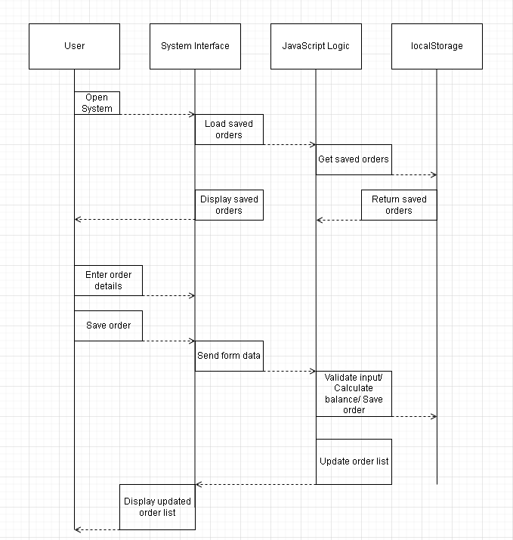
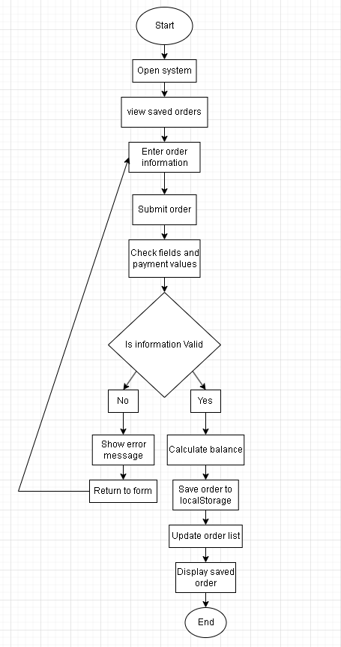
HOW THE SYSTEM WORKS
Sequence Diagram
Activity Diagram

Slide 5
Results and next steps
The system replaces manual order tracking with a simple effective web app.
Keeps customer, project, status, and payment details in one place.
Reduces small mistakes with automatic balance calculation and validation.
Uses simple files that are easy to maintain and update.
Could be expanded late with search, invoices, backups, or an actual database.

